Slide 1
ADS401 EVALUATION METHODS AND STATISTICS
Museum AI Guide:
Post-Visit Experience
Presentation 3 · Statistical analysis and interpretation
GROUP H
Cheng Qian 2687280 · Chen Cui 2687288
Ziqian Wang 2684921 · Simu He 2686299
9 November 2026
Notes:
Good morning. We are Group H. This presentation reports the final two-group comparison of post-visit experience with and without the XJTLU Museum AI guide.

Slide 2
STUDY RECAP AND RESEARCH QUESTION
The study compares post-visit experience in two museum conditions
RESEARCH QUESTION
30
students
15 + 15
AI / no AI
How do post-visit experience ratings differ between students who used the museum AI guide and those who toured without it?
9
1-5 ratings
0
missing
DESIGN
Two groups · 17 undergraduates and 13 postgraduates · anonymous post-visit questionnaire
PROCEDURE
Consent / assigned-condition record / museum visit / post-visit survey / group comparison
ALLOCATION CAUTION
Planned alternating by arrival, but the recorded sequence is not strictly alternating. We do not label the study randomized or causal.
GROUP H / ADS401 PRESENTATION 3
2 / 7
Notes:
The final RQ asks how nine post-visit ratings differ between AI-guide and no-AI conditions. The dataset has 30 students, 15 per group. The recorded allocation is not strictly alternating, so the study is not described as randomized and group differences are not interpreted as causal.

Slide 3
DATASET AND PREPARATION
Thirty complete anonymous records support item-level comparisons
30
15 / 15
270 / 270
0
unique IDs
AI / no AI
valid ratings
duplicates or missing
One questionnaire file
Quality checks
16 variables:
ID · consent · recent visit · AI-group indicator · student level · prior visits · AI-tool frequency · Q7-Q15
All 30 consented and confirmed a recent visit.
All 270 experience ratings are present and within 1-5.
No duplicate IDs or out-of-range responses.
Category labels were mapped to numeric codes; rating values were unchanged.
SCOPE
The final data contain self-reported experience ratings. They do not contain task success, completion time, SUS, observation records, or an objective learning test.
GROUP H / ADS401 PRESENTATION 3
3 / 7
Notes:
Data preparation found 30 unique records, 15 per group, and 270 valid ratings. The cleaned file preserves response values and changes only category labels. The dataset does not support the old SUS or task-performance analysis.

Slide 4
STATISTICAL METHOD
Nine ordinal item comparisons use Mann-Whitney with Holm correction
1
2
3
4
Describe
Compare
Adjust
Quantify
Mean, median and spread for each item by group.
Two-sided independent-samples Mann-Whitney U test.
Holm correction across all nine exploratory tests.
Rank-biserial correlation for direction and magnitude.
INFERENCE RULES
EFFECT SIZE
INTERPRETATION RULE
H0: no distributional difference between groups
Two-sided alpha = .05
Ties receive average ranks
r-rb = 1 - 2U(no AI) / (15 x 15)
Positive = favours AI group
Negative = favours no-AI group
Means describe the sample. Tests use ranks. The report does not call a visible mean difference significant without the adjusted test.
All nine comparisons are exploratory because no verified pre-specified primary endpoint was available.
GROUP H / ADS401 PRESENTATION 3
4 / 7
Notes:
Each item uses a two-sided Mann-Whitney U test. Holm adjustment controls the family of nine exploratory tests. Rank-biserial correlation describes direction and magnitude. The analysis does not claim a pre-specified primary outcome.

Slide 5
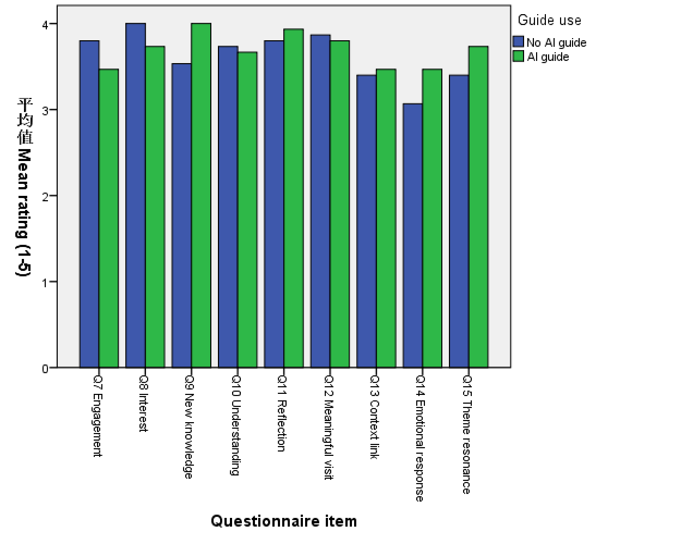
RESULTS
No item is statistically significant before or after correction
WHAT THE DESCRIPTIVE MEANS SHOW
AI group higher on 5 items
Q9 +0.47 · Q14 +0.40 · Q15 +0.33 · Q11 +0.13 · Q13 +0.07
No-AI group higher on 4 items
Q7 -0.33 · Q8 -0.27 · Q10 -0.07 · Q12 -0.07
Largest descriptive difference
Q9 new knowledge
AI mean 4.00 vs no-AI 3.53
Raw p = .230 · Holm p = 1.000 · r-rb = +.249
No raw p-value is below .05. All effect magnitudes are below .30.
SPSS grouped mean chart · blue = no AI; green = AI · bar height is descriptive
GROUP H / ADS401 PRESENTATION 3
5 / 7
Notes:
The AI group has higher descriptive means on five items and the no-AI group on four. The largest mean difference is Q9, but its raw p-value is .230 and the Holm value is 1.000. No item reaches significance before or after correction.

Slide 6
FULL RESULT TABLE
All nine adjusted p-values remain 1.000
Item | No AI | AI | Delta | U | Raw p | Holm p | r-rb
Q7 Engagement | 3.80 | 3.47 | -0.33 | 138.0 | .278 | 1.000 | -.227
Q8 Interest | 4.00 | 3.73 | -0.27 | 135.5 | .328 | 1.000 | -.204
Q9 New knowledge | 3.53 | 4.00 | +0.47 | 84.5 | .230 | 1.000 | +.249
Q10 Understanding | 3.73 | 3.67 | -0.07 | 118.5 | .804 | 1.000 | -.053
Q11 Reflection | 3.80 | 3.93 | +0.13 | 105.0 | .757 | 1.000 | +.067
Q12 Meaning | 3.87 | 3.80 | -0.07 | 124.0 | .622 | 1.000 | -.102
Q13 Context | 3.40 | 3.47 | +0.07 | 108.5 | .875 | 1.000 | +.036
Q14 Emotion | 3.07 | 3.47 | +0.40 | 90.0 | .318 | 1.000 | +.200
Q15 Resonance | 3.40 | 3.73 | +0.33 | 94.0 | .427 | 1.000 | +.164
n = 15 per group. Delta = AI mean minus no-AI mean. Positive r-rb favours the AI group.
GROUP H / ADS401 PRESENTATION 3
6 / 7
Notes:
This is the complete result table. Item-level means differ slightly in direction, but no raw or adjusted p-value reaches .05. The largest positive difference is Q9, and the largest negative difference is Q7.

Slide 7
CONCLUSION AND REFLECTION
The sample does not show an AI-guide effect on the nine ratings
01
No item-level evidence of difference
The raw and Holm-adjusted tests are all non-significant.
Answer
The current data do not provide sufficient evidence that AI-guide use changes post-visit experience ratings.
02
Absence of evidence is not equivalence
The sample is small and cannot rule out modest effects.
03
Allocation limits causal interpretation
Q9 is hypothesis-generating only:
AI - no AI = +0.47 · raw p = .230 · Holm p = 1.000
The recorded sequence does not match strict alternation.
04
Next study
Q&A
Group H
Verify allocation, pre-specify a primary outcome, and increase the sample.
GROUP H / ADS401 PRESENTATION 3
7 / 7
Notes:
In this sample, the nine post-visit ratings do not provide evidence of a difference between AI-guide and no-AI conditions. This is not proof of equivalence. The main methodological lesson is that allocation records and a pre-specified primary endpoint must be established before data collection.

