Slide 2
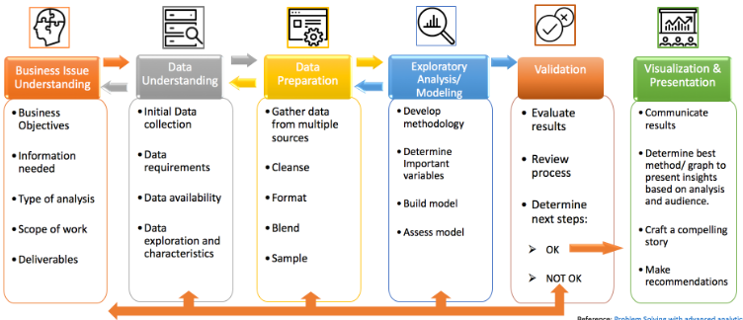
CRISP-DM Methodology
Why Crisp-DM?
Flexible
cyclical nature
can be implemented without much training, organizational role changes, or controversy.
provides strong guidance for data science activities

Slide 3


Data Modeling
Tools Used:
Why Rapid Miner?
Flow based programming allows visualization of pipelines
Contains modules for statistical analysis,machine learning,etl,etc
Easy to setup
Multiple deployment options based on your preference.
Accurate Preprocessing.
Multiple interfaces.
Why Tableau ?
Data Blending
No need of technical knowledge
Real-time analysis
cost effective.
Provides great visualizations and reports on data.
user-friendly, and interactive user-interface

Slide 4
Business Understanding
Background:
Analysis on data extracted from 1985 Ward's Automotive Yearbook.
Objective:
Is the price of the car related to its fuel type?
Can horsepower affect the car price?
Can the price of the car be predicted based on its features?
Does width and height of a car affect the price prediction?

Slide 5
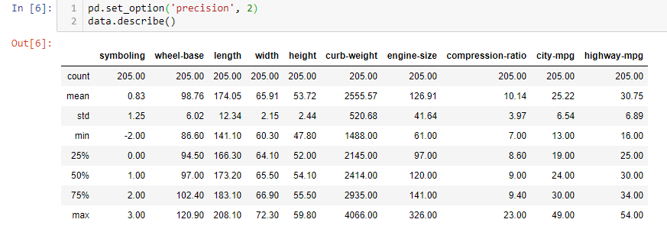
Data Understanding
Dataset contain 205 observations and 16 features
Each record in the data describes car specifications

Slide 6
Data preparation

Slide 7
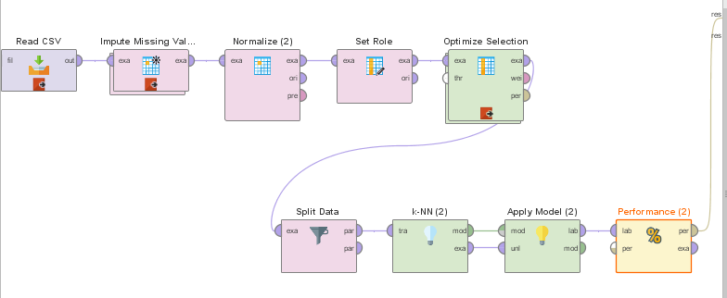
Model Built -Manual

Slide 8
