Slide 1

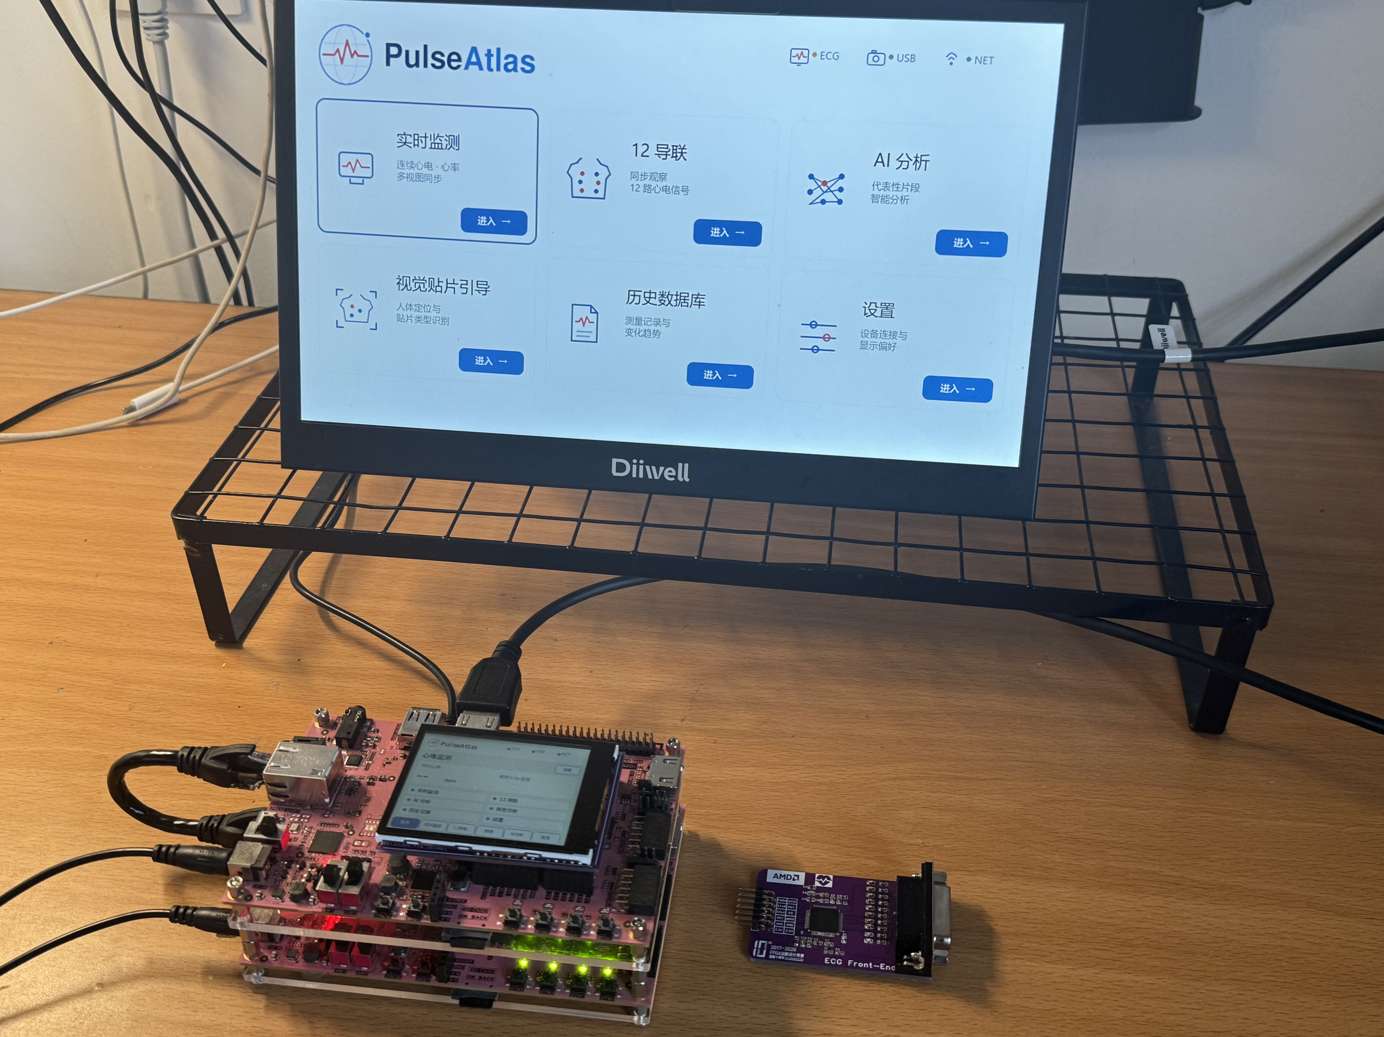

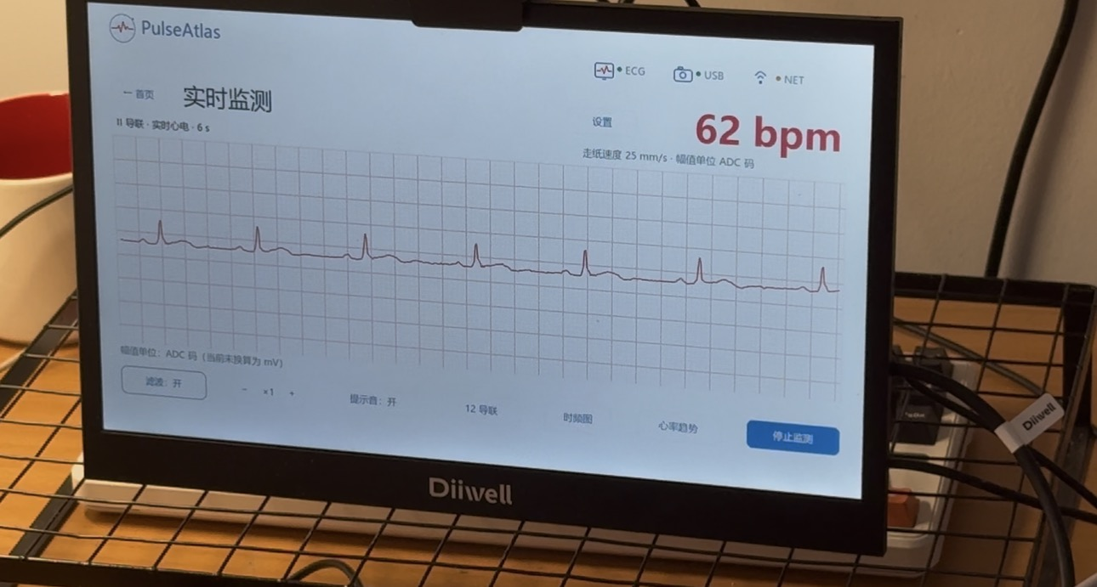
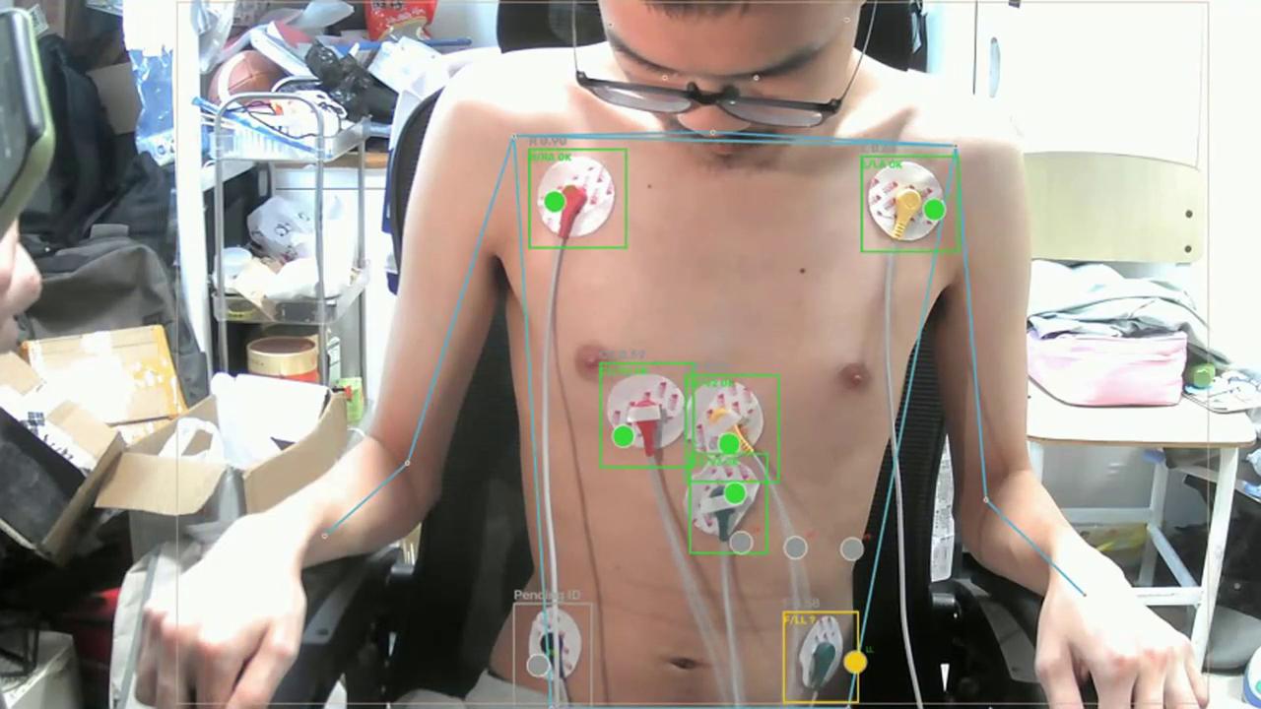
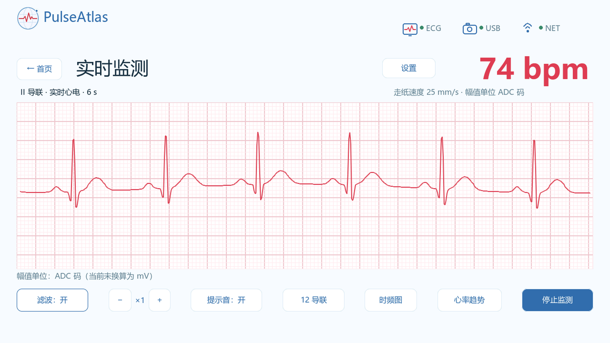
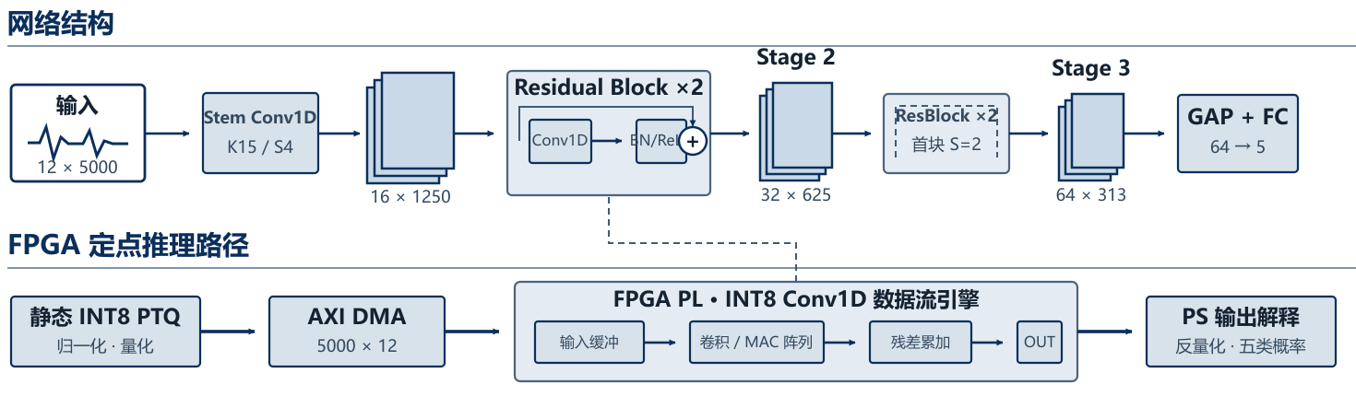
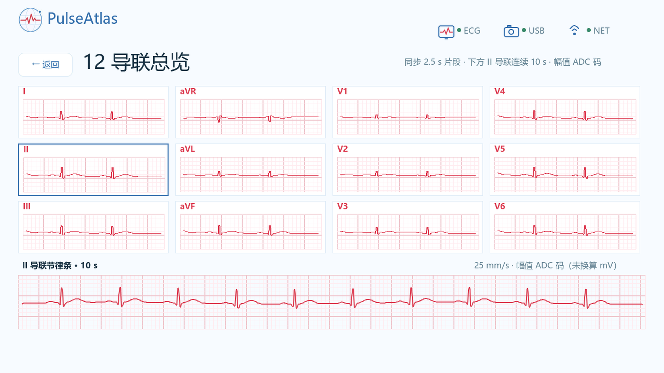
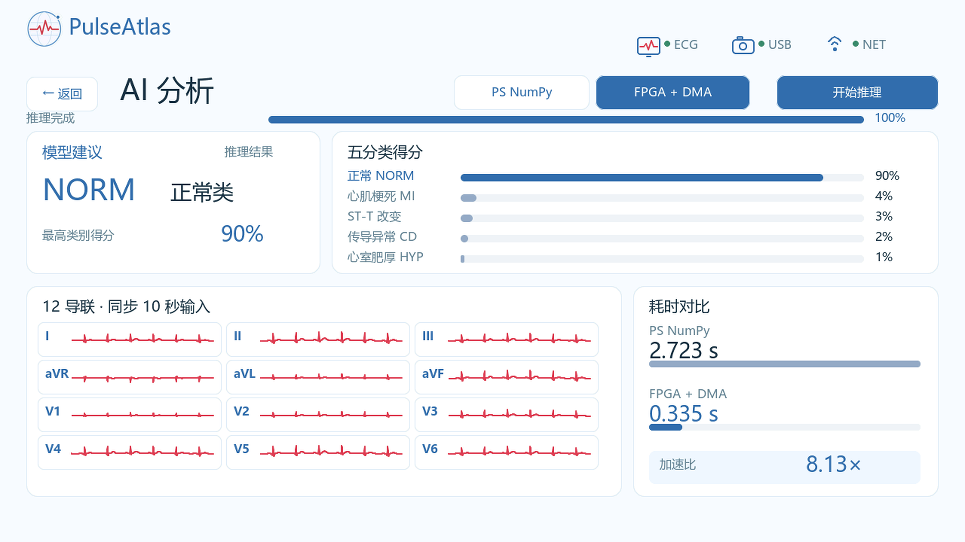
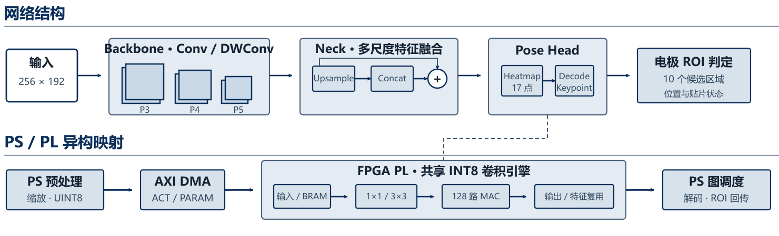
© 2026 大连理工大学
队员：张思东 · 陈弈璋 · 皮俊杰
双PYNQ-Z2心电分析与视觉贴片引导系统
大连理工大学
项目摘要
PulseAtlas将12导联采集、PL实时处理、视觉贴片引导和AI分析部署于双PYNQ-Z2平台。
系统形成从信号采集到交互显示的端到端闭环。
作品实物缩略图
双PYNQ-Z2｜ADS1298｜USB相机｜HDMI/TFT
关键词：双PYNQ-Z2，12导联ECG，PL流水线，INT8视觉引导
实时心电监测
人体电极片识别
01 心电分析网络
离线 Macro-AUROC
1D-ResNet
0.9312
12导联 × 10 s
5类输出 · 139,493参数
离线 Macro-AUPRC
0.8273
12 导联总览
AI 辅助分析
性能指标
02 视觉姿态网络
计算量
指标 | 结果
ECG Macro-AUROC | 0.9312
ECG Macro-AUPRC | 0.8273
A板 LUT | 58.13%
B板 LUT | 61.0%
视觉服务 | 5.05 FPS
YOLO11n-pose
244.27 MMAC/f
固定输入 256×192
96个卷积节点
PL主核时钟
90.909 MHz
纯PL核耗时
≈0.184 s
1
Notes:
中文海报，基于AMD官方模板。
School emblem source: https://www.dlut.edu.cn/info/1364/35309.htm
Project evidence and metrics: PulseAtlas_Report_Handoff_20261029.zip and 双Zynq心电分析与视觉贴片引导系统_设计报告.docx.
Visual materials: user-provided prototype photographs and 8_2.mp4.

Slide 2
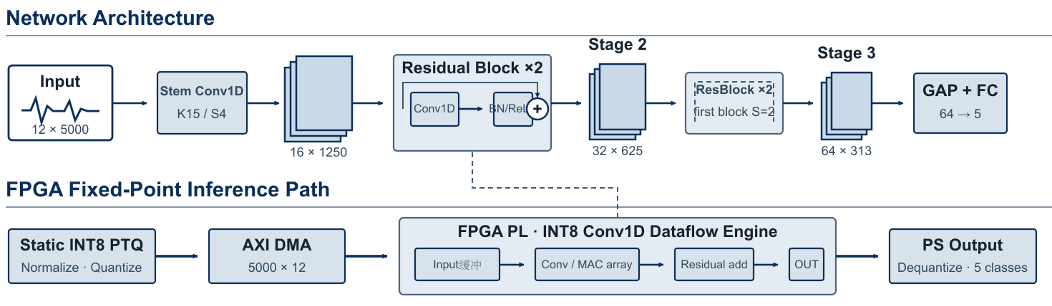
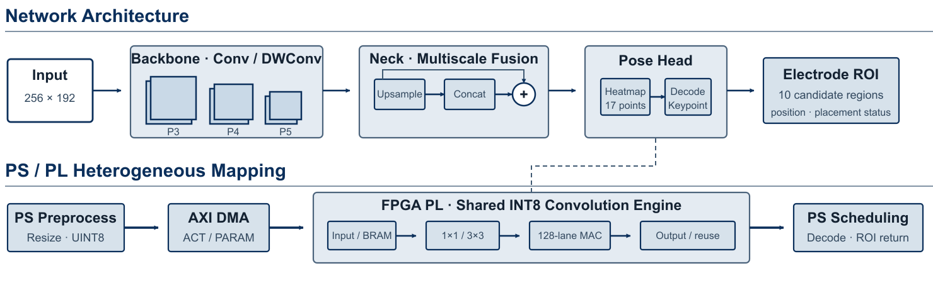
© 2026 Dalian University of Technology
Sidong Zhang · Yizhang Chen · Junjie Pi
Dual PYNQ-Z2 ECG Analysis and Visual Electrode Guidance System
Dalian University of Technology
Project Summary
PulseAtlas integrates 12-lead ECG acquisition, real-time PL processing, visual electrode-placement guidance, and AI analysis on two PYNQ-Z2 boards.
The system forms an end-to-end loop from signal acquisition to interactive display.
Prototype Hardware
Dual PYNQ-Z2 | ADS1298 | USB Camera | HDMI/TFT
Keywords: dual PYNQ-Z2, 12-lead ECG, PL pipeline, INT8 visual guidance
Real-Time ECG Monitoring
Electrode Placement Detection
01 ECG Analysis
Offline Macro-AUROC
1D-ResNet
0.9312
12 leads × 10 s
5 classes · 139,493 parameters
Offline Macro-AUPRC
0.8273
12-Lead ECG Overview
AI-Assisted Analysis
Performance Metrics
02 Visual Guidance
Compute
Metric | Result
ECG Macro-AUROC | 0.9312
ECG Macro-AUPRC | 0.8273
Board A LUT | 58.13%
Board B LUT | 61.0%
Vision inference throughput | 5.05 FPS
YOLO11n-pose
244.27 MMAC/f
Fixed input 256 × 192
96 convolution nodes
PL core clock
90.909 MHz
PL kernel latency
≈0.184 s
1
Notes:
中文海报，基于AMD官方模板。
School emblem source: https://www.dlut.edu.cn/info/1364/35309.htm
Project evidence and metrics: PulseAtlas_Report_Handoff_20261029.zip and 双Zynq心电分析与视觉贴片引导系统_设计报告.docx.
Visual materials: user-provided prototype photographs and 8_2.mp4.

