Slide 1

HOUSING DATASET ANALYSIS USING PYTHON
KIRAN M
DA & DS
2025 MAY BATCH

Slide 2
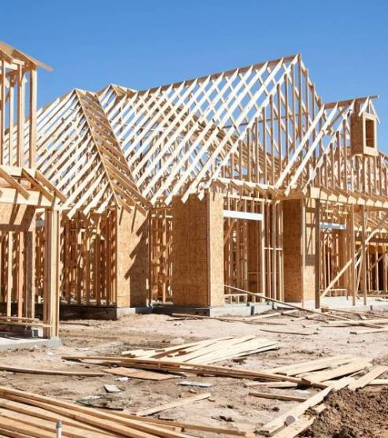

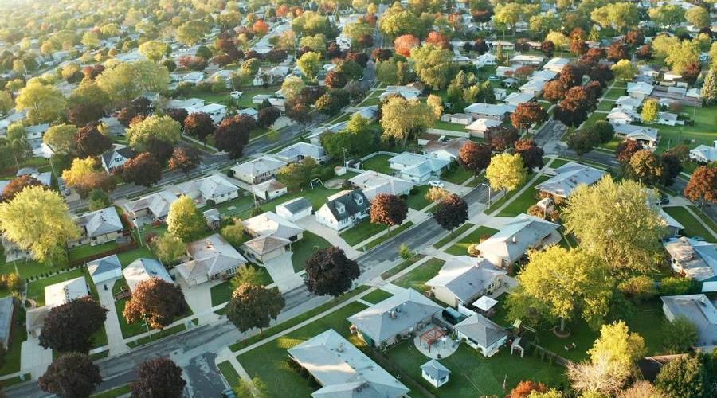
INTRODUCTION
Brief outline of the analysis process for a housing dataset.
Problem Statement: What factors most influence property prices?
Objective: Leverage data analytics to enhance housing market decisions.

Slide 3


DATA UNDERSTANDING
Source: Real estate listings data.
Rows: 4,600
Columns: 18
Key Attributes:
Price, bedrooms, bathrooms, sqft_living, sqft_lot, city, year built, etc.

Slide 4
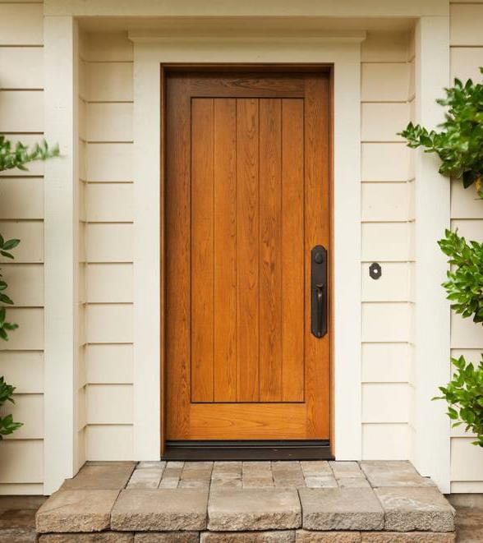
DATA CLEANING
Why? Ensures reliability and accuracy in analysis.
Key Steps:
Removed columns: date, street
Created new features: property_age, price_per_sqft
Corrected datatypes for numeric/categorical fields
Approach: Systematic transformation for consistency.

Slide 5
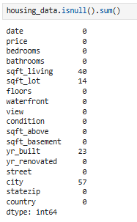

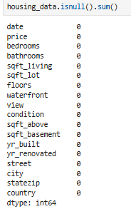
HANDLING MISSING VALUES
Finding missing values using isnull
Fill the row using fillna.
BEFORE
AFTER

Slide 6
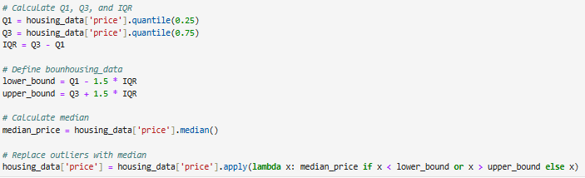
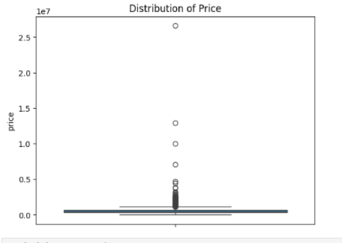
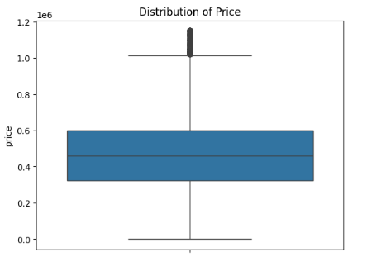
OUTLIER HANDLING
Identification: Used boxplots and statistical summaries.
Cleansing: Capped extreme values in price, area.
Result: More robust distributions for modeling.
BEFORE
AFTER

Slide 7
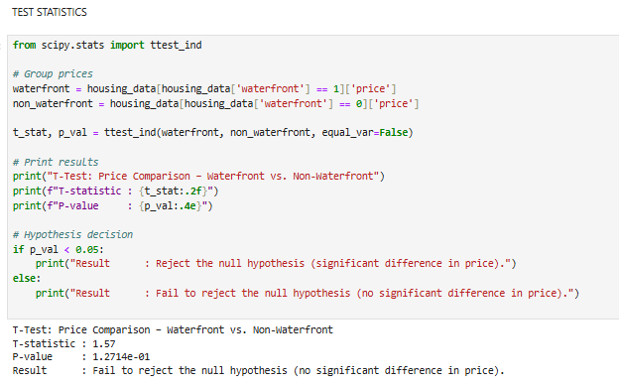
STATISTICAL ANALYSIS
T-TEST
T-tests for differences in price by waterfront vs Non-waterfront status.

Slide 8
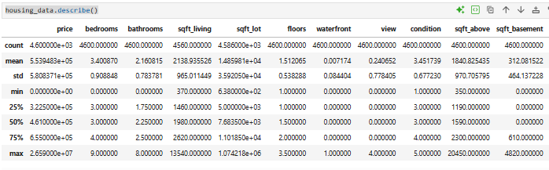
DESCRIPTIVE ANALYSIS
Using statistical measures such as mean, median, mode (central tendency), frequency, range, and standard deviation (dispersion).
Serving as a foundation for more advanced analyses such as predictive or prescriptive analytics

Slide 9
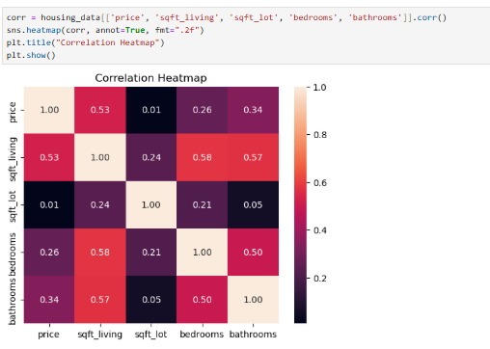
RELATIONSHIP BETWEEN VARIABLES
Variables: Price, sqft_living, sqft_lot , bedrooms, bathroom,
Analysis: Correlation and group differences.
Result: Sqft_living,bedroom and bathroom is high price

Slide 10
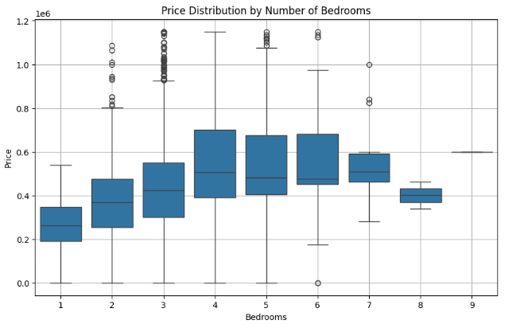
DATA VISUALIZATION
Purpose: Communicate trends and discoveries.
Types Used:
Histograms (price, area)
Scatter plots (sqft vs. price)
Boxplots (condition vs. price)
Heatmaps (feature correlations)

Slide 11
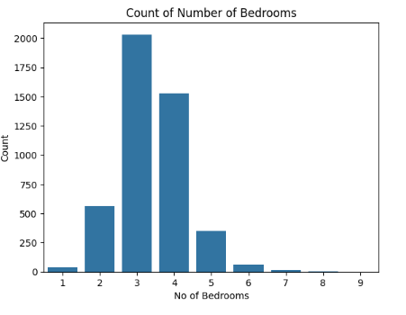
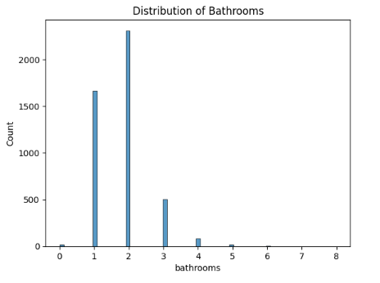
UNIVARIATE ANALYSIS
Focus: Distributions of individual features
Findings:
Bedrooms and bathrooms cluster at lower values
Most homes: 3-4 bedrooms, 1-2 bathrooms
Suggestion: Histogram of price; barplot of bedroom counts

Slide 12
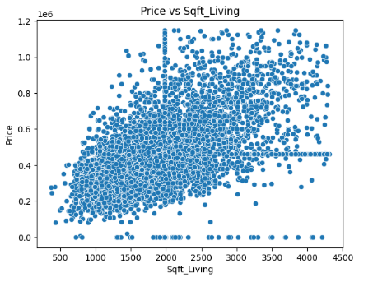
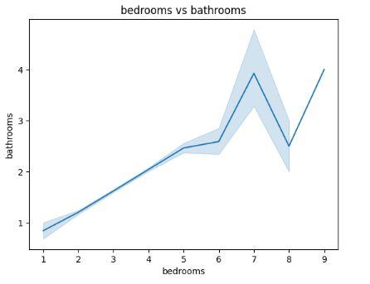
BIVARIATE ANALYSIS
Comparisons: Price vs. sqft_living, bedroom, bathroom
Findings: Larger homes → higher prices; sqft_living and better-conditioned properties cost more
Suggestion: Scatter and box plots

Slide 13
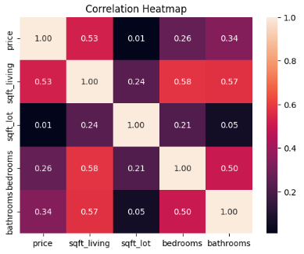
MULTIVARIATE ANALYSIS
A multivariate analysis explores how multiple factors collectively influence housing prices. Understanding these relationships helps buyers, sellers, and policymakers make informed decisions.
Strong Positive Correlations:
Price & Living Area (sqft_living): 0.53
Price & Number of Bathrooms: 0.34
Price & Number of Bedrooms: 0.26
Moderate Feature Inter-relationships:
Bedrooms & Bathrooms: 0.50
Living Area & Bathrooms: 0.57
Weak Correlations:
Price & Lot Size (sqft_lot): 0.01 (almost no relationship)
Lot Size has minimal effect on other variables

Slide 14
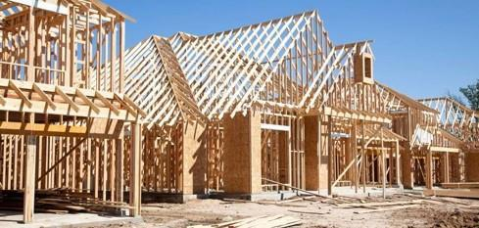


CONCLUTION
Key Insights
Location plays a major role in price variability
Waterfront and view properties command premium prices
Bathrooms have more pricing impact than bedrooms
Renovated homes tend to sell at higher prices
Larger homes (higher sqft_living) = higher value
Recomentation
Focus on layouts that feel larger and more functional to buyers
Location has the greatest long-term impact on price appreciation

Slide 15




Thank you
KIRAn| kiranklgd2000@gmail.com | 🔗 [https://github.com/KIRAN-06012000]

