Slide 1
PSCS64-Customer Support Chatbot With ML
PIP2001 Capstone Project
Review-4
Batch Number:CSE-G27
Under the Supervision of,
Mr. Md Ziaur Rahman
Assistant Professor
School of Computer Science and Engineering
Presidency University
Roll Number | Student Name
20211CSE0382 | Kiran R
20211CSE0378 | ArunKumar P
20211CSE0386 | Jishnukumar GS
20221LCS0022 | Praveen Kumar S
Name of the Program: CSE
Name of the HoD: Dr.Asif Mohammed
Name of the Program Project Coordinator: Mr.Amarnath JL/Dr.Jayanthi K
Name of the School Project Coordinators: Dr. Sampath A K / Dr. Abdul Khadar A / Mr. Md Ziaur Rahman

Slide 2
Content
Introduction
Literature Review
Existing Methods Drawback
Hardware/Software Components
Objectives
Methodology
Algorithm
Expected Outcomes
Output
Conclusion
TimeLine of the Project
Github Link
References

Slide 3
Introduction
In customer support, chatbot by using machine learning customer can converse by a chatbot and acquire the query intent information.
With the enhancement of globalization and industrialization, it becomes a problem for enterprises to interact with the customer and listen to their difficulties to a big extent.
Chatbots make ease the pain that the industries nowadays facing.
The aim of this chatbot is to support and reply to the client by giving him/her the relevant intent depending on the query request from the customers.

Slide 4
Literature Review
Sl.no | Title/Author/publisher | Advantages | limitations
1. | Choudhury, S. D. G., & Rahman, M. A. H. B, Customer Support Chatbot: A Survey, International Journal of Computer Applications-2019 | Comprehensive overview of existing chatbot architectures. Identifies various machine learning techniques for natural language processing. | Limited focus on specific implementation challenges. Lacks empirical data on user satisfaction.
2. | Ali, A. D. S. A. Z., & Al-Harbi, Artificial Intelligence in Customer Service: A Study of Chatbot, Journal of Business Research-2021 | Highlights the efficiency improvements in customer service . Discusses various AI techniques enhancing customer satisfaction. | Primarily theoretical with limited case studies . May not cover all industry-specific applications.

Slide 5
Literature Review
Sl.no | Title/Author/publisher | Advantages | limitations
3. | Hu, J. P., & Chen, C. T, Design and Implementation of a Customer Support Chatbot Using Machine Learning , IEEE Access-2020 | Provides a practical implementation framework ,Compares performance metrics with traditional systems. | Focus on a single implementation context may limit generalizability, Potential scalability issues not fully addressed.
4. | Asad, M. A. O., & Ali, Enhancing Customer Experience with Chatbot Systems: A Machine Learning Perspective, Journal of Customer Service-2022 | Explores user experience improvements through ML-driven chatbots , Includes empirical case studies with quantitative results. | Limited by the sample size of case studies , May not address multilingual or culturally specific challenges.
5. | Sharma, T. R. S. S. J. A., & Gupta, R. K, A Comparative Study of Chatbot Systems for Customer Support, Computers in Human Behavior-2023 | Provides a comparative analysis of various chatbot systems . Evaluates effectiveness based on user queries and responses. | Comparisons may be influenced by varying evaluation criteria . Focused on a narrow range of chatbot technologies.

Slide 6
Existing method Drawback
Limited Understanding: Chatbots are a handy tool to help with easy queries, but with more complex tasks, there may be the need for human intervention.
Maintenance and Updates: Chatbots require ongoing maintenance and updates to remain effective and up-to-date.
Predefined Scripts: Many chatbots have predefined scripts or decision trees, limiting their flexibility and adaptability, so if the query lies outside of this, there may be the need for a customer service assistant to help. Nevertheless, there are some tools to help widen conversations so that they aren’t as stringent, and this will improve as technology does.

Slide 7
Hardware/software components
• Windows OS, Html, CSS, Java Script for fronted.
• Python ML Algorithms-NLP for backend.
• SQL Database for storing the Queries.

Slide 8
Objectives
Automate Customer Interactions
Improve Response Accuracy
Enhance User Experience
Learn from Interactions
Scalability

Slide 9
Methodology/Modules
The Proposed method consists of the following steps:
Step-1: Customer Query/Request: Customer types the phrase in the chatbox.
Step-2: Chatbot: It packs the data and responds to the customer and the phrase
sent to ML-NLP engine (ML-NLP).
Step-3: Machine Learning NLP engine (ML-NLP): Extracted user intent and
entities sent back to chatbot.
Step-4: Data Query Search Engine: Chatbot based on intent call upon services
using entity information to find data from database. And data is returned to the
chatbot

Slide 10
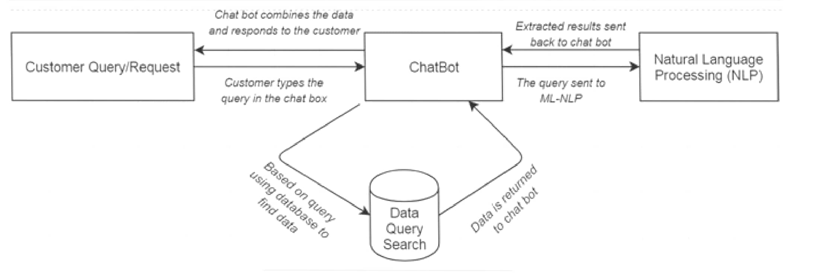
Architecture

Slide 11
Pseudocode
Flask Application for Chatbot Query Management
Initialize Flask Application
Import necessary modules (Flask, sqlite3, etc.).
Create an app instance.
Database Setup
Define DB_PATH for the database file.
Create helper functions:
get_db_connection: Opens a SQLite connection with row factory for easier data manipulation.
query_db: Executes queries with optional arguments and commits changes.
Routes and Functionality

Slide 12
Pseudocode
Homepage (/)
Render the index.html template.
Get Chatbot Response (/get-response)
Accepts a user query (POST request, JSON format).
Searches the database table Solutions for an answer matching the query.
If match found:
Return the answer as a JSON response.

Slide 13
Pseudocode
If no match found:
Log the query to the Queries table with status Pending.
Return a generic "Your query has been logged" message.
View Pending Queries (/view-pending-queries)
Fetches all queries with Pending status from the Queries table.
If pending queries exist:
Return them as a JSON list of dictionaries (e.g., id, query).
If no queries are found:
Return a message saying "No pending queries."
Respond to a Query (/respond-to-query)

Slide 14
Pseudocode
Accepts query ID and response as JSON input (POST request).
Validations: Ensure both query_id and response are provided.
Updates the Queries table:
Set status to Answered.
Save the provided response.
Return success message upon completion.
Run the App
Launch the Flask application with debugging enabled.

Slide 15
Expected Outcomes
Efficient Automation of Customer Service
Text inputs will be used by the chatbot to respond to queries.Smooth User Interface Accurate
Comprehension of user inquiries is ensured by Natural Language Processing (NLP).Customer satisfaction is increased by prompt responses and effective data retrieval . Feedback-Based Continuous Improvement
By gathering user input, the chatbot will guarantee frequent updates and increased precision . As new data becomes available, machine learning models will change over time . Greater Accessibility
For small and medium-sized businesses, the chatbot will be an affordable option . Using text, speech, input will boost user engagement for a variety of people.

Slide 16
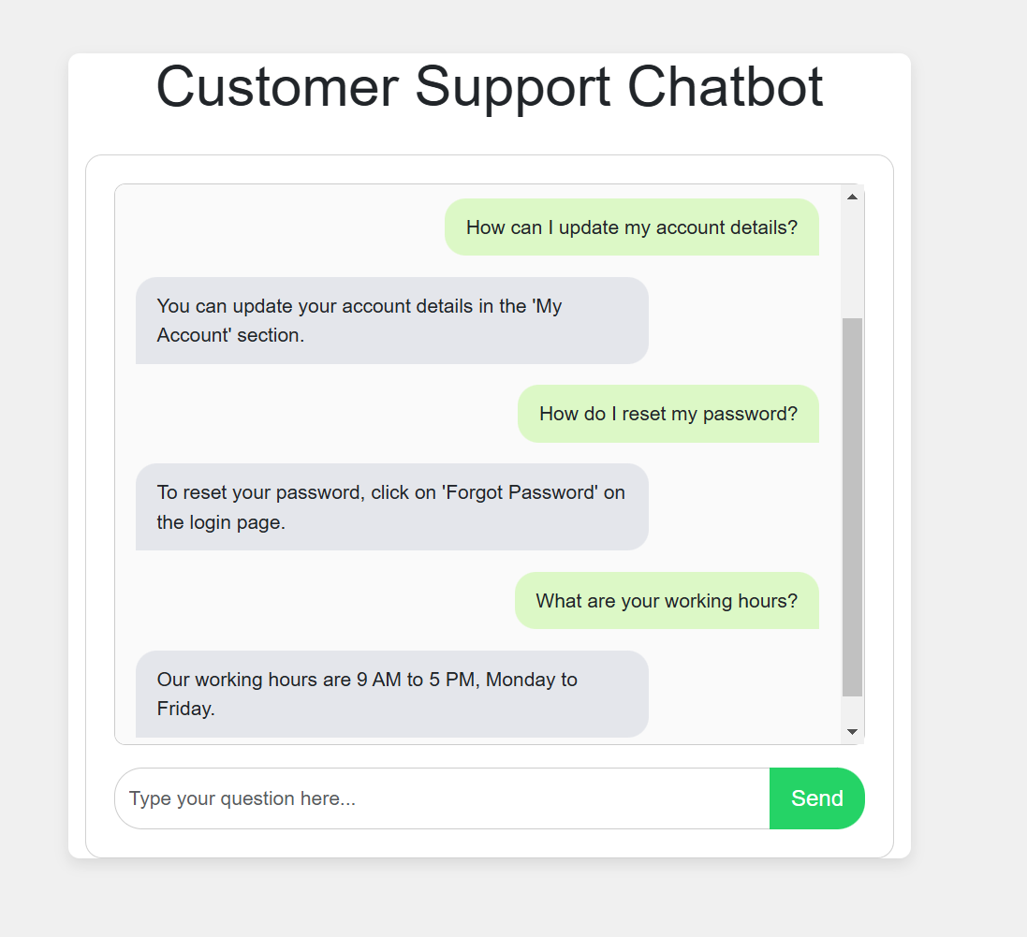
Output

Slide 17
Conclusion
The contribution is the development of a customer support chatbot using machine learning (ML) and natural language processing (NLP) in Python. While there are various chatbots available—both rule-based and self-learning—many are underutilized in the customer service domain. Rule-based chatbots tend to be rigid and struggle to comprehend the nuances of customer inquiries, such as context or slang. In contrast, self-learning chatbots utilize ML and NLP to understand and respond to diverse queries more effectively. This adaptability not only allows for immediate access to information but also enhances user satisfaction by providing personalized interactions. Moreover, these chatbots can operate around the clock, reducing wait times and freeing human agents to tackle more complex issues

Slide 18
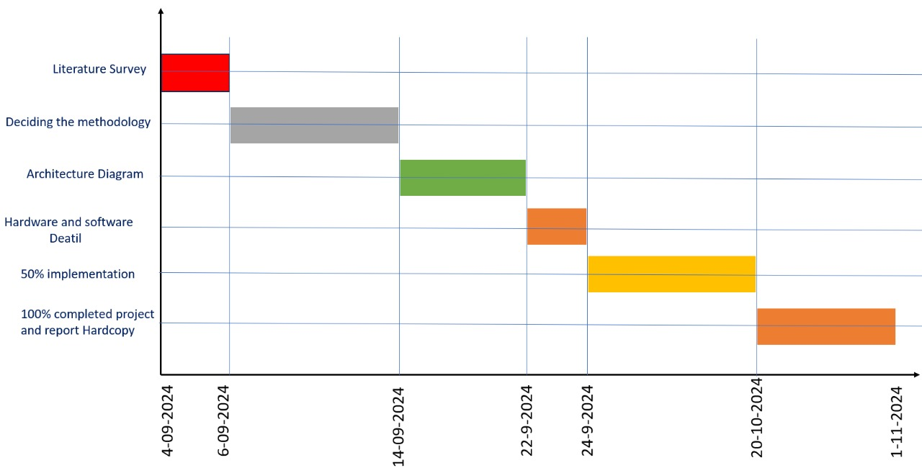
Timeline of Project

Slide 19
Github Link
The Github link provided should have public access permission.
Github Link:
https://github.com/KIRAN0382/Chatbot.git

Slide 20
References
R. Madana Mohana, Bharat institute of Engineering and Technology, Hyderabad, Telangana and N. Pity, Indian Institute of Science, Bangalore, India. Advances in intelligent Systems and Computing(2020)- Customer Support Chatbot Using Machine Learning.
https://www.researchgate.net/publication/343980800_Customer_Support_Chatbot_Using_Machine_Learning
K. Jwala, G.N.V.G Sirisha, G.V. Padma Raju, International Journal of Recent Technology and Engineering (IJRTE) ISSN: 2277-3878, Volume-8 Issue-1S3, June 2019, developing a Chatbot using Machine Learning
https://www.ijrte.org/wp- content/uploads/papers/v8i1S3/A10170681S319.pdf
A step-by-step guide to pdf chatbots with ML and Ollama, Jul-2024
https://www.analyticsvidhya.com/blog/2023/10/a-step-by-step-guide-to-pdf-chatbots-with-langchain-and-ollama/
Binny Vyas (November 9, 2017). 6 key metrics to measure the performance of your chatbot. Retrieved from https://chatbotslife.com/
Sasa Arsovski, Imagineering Institute and City, University of London and Idris Muniru, Universiti Teknologi Malaysia: Analysis of the Chatbot Open Source Languages a AIML and Chatscript: A Review, February 2017. https://www.researchgate.net/publication/323279398_ANALYSIS_OF_THE_CHATBOT_OPEN_SOURCE_LANGUAGES_AIML_AND_CHATS CRIPT_A_Review
Will Gannon: An Interactive History of Chatbots, 21 Jul, 2017. http://blog.aylien.com/interactive-history-chatbots/
Pavel Surmenok: Chatbot Architecture, Sep 11, 2016. https://medium.com/@surmenok/chatbot-architecture-496f5bf820ed

Slide 21
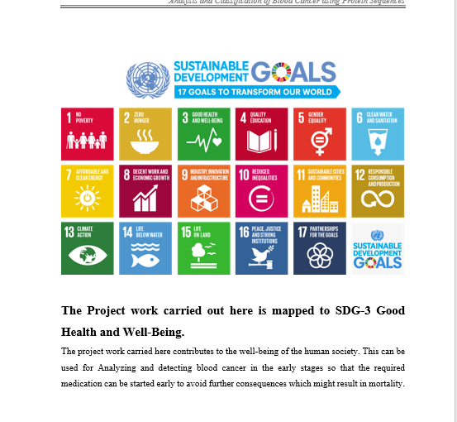
Project work mapping with SDG
The Project work carried out here is mapped to SDG-9
industry,innovation and infrastructure:
A chatbot can enhance business operations
and customer service efficiency through innovation.

Slide 22
Thank You

