Slide 1
PSCS_342 Mobile App for Direct Market Access for Farmers
CSE7301 Capstone Project
Review-0
Batch Number: CSE-G23
 | Roll Number | Student Name
 | 20211CSE0382 | Kiran R
 | 20211CSE0378 | ArunKumar P
 | 20211CSE0386 | Jishnukumar GS
 | 20221LCS0022 | Praveen Kumar S
Under the Supervision of,
Mr.Md Ziaur Rahman
Assistant Professor
Presidency School of Computer Science and Engineering
Presidency University
Name of the Program: B-Tech
Name of the HoD: Dr . Asif Mohammed
Name of the Program Project Coordinator: Dr.Jayanthi K
Name of the School Project Coordinators: Dr. Sampath A K / Mr. Md Ziaur Rahman

Slide 2
Content
Problem Statement
Github Link
Analysis of Problem Statement
Timeline of the Project
References

Slide 3
Problem Statement Number:
Organization: Ministry of Agriculture and Farmers Welfare
Category (Hardware / Software / Both) :Software
Problem Description : Farmers often face challenges in accessing markets, leading to lower income due to middlemen. This gap restricts their ability to sell produce at fair prices. Description: Create a mobile application that connects farmers directly with consumers and retailers. The app should include features for listing produce, negotiating prices, and managing transactions, thereby reducing dependence on intermediaries. Expected Solution: A user-friendly mobile platform that enables farmers to showcase their products and connect with buyers directly, enhancing their income potential.
Difficulty Level: Complex

Slide 4
Github Link
The Github link provided should have public access permission.
Github Link
https://github.com/KIRAN0382/Farmer_Market_Access.git

Slide 5
Analysis of Problem Statement
Technology Stack Components:
Frontend: android, html,
Backend: Java, or kotline
Database: SQL database or orcale

Slide 6
Analysis of Problem Statement (contd...)
Software and Hardware Requirements:
Software Tools:
Mobile App Development Platforms
Android (Java/Kotlin)
Backend Server
A backend server to manage data storage, transactions, user accounts, and notifications.Node.js, Django, or Ruby on Rails for backend development.
Database
Relational databases such as MySQL
Hardware Tools:
Smartphones
GPS-enabled Devices

Slide 7
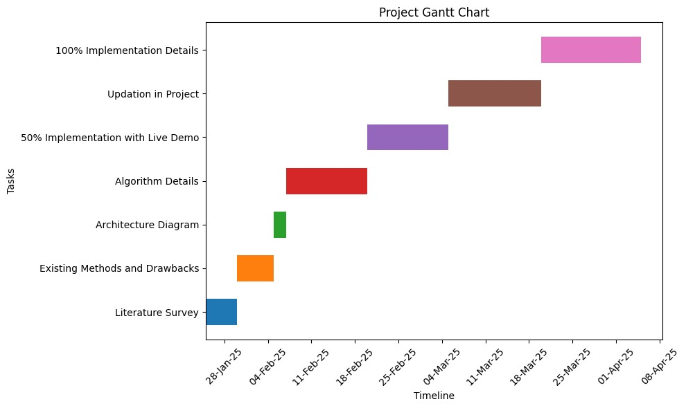
Timeline of the Project (Gantt Chart)

Slide 8
References
[1]. P. Mehta, "A Case Study on Farm-to-Consumer Mobile Platforms," International Conference on
Digital Transformation in Agriculture, 2021.
https://www.researchgate.net/publication/354980800_Farm-to-Consumer_Mobile_Platforms
[2]. K. Speina, "Foogly: A Farm-to-Consumer E-commerce Platform," NewAgeSys IT Solutions, 2023.
https://newagesysit.com/foogly-farm-to-consumer-ecommerce-platform/
[3]E. Evans, "ConFarm: An Agricultural Technology Mobile Application," Medium, 2021.
https://medium.com/@Esther_Evans/case-study-confarm-b4d52e8221eb
[4].Fusion Informatics, "Farmerprice: Online Marketplace App for Farmers," 2022.
https://www.fusioninformatics.com/farmerprice-app.html
[5].C. Hinojosa, K. Sanchez, A. Camacho, H. Arguello, "AgroTIC: Bridging the Gap Between Farmers, Agronomists, and Merchants Through Smartphones and Machine Learning," arXiv preprint arXiv:2305.12418, 2023.
https://arxiv.org/abs/2305.12418

Slide 9


