Slide 1
PSCS_342 Mobile App for Direct Market Access for Farmers
PIP2001 Capstone Project
Review-1
Batch Number:CSE-G27
Under the Supervision of,
Mr. Md Zia Ur Rahman
Assistant Professor
School of Computer Science and Engineering
Presidency University
Roll Number | Student Name
20211CSE0382 | Kiran R
20211CSE0378 | ArunKumar P
20211CSE0386 | Jishnukumar GS
20221LCS0022 | Praveen Kumar S
Name of the Program: CSE
Name of the HoD: Dr.Asif Mohammed
Name of the Program Project Coordinator: Mr.Amarnath JL/Dr.Jayanthi K
Name of the School Project Coordinators: Dr. Sampath A K / Dr. Abdul Khadar A / Mr. Md Ziaur Rahman

Slide 2
Introduction
Middlemen exploitation: Farmers often receive low prices for their produce due to intermediaries who take a significant cut.
Lack of market information: Farmers may not have access to real-time market prices and demand, limiting their ability to make informed decisions.
Direct connection: A mobile app can connect farmers directly with consumers, retailers, and businesses, eliminating intermediaries.
Real-time information: The app can provide up-to-date market prices, demand trends, and other relevant information.
Expanded market access: Farmers can reach a wider customer base, including urban consumers and businesses.
Increased income: By cutting out middlemen and accessing better prices, farmers can increase their income.

Slide 3
Literature Review
Sl.no | Title/Author/publisher | Advantages | limitations
1. | Choudhury, S. D. G., & Rahman, M. A. H. B, Customer Support Chatbot: A Survey, International Journal of Computer Applications-2019 | Comprehensive overview of existing chatbot architectures. Identifies various machine learning techniques for natural language processing. | Limited focus on specific implementation challenges. Lacks empirical data on user satisfaction.
2. | Ali, A. D. S. A. Z., & Al-Harbi, Artificial Intelligence in Customer Service: A Study of Chatbot, Journal of Business Research-2021 | Highlights the efficiency improvements in customer service . Discusses various AI techniques enhancing customer satisfaction. | Primarily theoretical with limited case studies . May not cover all industry-specific applications.

Slide 4
Literature Review
Sl.no | Title/Author/publisher | Advantages | limitations
3. | Hu, J. P., & Chen, C. T, Design and Implementation of a Customer Support Chatbot Using Machine Learning , IEEE Access-2020 | Provides a practical implementation framework ,Compares performance metrics with traditional systems. | Focus on a single implementation context may limit generalizability, Potential scalability issues not fully addressed.
4. | Asad, M. A. O., & Ali, Enhancing Customer Experience with Chatbot Systems: A Machine Learning Perspective, Journal of Customer Service-2022 | Explores user experience improvements through ML-driven chatbots , Includes empirical case studies with quantitative results. | Limited by the sample size of case studies , May not address multilingual or culturally specific challenges.
5. | Sharma, T. R. S. S. J. A., & Gupta, R. K, A Comparative Study of Chatbot Systems for Customer Support, Computers in Human Behavior-2023 | Provides a comparative analysis of various chatbot systems . Evaluates effectiveness based on user queries and responses. | Comparisons may be influenced by varying evaluation criteria . Focused on a narrow range of chatbot technologies.

Slide 5
Existing method Drawback
Price manipulation: Middlemen often buy produce at low prices from farmers and sell at higher prices to consumers, taking a significant cut.
Limited access to real-time prices: Farmers may not have access to up-to-date market prices and demand, making it difficult to make informed decisions about what to grow and when to sell.
Multiple intermediaries: The presence of multiple intermediaries in the supply chain can lead to delays and increased costs
Lack of awareness: Farmers may not be aware of government schemes, market trends, or new technologies that could benefit them.
Smallholder farmers: Smallholder farmers often have limited bargaining power due to their small scale of production and lack of market information.

Slide 6
Objectives
Eliminate Middlemen
Enhance Market Transparency
Improve Farmer Income
Facilitate Easy Transactions
Expand Market Reach
Promote Sustainable Farming

Slide 7
Methodology/Modules
The Proposed method consists of the following steps:
Step-1 Registration/Login: Secure login for farmers and buyers (potentially different registration processes).
Step-2: Profile Management: Farmers can create profiles detailing their farm, produce, certifications (organic, etc.), location, contact info, etc. Buyers can create profiles with delivery addresses, preferred produce, etc.
Step-3: Add Product: Farmers can easily list their products with photos, descriptions, available quantities, pricing (fixed or negotiable), harvest dates, etc.
Step-4: Search and Filter: Buyers can search for specific products, filter by category, location, price range, etc.

Slide 8
Step-5 Order Placement: Clear order summary with product details, quantities, total cost, delivery address, etc.
Step-6 Payment Gateway Integration: Secure payment options (credit card, debit card, UPI, mobile wallets, cash on delivery - potentially with limitations).
Step-7 Delivery Scheduling: Buyers and farmers can coordinate delivery times.
Step-8 Rating System: Buyers can rate and review farmers based on their experience.

Slide 9
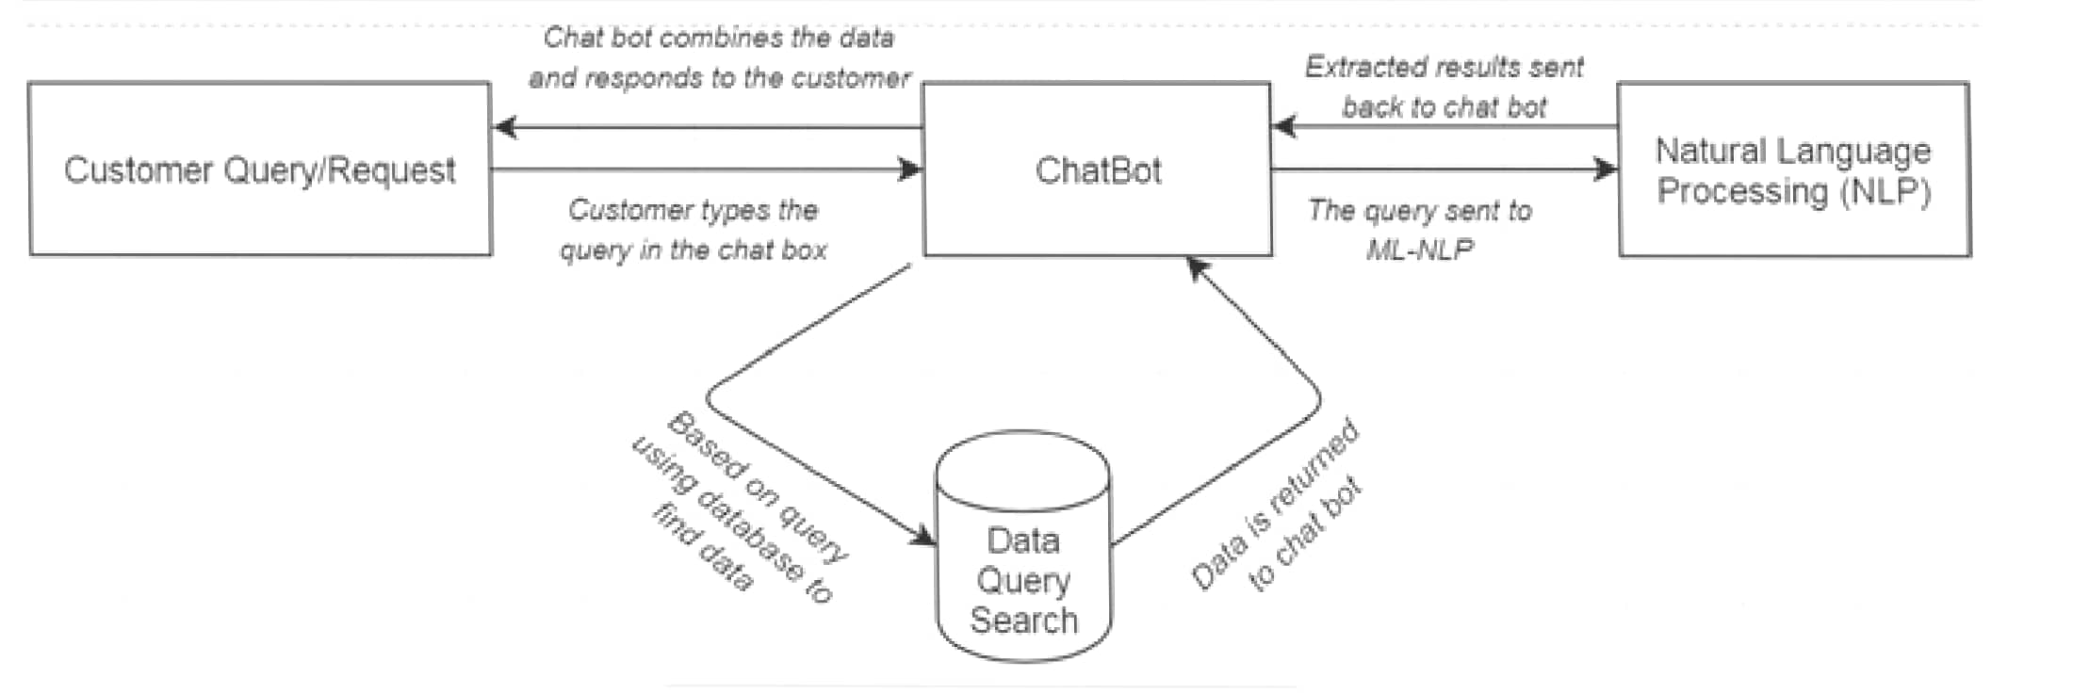
Architecture

Slide 10
Hardware/software components
• Windows OS, Visual Studio, Html, CSS, Java Script for fronted.
• Python ML Algorithms-NLP for backend.
• SQL Database for storing the Queries.
• Central Processing Unit (CPU), RAM (Memory), Storage (SSD), Network
Interface Card (NIC)

Slide 11
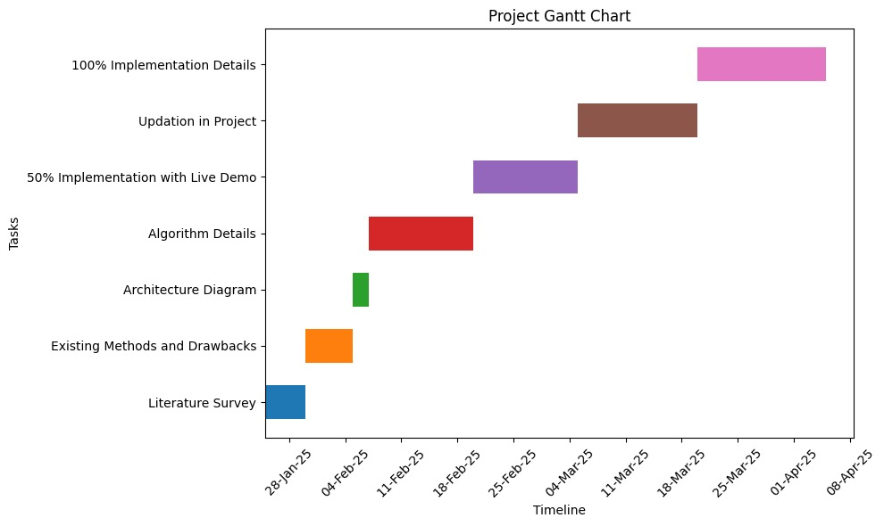
Timeline of Project

Slide 12
Expected Outcomes
Increased Farmer Profits- Farmers earn higher revenues by selling directly to buyers without middlemen.
Better Price Transparency- Real-time market price updates help farmers make informed selling decisions.
Wider Market Reach-Farmers can sell their produce to buyers across different regions, including urban markets.
Efficient Transaction System-Digital payments ensure secure, transparent, and hassle-free transactions.
Enhanced Quality Assurance-Buyers can verify product quality through ratings, reviews, and certifications.
Increased Farmer Awareness-Farmers gain knowledge about government schemes, subsidies, and best practices.
Higher Adoption of Technology in Agriculture-Farmers become more comfortable using digital platforms, improving overall efficiency.

Slide 13
Conclusion
The Mobile App for Direct Market Access for Farmers is a transformative solution that empowers farmers by providing them with a direct, transparent, and efficient platform to sell their produce. By eliminating middlemen, ensuring real-time price updates, and integrating secure digital transactions, the app enhances farmer income and market accessibility. Additionally, features like logistics support, quality assurance, and multilingual accessibility make it a comprehensive tool for farmers of all backgrounds. The app not only reduces post-harvest losses but also fosters a more sustainable and technology-driven agricultural ecosystem.With the successful implementation of this platform, farmers can achieve financial stability, buyers can access fresh and quality produce at fair prices, and the agricultural supply chain can become more streamlined and efficient. This initiative marks a significant step toward modernizing agriculture and improving rural livelihoods.

Slide 14
Github Link
The Github link provided should have public access permission.
Github Link:
https://github.com/KIRAN0382/Chatbot.git

Slide 15
References
R. Madana Mohana, Bharat institute of Engineering and Technology, Hyderabad, Telangana and N. Pity, Indian Institute of Science, Bangalore, India. Advances in intelligent Systems and Computing(2020)- Customer Support Chatbot Using Machine Learning.
https://www.researchgate.net/publication/343980800_Customer_Support_Chatbot_Using_Machine_Learning
K. Jwala, G.N.V.G Sirisha, G.V. Padma Raju, International Journal of Recent Technology and Engineering (IJRTE) ISSN: 2277-3878, Volume-8 Issue-1S3, June 2019, developing a Chatbot using Machine Learning
https://www.ijrte.org/wp- content/uploads/papers/v8i1S3/A10170681S319.pdf
A step-by-step guide to pdf chatbots with ML and Ollama, Jul-2024
https://www.analyticsvidhya.com/blog/2023/10/a-step-by-step-guide-to-pdf-chatbots-with-langchain-and-ollama/
Binny Vyas (November 9, 2017). 6 key metrics to measure the performance of your chatbot. Retrieved from https://chatbotslife.com/
Sasa Arsovski, Imagineering Institute and City, University of London and Idris Muniru, Universiti Teknologi Malaysia: Analysis of the Chatbot Open Source Languages a AIML and Chatscript: A Review, February 2017. https://www.researchgate.net/publication/323279398_ANALYSIS_OF_THE_CHATBOT_OPEN_SOURCE_LANGUAGES_AIML_AND_CHATS CRIPT_A_Review
Will Gannon: An Interactive History of Chatbots, 21 Jul, 2017. http://blog.aylien.com/interactive-history-chatbots/
Pavel Surmenok: Chatbot Architecture, Sep 11, 2016. https://medium.com/@surmenok/chatbot-architecture-496f5bf820ed

Slide 16
Thank You

