Slide 1
PSCS_342 Mobile App for Direct Market Access for Farmers
PIP4004 Capstone Project
Review-3
Batch Number:CSE-G23
Under the Supervision of,
Mr. Md Zia Ur Rahman
Assistant Professor
School of Computer Science and Engineering
Presidency University
Roll Number | Student Name
20211CSE0382 | Kiran R
20211CSE0378 | Arun Kumar P
20211CSE0386 | Jishnu kumar G S
20221LCS0022 | Praveen Kumar S
Name of the Program: CSE
Name of the HoD: Dr.Asif Mohammed
Name of the Program Project Coordinator: Mr.Amarnath JL/Dr.Jayanthi K
Name of the School Project Coordinators: Dr. Sampath A K / Dr. Abdul Khadar A / Mr. Md Ziaur Rahman

Slide 2
Introduction
Middlemen exploitation: Farmers often receive low prices for their produce due to intermediaries who take a significant cut.
Lack of market information: Farmers may not have access to real-time market prices and demand, limiting their ability to make informed decisions.
Direct connection: A mobile app can connect farmers directly with consumers, retailers, and businesses, eliminating intermediaries.
Real-time information: The app can provide up-to-date market prices, demand trends, and other relevant information.
Expanded market access: Farmers can reach a wider customer base, including urban consumers and businesses.
Increased income: By cutting out middlemen and accessing better prices, farmers can increase their income.

Slide 3
Literature Review
Sl.no | Title/Author/publisher | Advantages | limitations
1. | International Journal of Creative Research Thoughts (IJCRT) | Empowers farmers by providing direct access to markets. Ensures fairer pricing by reducing intermediary involvement. | Potential challenges in technology adoption among farmers due to varying levels of digital literacy.
2. | Farm Connect Application: Bridging the Gap Between Farmers and Consumers Through Digital Technology | Improves transparency in the supply chain. Provides consumers with access to fresh produce. Enhances farmer-consumer relationships. . | Equires reliable internet connectivity, which may be lacking in rural areas.

Slide 4
Literature Review
Sl.no | Title/Author/publisher | Advantages | limitations
3. | Mobile Applications Empowering Smallholder Farmers: An Analysis of the Impact on Agricultural Development | Facilitates direct connections between farmers and buyers. Serves as a platform for sharing knowledge and best practices. | Challenges include varying levels of literacy, internet connectivity, and mobile network coverage among farmers.
4. | International Journal of Engineering Science Invention (IJESI) | Offers farmers better price discovery mechanisms. Simplifies the process of marketing products online. | Dependence on mobile-based platforms may exclude farmers without access to smartphones.
5. | Carlos Hinojosa, Karen Sanchez, Ariolfo Camacho, Henry Arguello | Utilizes machine learning for crop health monitoring. Facilitates direct connections between farmers and merchants. | Implementation may be challenging in regions with limited technological infrastructure.

Slide 5
Existing method Drawback
Price manipulation: Middlemen often buy produce at low prices from farmers and sell at higher prices to consumers, taking a significant cut.
Limited access to real-time prices: Farmers may not have access to up-to-date market prices and demand, making it difficult to make informed decisions about what to grow and when to sell.
Multiple intermediaries: The presence of multiple intermediaries in the supply chain can lead to delays and increased costs
Lack of awareness: Farmers may not be aware of government schemes, market trends, or new technologies that could benefit them.
Smallholder farmers: Smallholder farmers often have limited bargaining power due to their small scale of production and lack of market information.

Slide 6
Objectives
Eliminate Middlemen
Enhance Market Transparency
Improve Farmer Income
Facilitate Easy Transactions
Expand Market Reach
Promote Sustainable Farming

Slide 7
Methodology/Modules
The Proposed method consists of the following steps:
Step-1 Registration/Login: Secure login for farmers and buyers (potentially different registration processes).
Step-2: Profile Management: Farmers can create profiles detailing their farm, produce, certifications (organic, etc.), location, contact info, etc. Buyers can create profiles with delivery addresses, preferred produce, etc.
Step-3: Add Product: Farmers can easily list their products with photos, descriptions, available quantities, pricing (fixed or negotiable), harvest dates, etc.
Step-4: Search and Filter: Buyers can search for specific products, filter by category, location, price range, etc.

Slide 8
Step-5 Order Placement: Clear order summary with product details, quantities, total cost, delivery address, etc.
Step-6 Payment Gateway Integration: Secure payment options (credit card, debit card, UPI, mobile wallets, cash on delivery - potentially with limitations).
Step-7 Delivery Scheduling: Buyers and farmers can coordinate delivery times.
Step-8 Rating System: Buyers can rate and review farmers based on their experience.

Slide 9
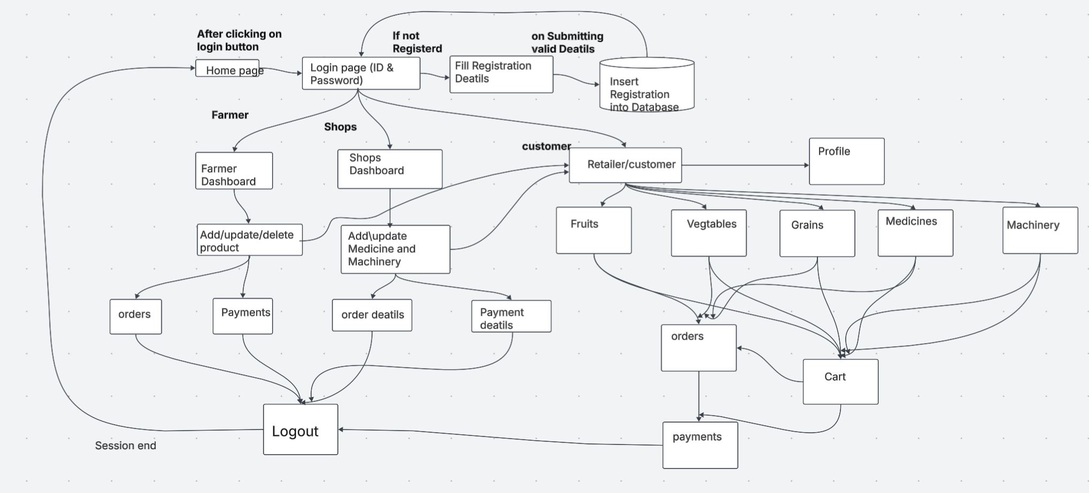
Architecture

Slide 10
Pseudo code:
Start
Show Home Page
If user clicks Login:
Go to Login Page
If user is not registered:
Show Registration Form
On valid details submission:
Insert Registration into Database
Redirect to Login Page
Else:
On successful login:
If user role is "Farmer":
Show Farmer Dashboard
Farmer can:
Add/Update/Delete Product
View Orders
View Payments
Logout ends session

Slide 11
Pseudo code:
Else if user role is "Shop":
Show Shop Dashboard
Shop can:
Add/Update Medicines and Machinery
View Order Details
View Payment Details
Logout ends session
Else if user role is "Customer":
Show Retailer/Customer Dashboard
Customer can:
View Profile
Browse Categories:
- Fruits
- Vegetables
- Grains
- Medicines
- Machinery
Add items to Cart
View Cart
Place Orders
Make Payments
Logout ends session
End

Slide 12
Hardware/software components
• Windows OS, Android Studio, xml for fronted, Azure Data Studio.
• SQL Database
Java backend

Slide 13
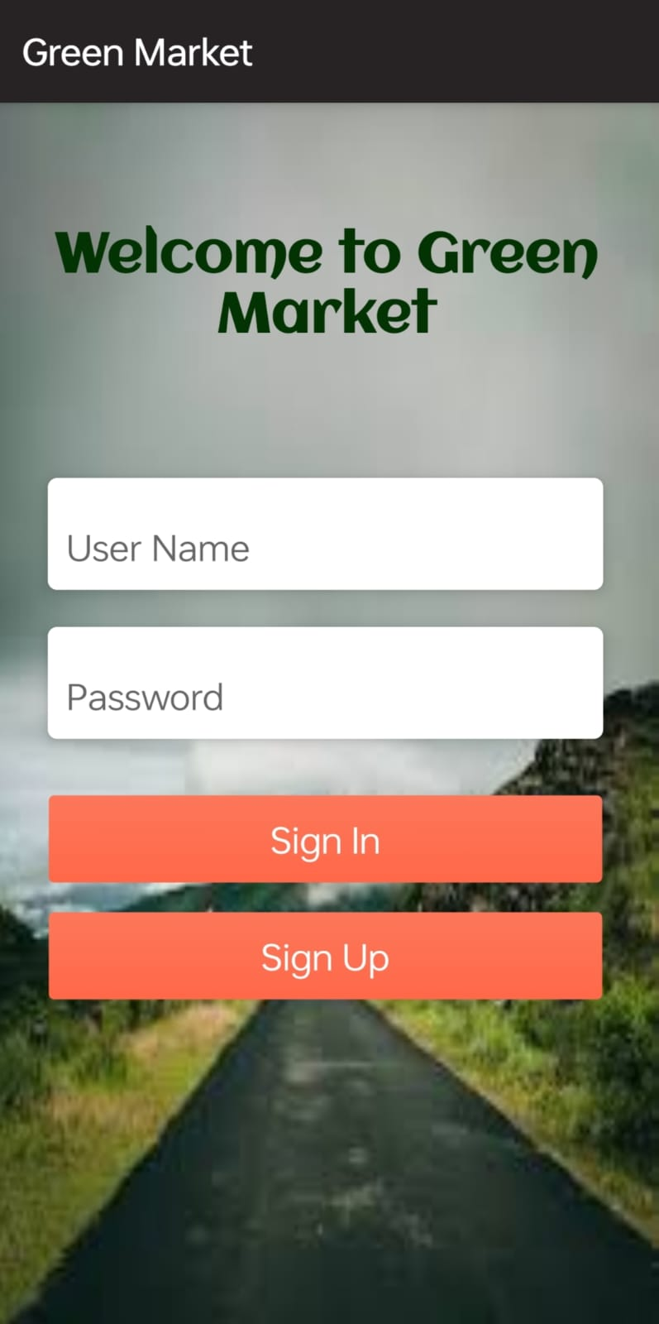
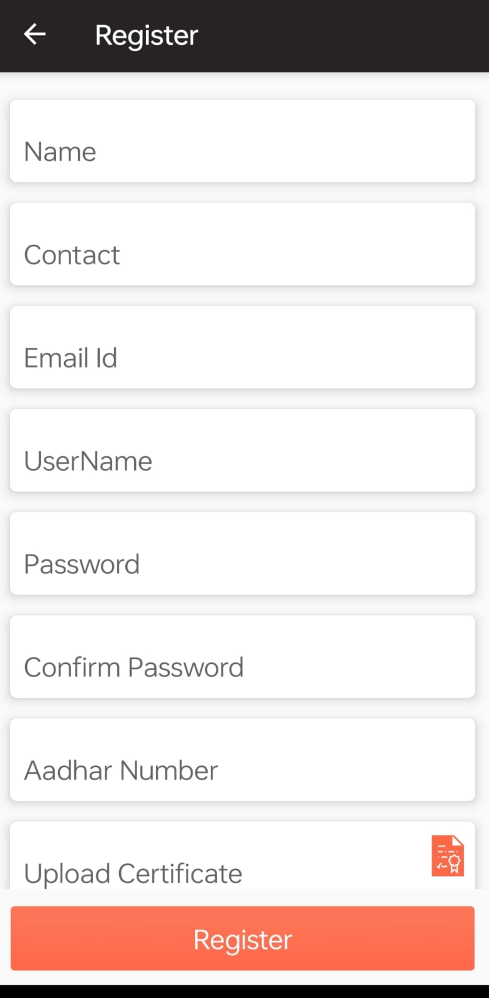
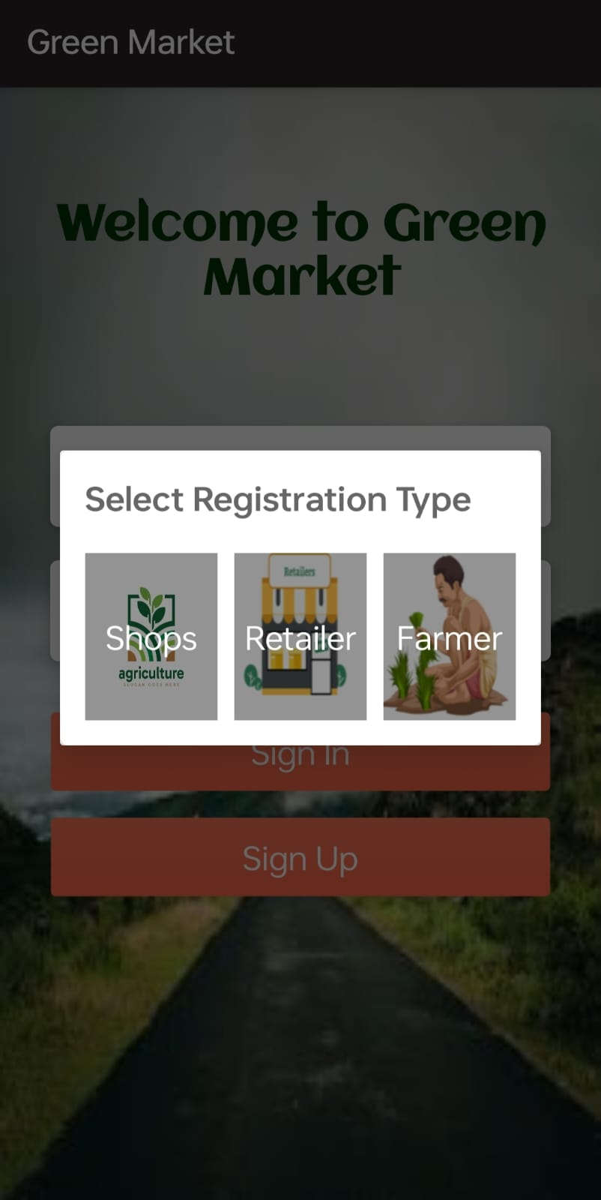
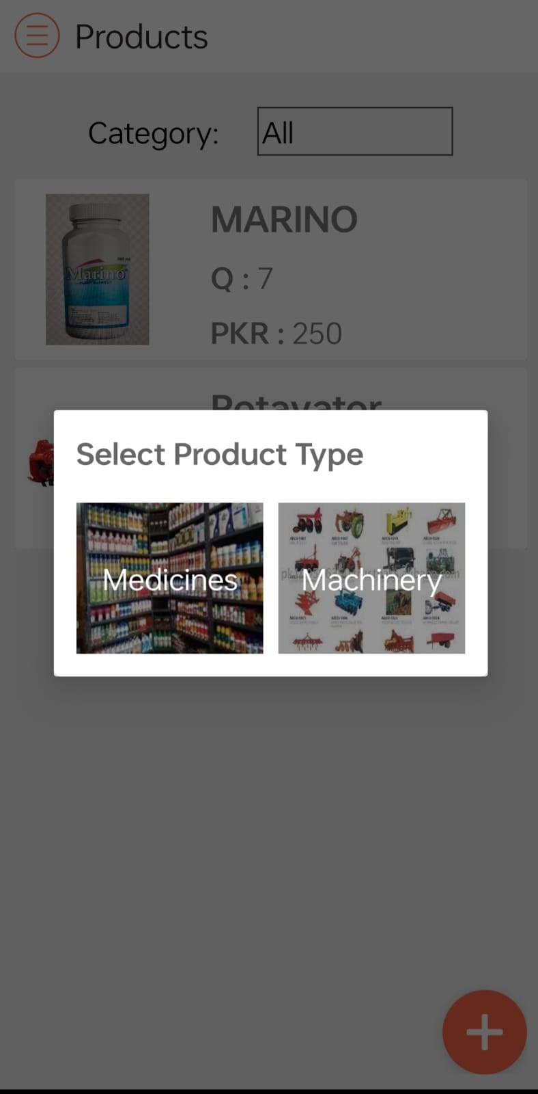
OUTPUTS

Slide 14
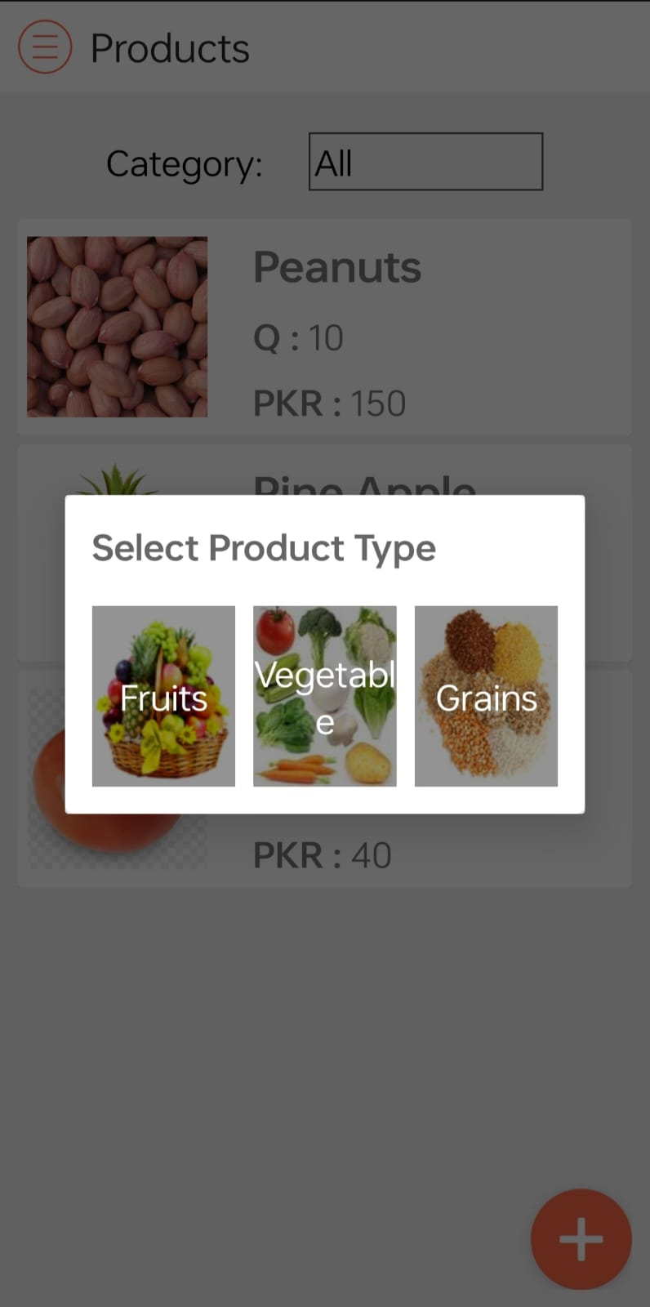
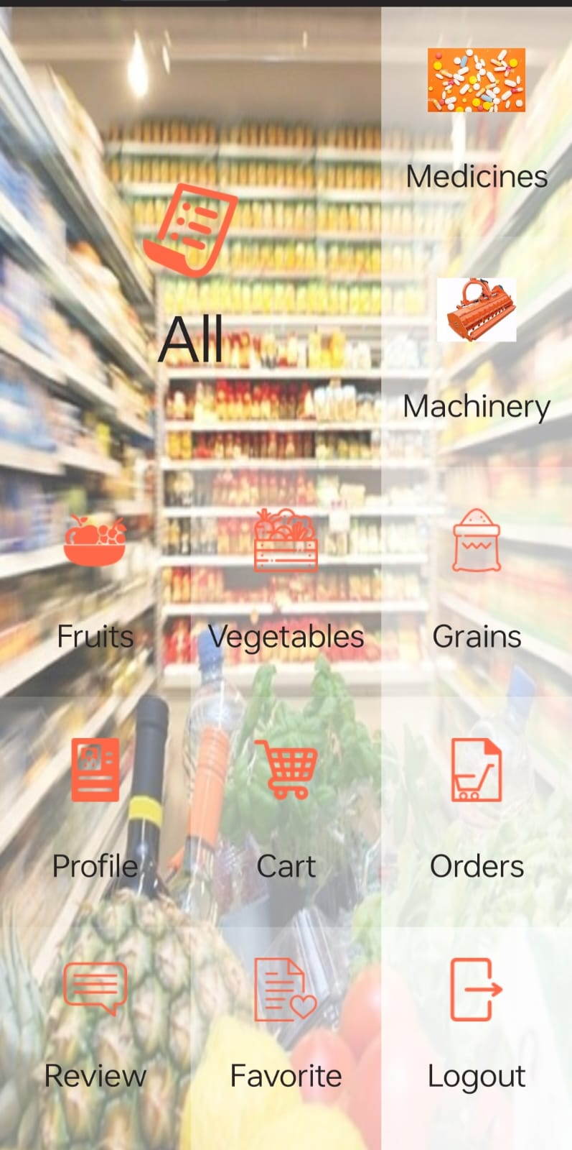
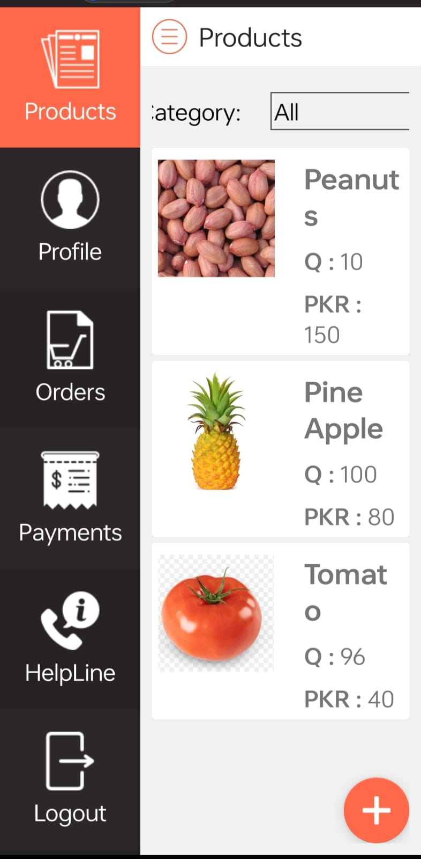
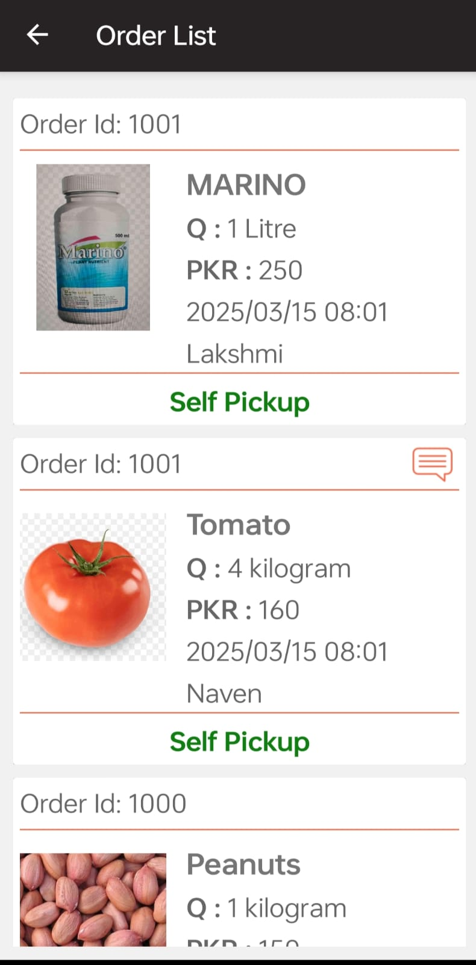
OUTPUTS

Slide 15
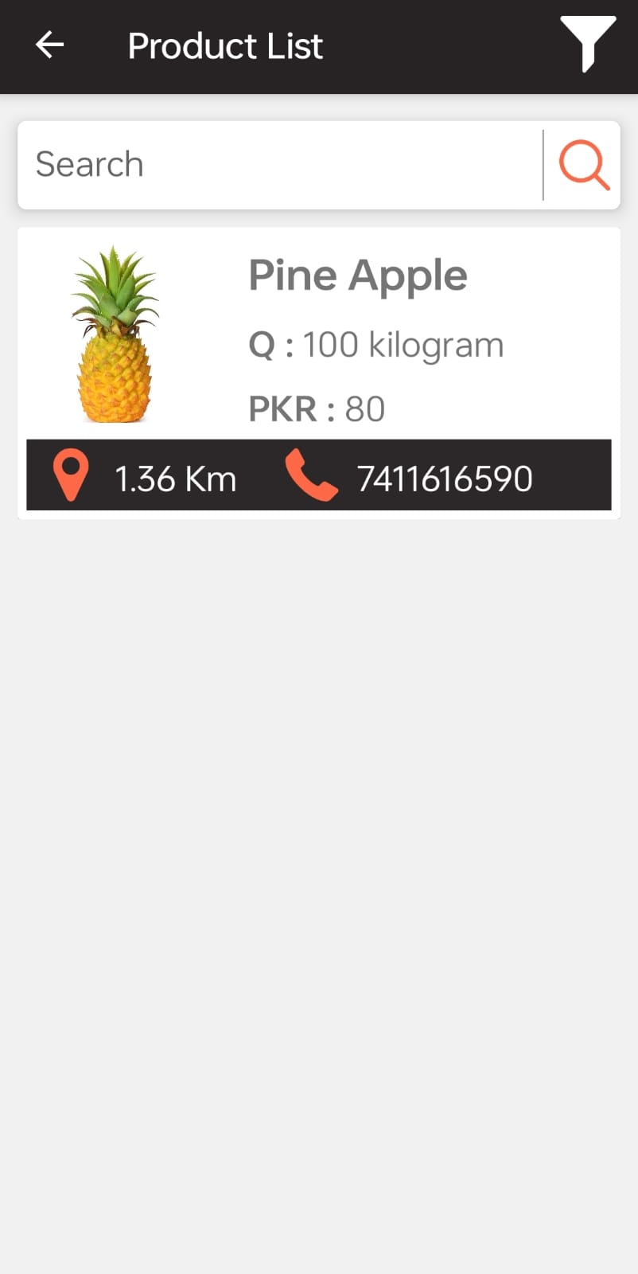
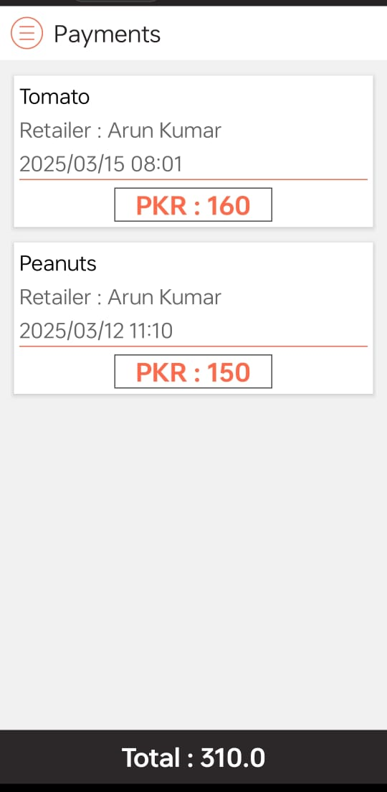
OUTPUTS

Slide 16
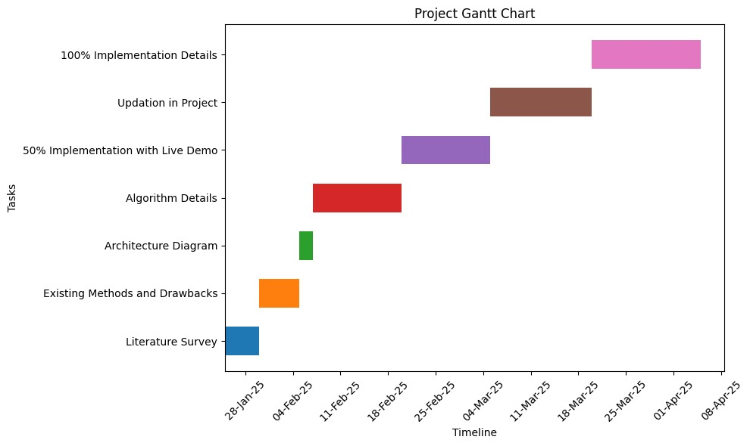
Timeline of Project

Slide 17
Expected Outcomes
Increased Farmer Profits- Farmers earn higher revenues by selling directly to buyers without middlemen.
Better Price Transparency- Real-time market price updates help farmers make informed selling decisions.
Wider Market Reach-Farmers can sell their produce to buyers across different regions, including urban markets.
Efficient Transaction System-Digital payments ensure secure, transparent, and hassle-free transactions.
Enhanced Quality Assurance-Buyers can verify product quality through ratings, reviews, and certifications.
Increased Farmer Awareness-Farmers gain knowledge about government schemes, subsidies, and best practices.
Higher Adoption of Technology in Agriculture-Farmers become more comfortable using digital platforms, improving overall efficiency.

Slide 18
Conclusion
The Mobile App for Direct Market Access for Farmers is a transformative solution that empowers farmers by providing them with a direct, transparent, and efficient platform to sell their produce. By eliminating middlemen, ensuring real-time price updates, and integrating secure digital transactions, the app enhances farmer income and market accessibility. Additionally, features like logistics support, quality assurance, and multilingual accessibility make it a comprehensive tool for farmers of all backgrounds. The app not only reduces post-harvest losses but also fosters a more sustainable and technology-driven agricultural eco system. This initiative marks a significant step toward modernizing agriculture and improving rural livelihoods.

Slide 19
Github Link
The Github link provided should have public access permission.
Github Link:
https://github.com/KIRAN0382/Farmer_Market_Access.git

Slide 20
References
[1]. P. Mehta, "A Case Study on Farm-to-Consumer Mobile Platforms," International Conference on
Digital Transformation in Agriculture, 2021.
https://www.researchgate.net/publication/354980800_Farm-to-Consumer_Mobile_Platforms
[2]. K. Speina, "Foogly: A Farm-to-Consumer E-commerce Platform," NewAgeSys IT Solutions, 2023.
https://newagesysit.com/foogly-farm-to-consumer-ecommerce-platform/
[3]E. Evans, "ConFarm: An Agricultural Technology Mobile Application," Medium, 2021.
https://medium.com/@Esther_Evans/case-study-confarm-b4d52e8221eb
[4].Fusion Informatics, "Farmerprice: Online Marketplace App for Farmers," 2022.
https://www.fusioninformatics.com/farmerprice-app.html
[5].C. Hinojosa, K. Sanchez, A. Camacho, H. Arguello, "AgroTIC: Bridging the Gap Between Farmers, Agronomists, and Merchants Through Smartphones and Machine Learning," arXiv preprint arXiv:2305.12418, 2023.
https://arxiv.org/abs/2305.12418

Slide 21
Thank You

