Slide 1
Travel Planner Agent
CAPSTONE PROJECT
Presented By:
1. KIRAN KUMAR-ALVA’S INSTITUTE OF ENGINEERING AND TECHNOLOGY-INFORMATION SCIENCE AND ENGINEERING

Slide 2
OUTLINE
Problem Statement (Should not include solution)
Proposed System/Solution
System Development Approach (Technology Used)
Algorithm & Deployment
Result (Output Image)
Conclusion
Future Scope
References

Slide 3
Problem Statement
A Travel Planner Agent is an AI-powered assistant that helps users plan trips efficiently
and intelligently.
It uses real-time data to suggest destinations, build itineraries, and recommend transport and
accommodation options.
By understanding user preferences, budgets, and constraints, it tailors personalized travel plans.
Integrated with maps, weather updates, and local guides, it ensures a smooth travel experience.
The agent can also manage bookings, alert users to changes, and optimize schedules on the go.
This smart assistant transforms complex travel planning into a seamless, enjoyable process.

Slide 4
Proposed Solution
IBM Cloud Watsonx AI + Mistral Large Model
Personalized Planning: Understands user preferences, budget, and time constraints.
Real-Time Intelligence: Fetches live weather, transport, and accommodation data.
Dynamic Itineraries: Updates schedules on-the-go and manages bookings.
Integrated Services: Maps, local guides, and alerts for a seamless experience.

Slide 5
System Approach
1. Requirement Analysis
Understand user preferences, budget, and travel dates.
2. Data Integration
Real-time data from maps, weather, transport, and accommodation APIs.
3. AI Model
IBM watsonx.ai with Mistral Large LLM for itinerary generation & personalization.
4. Architecture
Frontend: User interface
Backend: AI agent + data pipelines
APIs: Maps, weather, booking services
5. Workflow
Input → AI planning → Recommendations → Booking & Alerts
6. Deployment
Hosted on IBM Cloud, monitored & updated with feedback.

Slide 6
Algorithm & Deployment
Input Gathering
Collect user details: destination preferences, budget, dates, interests.
Fetch real-time data (flights, hotels, weather, local attractions).
Data Processing
Use Watsonx AI with Mistral Large LLM for understanding user intent.
Apply NLP for extracting key constraints and goals.
Personalization & Optimization
Generate itinerary using AI planning algorithms.
Optimize travel routes and schedule based on user priorities.
Integration
Connect APIs: Maps, Weather, Booking Platforms.
Provide alternative suggestions dynamically.
Output
Present personalized travel plan.
Enable booking and real-time updates.

Slide 7
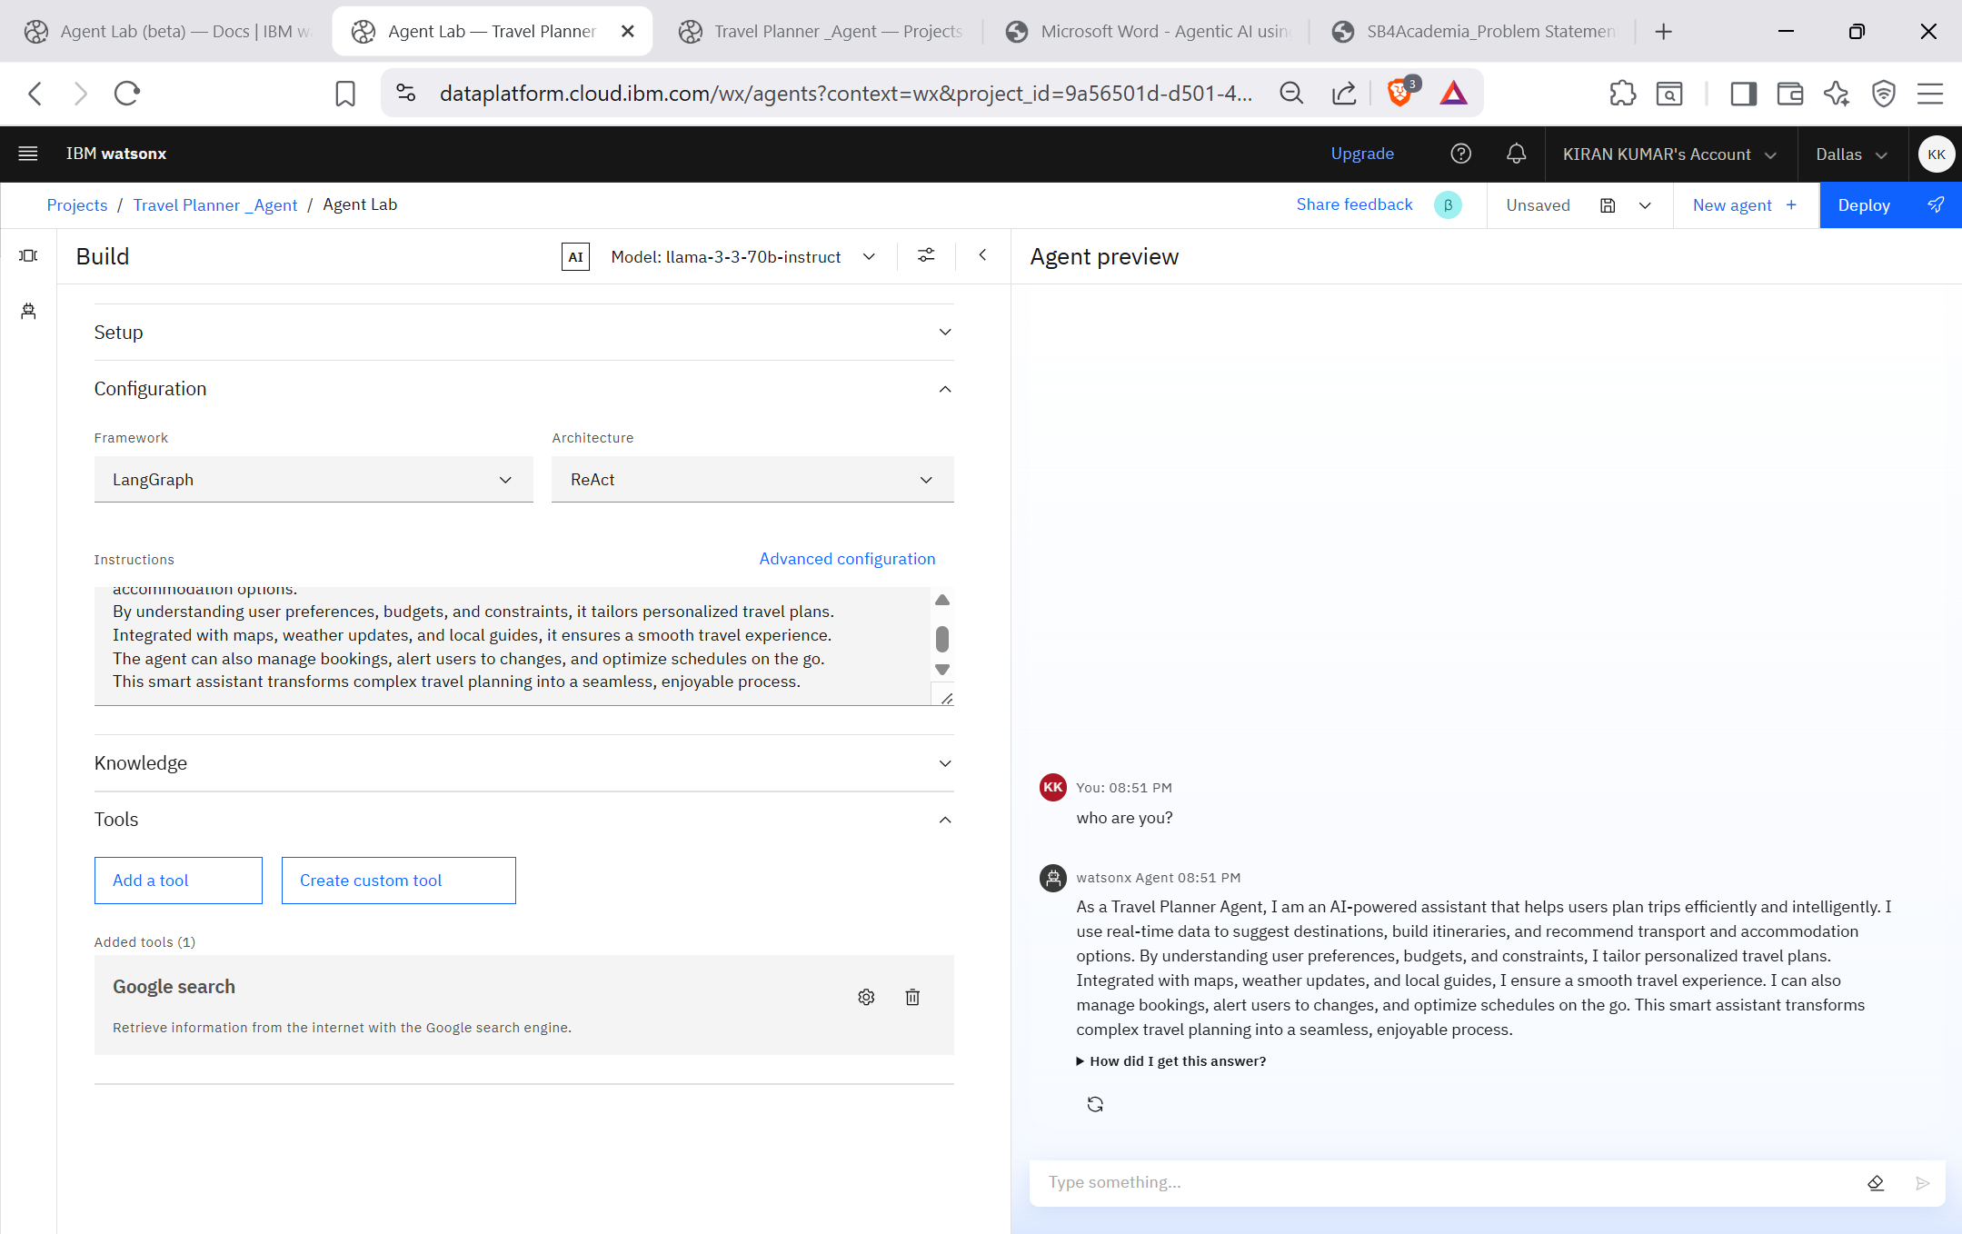
Result

Slide 8
Conclusion
AI-powered Travel Planner Agent simplifies and personalizes trip planning.
Leveraged IBM Cloud Watsonx.ai with Mistral Large Language Model for intelligent decision-making.
Integrated real-time data for destinations, weather, transport, and accommodation.
Achieved efficient itinerary generation, dynamic schedule optimization, and seamless booking management.
Delivered a user-centric, adaptive, and automated travel experience, transforming complex planning into an effortless process.

Slide 9
Future scope
Multi-Modal AI Integration Combine text, voice, and image inputs for richer user interactions.
AR/VR Travel Previews Enable virtual tours of destinations before booking.
Advanced Personalization Leverage user behavior analytics & AI to provide hyper-personalized itineraries.
Dynamic Real-Time Optimization Adjust plans on-the-fly using live traffic, weather, and event data.
Global Language Support Expand to multi-lingual and cross-cultural recommendations.
Integration with IoT & Smart Devices Smart luggage tracking, hotel room automation, and connected experiences.
Blockchain for Secure Payments Ensure transparent, tamper-proof transactions and bookings.

Slide 10
References
IBM Cloud Watsonx AI: https://www.ibm.com/watsonx
Mistral Large Language Model: https://mistral.ai/
IBM Cloud Docs – AI and Data Services: https://cloud.ibm.com/docs
IBM Watsonx.ai Overview: https://www.ibm.com/watsonx/ai
IBM Developer – AI Agents: https://developer.ibm.com

Slide 11
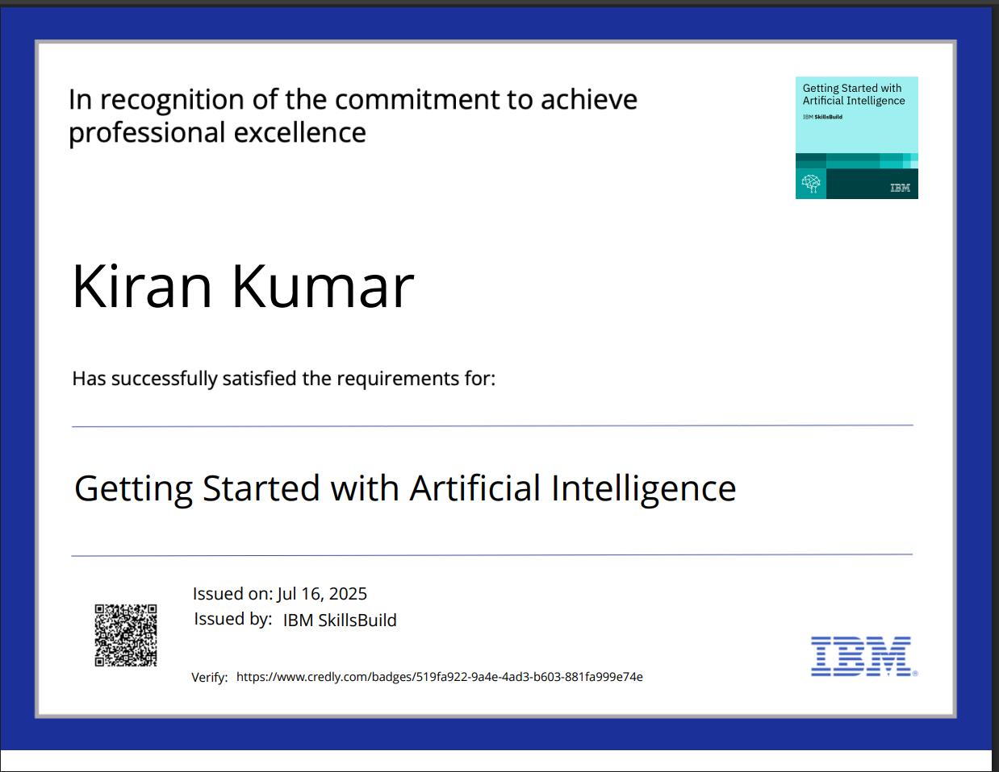
IBM Certifications

Slide 12
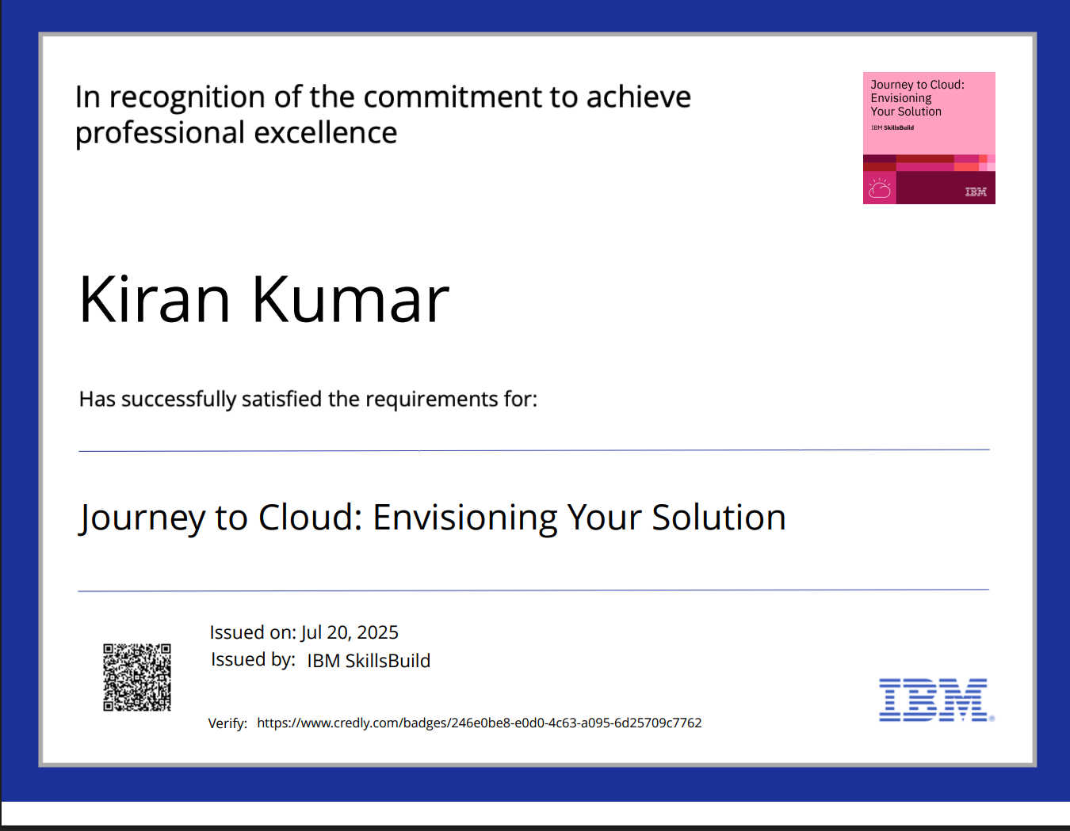
IBM Certifications

Slide 13
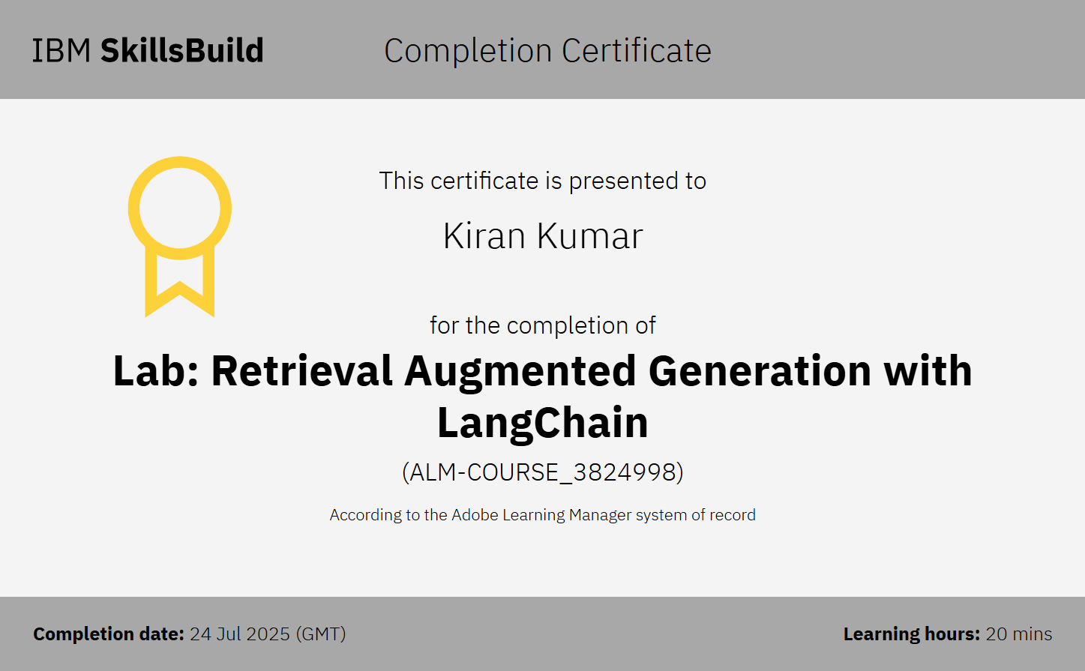
IBM Certifications

Slide 14
THANK YOU

