Slide 1
Rescue Connect An application where all rescue agencies can register and display their locations to coordinate relief efforts during calamities.
CSE7101- Capstone Project
Review-1
Batch Number:
Under the Supervision of,
Ms.Kummara Sruthi
Assistant Professor
School of Computer Science and Engineering
Presidency University
Roll Number | Student Name
20221CSE0532 20221CSE0508 20221CSE0527 | Kiran Kumar AMITH KUMAR D S Hemanth Nagaraj
Name of the Program: Computer Science And Engineering
Name of the HoD: Dr. Asif Mohammed
Name of the Program Project Coordinator: Dr. Jayavadivel Ravi
Name of the School Project Coordinators: Dr. Sampath A K , Dr. Geetha A

Slide 2
Problem Statement Number: 108
Organization: Computer Science And Engineering
Category : Software
Problem Description :
During natural or man-made calamities in metropolitan areas like Bengaluru, multiple government and non-government agencies (NDRF, SDRF, Fire Services, Police, Civil Defence, NGOs) are deployed for rescue and relief operations. However, these agencies often operate in informational silos, lacking a centralized, real-time platform to view the operational location, status, and resource availability of other nearby units. This lack of inter-agency coordination leads to critical delays in response time, inefficient allocation of resources, and a duplication of efforts, ultimately hindering the effectiveness of relief operations and risking lives and property that could otherwise be saved.

Slide 3
Content
Problem Statement
Objectives
Background and Related work for title Selection
Analysis of Problem Statement
Innovation or Novel Contributions
Git-hub Link
Timeline of the Project
References

Slide 4
Analysis of Problem Statement
Technology Stack Components:
Web Framework : React.js
Real-Time Location & Data Backend : Node.js with WebSockets
Key Frontend Technology : Progressive Web App (PWA)
Mapping Service : MapBox
Primary Backend & API : Node.js with Express.js framework
Database : PostgreSQL

Slide 5
Github Link
Github Link
https://github.com/HemanthNagaraj04/Rescue-Connect

Slide 6
Analysis of Problem Statement (contd...)
Software Requirements:
Client-Side: Modern Web Browsers (Google Chrome, Microsoft Edge, Safari) with support for Geolocation APIs and Service Workers (for PWA functionality).
Development Tools: VS Code, Git & GitHub.
Runtime Environments: Node.js v18+.
Database Management: PostgreSQL Server.

Slide 7
Analysis of Problem Statement (contd...)
Hardware Requirements:
Development Machine: Standard laptop (Intel i5/Ryzen 5, 16GB RAM, 512GB SSD).
Client Devices: Any device with a modern web browser. This includes desktops and laptops for command centers and smartphones with reliable GPS chips for field agents.

Slide 8
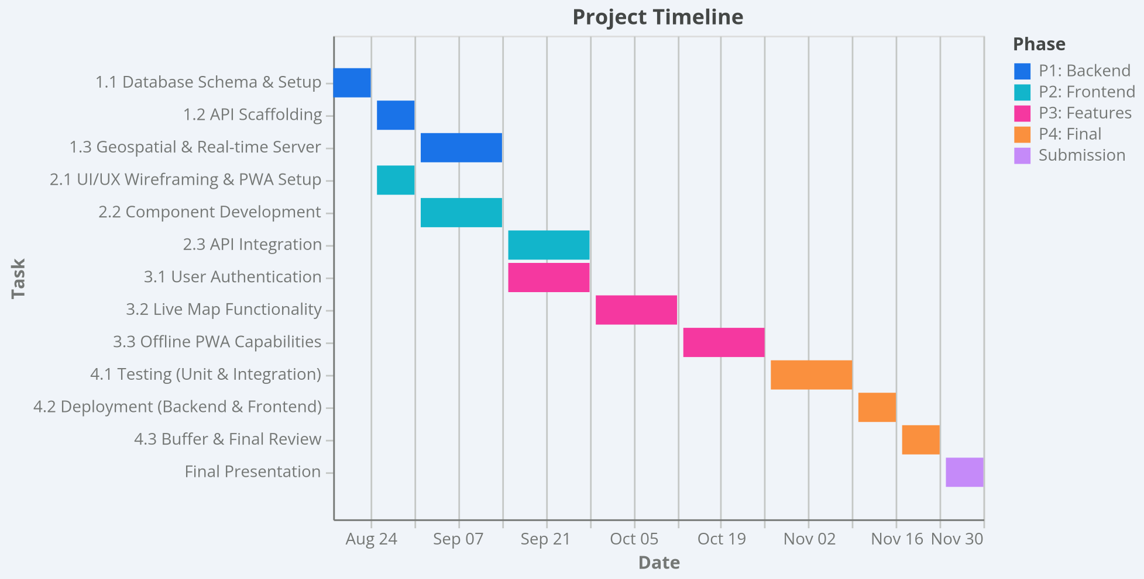
Timeline of the Project (Gantt Chart)

Slide 9
References (IEEE Paper format)
[1]. S. Gupta and R. Kumar, “Inter-Agency Communication Gaps During Urban Flood Response in India: A Case Study,” International Journal of Disaster Risk Reduction, vol. 42, pp. 101-112, Jan. 2022.
[2]. M. Chen, L. Zhang, and H. Wang, “A Performance Analysis of WebSockets for Real-Time Geospatial Data Visualization,” in Proc. IEEE International Conference on Mobile Data Management (MDM), pp. 215-220, Jun. 2023.
[3]. J. Williams, “Crisis-Map: A Volunteer-Driven GIS Platform for Community-Based Disaster Reporting,” Journal of Systems and Software, vol. 180, pp. 45-55, Oct. 2021.

Slide 10


