Slide 1
TrustGuard
DLW DATATHON 2026 · TRACK 2 · FINALS
Ranking fraud risk when 98% accuracy catches nothing
Team AI of Spades · final entry #2756
0.2365
61%
0.0
cross-validated PR-AUC (random ranking: 0.0177)
of our top 100 alerts are fraud, 35× the base rate
difference when the submitted package is re-run from scratch
Notes:
Open with the problem, not the model: we rank transactions by fraud risk so a bank can send the riskiest ~1% to a step-up check. Each number on this slide is backed later: PR-AUC and top-100 precision on slide 9, exact replay on slide 3.

Slide 2
Only 1.77% of transactions are fraud
THE PROBLEM
98.24%
0.0176
accuracy from calling everything legitimate
PR-AUC of a random ranking
…and it catches 0 of 353 frauds.
That is the real floor. We optimise PR-AUC (average precision), not accuracy or ROC.
20,000 training transactions, drawn to scale
19,647 legitimate (98.24%)
353 fraud (1.77%) →
EVIDENCE train.csv: 353 fraud / 20,000 rows; always-legitimate baseline computed directly
02
Notes:
Accuracy is meaningless: the trivial model scores 98.24% and catches nothing. So the target is ranking quality, PR-AUC. A random ranking has PR-AUC equal to the fraud rate, 0.0177: that is the floor. Saito & Rehmsmeier (2015, PLOS ONE) show PR curves are more informative than ROC under heavy imbalance. We submit probabilities, not hard labels.

Slide 3

From raw transactions to a risk score
WHAT WE BUILT
02
03
04
05
01
Clean + engineer features, in-fold
20,000 labelled transactions
Three models: LR, CatBoost, TAN
Blend 63 / 27 / 10 into one score
Top ~1% → step-up check (OTP)
Rank, don't classify
No peeking
Rules before results
Exact replay
Optimise PR-AUC and hand the bank a score; the cut-off is an operating decision.
Every imputer, encoder and helper model is refitted inside each training fold.
Each experiment's pass mark was written down before it ran. We kept the failures.
Re-running the uploaded package from scratch reproduces the scored CSV: max difference 0.0.
EVIDENCE upload_2756/prediction.ipynb: p = 0.63·LR + 0.27·CatBoost + 0.10·TAN; fresh replay 4 Oct
03
Notes:
The whole pipeline on one slide. The output is a probability-like score; the business decides the cut-off. The four principles are how we worked. Replay detail: the exact uploaded notebook and model.pkl (sha256 c459d365…) were re-run in a clean kernel on shuffled, ID-free test input; all 12,000 predictions matched the CSV the leaderboard scored (hash 7b3000d1…) with max difference 0.0. An earlier Linux Python 3.12 replay matched within 2.2e-16. Unseen/missing categories, single rows and batch size all give valid probabilities. Only extra dependency: catboost 1.2.10.

Slide 4
Small, clean, and missing the one thing fraud teams rely on
THE DATA
Grain
One row per transaction; IDs unique; 0 duplicate rows
Test has 3× more gaps
Train, any gap
4.88%
Size
20,000 train (353 fraud) · 12,000 test
Test, any gap
13.86%
Predictors
10: 3 categorical, 7 numeric
Train, 2+ gaps
0.31%
Test, 2+ gaps
3.88%
Not included
Customer ID and timestamp (hour of day only)
Fraud rate in incomplete rows: 2.05% (20/975) vs 1.75% in complete rows. We keep every row: in-fold median plus an explicit “missing” level.
Caps
account_age capped at 4,000 days (1.77% of rows)
EVIDENCE train/test CSVs: per-column gaps 0.54–0.80% train vs 2.04–2.44% test; 0 duplicates
04
Notes:
Checks: no duplicate rows, IDs unique and excluded from every model, values in valid ranges. Per-column missingness is small in train (0.5–0.8%), but rows with any gap rise from 4.88% to 13.86% in test. Incomplete training rows are not meaningfully riskier (20 frauds in 975 rows), so we keep them. KNN and MICE imputation were tested and lost (slide 7). The big structural gap: no customer ID or timestamp, so no per-customer history. That is what limits recall later (slide 11).

Slide 5
Risks stack, and one corner is worse than predicted
FINDINGS 1–3
Known device · account ≥ 90 days
Known device · account < 90 days
A new device alone
1.09%
2.05%
7.5% fraud vs 1.21% on a known device (6.2×). New devices are 9% of rows but 38% of fraud.
174 / 15,925 fraud
44 / 2,151 fraud
If the risks simply multiplied
1.09% × 4.24 (new device) × 1.87 (young account) = 8.7%
New device · account ≥ 90 days
New device · account < 90 days
4.63%
18.4%
What we observe
18.4%, about twice that.
66 / 1,425 fraud
69 / 375 fraud
Plain logistic regression assumes the multiplied version and under-scores this corner, so we added an explicit new device × young account term.
EVIDENCE train.csv: new_device × (account_age < 90); relative risks vs the known · ≥90-day cell
05
Notes:
Finding 1: a new device is the strongest single signal, 7.5% vs 1.21% (135/1,800 vs 218/18,076). It's an association, not proof of account takeover. Finding 2, the grid: each factor alone roughly doubles to quadruples the risk. Finding 3, amount: inside the risky corner, every amount band is high-risk: under $50 17.0%, $50–200 11.4%, $200–1,000 16.9%, $1,000+ 60.7% (17/28, small cell), against 0.6–2.8% for known device + older account. Hence the amount crosses. Multiplying them, which is what additive log-odds means, predicts 8.7% in the corner; we observe 18.4% on 375 rows. That super-multiplicative corner is the evidence for the interaction crosses. Wording to use on stage: main effects combine roughly multiplicatively, which is why LR is strong, and the crosses fix the corners where they don't. Older notes quoted 9–34% here; use the recomputed numbers in these notes.

Slide 6
Bursts, night hours and merchant context add the rest
FINDINGS 4–6
Last-hour bursts
Night hours
Merchant and context
Fraud rate by transactions in the last hour
Fraud rate by time of day
Fraud rate by merchant category (top 3, bottom 2)
0
1.4%
00–04h
2.60%
1
1.3%
22–23h
2.23%
luxury
5.29%
2
1.3%
05–21h
1.46%
cash transfer
4.74%
3
3.3%
Night overall 2.5% vs 1.46% by day: 1.7×. A single night flag beat sin/cos hour (−0.0028 AP).
electronics
3.94%
4
10.2%
transport
0.88%
5
23.3%
grocery
0.76%
≥ 13 in 24h and ≥ 3 in the last hour: 24.7% (58/235).
Big luxury/travel buys: 4.3% vs 6.7% for other big buys. “Large” depends on context → two context-residual features.
EVIDENCE train.csv: fraud rate by transactions_last_1h (n ≥ 50), hour block, merchant_category
06
Notes:
Three smaller signals. Bursts: 0–2 transactions in the last hour sit at the base rate; from 3 upwards risk climbs to 23% at five; burst on a busy day is 24.7%. Basis for the new device × last-hour cross; 1h/24h velocity ratios gave +0.0007 (noise). Night: U-shaped curve, each hour ~800 rows; one night flag captures it, richer encodings lost. Merchant: luxury, cash transfer and electronics 4–5% vs under 1% for grocery and retail. But a big luxury/travel purchase (38/875) is less suspicious than other big purchases (75/1125). That became the final model's context residuals: how unusual this amount and last-hour count are versus legitimate-only median models, cross-fitted. Their local gain was tiny (+0.00016 on confirmation, 4/5 folds) but this release produced our best public score 0.18900. Country: other countries 1.47–4.05% vs SG 1.31%, hence the non-SG flag.

Slide 7
We tested 14 feature ideas; one clearly paid off
EXPERIMENTS
Explicit interaction crosses
+0.0056
3/3 Adopt
KMeans cluster membership, k=8
+0.0042
3/3 Overlaps crosses
KMeans cluster membership, k=16
+0.0021
3/3
1h vs 24h velocity features
+0.0007
2/3 Noise
Isolation-forest outlier score
+0.0002
3/3 Noise
Hour as 6 time blocks
-0.0005
2/3
Hour cyclical + blocks
-0.0008
1/3
Amount relative to merchant
-0.0009
0/3
Within-cluster outlier score
-0.0009
0/3
Missing: median + flags
-0.0019
0/3
Missing: MICE imputation
-0.0019
0/3
Missing: KNN imputation
-0.0024
0/3
Hour as sin / cos
-0.0028
0/3
Target-encoded category crosses
-0.0048
0/3
Change in PR-AUC vs the logistic regression baseline (0.2316), 5-fold × 3 repeats, with repeats won. Crosses were then confirmed on fresh splits inside the blend: +0.0033, 3/3 (pre-set bar: more than +0.003 and at least 2/3).
EVIDENCE docs/ANALYSIS_REPORT.md §3 (seed 2026); confirmation on unused seed-7007 splits
07
Notes:
Each row changes one thing in the same LR pipeline, scored on identical splits. Crosses won 3 of 3 repeats and were confirmed on splits never used to design them. Clusters also helped but didn't stack with crosses, so we kept the simpler, more interpretable one. Missing-data rows: KNN and MICE lost, so median imputation stayed. Caveat we volunteer: the crosses were suggested by segment tables on the full training set, so some selection optimism remains.

Slide 8
Three models, one score
FINAL MODEL · #2756
63%
27%
10%
Logistic regression
CatBoost
Tree-augmented naive Bayes
L2, C = 0.1 · crosses + context residuals
depth 5 · 600 trees · strong L2
The backbone: additive log-odds
Thresholds and interactions LR misses
alone: PR-AUC 0.2349
alone: PR-AUC 0.2059
Bayesian network over binned features
Integrates over missing values exactly
alone: PR-AUC 0.1421
Blended risk score
Why LR leads
PR-AUC 0.2365
Alone, it beat 12+ model families on identical folds (LR 0.228; CatBoost 0.219, TabICL 0.215, EBM 0.211, LightGBM 0.205, XGBoost 0.198). Risks mostly add up in log-odds, LR's exact shape.
Features: logs · amount vs 24h average · night and non-SG flags · 5 crosses · 2 context residuals · gaps kept
EVIDENCE #2756 OOF, seed-17 5-fold; blend identity max err 0.0; research_v2/research_comparison.csv
08
Notes:
Model families: on our earlier benchmark (identical 5-fold splits, before the final crosses/residuals), standalone LR beat generative LDA, XGBoost (log loss and pairwise), TabM, LightGBM, EBM, TabICL and CatBoost; RBF SVM, TabPFN, AutoGluon, class weighting and resampling were also tried and didn't beat it. Features: log amount/24h spend/account age; amount ÷ (24h spend ÷ 24h count); night (22–04) and non-SG flags; five crosses; two cross-fitted context residuals; in-fold median + explicit missing level. Each component's standalone PR-AUC is on its card; the blend beats the best component. Most of the lift is LR. CatBoost adds non-linear thresholds. TAN, a small Bayesian network, handles missing inputs by summing over them instead of imputing, which matters because test has three times more gaps. The weights nest: 0.7 LR / 0.3 CatBoost (#1486), then 10% TAN (#2510): 0.9 × 0.7 = 0.63, 0.9 × 0.3 = 0.27. Honest note if asked: TAN passed its first screen (+0.0025) but only weakly confirmed (+0.0003, 2/5 folds); it was kept as an approved exploratory addition.

Slide 9
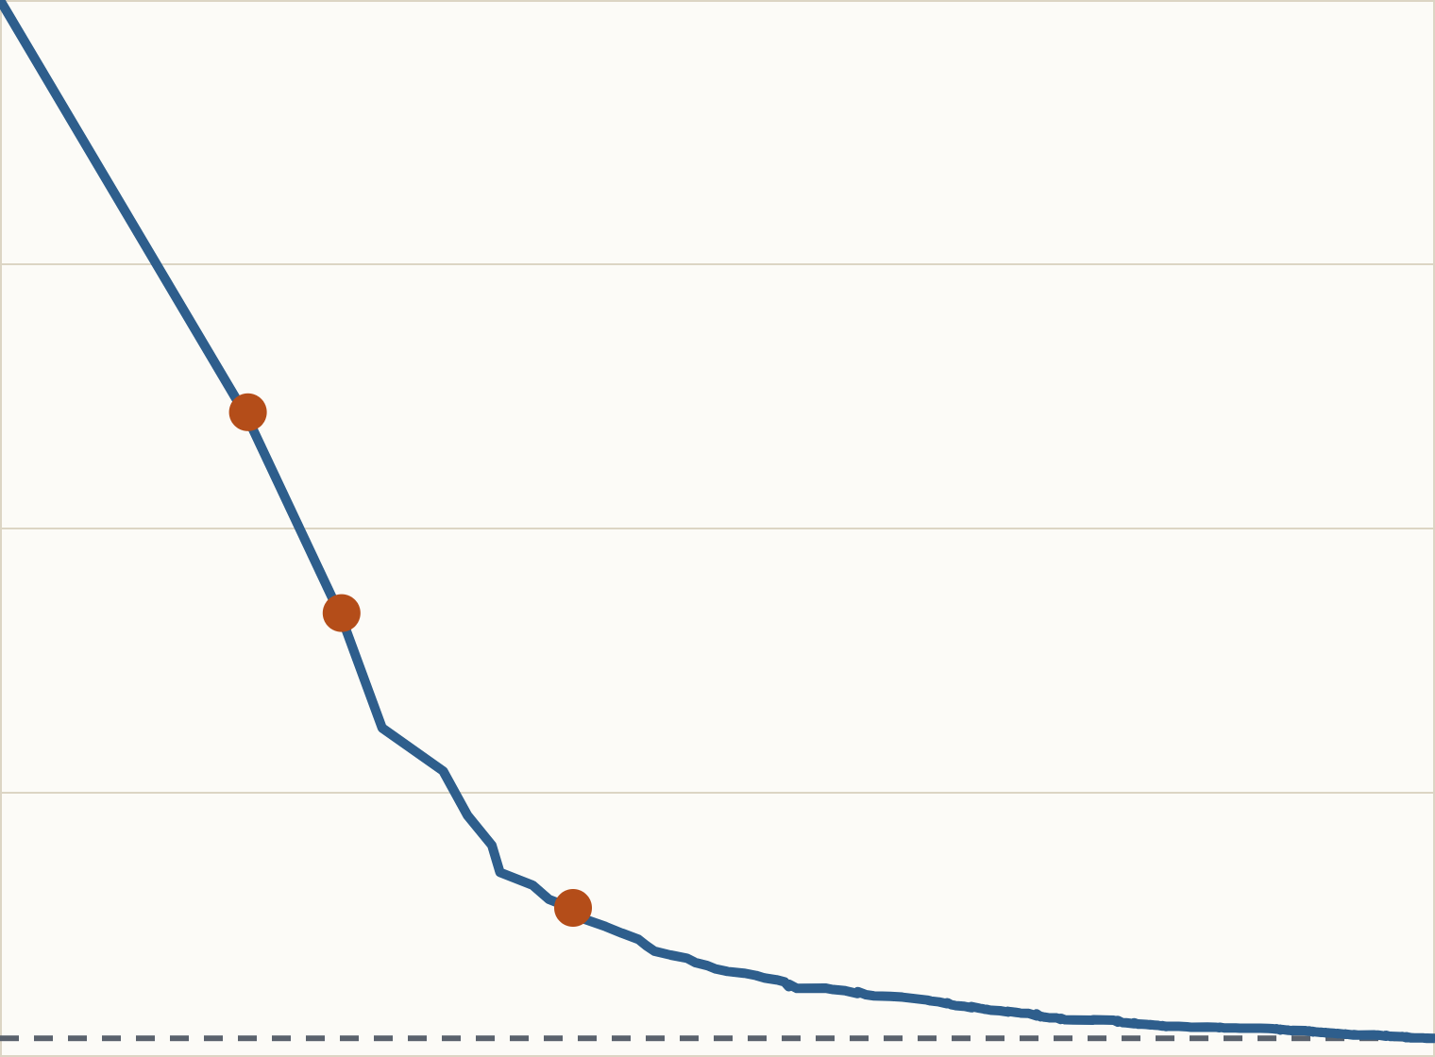
The top of the list is where the value is
RESULTS AND VALIDATION
100%
Alerts | Share | Frauds | Precision | Recall | Lift
50 | 0.25% | 35 | 70% | 9.9% | 40×
100 | 0.5% | 61 | 61% | 17.3% | 35×
200 | 1.0% | 84 | 42% | 23.8% | 24×
500 | 2.5% | 114 | 23% | 32.3% | 13×
1,000 | 5.0% | 141 | 14% | 39.9% | 8×
top 100
50%
top 200
Reviewing from the top, the first 100 alerts are 61% fraud; the first 1,000 catch 40% of all fraud.
top 1,000
How it was validated
random = 1.8%
Stratified 5-fold CV, everything refit inside each fold. PR-AUC 0.2365 pooled; 0.2330 over 25 repeated folds (SD 0.0046); 13× random.
0%
Recall (share of fraud caught) → · y: precision
EVIDENCE #2756 OOF, seed-17 5-fold, all 20,000 rows; repeated_validation/RESULTS.md (25 folds)
09
Notes:
Validation: stratified 5-fold, so each fold keeps the 1.77% fraud share; imputers, encoders, CatBoost and the legitimate-only median models are refit inside every training fold; repeated over 5 split seeds (25 folds); adoption rules written before results. Per-fold PR-AUC on the reported split ranges 0.160–0.326 (~70 frauds per fold), which is why we never picked on one split or the leaderboard. Caveat: the same 353 labels were reused across many experiments, so some selection optimism remains. Left: precision-recall curve of the final blend; the dashed line is a random ranking. Right: what an analyst sees reviewing from the top. 100 alerts (0.5% of traffic) catch 61 frauds, 35× the base rate. Going to 1,000 alerts lifts recall to 40% but precision falls to 14%. Every row here was scored by a model that never trained on it.

Slide 10
Choosing a cut-off is a business decision
OPERATING POINT
cut-off ≥ 0.194
cut-off ≥ 0.05
Best-F1 policy
Recall-leaning policy
83
105
137
788
frauds caught
false alarms
frauds caught
false alarms
Precision 44.1% · recall 23.5%
1.3 false alarms per fraud caught
Precision 14.8% · recall 38.8%
5.8 false alarms per fraud caught
Recommendation: the score triggers a step-up check, not a card block
An OTP costs a legitimate customer seconds; a blocked card costs far more. Set the cut-off from review capacity and re-check it live: on test, the 0.194 cut-off flags 1.55% of rows vs 0.94% in validation.
EVIDENCE #2756 OOF on 20,000 training rows (best F1 = 0.307); test flag rate from the scored #2756 CSV
10
Notes:
Same model, two policies. The best-F1 cut-off flags 188 transactions and catches 83 of 353 frauds. Dropping to 0.05 catches 137 but costs 788 false alarms. Which is right depends on what an alert triggers. Industry practice layers an ML score with step-up authentication (Databricks; 3-D Secure studies). Cut-offs picked on validation predictions are optimistic, and the test population is shifted, so the flag rate rises on test.

Slide 11
We catch the obvious fraud and miss the quiet kind
ERROR ANALYSIS
 | Caught (top 200) | Missed fraud | Legitimate
Median account age | 55 days | 645 days | 796 days
On a new device | 95% | 8.5% | 8.5%
Account < 90 days | 68% | 19% | 12%
Median last-hour count | 5 | 1 | 1
Median amount | $609 | $130 | $74
Night (22:00–04:59) | 58% | 32% | 29%
Rows | 84 | 212 | 19,647
194/212
missed frauds (ranked below 1,000) are on a known device.
PR-AUC within known-device rows: 0.049; within new-device rows: 0.512.
Missed fraud looks like legitimate traffic. Catching it needs per-customer history we do not have.
EVIDENCE #2756 OOF: frauds in the top 200 vs frauds ranked below 1,000; profiles from train.csv
11
Notes:
Compare the middle column with the right one: missed frauds are nearly indistinguishable from legitimate transactions on every field we have. Same device mix, similar account age, same burst counts. That is why recall levels off around 40% at 1,000 alerts. An earlier audit on #1486 across three split schemes found the same: 185 of 202 persistent misses on known devices, and no subgroup with ≥100 rows and ≥20 frauds whose observed rate fell outside the model's prediction. So we did not add ad-hoc boosts or relabel 'hard' rows.

Slide 12
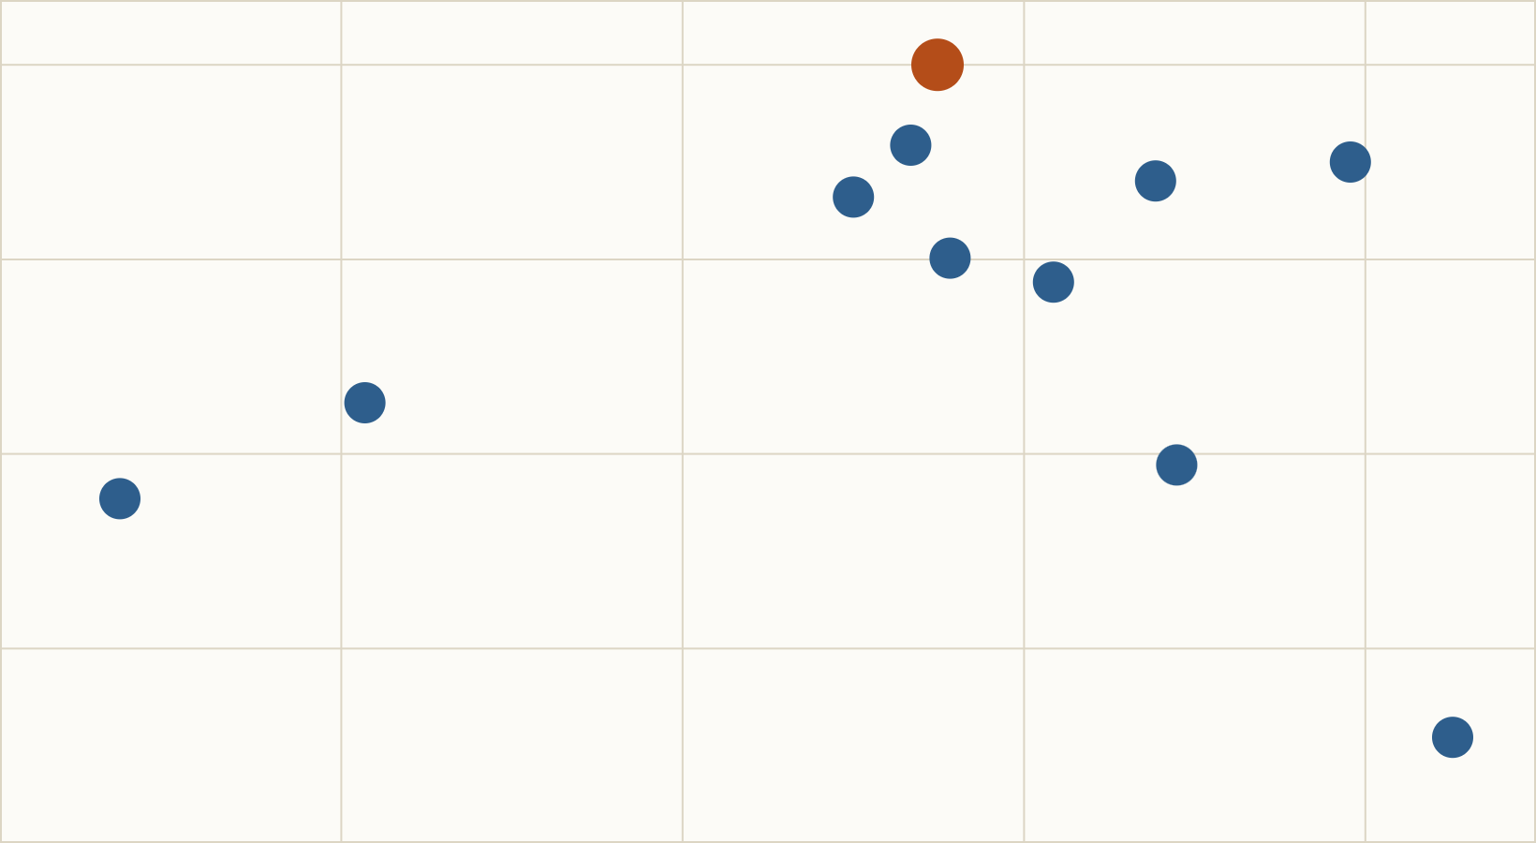
A noisy leaderboard and a shifted test set
HONEST LIMITS
.189
#2756 final · 0.18900
#2573
0.67
The test set is shifted
AUC of a train-vs-test classifier (0.5 = identical). Rows with gaps 4.88% → 13.86%; new devices 9.06% → 15.37%; 90th-pct amount $530 → $1,707. Reweighting for it did not close the gap.
#370
#2651
.180
Tested and closed
#964: best CV, worst public
Hidden account IDs (P(fraud | group-mate fraud) only 1.9–4.7%), transaction-chain rebuilds (1 vs 1 in a shuffled control), 8 value fingerprints (all CMH p ≥ 0.49), label-shift correction (−0.006).
0.233
0.237
Local cross-validated PR-AUC → · y: public leaderboard PR-AUC
−0.06
rank correlation of local CV vs public score across 11 submissions. The public slice has ~60–100 frauds.
EVIDENCE public_transfer_comparison.csv (11 submissions); adversarial HGB AUC 0.6661; research/claude_*
12
Notes:
Shift detail: 556 test rows exceed train's 99th-percentile amount ($3,732), mostly luxury/travel/electronics in AU, SG, JP, MY on accounts with median age 2,446 days and 1.4% new devices. Train has the same profile at an ordinary 2.5% fraud rate (5/200); our model puts 0 of its top 100 test alerts there. Domain-weighted LR (#2541) scored 0.18721; even an oracle segment label-shift correction gained at most +0.008 under heavy simulated shifts. Dead ends: in IEEE-CIS-style fraud contests winners rebuilt hidden customer IDs; a true identity key would push conditional fraud into tens of percent, we see 2–5%. A 120-trial Optuna search gained +0.0017, under its pre-set bar. Each check ran once against a protocol written beforehand. Scatter: each dot is a submission we scored publicly, placed by its local cross-validated PR-AUC and its public score. Spearman correlation is −0.06. The clearest case is #964: highest local score, lowest public score. On CV, #2756, #2510 and #1486 are statistically indistinguishable (differences ≤ 0.0009, mixed fold wins); #2756 was chosen because it was tied-best on CV, had the best public score and a fully replay-verified package. CV ≈ 0.24 versus public ≈ 0.19 is a gap we couldn't close, and we say so.

Slide 13
What would move the needle from here
LIMITS AND NEXT STEPS
Limitations
What we would do next
No customer history
Add per-customer history
No customer ID or timestamp; per-card history drives the field's biggest gains (Wedge 2017: −54% false positives).
Customer ID + real timestamps → rolling behaviour features.
Device intelligence
Few positives
Fingerprints for the known-device fraud we miss today.
353 frauds: folds are noisy and labels were reused across many experiments.
Monitor and retrain
Track score drift and alert rate; re-pick the cut-off against review capacity.
Shifted test set
Adversarial AUC 0.67; local gains did not always transfer (CV ≈ 0.24, public ≈ 0.19).
Fraud drifts
Patterns change and labels arrive late; model and cut-off need monitoring.
EVIDENCE docs/ANALYSIS_REPORT.md §4 literature review; Wedge et al. 2017, arXiv:1710.07709
13
Notes:
Close the technical story here. The biggest lever in the fraud literature, customer-level history (Whitrow 2009; Bahnsen 2016; Wedge 2017), is exactly what this dataset lacks, and it matches our error analysis: the frauds we miss only look odd relative to that customer's usual behaviour. Don't claim a performance ceiling: none of our ideas beat ~0.24 CV, which is not the same as none can.

Slide 14
Thank you. Questions?
THREE THINGS TO REMEMBER
01
02
03
Rank, don't classify
Risks stack
Honest by design
98% accuracy is free; we optimised PR-AUC and reached 0.2365, 13× random.
New device × young account is 18.4% fraud, twice what the parts predict; five crosses capture it.
Rules before results, everything fitted in-fold, exact replay, and the failures on file.
Team AI of Spades · TrustGuard · DLW Datathon 2026 Track 2
Notes:
End on the three takeaways and invite questions. Where to point: Why PR-AUC? slide 2. Why is LR best? slides 5 and 8. Imbalance? natural prior; weighting and resampling tested and lost (8). Missing data? slides 4 and 7. Overfitting? slide 9. Public lower than CV? slide 12. What do you miss? slide 11. Real-world use? slide 10. Reproducibility? slide 3. Do not claim: that the public score predicts the final ranking; that features cause fraud; a fixed performance ceiling.

