Slide 1

SRM INSTITUTE OF SCIENCE AND TECHNOLOGY
Ramapuram , Chennai – 600 089
DEPARTMENT OF COMPUTER SCIENCE AND ENGINEERING
21CSC305P/ MACHINE LEARNING
Multimodal Machine Learning Framework for Early Warning of Dissolved-Oxygen Deterioration in Rivers
BATCH NUMBER : 15
Team Members | Supervisor
Jackroshan J – RA2411003020031 Yagnesh C – RA2411003020036 Kirithikji – RA2411003020044 | Dr. Sahaya Sakila.V, ME., Ph.D. Assistant Professor

Slide 2
ABSTRACT
Dissolved oxygen (DO) below 5 mg/L causes hypoxic stress and fish kills in rivers, yet conventional monitoring flags low DO only after it has occurred. This work presents a multimodal stacking-ensemble framework that forecasts DO 6, 12, 24 and 48 h ahead and issues early warnings of Low-DO conditions.
Hourly sensor data from 30 USGS stations in 15 US states (2023–2025, 789,120 station-hours) are fused with ERA5 weather and CAMS air quality to build 211 strictly causal features. Each forecast has two outputs: the DO value in mg/L (regression) and a water class, Low (< 5), Medium (5–7) or Good (> 7 mg/L) (three-class classification).
Five base models (Random Forest, XGBoost, LightGBM, BiLSTM, CNN-LSTM) are combined by a stacking meta-learner and a probability-threshold warning rule. Models are trained on 2023, tuned on 2024 and evaluated once on the unseen 2025 year.
The ensemble gives the lowest DO error at every horizon (24 h: RMSE 0.672 mg/L, R² 0.951) and classifies water condition with 90.4% accuracy and 0.886 macro F1 at 24 h, with 94.1% recall on Low-DO hours. Ablation shows weather and air quality add small gains over water sensors alone.

Slide 3
Scope and Motivation
Motivation
Ecological risk: DO below 5 mg/L stresses fish and aquatic life; prolonged hypoxia leads to fish kills and poorer drinking-water sources.
Reactive monitoring: sensor alarms fire only after DO has already fallen, leaving no time for aeration, flow release or discharge control.
Research gap: most studies train one regression model on one site, often with random or block splits that leak future data.
Project scope
Coverage: 30 USGS continuous-monitoring stations in 15 US states, hourly, 2023–2025.
Outputs: DO in mg/L and a Low / Medium / Good class, at 6, 12, 24 and 48 h ahead.
Modalities: in-situ water sensors, ERA5 weather, CAMS air quality.

Slide 4
Introduction
DO dynamics: governed by water temperature, the photosynthesis–respiration daily cycle, reaeration and organic load; strongly non-linear and seasonal.
Dual forecasting task: regression of the DO value (for operators) and three-class classification of water condition (for alerts) from one shared feature set.
Hybrid model family: tree ensembles (RF, XGBoost, LightGBM) capture feature interactions; deep sequence models (BiLSTM, CNN-LSTM) learn 72-hour temporal patterns.
Stacking: a meta-learner learns how much to trust each base model, using out-of-fold predictions only.
Early warning: a frozen threshold on P(Low) turns class probabilities into an actionable yes / no alert.

Slide 5
Literature Survey
# | Paper / Author | Year | Methodology | Evaluation Metrics | Key Remarks & Limitations
1 | Moon et al. (Water) | 2022 | RF, Gradient Boosting, AdaBoost regressors | R², RMSE, MAE, CV(RMSE) | AdaBoost performed best; static estimation with no future forecast horizon.
2 | Rocha et al. (Environments) | 2023 | GNN-SAGE & Transformer vs. XGBoost; SHAP | RMSE, MAE, MAPE, R² | GNN-SAGE RMSE 0.34 mg/L at 6 h; value regression only; no event lead-time evaluation.
3 | Pant et al. (Sci. Reports) | 2024 | CEEMDAN + AdaBoost-BiLSTM + LSTM | RMSE, MAE, MAPE, DM test | River Ganga; ~25% RMSE reduction at 1–3 h; short multi-step regression only.
4 | Granata et al. (Env. Sci.: Advances) | 2024 | Additive regression with RBF; stacked MLP-RF | R², MAE, MAPE, RMSE | Mississippi River; 3-day RMSE 0.28 mg/L; no warning logic.
5 | Cerqueira et al. (Front. Aquac.) | 2024 | Global autoregressive LightGBM (1–24 h) | Event recall, FAR, lead time | Event recall 60–85% with 5–8 h anticipation; ocean salmon farms only.
6 | Simonetti et al. (STOTEN) | 2024 | Hydrodynamic model coupled with RF | Accuracy, severe-hypoxia score | Coastal lagoon; 91% accuracy; single site; accuracy distorted by imbalance.
7 | Zhao & Chen (PLOS ONE) | 2025 | DWT denoising, KPCA, GWO-optimised XGBoost | MAE, MSE, MAPE, NSE, KGE | Multi-source weather improves regression (NSE 0.78–0.90); no early-warning test.
8 | Merabet et al. (Earth Sci. Inf.) | 2025 | CatBoost, LightGBM, NGBoost, XGBoost; SHAP | RMSE, MAE, R², NSE | DO highly predictable (NSE 0.961); SHAP analysis; regression only.
9 | Choudhary et al. (Sci. Reports) | 2025 | Stacking of 6 tree ensembles, linear meta-learner | R², Adj. R², MAE, RMSE | Water quality index; static, no temporal forecast.
10 | Base paper (J. Hydrology) | 2026 | LSTM + Transformer + MLP gated fusion | NSE, RMSE, MAE, interval coverage | Multimodal value forecasting; risk of temporal leakage via block splits.

Slide 6
Problem Statement
Operational blind spot: river monitoring detects hypoxia only after it occurs, so no preventive action is possible.
Single-task, single-model studies: prior work predicts either the DO value or a hypoxia class, usually with one algorithm; the benefit of combining ML and DL models is untested.
Evaluation flaws: random or block cross-validation leaks future information and inflates accuracy.
Unquantified multimodality: the value of weather and air-quality data for river DO is rarely tested by controlled ablation.
Problem definition
Given hourly multi-source data up to time t, predict DO(t+h) and its class (Low / Medium / Good) for h = 6, 12, 24, 48 h, and warn before DO falls below 5 mg/L, using only past information.

Slide 7
Objectives
Objective 1: build a leakage-free hourly multimodal dataset (30 stations; water, weather, air) with 211 causal features.
Objective 2 (Regression): forecast DO in mg/L at 6, 12, 24 and 48 h ahead.
Objective 3 (Classification): classify future water condition as Low / Medium / Good, with class-wise evaluation.
Objective 4: train and compare 3 ML (RF, XGBoost, LightGBM) and 2 DL (BiLSTM, CNN-LSTM) models against persistence and linear / logistic baselines.
Objective 5: design a stacking ensemble with a warning rule, and measure onset recall, false alarms and lead time.
Objective 6: quantify each data source by ablation and deploy the frozen models in a Streamlit + FastAPI application.

Slide 8
Proposed Work
Data integration: USGS NWIS sensors (DO, temperature, conductivity, pH, turbidity, discharge), ERA5 weather and CAMS air quality via Open-Meteo, aligned to one hourly UTC grid.
Causal features: 211 features using only values at or before t: lags 1–48 h, rolling 6 / 24 / 72 h statistics, 24 h DO swing, hours since Low, rain sums, cyclic time.
Five base models: RF, XGBoost, LightGBM, BiLSTM, CNN-LSTM; each predicts DO and class for all four horizons.
Stacking ensemble: Ridge meta-learner for DO and multinomial logistic meta-learner for class, fitted out-of-fold on 2024.
Warning rule: warn when P(Low) ≥ τ_h; τ_24h = 0.24, chosen to keep false alarms ≤ 2%.
Deployment: Streamlit dashboard and FastAPI service running on live USGS data.

Slide 9
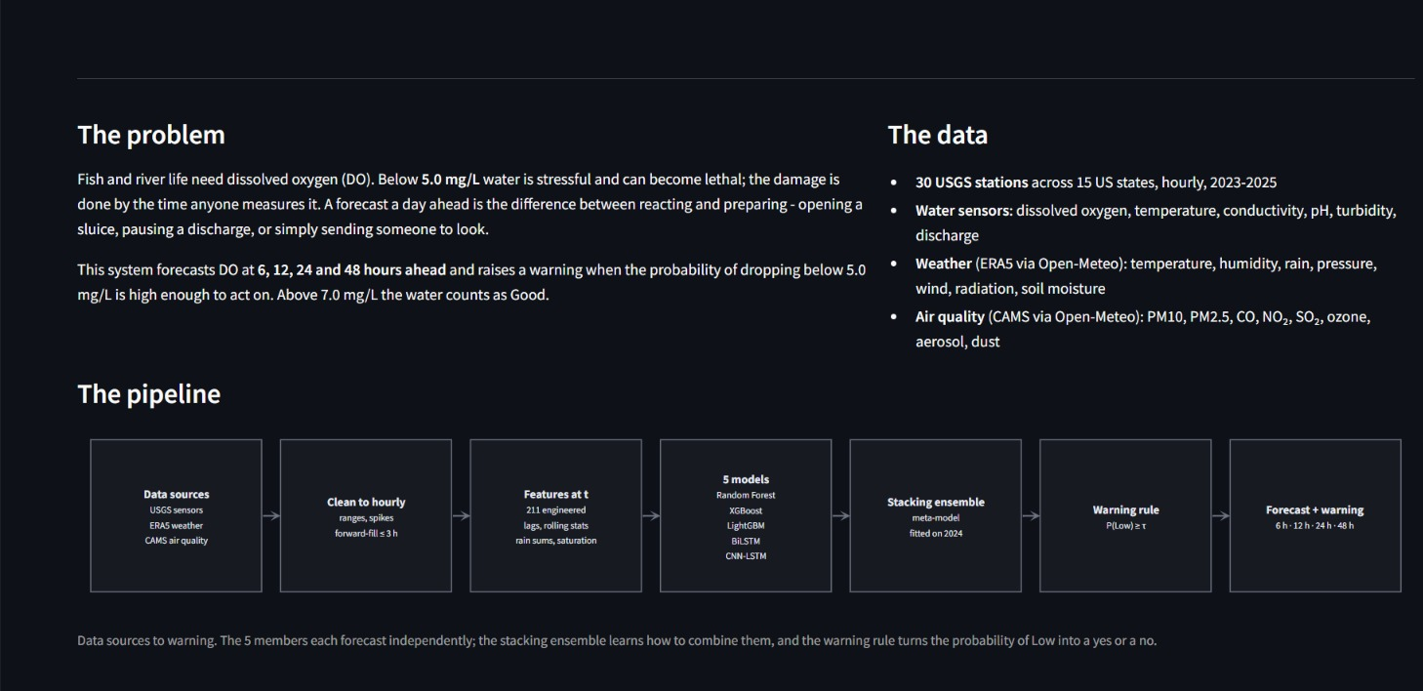
Proposed Work: Problem, Data & Pipeline

Slide 10
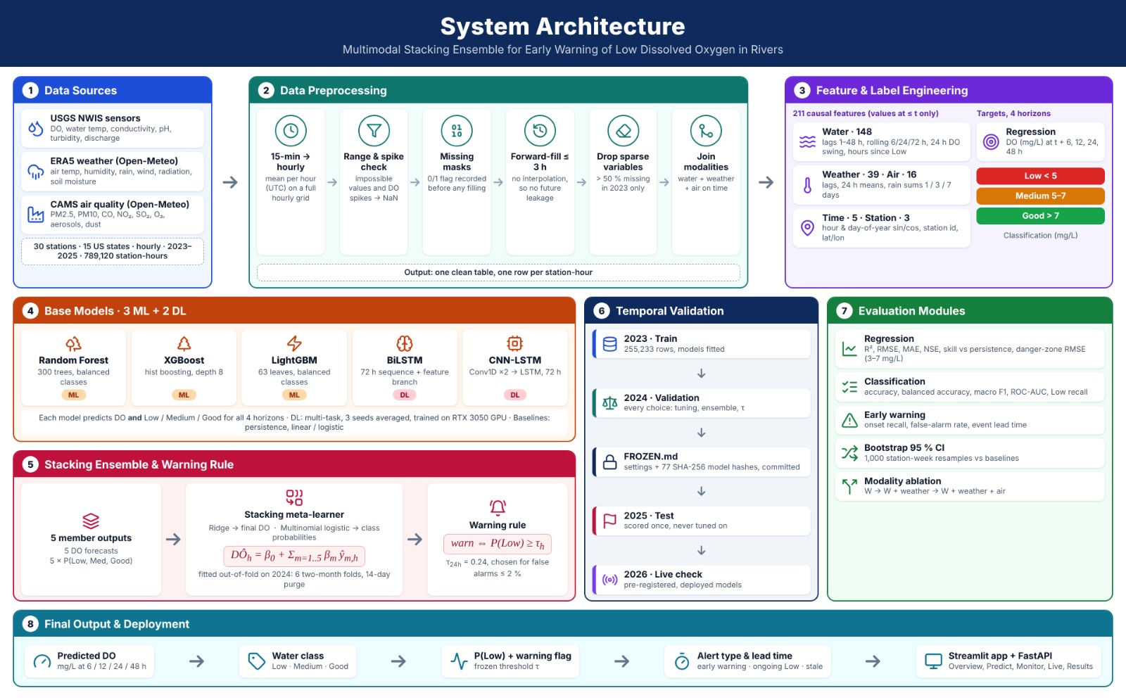
System Architecture

Slide 11
Modules
1
Data Ingestion
2
Preprocessing & QC
3
Feature & Label Engineering
USGS sensors, ERA5 weather and CAMS air quality harmonised to hourly UTC.
Range and spike checks, missing masks, forward-fill ≤ 3 h.
211 causal features; DO target and Low / Medium / Good class at 4 horizons.
4
Base Model Training
5
Stacking & Warning Rule
6
Evaluation & Deployment
3 ML + 2 DL models, trained on 2023; DL on RTX 3050 GPU.
Ridge and multinomial-logistic meta-learners; frozen P(Low) ≥ τ rule.
Regression, class-wise and warning metrics; ablation; Streamlit + FastAPI.

Slide 12
Module Description (1–3)
Module 1: Multi-Source Ingestion & Harmonisation
  USGS NWIS 15-minute sensor readings averaged to hourly values on a full UTC grid.
  ERA5 weather and CAMS air quality fetched from Open-Meteo for each station's coordinates.
  30 stations × 2023–2025 = 789,120 station-hours.
Module 2: Preprocessing & Quality Control
  Range and spike checks: impossible values and DO spikes set to missing.
  Missing-value flags recorded before filling; forward-fill ≤ 3 h, no interpolation (no future leakage).
  Variables more than 50% missing in 2023 are dropped.
Module 3: Feature & Label Engineering
  211 causal features: water 148, weather 39, air 16, time 5, station 3.
  Targets for h = 6, 12, 24, 48 h: DO(t+h) in mg/L and class Low < 5, Medium 5–7, Good > 7 mg/L.

Slide 13
Module Description (4–6)
Module 4: Base Model Training
  RF (300 trees, balanced classes), XGBoost (hist, depth 8), LightGBM (63 leaves, balanced classes).
  BiLSTM (72 h sequence + feature branch) and CNN-LSTM (Conv1D ×2 → LSTM); multi-task (DO + class), 3 seeds, RTX 3050 GPU.
Module 5: Stacking Ensemble & Warning Rule
  Meta-learners fitted out-of-fold on 2024 (6 two-month folds, 14-day purge): Ridge → DO, multinomial logistic → class.
  Warning when P(Low) ≥ τ_h; τ set for false alarms ≤ 2%; all settings frozen with 77 SHA-256 model hashes.
Module 6: Evaluation & Deployment
  Regression: R², RMSE, MAE, NSE, skill vs persistence. Classification: accuracy, balanced accuracy, macro F1, ROC-AUC, class-wise P / R / F1.
  Early warning: onset recall, false-alarm rate, lead time; bootstrap 95% CI; modality ablation.
  Streamlit + FastAPI app: Overview, Predict, Monitor, Live, Results.

Slide 14
Algorithm 1: Causal Features & Labels
Algorithm 1 — Causal Feature and Multi-Horizon Label Generation
Input: hourly series X_raw(s, t) for each station s; horizons H = {6, 12, 24, 48}
Output: feature vector x(s, t) ∈ R^211; targets y_reg(h), y_cls(h)
1. for each station s and hour t:
2. Lags: DO, temperature, pH, conductivity, turbidity at t−1 … t−48
3. Rolling mean / min / max / std over W ∈ {6, 24, 72} h, window ending at t
4. DO_swing24 = max(DO[t−24 : t]) − min(DO[t−24 : t]); hours_since_Low
5. Weather and air: 24 h means; rain sums over 1, 3 and 7 days
6. Time and station: sin / cos(hour), sin / cos(day of year), station id, lat / lon
7. for each h ∈ H:
8. y_reg(h) = DO(t + h)
9. y_cls(h) = Low if DO(t+h) < 5; Medium if 5 ≤ DO(t+h) ≤ 7; Good if DO(t+h) > 7
10. return x(s, t), y_reg, y_cls (only values at time ≤ t enter x)

Slide 15
Algorithm 2: Stacking & Warning Rule
Algorithm 2 — Proposed Stacking Ensemble with Early-Warning Rule
Input: D_train (2023), D_val (2024), D_test (2025); base models M1 … M5 (RF, XGB, LGBM, BiLSTM, CNN-LSTM)
Output: forecast DÔ_h, class probabilities p_h, warning W_h for each horizon h
1. Train M1 … M5 on D_train for every horizon h
2. Predict on D_val: DO forecasts ŷ_m,h and class probabilities p̂_m,h (m = 1 … 5)
3. Ridge meta-learner: DÔ_h = β0 + Σ_m β_m · ŷ_m,h
4. Multinomial logistic meta-learner: p_h = softmax(W · [p̂_1,h, …, p̂_5,h] + b)
5. Cross-fit steps 3–4 on 6 two-month folds of D_val with a 14-day purge → out-of-fold p_h
6. τ_h = lowest threshold with false-alarm rate ≤ 2% on out-of-fold p_h(Low)
7. Freeze β, W, τ_h and all model files (SHA-256 hashes in FROZEN.md)
8. On D_test, run once:
class_h = Low if p_h(Low) ≥ τ_h, else argmax over {Medium, Good}
W_h = 1 if p_h(Low) ≥ τ_h, else 0
9. return DÔ_h, class_h, W_h

Slide 16
Implementation Details
Language: Python 3.10
Hardware: Windows laptop; NVIDIA RTX 3050 (6 GB) for DL models, all CPU cores for tree models
ML: scikit-learn, XGBoost, LightGBM
DL: PyTorch (CUDA)
Data: pandas, NumPy, PyArrow (Parquet)
Deployment: Streamlit, FastAPI
Reproducibility: 77 model files frozen with SHA-256 hashes; 2025 test scored once
Model | Type | Key configuration
Random Forest | ML | 300 trees, balanced class weights
XGBoost | ML | hist tree method, max depth 8
LightGBM | ML | 63 leaves, balanced class weights
BiLSTM | DL | 72 h sequence + feature branch; multi-task; 3 seeds
CNN-LSTM | DL | Conv1D ×2 → LSTM; 72 h sequence; 3 seeds
Meta (DO) | Stack | Ridge regression
Meta (class) | Stack | Multinomial logistic regression
Warning rule | Stack | P(Low) ≥ τ_h; τ_24h = 0.24

Slide 17
Dataset Splits & Class Distribution
Chronological split (no shuffling)
Year | Role | Size / use
2023 | Train | 255,233 rows; base models fitted
2024 | Validation | tuning, stacking, τ
2025 | Test | ≈ 251,000 forecasts per horizon; scored once
2026 | Live check | deployed models on live USGS data
Class distribution of the 2025 test year (actual class, all 30 stations)
Horizon | Low (< 5 mg/L) | Medium (5–7 mg/L) | Good (> 7 mg/L) | Total
6 h | 49,787 (19.7%) | 63,003 (24.9%) | 140,110 (55.4%) | 252,900
12 h | 49,724 (19.7%) | 62,944 (24.9%) | 139,779 (55.4%) | 252,447
24 h | 49,655 (19.7%) | 62,782 (24.9%) | 139,234 (55.3%) | 251,671
48 h | 49,588 (19.8%) | 62,535 (25.0%) | 138,194 (55.2%) | 250,317

Slide 18
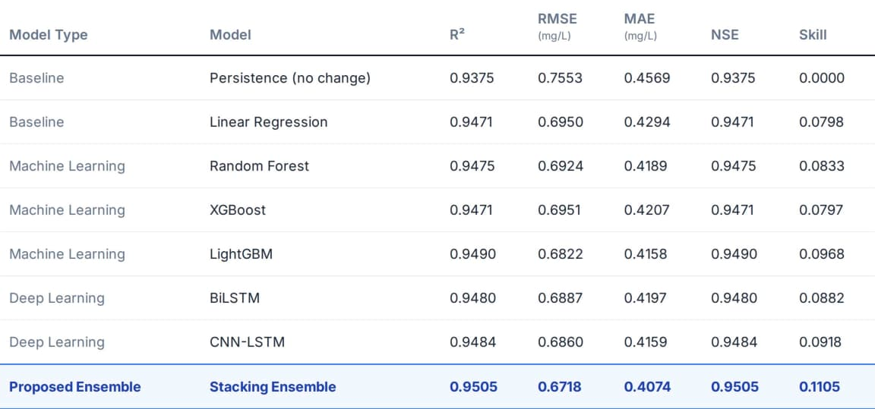
Results — Regression (DO in mg/L)
2025 test year, 30 stations. RMSE in mg/L (lower is better); R² (higher is better).
The stacking ensemble has the lowest RMSE and highest R² at all four horizons.
At 6 h it cuts RMSE by 62% vs persistence (0.514 vs 1.344 mg/L); at 24 h MAE is 0.407 mg/L (best of all models).
Error grows smoothly with horizon (R² 0.971 → 0.920), so forecasts stay useful up to 48 h.

Slide 19
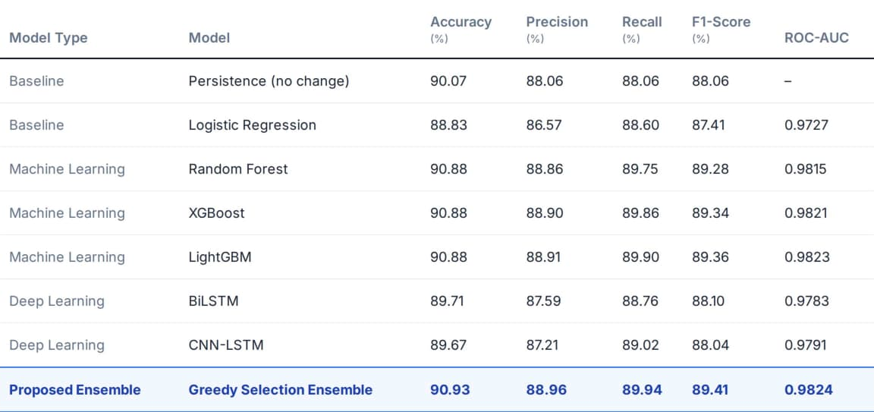
Results — Classification (24 h)
2025 test year, 24 h ahead. Every model uses the same warning rule P(Low) ≥ τ, so the comparison is like for like. Bold = best in column.
Stacking has the best balanced accuracy (89.60%), and the fewest false alarms (1.50%) among models with onset recall near 50%.
RF and LightGBM are marginally higher on accuracy and macro F1 (by under 0.2 percentage points): the top models are statistically close.
All learned models detect about half of Low onsets in advance; persistence detects none.

Slide 20
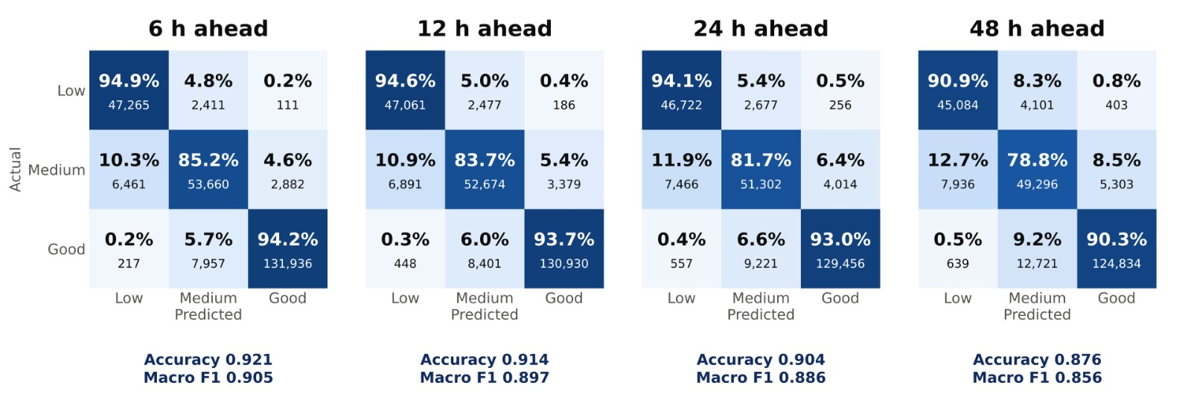
Results — Class-wise Performance (Stacking)
Horizon | Low |  |  | Medium |  |  | Good |  |  | Accuracy | Macro F1
 | P | R | F1 | P | R | F1 | P | R | F1
6 h | 0.876 | 0.949 | 0.911 | 0.838 | 0.852 | 0.845 | 0.978 | 0.942 | 0.959 | 0.921 | 0.905
12 h | 0.865 | 0.946 | 0.904 | 0.829 | 0.837 | 0.833 | 0.973 | 0.937 | 0.955 | 0.914 | 0.897
24 h | 0.853 | 0.941 | 0.895 | 0.812 | 0.817 | 0.814 | 0.968 | 0.930 | 0.949 | 0.904 | 0.886
48 h | 0.840 | 0.909 | 0.873 | 0.746 | 0.788 | 0.766 | 0.956 | 0.903 | 0.929 | 0.876 | 0.856
P = precision, R = recall. Confusion matrices: rows = actual class, cells = share of row (count). 2025 test year, ≈251,000 forecasts per horizon.

Slide 21
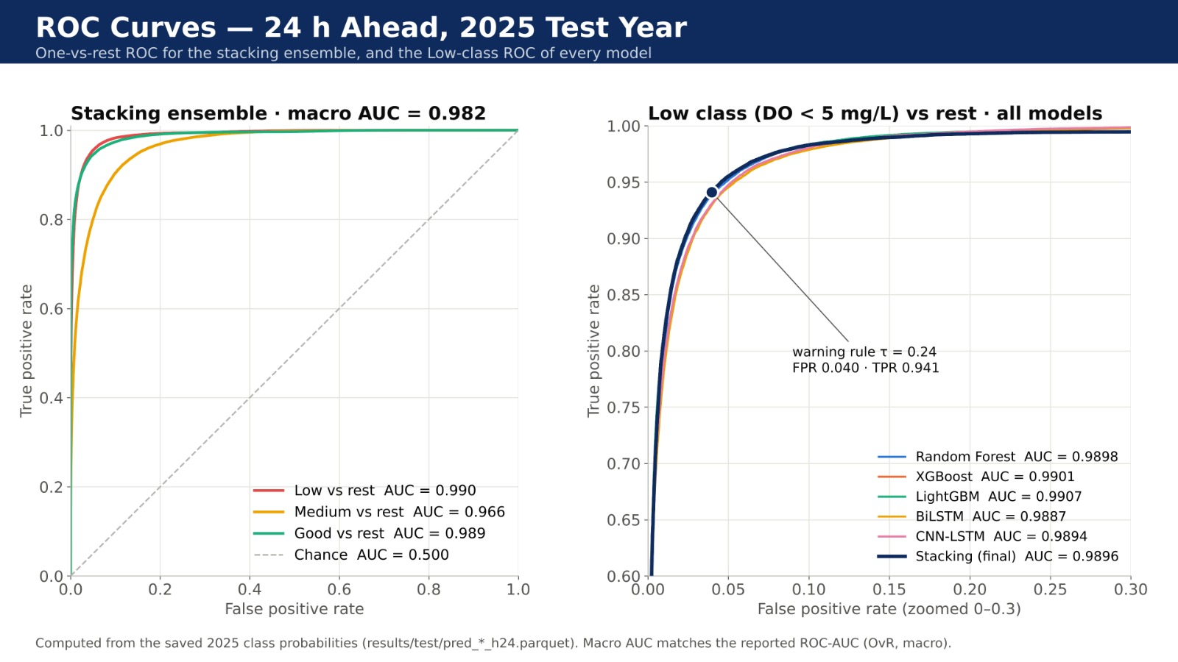
Results — ROC Curves (24 h)
Macro ROC-AUC 0.982; Low-vs-rest AUC 0.990. At τ = 0.24 the rule catches 94.1% of Low hours at a 4.0% false-positive rate. Medium is the hardest class (AUC 0.966) because it lies between two thresholds.

Slide 22
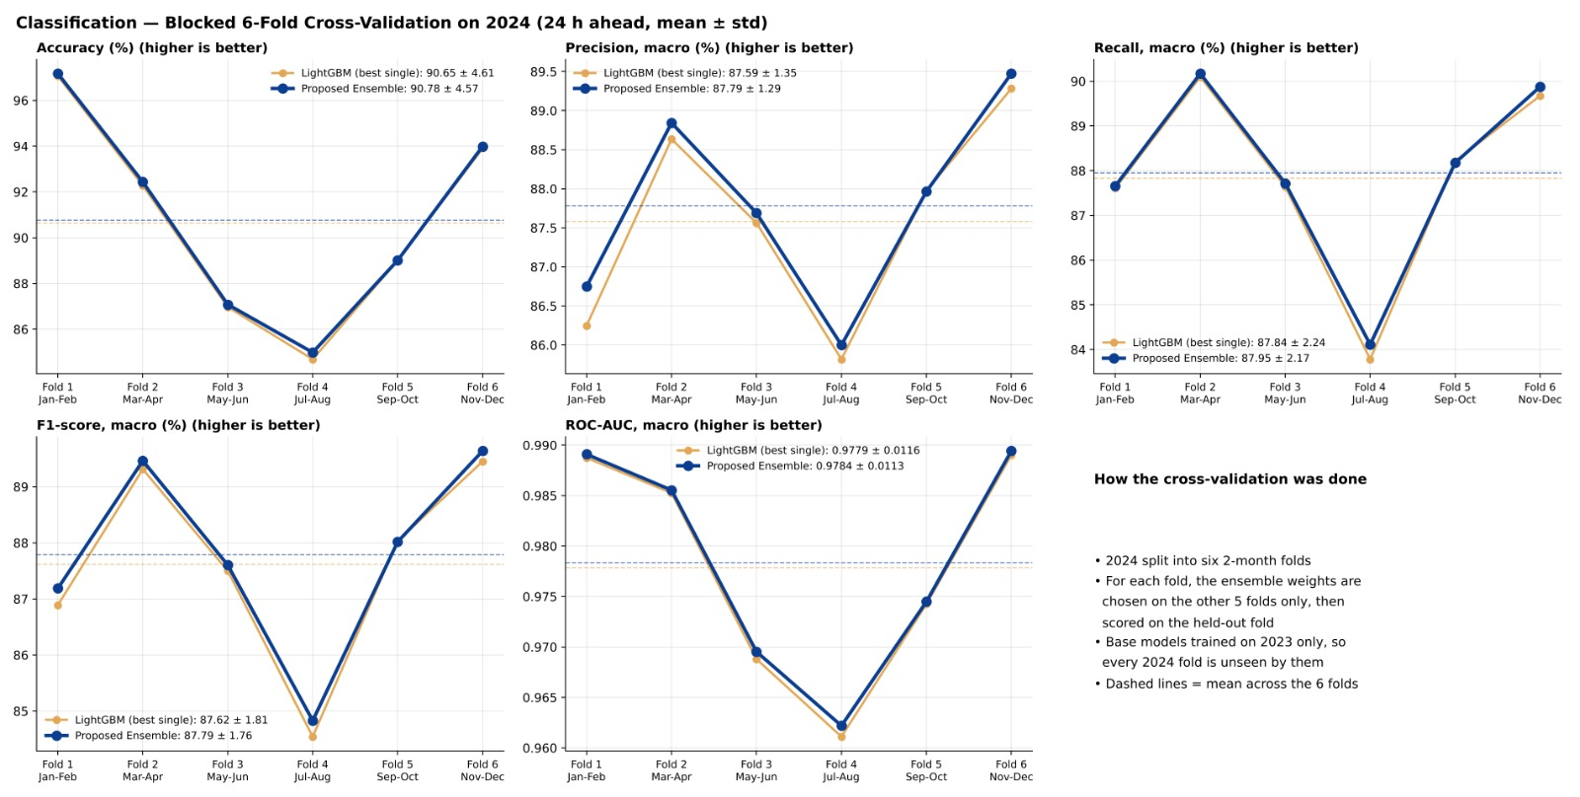
Results — Cross-Validation on 2024
Six two-month blocked folds give accuracy 0.897 ± 0.056 and macro F1 0.864 ± 0.026, close to the 2025 test result (0.904 / 0.886): performance is stable across seasons.

Slide 23
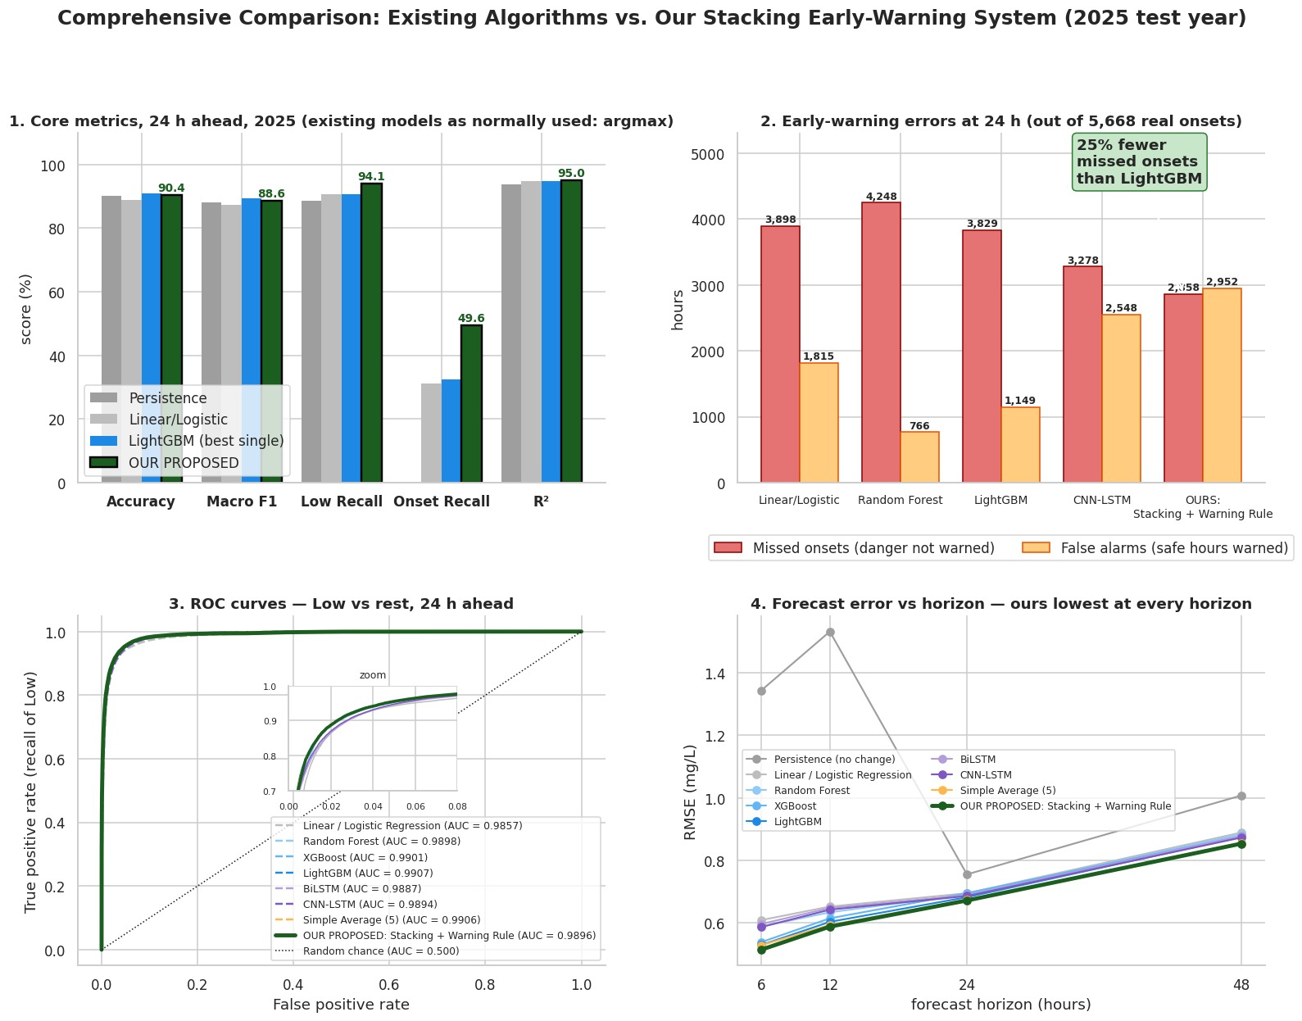
Results — Proposed vs Existing Algorithms
Panel 1 and 2 show existing models with their usual argmax decision; ours uses the warning rule.
At 24 h our system misses 2,858 of 5,668 onset hours vs 3,829 for LightGBM: 25% fewer missed onsets, at the cost of more false-alarm hours.
Panel 4: lowest DO error at every horizon.

Slide 24
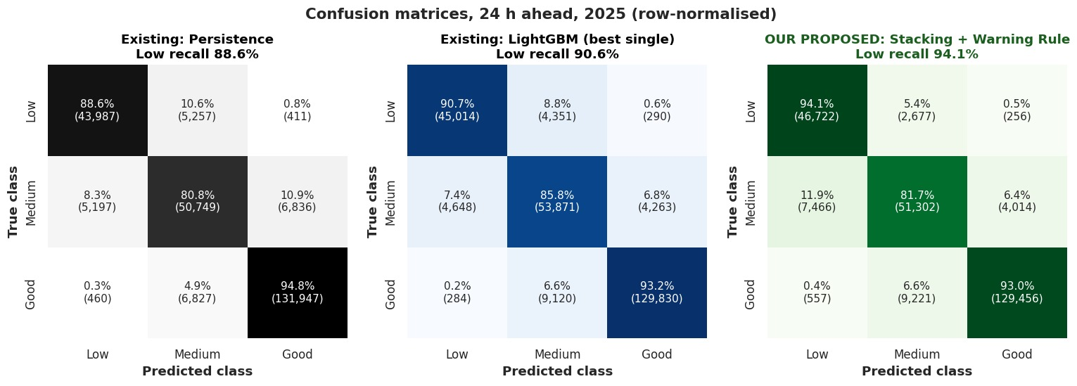
Results — Early-Warning Comparison (24 h)
Persistence and LightGBM shown with argmax decisions; ours with the frozen warning rule.
Low-class recall rises from 88.6% (persistence) and 90.6% (LightGBM, argmax) to 94.1%, with Medium and Good accuracy almost unchanged.

Slide 25
Results — Modality Ablation
Inputs | Features | RMSE (mg/L) | Macro F1 | Onset recall
W (water only) | 156 | 0.7001 | 0.887 | 0.487
W + M (adds weather) | 195 | 0.6834 | 0.888 | 0.488
W + M + A (adds air quality) | 211 | 0.6809 | 0.888 | 0.494
LightGBM alone with the same settings, so differences come from the data, not the model. 2025 test year.
W
Water sensors
M
+ Weather
A
+ Air quality
Carry most of the signal: water-only already reaches macro F1 0.887.
Lowers DO RMSE by 2.4% (0.700 → 0.683); classification unchanged.
Further 0.4% RMSE gain and onset recall 0.488 → 0.494: small but consistent.

Slide 26
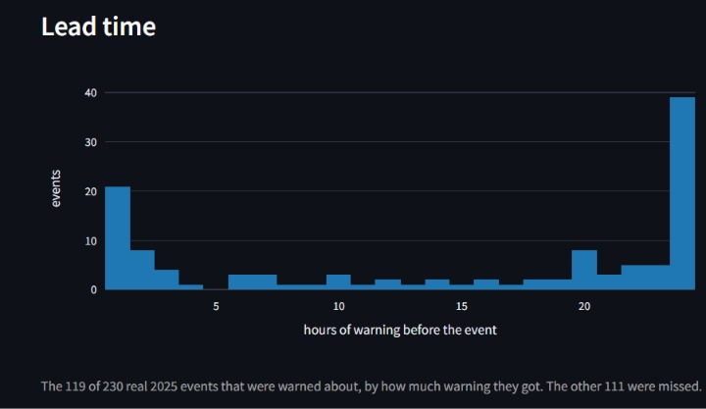
Results — Early-Warning Lead Time
Events warned: 119 of 230 real Low-DO events in 2025 (51.7%) were warned before onset.
Lead time: 1 to 24 h; the largest group of warned events received the full ~24 h notice.
Missed onsets: 25% fewer missed onset hours than LightGBM at 24 h.
Limitation: about half of onsets are still missed: the main target for future work.
Histogram: hours of warning before each warned 2025 event (24 h horizon).

Slide 27
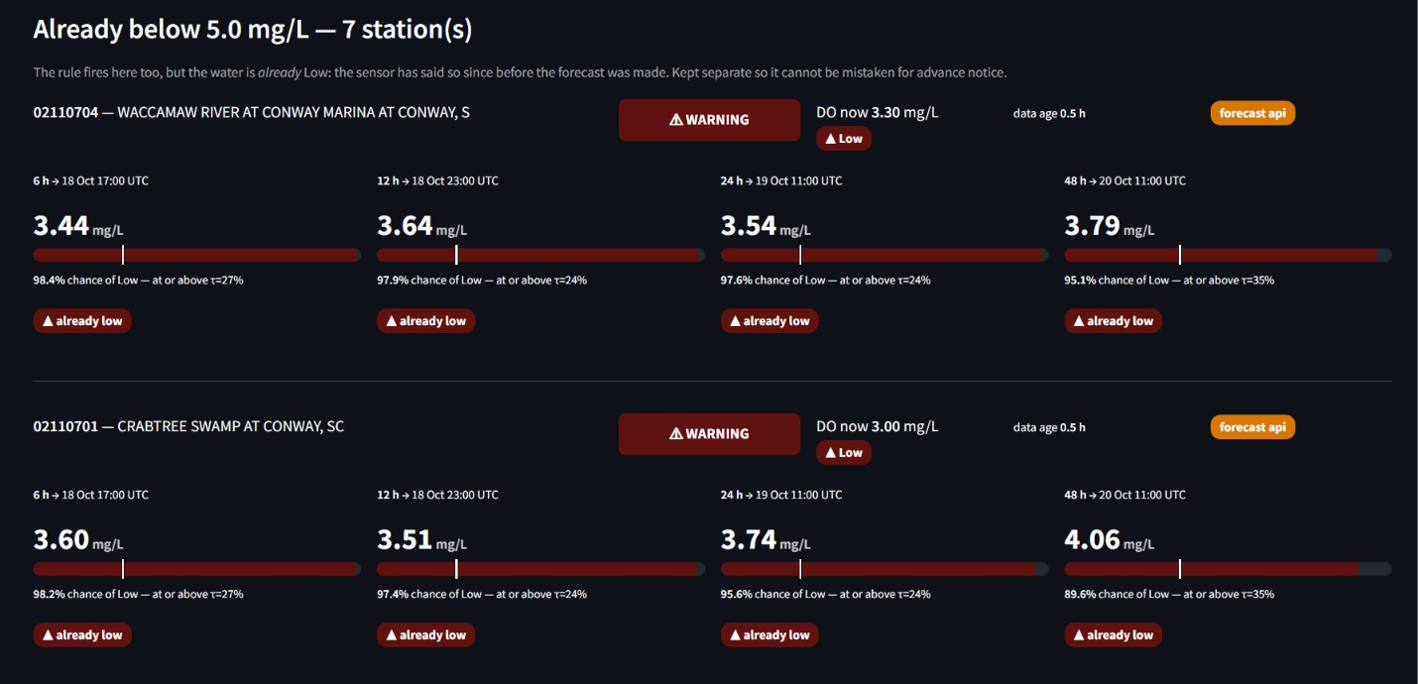
Deployment — Live Monitoring Dashboard
Streamlit + FastAPI app with Overview, Predict, Monitor, Live and Results tabs, using the frozen models on live USGS data (October 2026).
Stations already below 5 mg/L are listed separately as “already Low”, so they are never mistaken for advance warnings.

Slide 28
Comparison with Existing Work
Study | Data & sites | Task | Core model | Horizon | Reg. + Class. | Early warning | Modality ablation
Rocha et al. (2023) | Credit River; hourly | DO regression | GNN-SAGE | 6 h | No | No | No
Pant et al. (2024) | River Ganga; hourly | DO regression | CEEMDAN-BiLSTM | 1–3 h | No | No | No
Granata et al. (2024) | Mississippi; daily | DO regression | Stacked MLP-RF | 1–15 d | No | No | Partial
Cerqueira et al. (2024) | 14 salmon farms | Hypoxia forecast | LightGBM | 1–24 h | No | Yes | No
Simonetti et al. (2024) | Orbetello lagoon | Hypoxia class. | RF + hydrodynamic | Not stated | No | No | Partial
Zhao & Chen (2025) | 3 river sites | DO regression | GWO-XGBoost | Not stated | No | No | No
Merabet et al. (2025) | Illinois River (USGS) | DO regression | CatBoost / LightGBM | Single-step | No | No | No
Base paper (2026) | China national network | DO regression | Transformer + LSTM | 3–14 d | No | No | No
Proposed work | 30 USGS stations, 15 states; 789k station-hours | DO regression + 3-class | Stacking of 3 ML + 2 DL | 6–48 h | Yes | Yes (lead time) | Yes

Slide 29
Key Contributions
1
Dual-task forecasting
2
Hybrid ML + DL stacking
One causal feature set gives both the DO value and a Low / Medium / Good class at 4 horizons, with regression and class-wise evaluation.
RF, XGBoost, LightGBM, BiLSTM and CNN-LSTM combined by Ridge and multinomial-logistic meta-learners plus a frozen P(Low) warning rule.
3
Leakage-free protocol
4
Quantified multimodality
Chronological 2023 / 2024 / 2025 split, purged cross-fitting, and model hashes frozen before a single test run.
Weather and air quality lower DO RMSE by 2.7% over water-only but barely change classification.

Slide 30
Conclusion
Framework: built and deployed an end-to-end multimodal system that forecasts DO and warns of Low-DO conditions 6–48 h ahead at 30 US river stations.
Regression: the stacking ensemble has the lowest error at every horizon: RMSE 0.514 → 0.854 mg/L and R² 0.971 → 0.920 from 6 h to 48 h.
Classification: accuracy 92.1% (6 h) to 87.6% (48 h), macro F1 0.905 → 0.856, and Low-class recall ≥ 90.9% at every horizon.
Early warning: 119 of 230 real 2025 Low-DO events warned in advance, with 25% fewer missed onset hours than LightGBM at 24 h.
Modalities: water sensors carry most of the signal; weather and air quality give small, consistent gains in DO error.
Rigour: a strict temporal split with frozen settings makes the 2025 results a realistic estimate of deployed performance.

Slide 31
Future Work
Higher onset recall: about half of onsets are still missed; add onset-weighted training or a dedicated onset model.
Forecast inputs: replace reanalysis weather with numerical weather forecasts (NWP) for true operational use.
Explainability: attach SHAP explanations to every issued warning.
Indian rivers: adapt the framework to CPCB real-time monitoring stations (e.g. Ganga, Yamuna).
More parameters: extend warnings to ammonia (NH3-N) and turbidity; rolling-origin validation across years.
Edge deployment: run inference on solar-powered IoT buoys for on-site alerts.

Slide 32
References
[1] J. Moon, J. Lee, S. Lee, and H. Yoon, "Urban river dissolved oxygen prediction model using machine learning," Water, vol. 14, no. 12, p. 1899, 2022.
[2] P. A. C. Rocha, V. O. Santos, J. Van Griensven Thé, and B. Gharabaghi, "New graph-based and transformer deep learning models for river dissolved oxygen forecasting," Environments, vol. 10, no. 12, p. 217, 2023.
[3] N. Pant, D. Toshniwal, and B. R. Gurjar, "Multi-step forecasting of dissolved oxygen in River Ganga based on CEEMDAN-AdaBoost-BiLSTM-LSTM model," Scientific Reports, vol. 14, p. 11199, 2024.
[4] F. Granata, S. Zhu, and F. Di Nunno, "Dissolved oxygen forecasting in the Mississippi River: advanced ensemble machine learning models," Environmental Science: Advances, 2024, doi: 10.1039/D4VA00119B.
[5] V. Cerqueira et al., "Forecasting ocean hypoxia in salmonid fish farms," Frontiers in Aquaculture, vol. 3, p. 1365123, 2024.
[6] I. Simonetti, C. Lubello, and L. Cappietti, "On the use of hydrodynamic modelling and random forest classifiers for the prediction of hypoxia in coastal lagoons," Science of the Total Environment, vol. 951, p. 175424, 2024.
[7] Y. Zhao and M. Chen, "Prediction of river dissolved oxygen (DO) based on multi-source data and various machine learning coupling models," PLOS ONE, vol. 20, no. 3, p. e0319256, 2025.
[8] K. Merabet et al., "Predicting water quality variables using gradient boosting machine: global versus local explainability using SHapley Additive Explanations (SHAP)," Earth Science Informatics, vol. 18, p. 298, 2025.
[9] R. Choudhary et al., "Predicting water quality index using stacked ensemble regression and SHAP based explainable artificial intelligence," Scientific Reports, vol. 15, p. 31139, 2025.
[10] "Multimodal deep-learning–driven water-quality forecasting and scenario assessment: shifting from reactive monitoring to proactive basin management," Journal of Hydrology, 2026.
[11] L. Breiman, "Random forests," Machine Learning, vol. 45, no. 1, pp. 5–32, 2001.

Slide 33
References (contd.)
[12] T. Chen and C. Guestrin, "XGBoost: A scalable tree boosting system," in Proc. 22nd ACM SIGKDD, 2016, pp. 785–794.
[13] G. Ke et al., "LightGBM: A highly efficient gradient boosting decision tree," in Advances in Neural Information Processing Systems (NeurIPS), 2017.
[14] S. Hochreiter and J. Schmidhuber, "Long short-term memory," Neural Computation, vol. 9, no. 8, pp. 1735–1780, 1997.
[15] M. Schuster and K. K. Paliwal, "Bidirectional recurrent neural networks," IEEE Trans. Signal Processing, vol. 45, no. 11, pp. 2673–2681, 1997.
[16] T. N. Sainath, O. Vinyals, A. Senior, and H. Sak, "Convolutional, long short-term memory, fully connected deep neural networks," in Proc. IEEE ICASSP, 2015, pp. 4580–4584.
[17] D. H. Wolpert, "Stacked generalization," Neural Networks, vol. 5, no. 2, pp. 241–259, 1992.
[18] A. E. Hoerl and R. W. Kennard, "Ridge regression: Biased estimation for nonorthogonal problems," Technometrics, vol. 12, no. 1, pp. 55–67, 1970.
[19] H. Hersbach et al., "The ERA5 global reanalysis," Quarterly Journal of the Royal Meteorological Society, vol. 146, no. 730, pp. 1999–2049, 2020.
[20] A. Inness et al., "The CAMS reanalysis of atmospheric composition," Atmospheric Chemistry and Physics, vol. 19, pp. 3515–3556, 2019.
[21] P. Zippenfenig, "Open-Meteo.com Weather API," Zenodo, 2023.
[22] U.S. Geological Survey, "National Water Information System (NWIS)," waterdata.usgs.gov.
[23] U.S. Environmental Protection Agency, "Ambient water quality criteria for dissolved oxygen," EPA 440/5-86-003, 1986.

