Slide 1
COLLABROOM
PRESENTED BY-
KIRTI GUPTA
KOMAL
VAISHNAVI BATHAM
DOLLY KUSHWAHA
TITIKSHA

Slide 2
BRIEF ABOUT THE PROJECT
This project focuses on developing a full-stack video conferencing web application.
The system allows users to create, join, and schedule meetings online.
It provides real-time video and audio communication.
The application ensures secure authentication and smooth user experience.
It is designed to simulate modern online meeting platforms.

Slide 3
OBJECTIVE
Develop a real-time communication platform: Build a web application enabling users to create and join.
Secure and user-friendly experience: Provide secure authentication and an intuitive interface for smooth usage.
Apply full-stack development concepts: Integrate modern frontend, backend, and APIs for scalable system development.

Slide 4
KEY FEATURES
User authentication and authorization
Create instant meetings
Schedule future meetings
Join meetings via link or ID
Real-time video and audio streaming
Meeting history and recordings
Responsive and modern UI

Slide 5
COMPARISON WITH THE EXISTING SYSTEMS
FEATURE | EXISTING SYSTEMS | PROPOSED SYSTEM
Cost | Subscription Based | Free Prototype
Customisation | Limited | Fully customisable
Learning Purpose | Not Applicable | Educational
Scalability | High | Moderate
Features | Advanced | Core Features

Slide 6
TOOLS BEING USED FOR PROJECT
FRONT END
Next.js
React
Tailwind CSS
AUTHENTICATION
Clerk
DATABASE
Cloud database services
TOOLS BEING USED FOR PROJECT
DEVELOPMENT TOOLS
VS Code
GitHub
BACKEND
Node.js
Stream Video API

Slide 7
TIMELINE OF PROJECT
PHASE | DURATION | DESCRIPTION
Requirement Analysis | Week 1 | Understanding project goals
Planning and Design | Week 2 | UI design and architecture
Development | Week 3-5 | Coding frontend and backend
Integration | Week 6 | Video API Integration
Testing | Week 7 | Debugging and Improvements
Deployment | Week 8 | Final deployment
Documentation | Week 9 | Report and Presentation

Slide 8
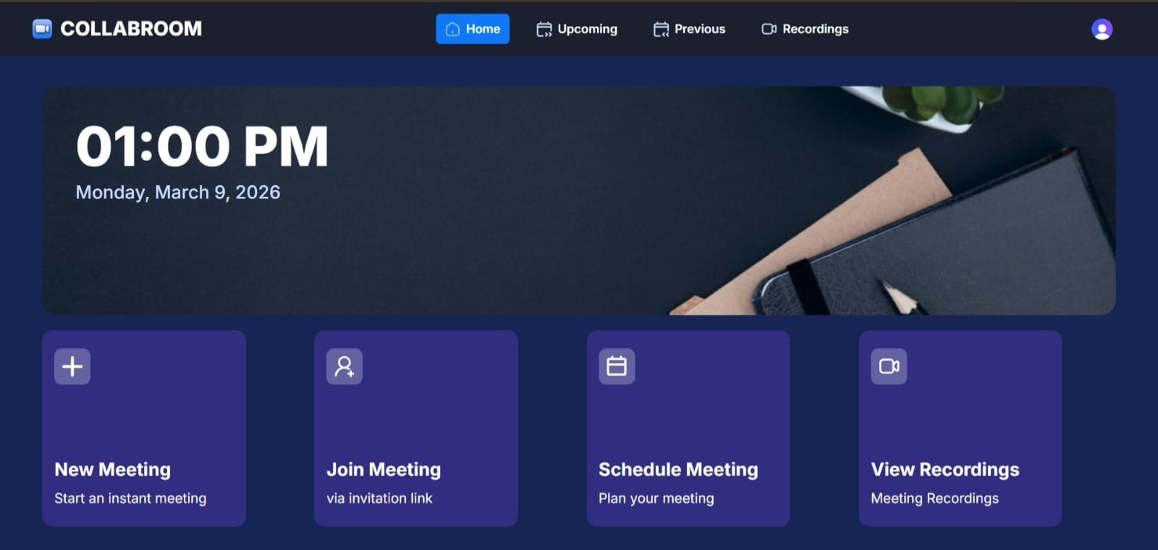
STATUS OF WORK DONE
1. Home Page

Slide 9
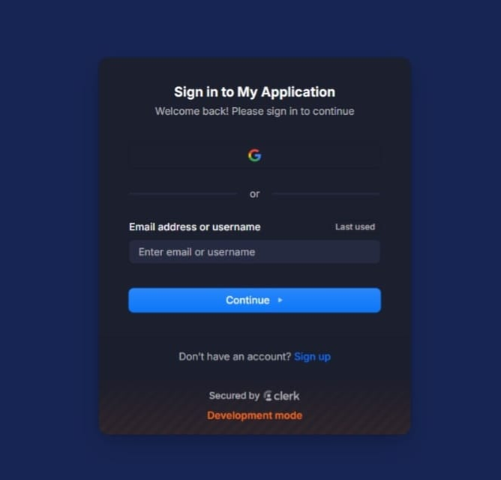
2. Sign in Page
Enables existing users to log in.
Authentication using registered email and password.
Enables existing users to log in.
Authentication using registered email and password.

Slide 10
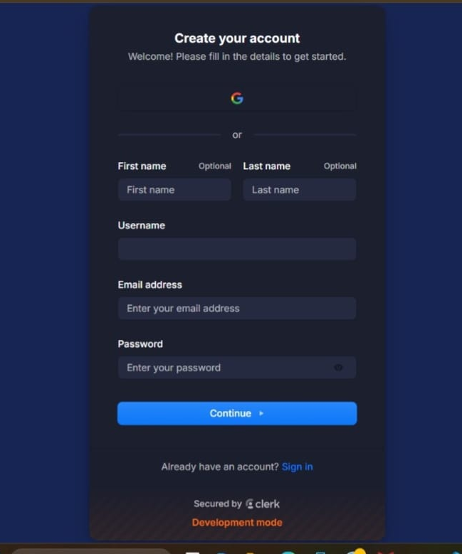
3. Sign Up Page
Allows new users to create an account.
User enters details such as name, email, and password.
Data stored in database.
Allows new users to create an account.
User enters details such as name, email, and password.

Slide 11
THANK YOU

