Slide 1
ShopVerse
Role-Based E-Commerce Management Platform
Node.js · Express.js · MongoDB · Mongoose · JWT · bcrypt
CIA-3 Project Development · 5th Semester
Christ University · L&T EduTech
Submitted by: ______________________________ Guide: ______________________
[ fill in on this line ]

Slide 2
Team Details
Slide 2
Fill in every field before submission — this page is required as page 1 of the submission PDF.
# | Name | Register Number | Department | Section
1
2
3
4
Course: ____________________________________ Semester: 5th
Guide / Faculty: ___________________________ Date of submission: ________________

Slide 3
Problem Statement
Slide 3
An online marketplace has to serve three different kinds of user at once — customers who buy, sellers who list and fulfil, and administrators who oversee the platform. Each needs a different view of the same data, and none may see or change what belongs to another.
Where such systems typically fail:
Stock oversells when two customers order the last unit at the same time
Any logged-in user can call any route, because role checks were never added
Order status becomes a free-text field, so invalid jumps go unnoticed
Coupons are validated in the browser and trusted by the server
A price change silently rewrites the totals of past orders
One unhandled error crashes the whole server

Slide 4
Objectives
Slide 4
Build a secure REST API with JWT authentication and bcrypt password hashing
Enforce role-based access for Customer, Seller and Administrator
Model the catalog, cart, orders, coupons and reviews in MongoDB with deliberate embed-vs-reference choices
Implement the complete order lifecycle as a controlled state machine, not free-form updates
Keep inventory correct under concurrency
Validate every request server-side and return consistent, documented JSON errors
Provide seller analytics and admin reporting through aggregation pipelines
Demonstrate the whole system through Postman and a working web frontend

Slide 5
Modules Implemented — all 14 mandatory
Slide 5
# | Module | # | Module
1 | Registration & Authentication | 8 | Order Status Workflow
2 | Role-Based Access Control | 9 | Inventory & Stock Management
3 | Product Catalog Management | 10 | Discount & Coupon Engine
4 | Category & Sub-Category | 11 | Payment Status Tracking
5 | Product Search & Filtering | 12 | Reviews & Ratings
6 | Shopping Cart Management | 13 | Seller Dashboard APIs
7 | Order Placement & Checkout | 14 | Admin Reporting & Analytics
Beyond the baseline: refresh tokens · saved addresses · wishlist-ready product model · inventory report · dark mode · fully responsive frontend

Slide 6
Technology Stack
Slide 6
Layer | Technology | Why
Runtime | Node.js 22 | Non-blocking I/O suits an API-heavy workload
Framework | Express 4.21 | Minimal, middleware-driven, matches MVC cleanly
Database | MongoDB 8 (Atlas) | Document model fits orders that embed their items
ODM | Mongoose 8 | Schema validation, hooks, population
Auth | jsonwebtoken | Stateless sessions, no server-side store
Hashing | bcryptjs | Adaptive cost factor (10 rounds)
Validation | express-validator | Declarative per-route request checking
Security | helmet · cors · rate-limit | Headers, origin control, brute-force protection
Frontend | HTML · CSS · JS · Bootstrap 5 | Demonstrates the API live
Charts | Chart.js 4 | Seller and admin analytics
Testing | Postman / Newman | 104 requests, 326 assertions

Slide 7
System Architecture — MVC
Slide 7
Client
Browser frontend · Postman
▼
Routes
Express routers · validation chains
▼
Middleware
protect (401) → authorize (403) → validate (400)
▼
Controllers
Business logic · rule enforcement
▼
Models
Mongoose schemas · hooks · indexes
▼
Database
MongoDB Atlas — 7 collections
Every request passes top to bottom; the centralised error handler sits below all of it and converts any failure into consistent JSON.

Slide 8
Database Design — 7 Collections
Slide 8
Collection | Relationship | Decision
users | 1 : N products / orders / reviews | addresses EMBEDDED
categories | self-reference via parent | REFERENCE (tree)
products | N : 1 category, N : 1 seller | REFERENCE
carts | 1 : 1 user (unique index) | items EMBEDDED
orders | N : 1 user | items EMBEDDED as snapshot
coupons | 1 : N orders | REFERENCE
reviews | N : 1 product, N : 1 user | REFERENCE + compound unique
The rule applied throughout: embed what is always read with its parent and rarely changes on its own; reference what is large, shared, or updated independently.
Order items are the clearest case — they are embedded and they copy name, image and price at checkout, so an order is a historical record that a later price change can never rewrite.

Slide 9
Indexes
Slide 9
Collection | Index | Purpose
users | { email: 1 } unique | Login lookup + uniqueness guarantee
products | { name, description, brand } text | Keyword search without a regex scan
products | { category: 1, isActive: 1 } | The most common listing query
products | { seller: 1 } · { price: 1 } | Seller catalog · price filter and sort
categories | { parent: 1, isActive: 1 } | Building the category tree
carts | { user: 1 } unique | One cart per user, enforced by the DB
orders | { user: 1, createdAt: -1 } | "My orders", newest first
orders | { status: 1 } · { items.seller: 1 } | Admin filtering · seller order queue
reviews | { user: 1, product: 1 } unique | One review per product per customer
The last one is the point: "one review per product" is a database guarantee, not just an if-statement.

Slide 10
Security Implementation
Slide 10
bcrypt hashing
Cost factor 10. A pre-save hook with an isModified guard, so a profile update never re-hashes.
JWT authentication
Stateless access tokens. The user is re-read on every request, so a deactivated account loses access at once.
Role-based access
protect returns 401; authorize returns 403. Two different failures, two different codes.
Ownership checks
A seller may only touch their own products; admin bypasses.
Server-side validation
express-validator on every write route, plus schema validation underneath.
ObjectId guarding
A malformed :id is a clean 400, never a 500 CastError.
Secrets in .env
No URI or signing key anywhere in source. .env is git-ignored; .env.example is committed.
Rate limiting
Auth routes are throttled per IP against brute force.

Slide 11
Business Rules — beyond CRUD
Slide 11
Rule | How it is enforced | On failure
Stock can never oversell | One conditional $inc; the guard is in the query | 400
Cart respects live stock | Checked against the product on every add | 400
Status follows the graph | Declared transition map, checked both ways | 400
Only some statuses cancel | Customer may cancel Placed / Confirmed only | 400
Cancelling restores stock | Reverse $inc on leaving the pipeline | —
Coupons re-validated | Same evaluate() at preview and at checkout | 400
Review needs delivery | Must own a Delivered order with that product | 403
One review per product | Compound unique index in MongoDB | 409
Sellers are isolated | Ownership check on every write | 403
Category in use | Refuses delete while products reference it | 400

Slide 12
API Design
Slide 12
Consistent envelope on every response
{
"success": true,
"message": "Products fetched.",
"data": [ ... ],
"meta": { "page": 1, "total": 33 }
}
{
"success": false,
"message": "Coupon has expired.",
"errorCode": "BUSINESS_RULE_VIOLATION"
}
Status codes used deliberately
Code | Meaning | errorCode
400 | Malformed input | VALIDATION_ERROR
400 | Valid input, rule says no | BUSINESS_RULE_VIOLATION
401 | Not authenticated | UNAUTHENTICATED
403 | Authenticated, wrong role or owner | FORBIDDEN
404 | No such record | NOT_FOUND
409 | Duplicate / already exists | CONFLICT

Slide 13

Demo — Home & Catalog
Slide 13
Landing page: category navigation, deals with a live countdown, featured products loaded from the API.

Slide 14
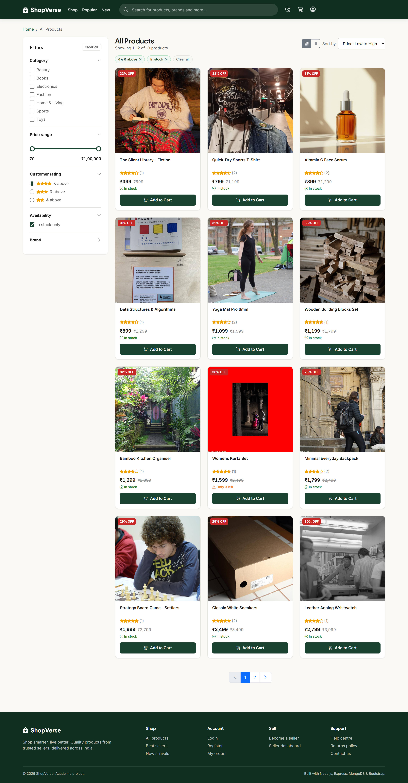
Demo — Search & Filtering
Slide 14
Module 5: rating and availability filters applied together, shown as removable chips; the price slider and sort are combinable.

Slide 15
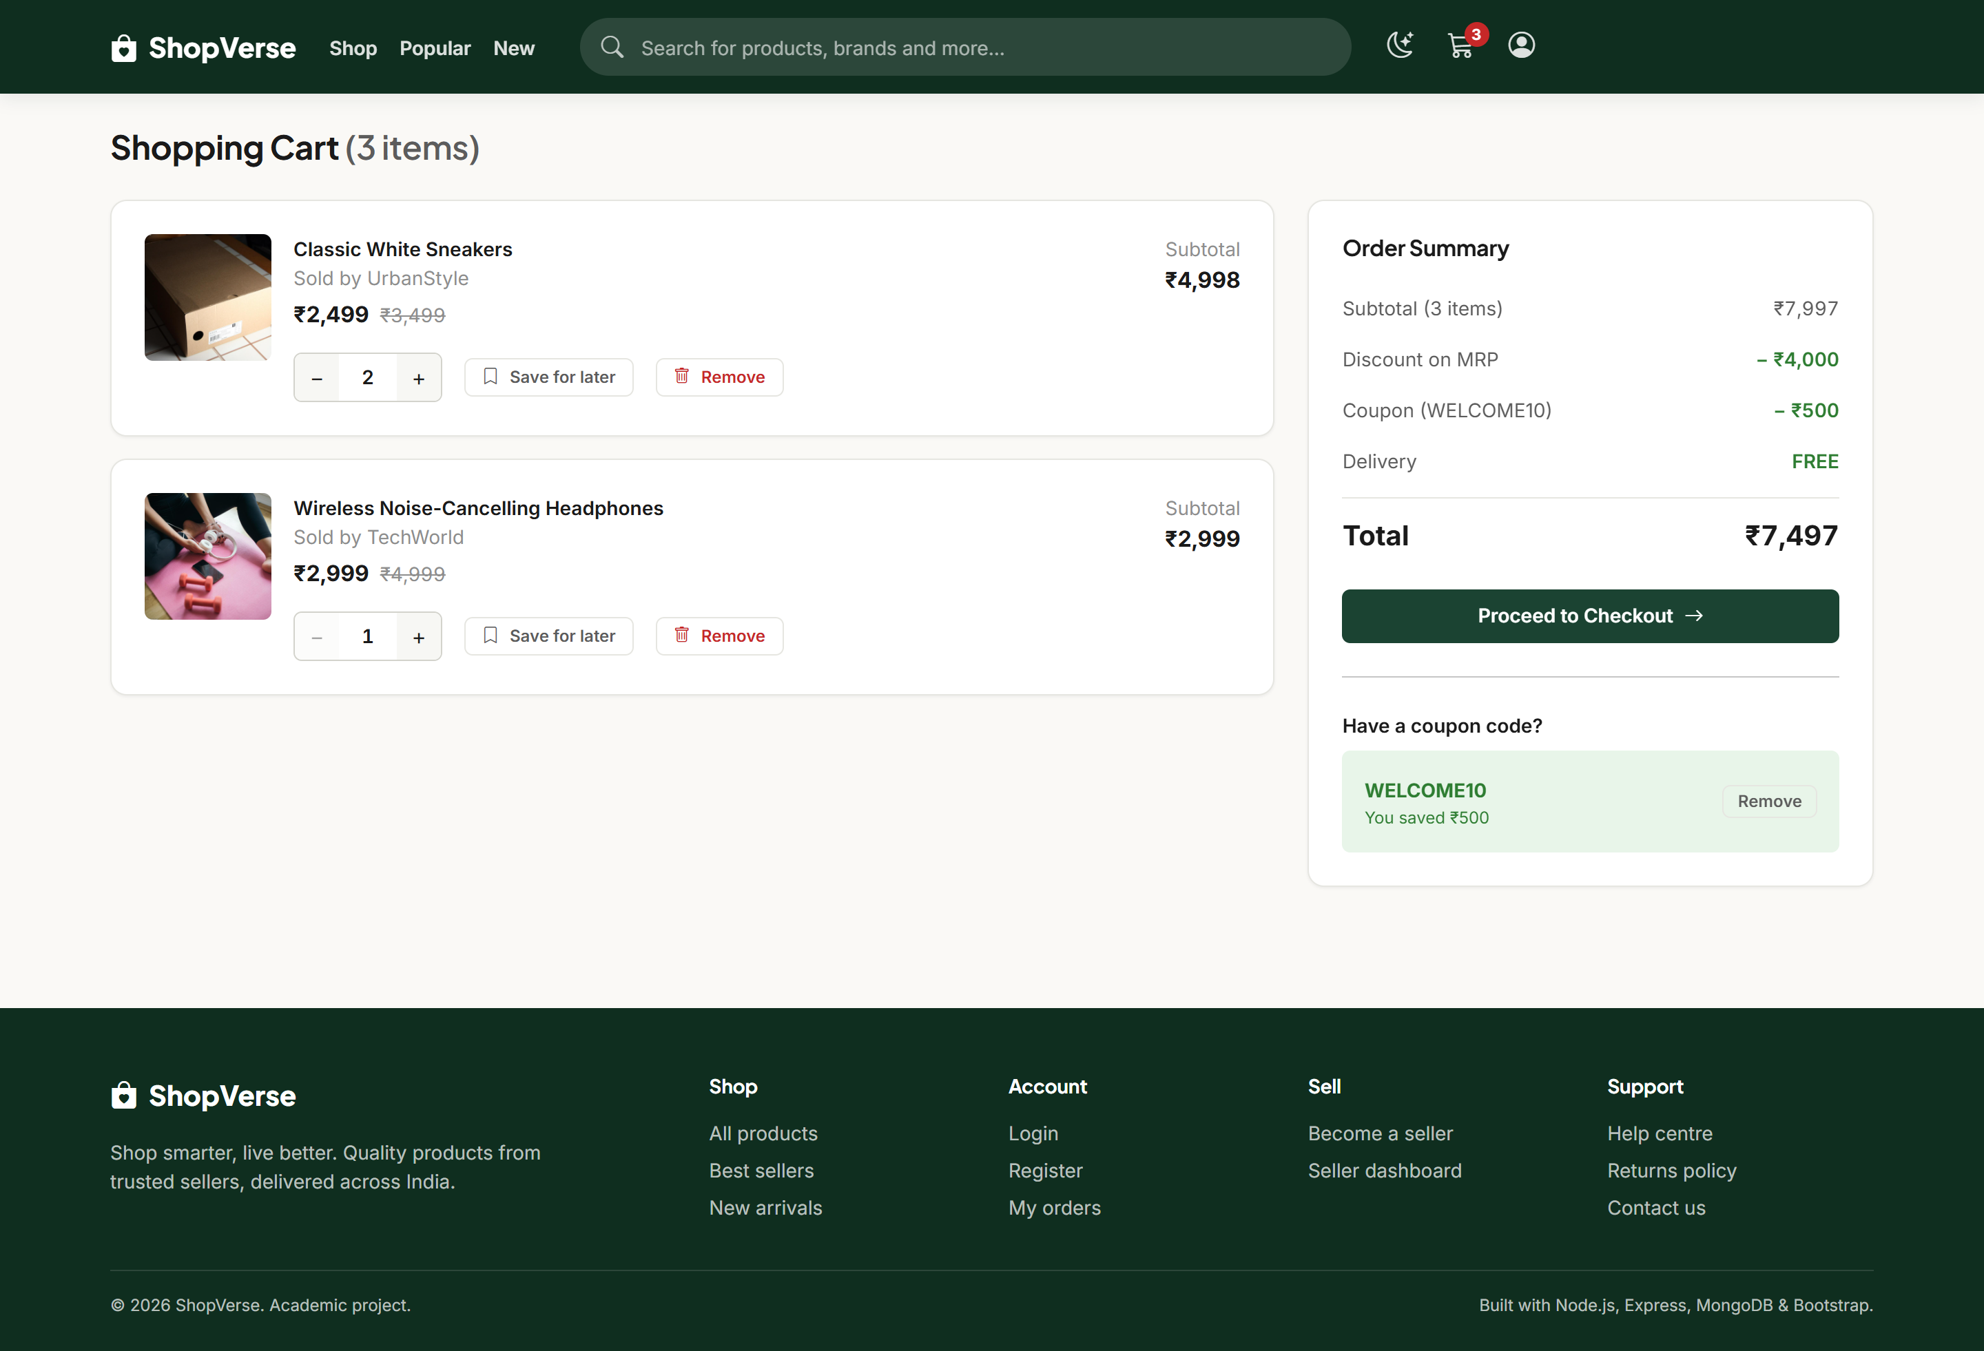
Demo — Cart & Coupon
Slide 15
Modules 6 and 10: quantity capped at live stock, WELCOME10 applied, totals recalculated server-side.

Slide 16
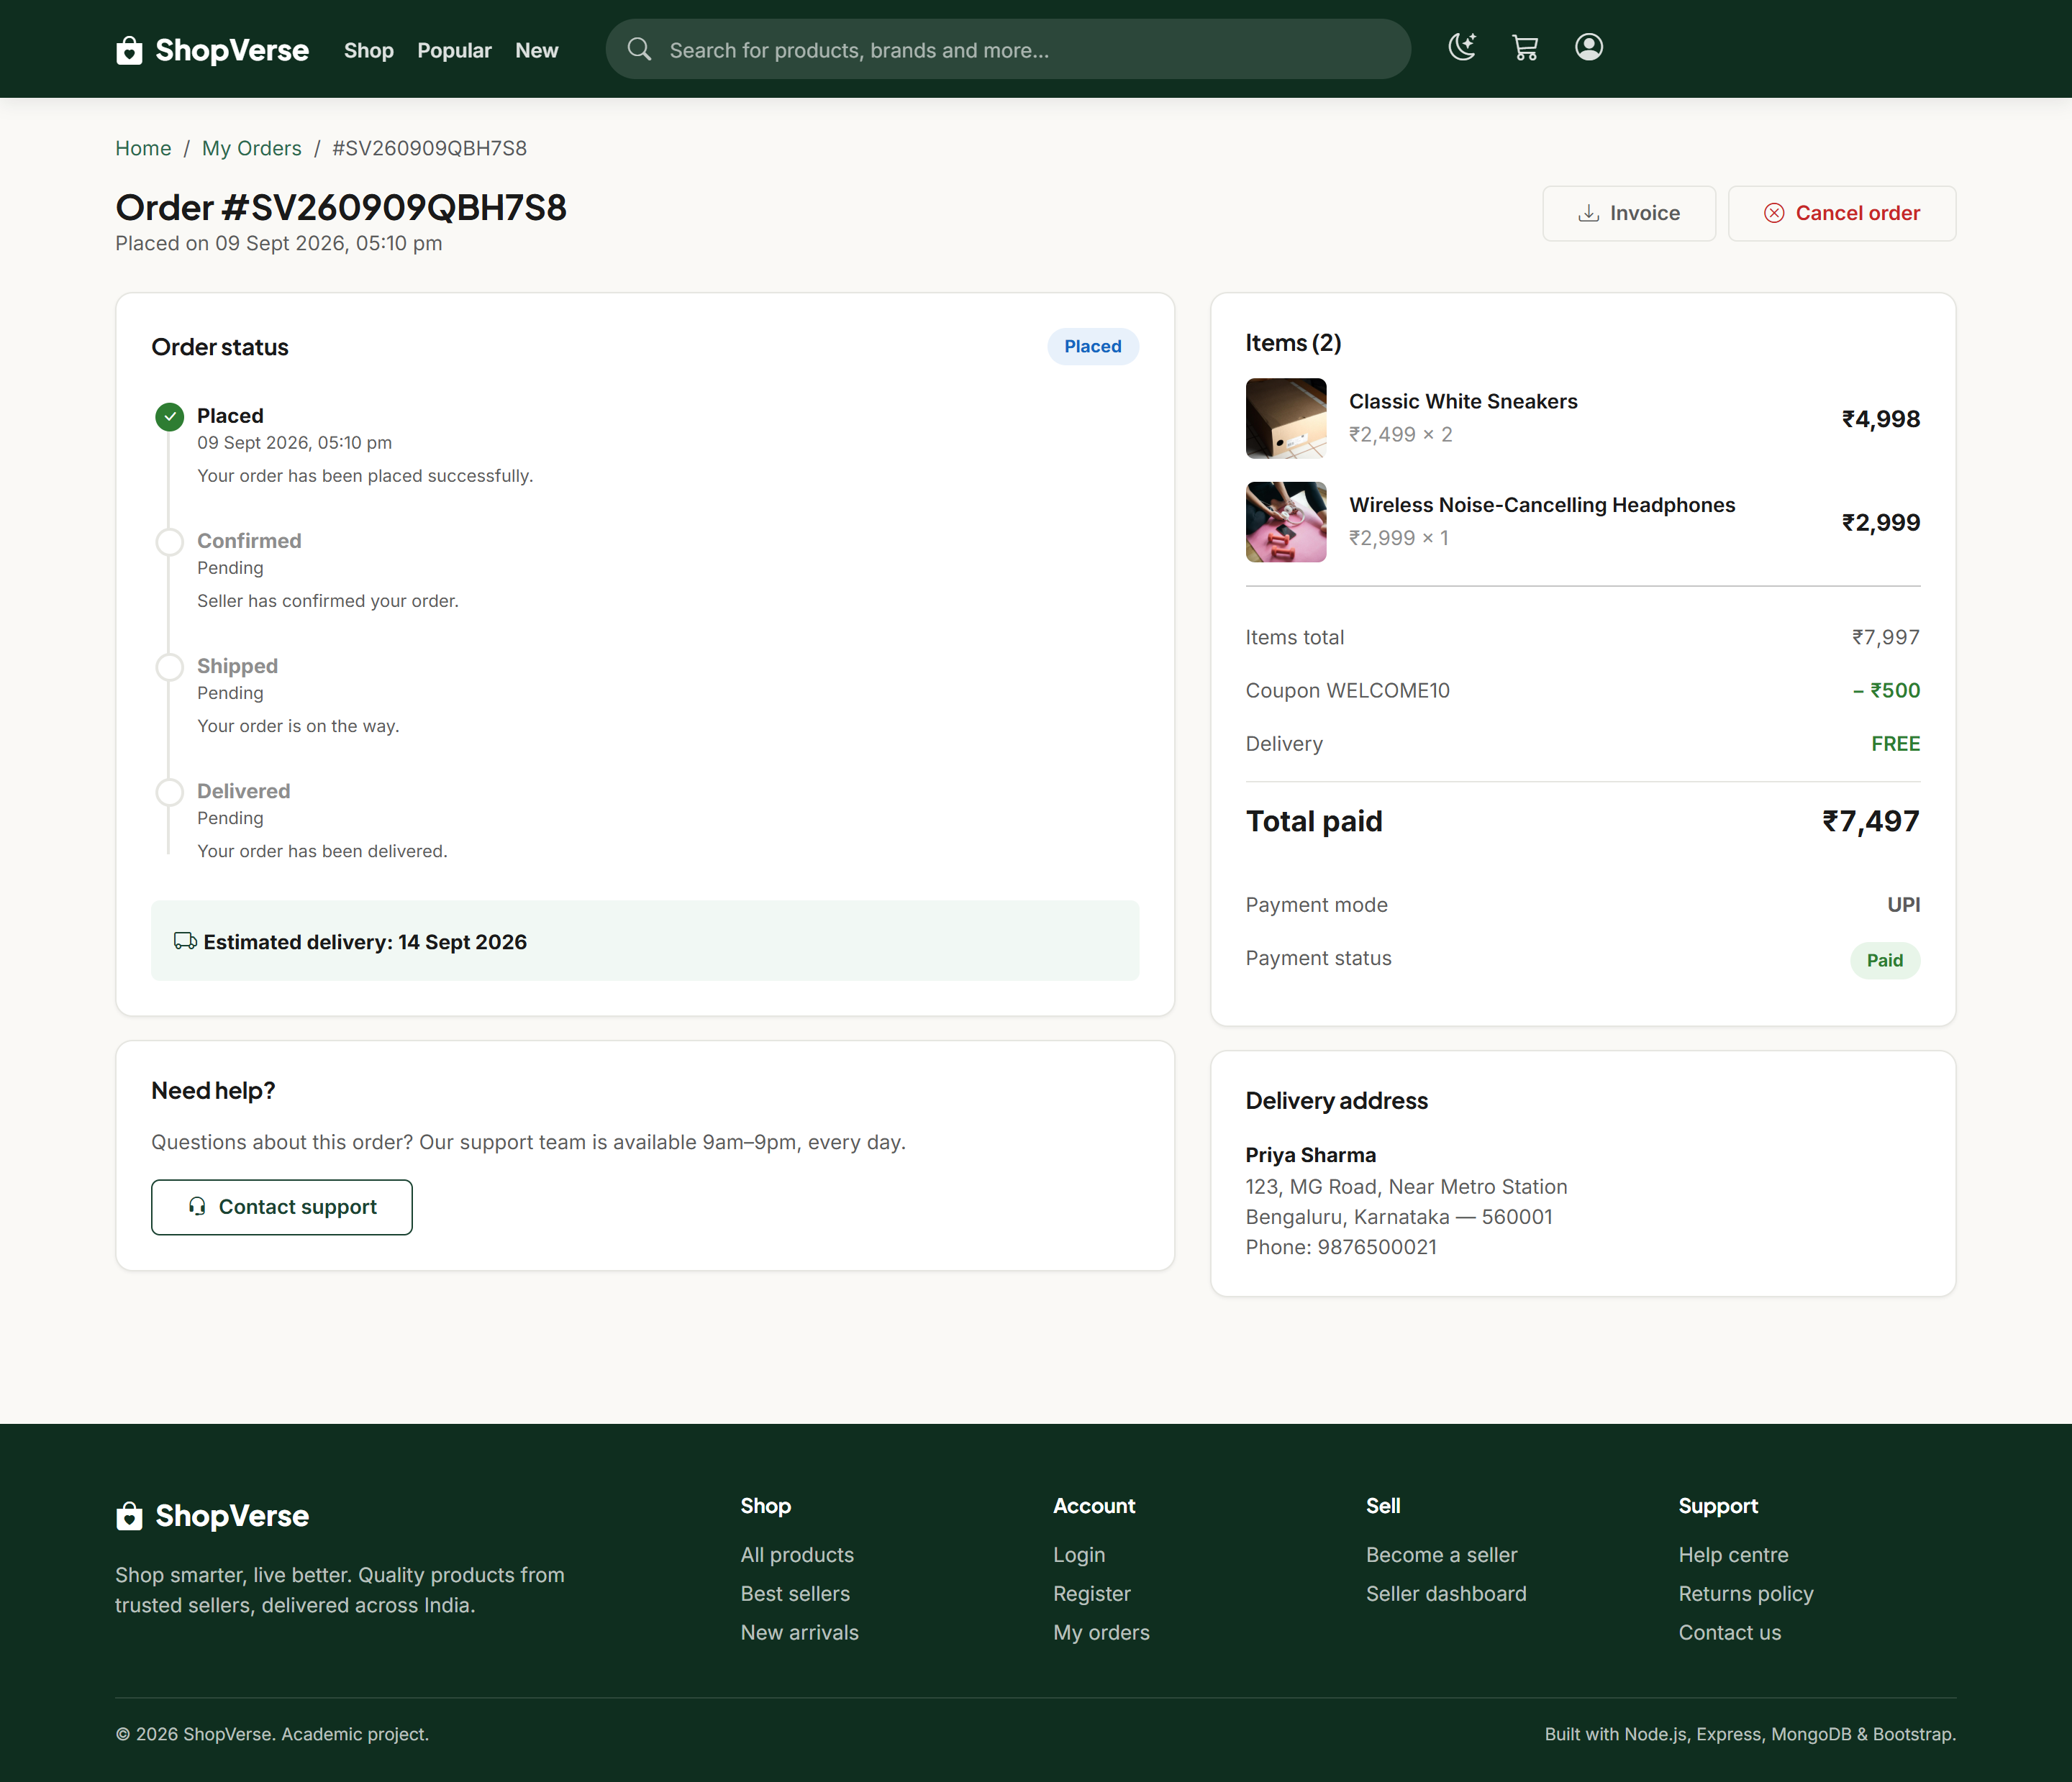
Demo — Order Tracking
Slide 16
Module 8: the status timeline, driven by the transition graph. Cancel appears only while the rules permit it.

Slide 17
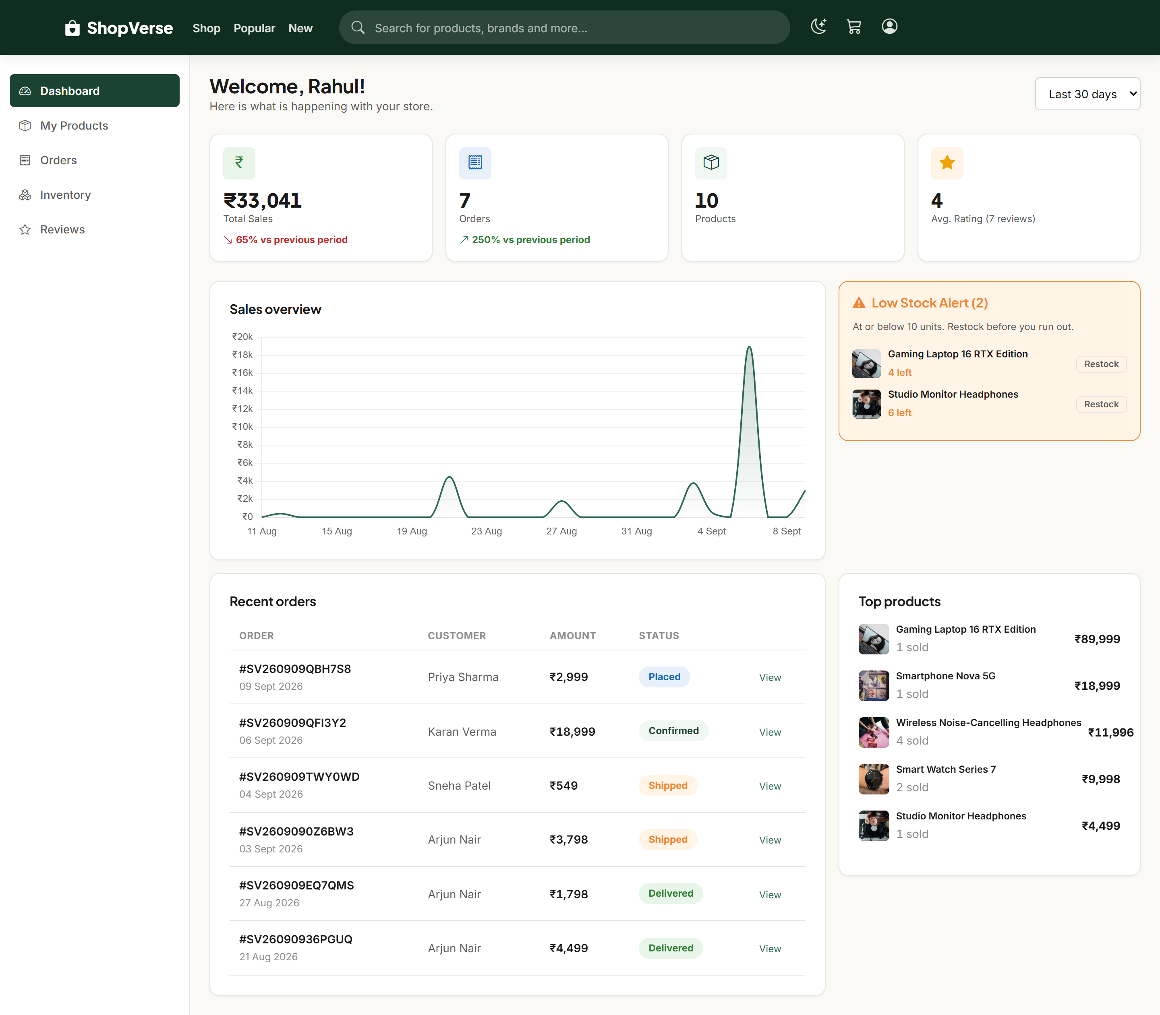
Demo — Seller Dashboard
Slide 17
Modules 9 and 13: revenue and rating KPIs with trend deltas, sales chart, and the low-stock alert panel.

Slide 18
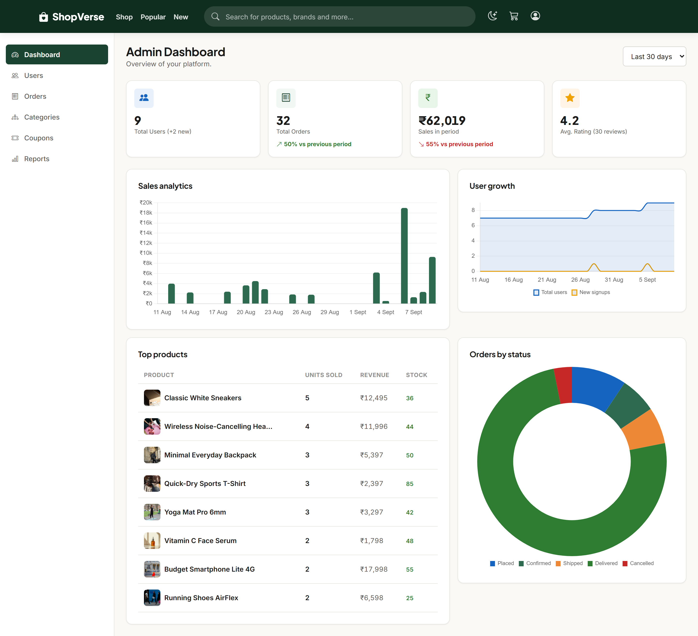
Demo — Admin Dashboard
Slide 18
Module 14: platform KPIs, sales analytics, user-growth chart, top products and an orders-by-status breakdown.

Slide 19
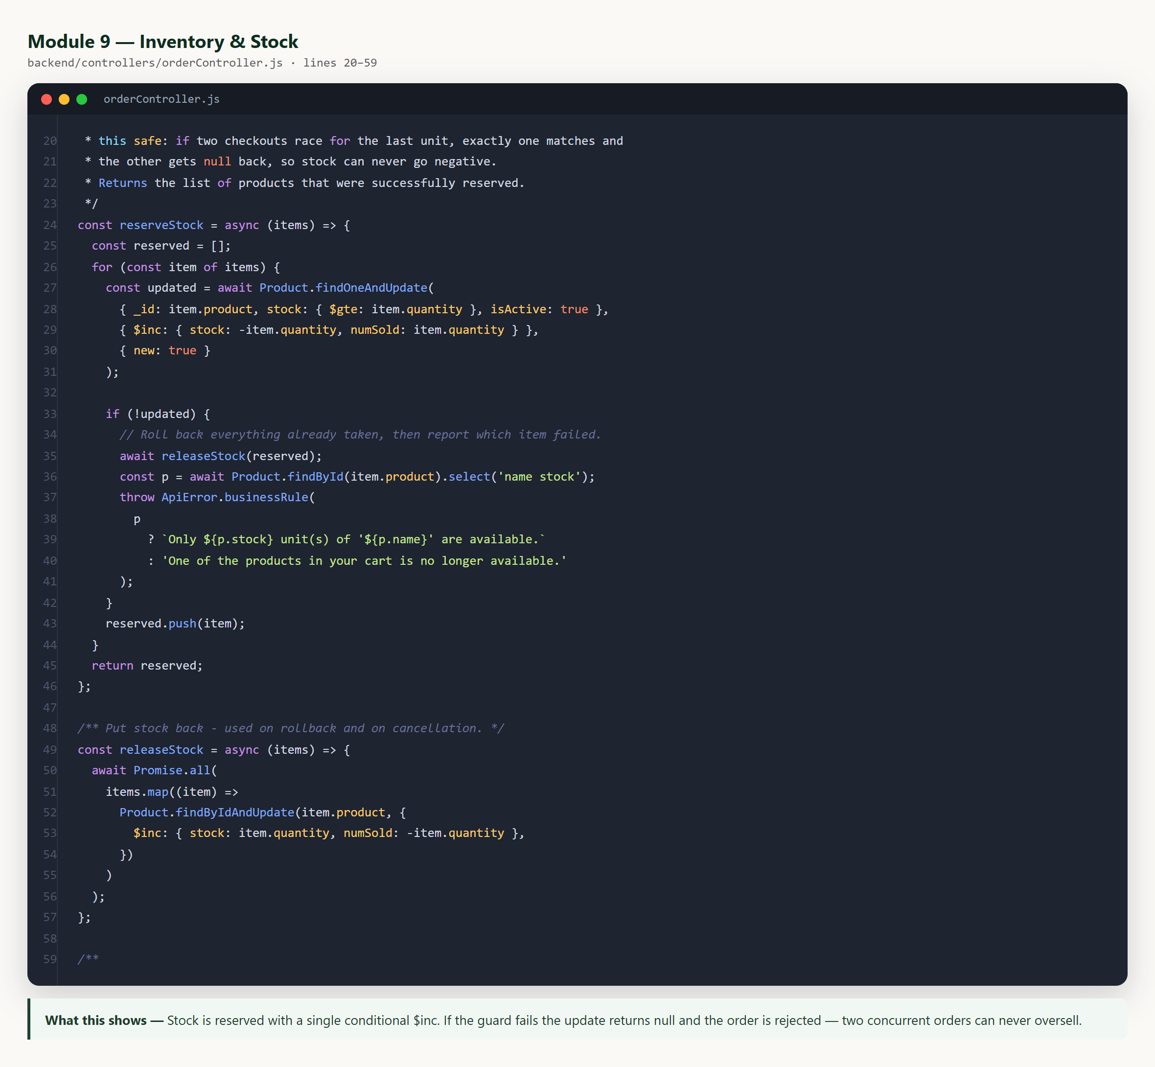
Code — Atomic Stock Reservation
Slide 19
The stock guard lives inside the query, so two concurrent checkouts for the last unit cannot both succeed.

Slide 20
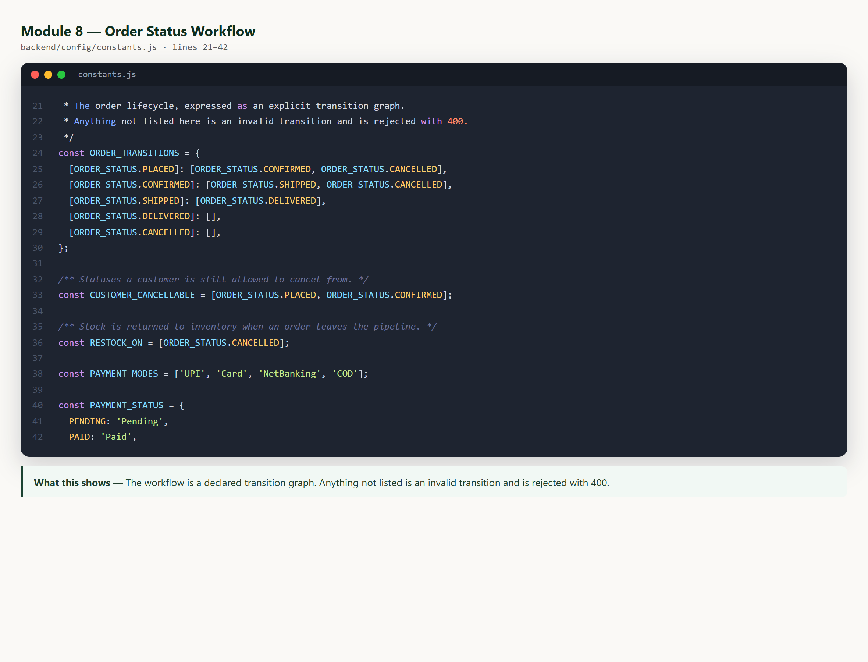
Code — Order Status Transitions
Slide 20
The workflow is declared data, not scattered if-statements. Anything not in the graph is rejected.

Slide 21
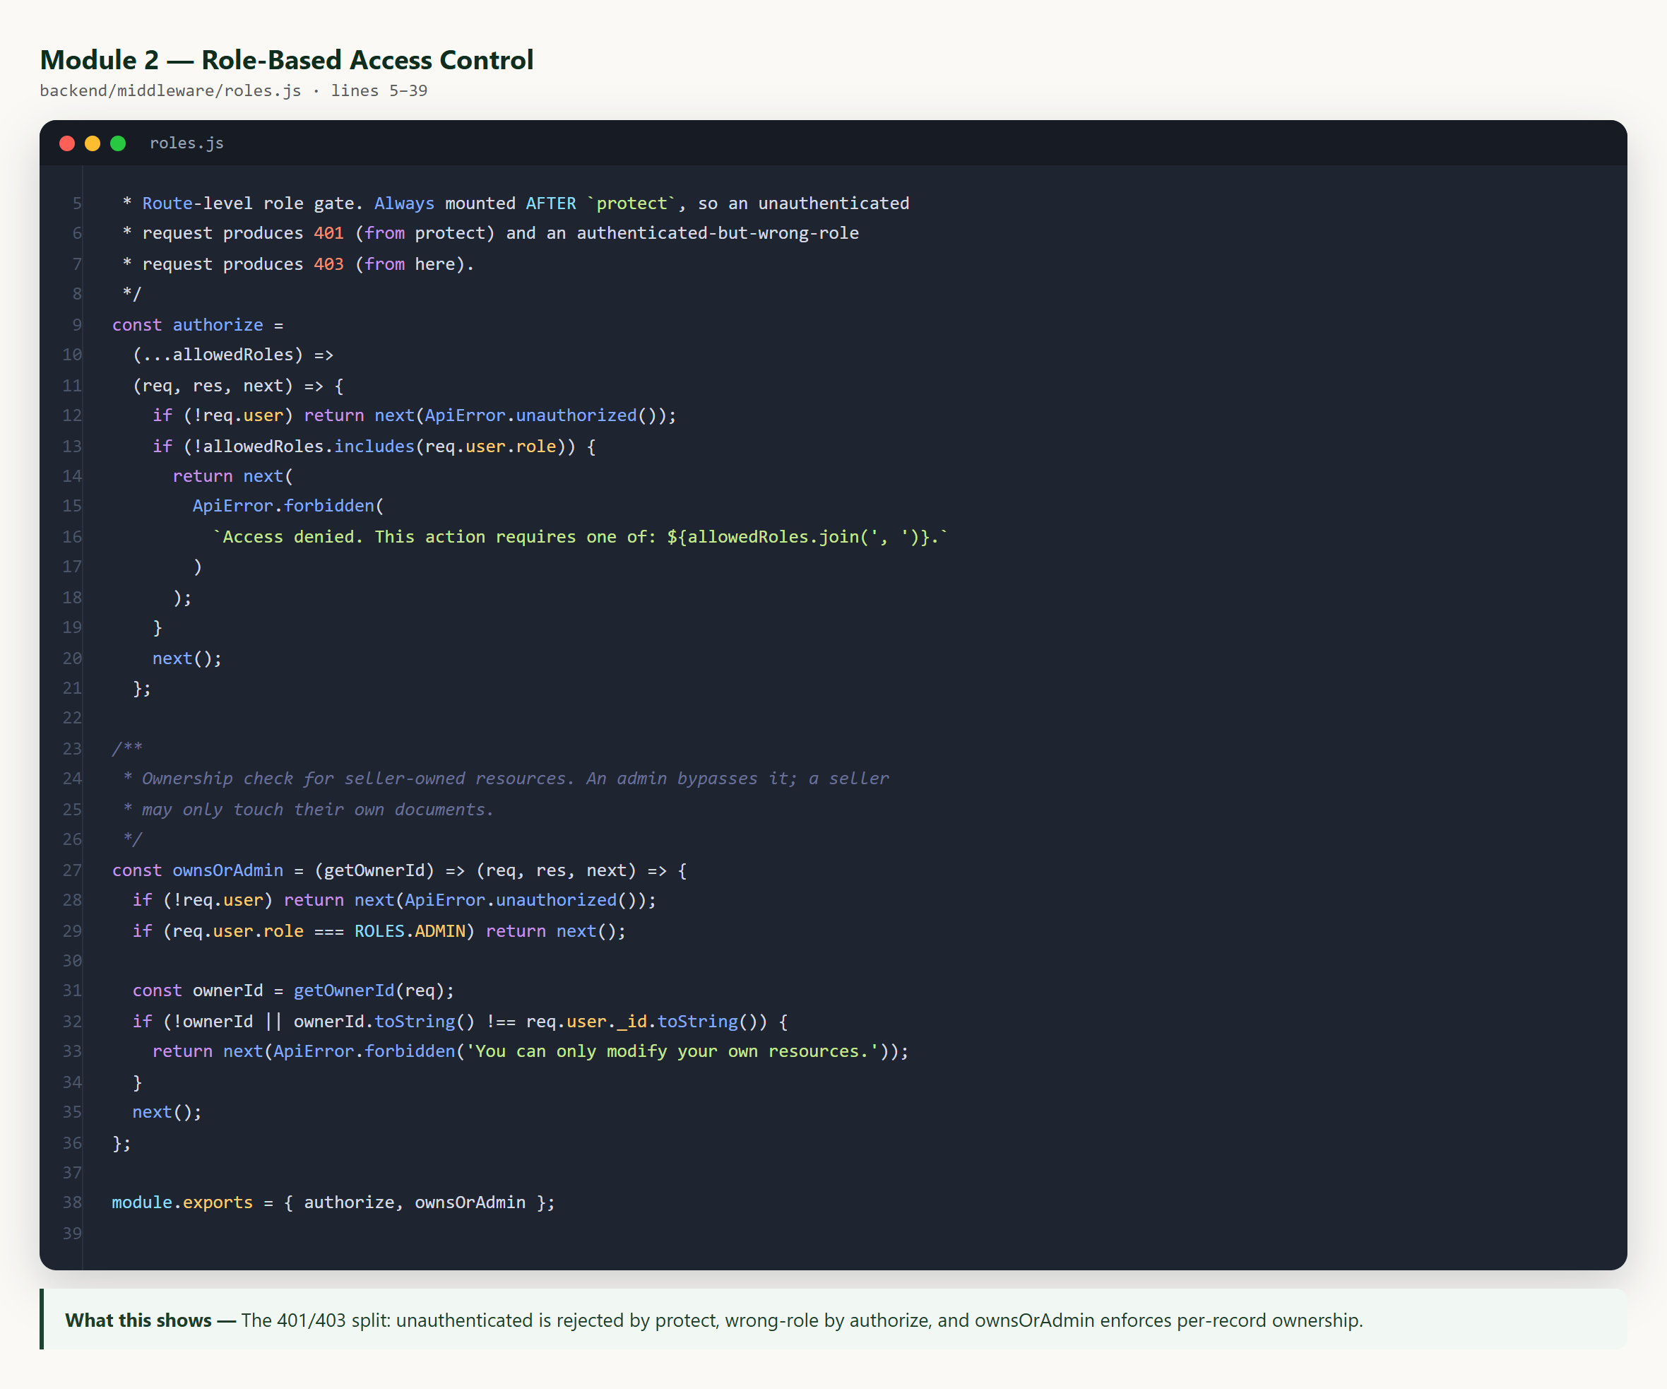
Code — Role-Based Access Control
Slide 21
authorize() produces 403 for a wrong role; ownsOrAdmin() enforces per-record ownership with an admin bypass.

Slide 22
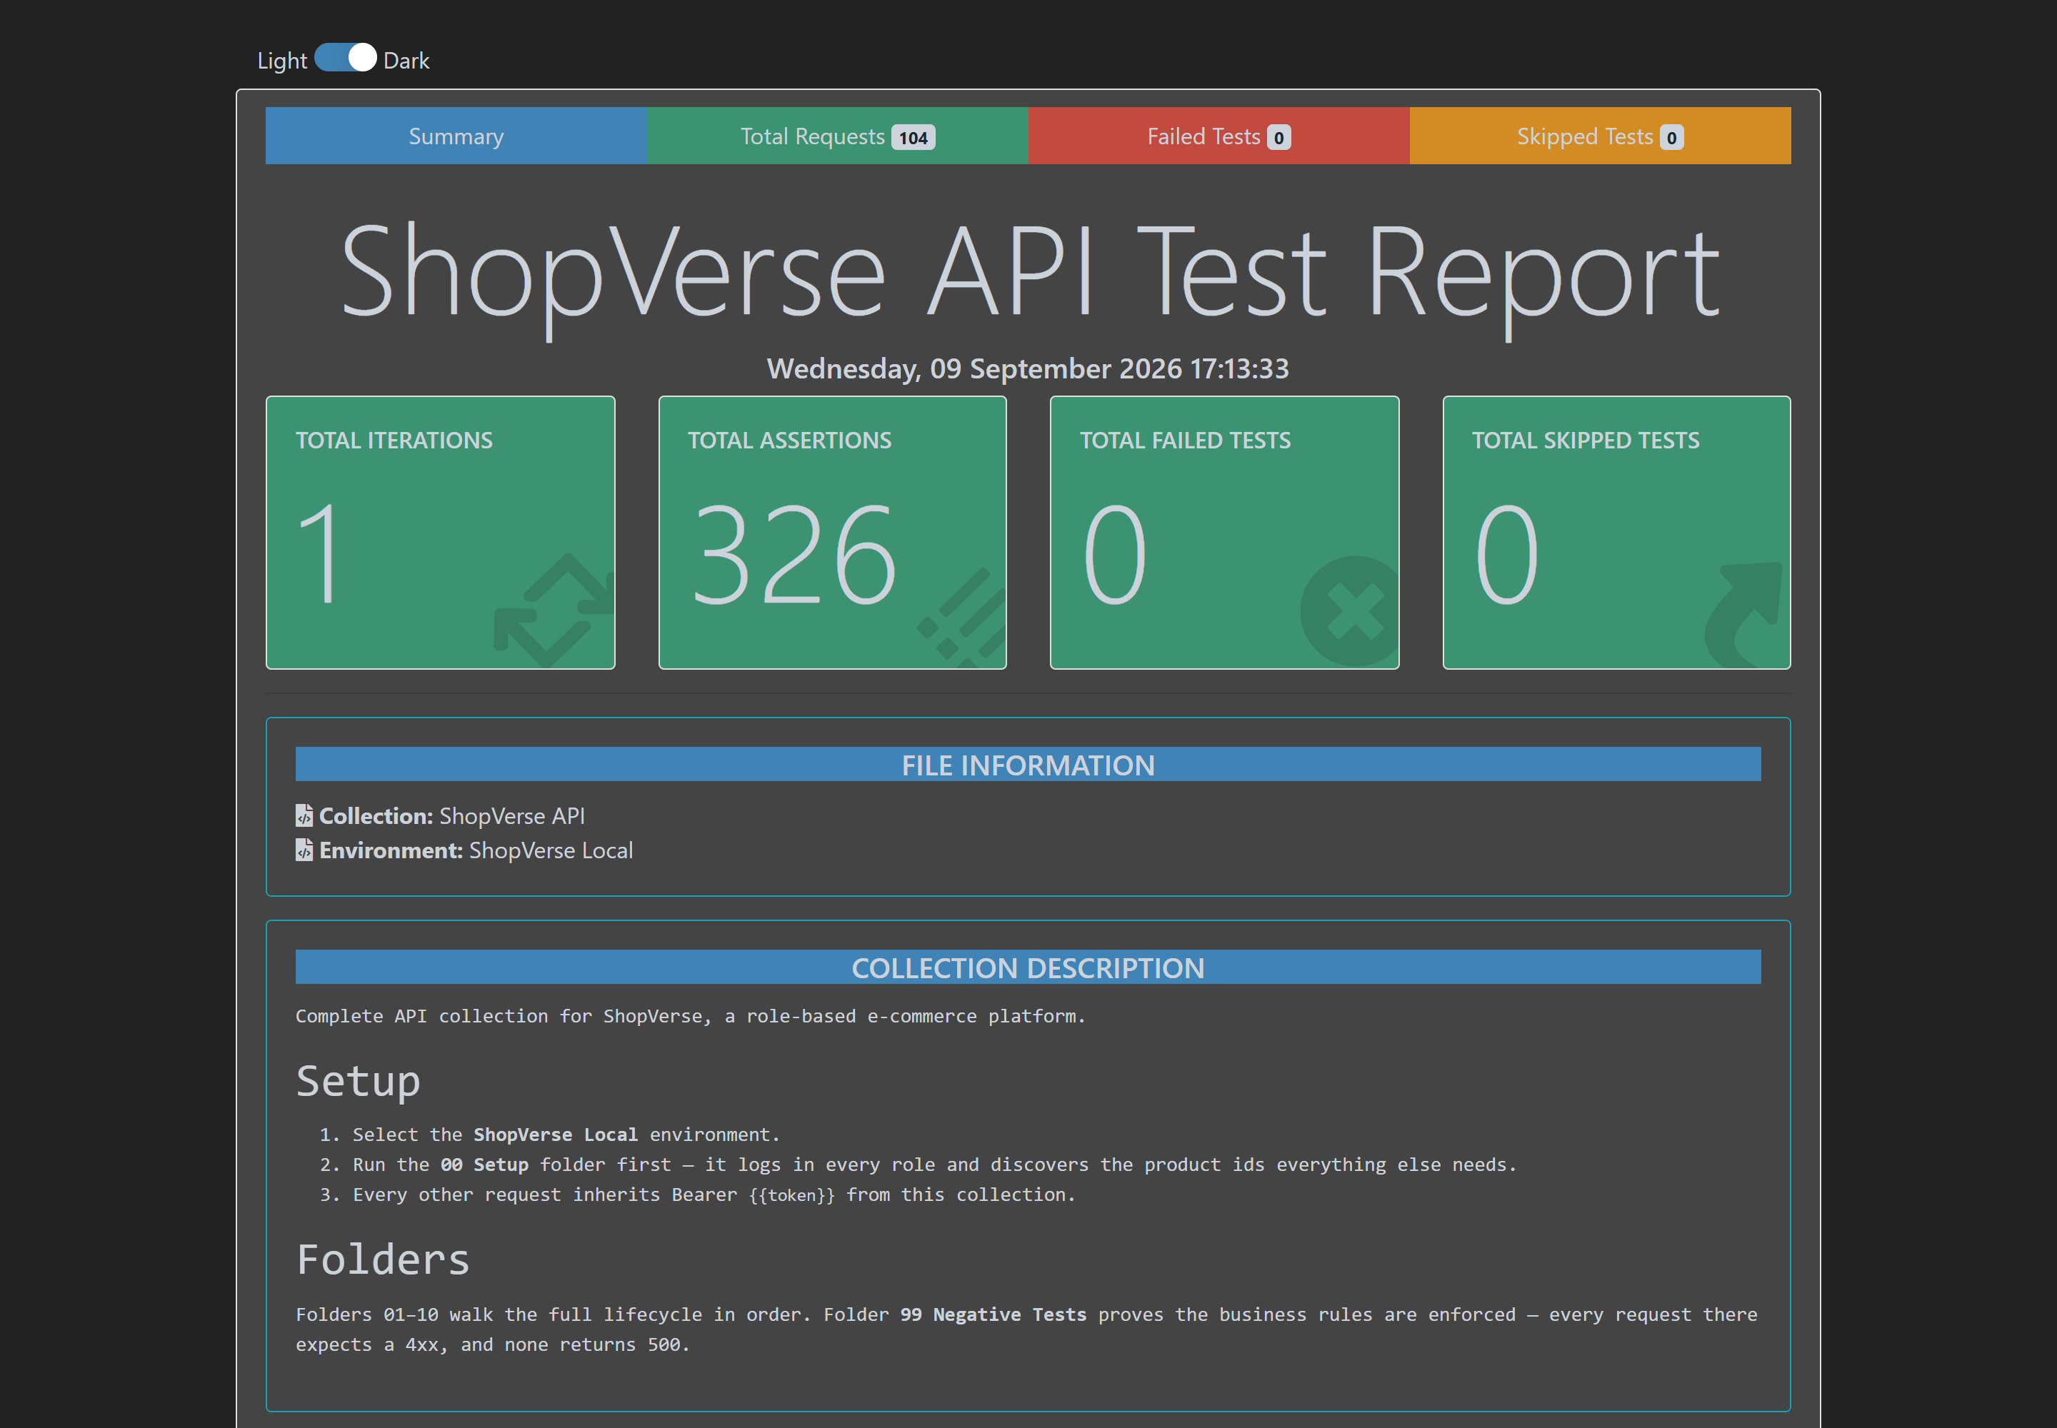
API Testing — Postman / Newman
Slide 22
104 requests · 326 assertions · 0 failures. Every request also asserts the response is JSON and the status is below 500.

Slide 23
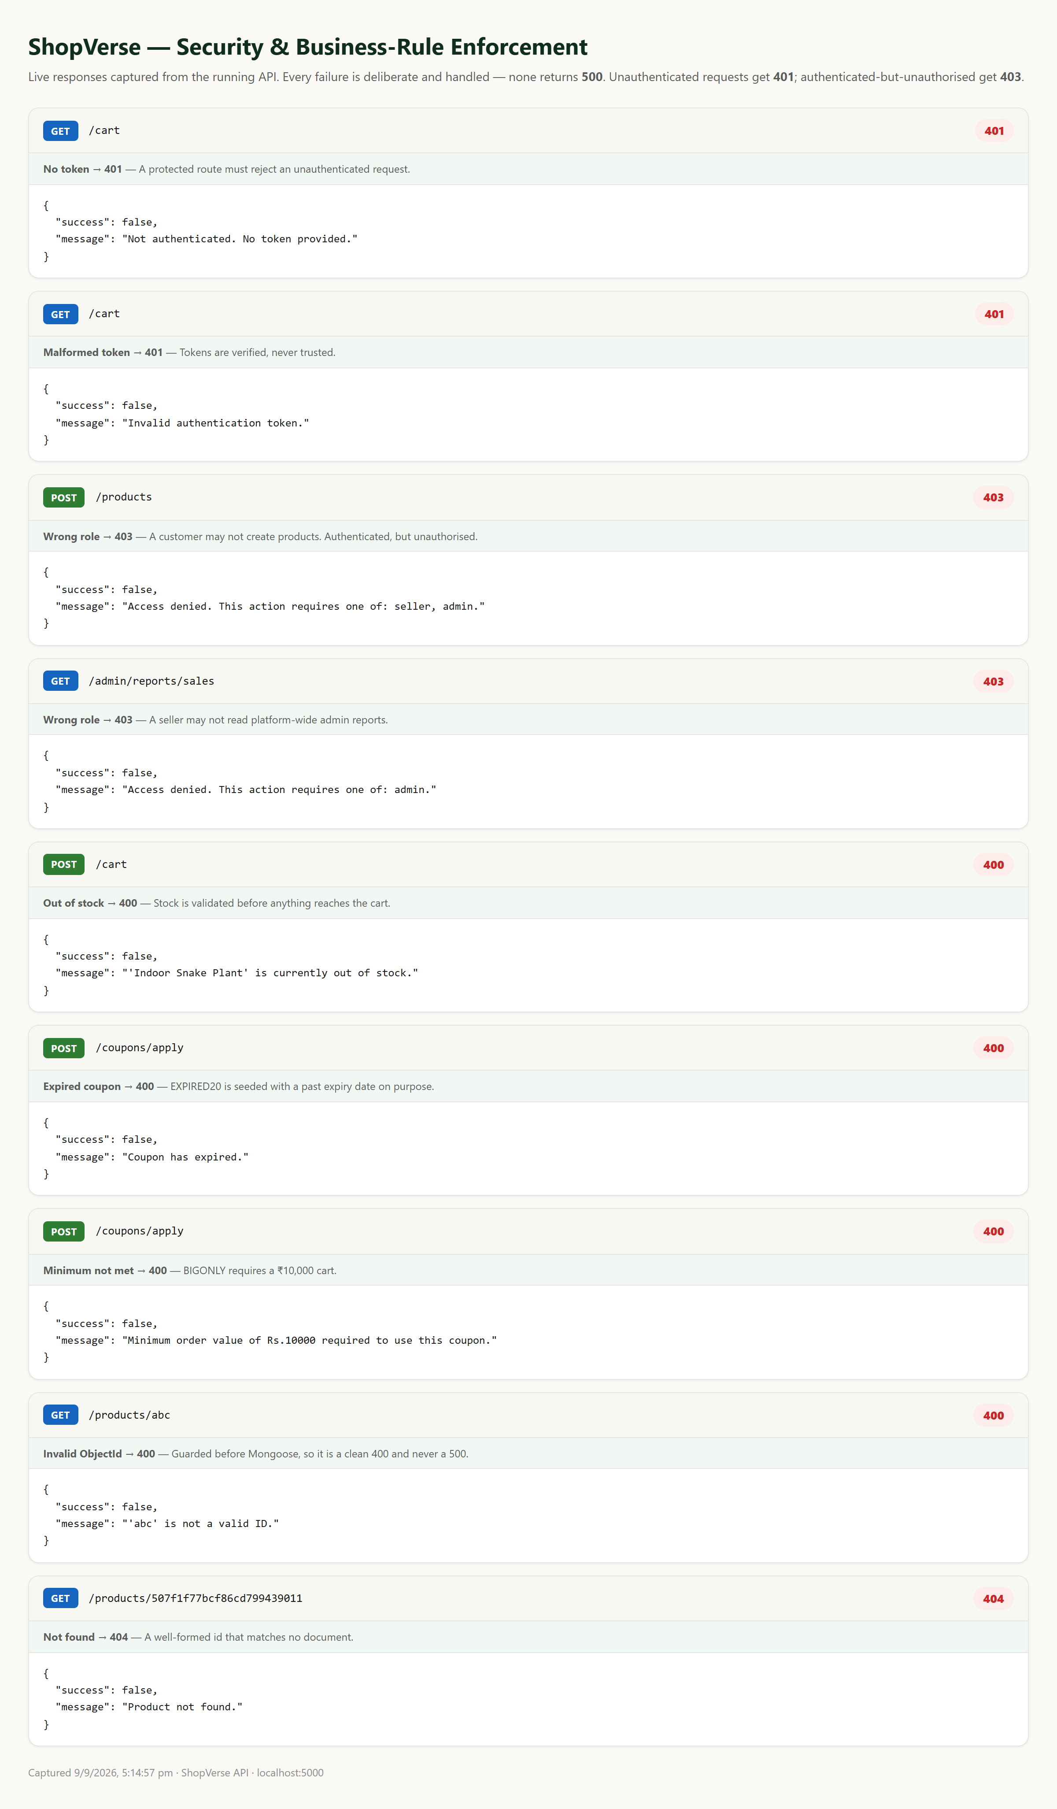
Negative Testing
Slide 23
Each failure path returns the right status and a stable errorCode — proving the rules are enforced, not merely documented.

Slide 24
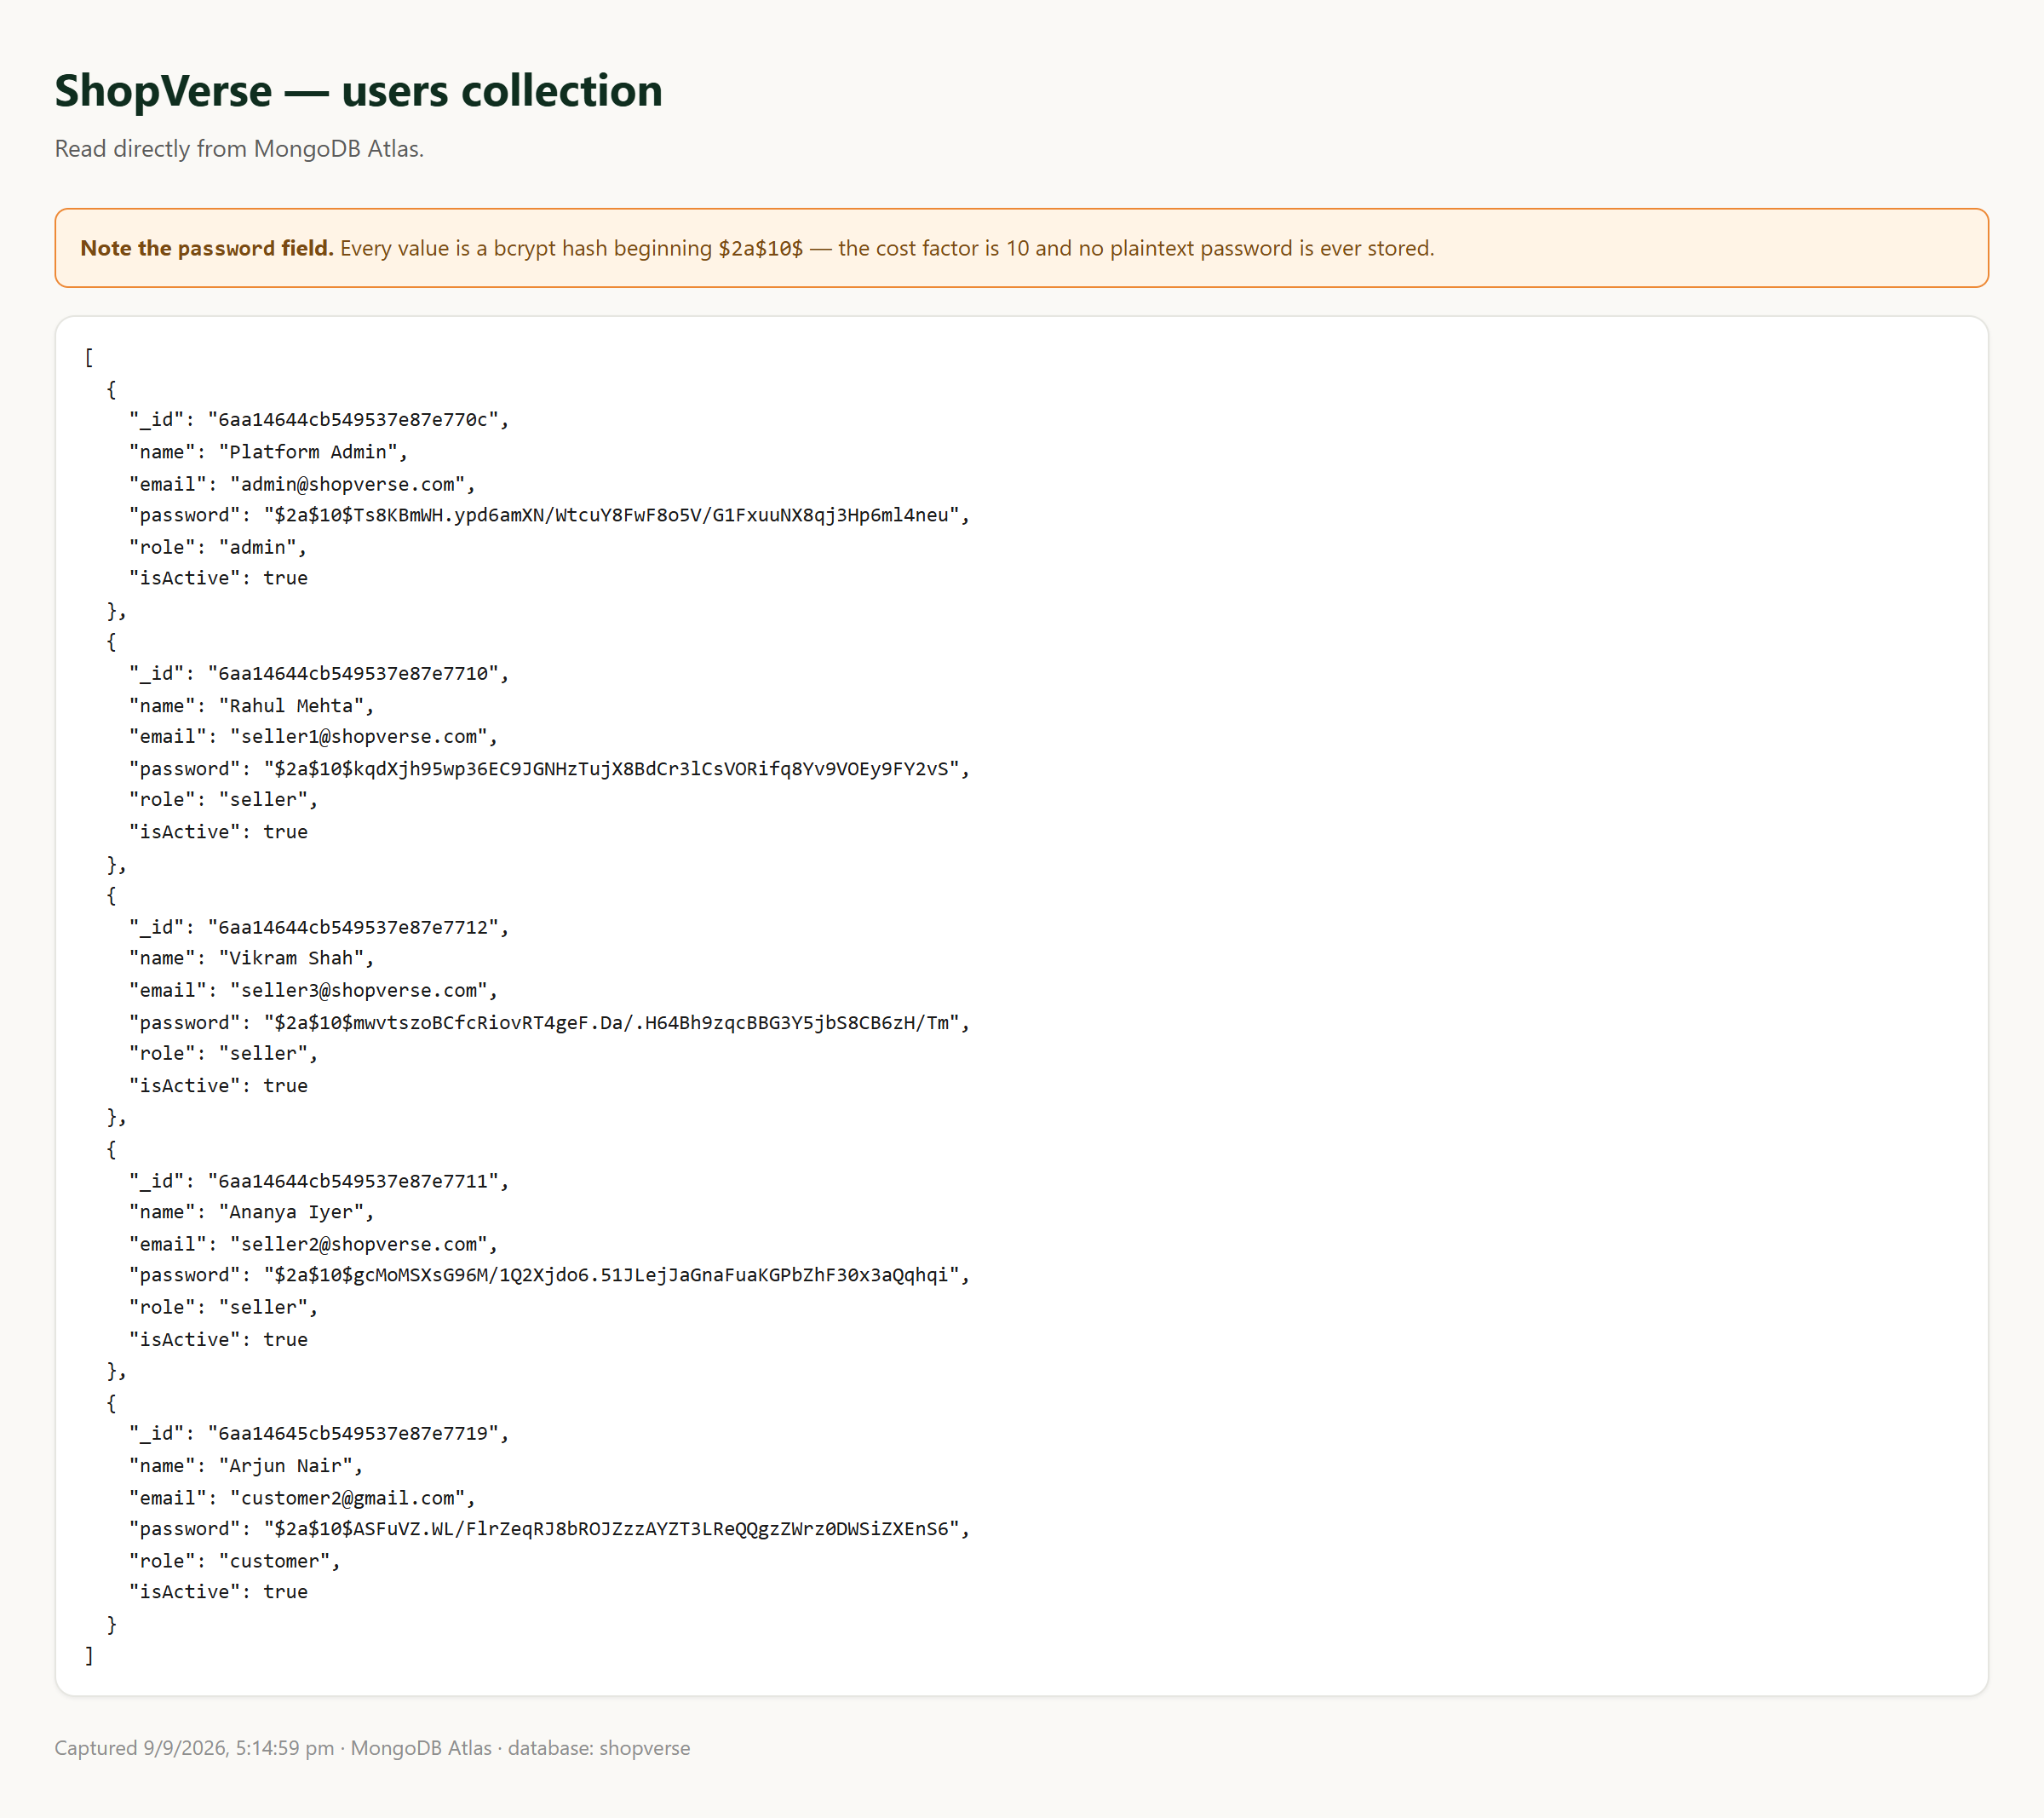
Security Evidence — bcrypt
Slide 24
The users collection read straight from Atlas: every password is a $2a$10$ bcrypt hash. No plaintext is ever stored.

Slide 25
Results
Slide 25
14 / 14
66
7
mandatory modules
REST endpoints
MongoDB collections
326
0
13
assertions passing
test failures
frontend pages
All 14 modules implemented and demonstrable — none stubbed
Every failure path returns a correct status code; no endpoint returns 500
Verified end to end against MongoDB Atlas, not a local mock

Slide 26
Limitations & Future Scope
Slide 26
Out of scope by design
Future scope
Payment gateway is mocked — permitted by the brief
No email or SMS notifications
Single currency (INR) and single time zone
Product images are external URLs, not uploaded files
No social login
Real gateway (Razorpay / Stripe) behind the existing interface
Multi-transaction checkout using MongoDB sessions
Redis caching for the catalog
Full-text search via Atlas Search
Refund and return workflow
Automated CI test run on every push

Slide 27
Conclusion
Slide 27
ShopVerse implements the complete product-to-order lifecycle for three distinct roles, on a MongoDB schema whose embed-versus-reference choices were made deliberately and are documented.
What distinguishes it from CRUD:
Inventory is correct under concurrency — the guard is inside the query
The order lifecycle is a declared state machine, not an editable field
Authorization is enforced per role and per record, returning 401 and 403 correctly
Coupons and reviews are re-validated server-side, never trusted from the client
Every error is translated into a consistent JSON response with a stable code

Slide 28
Thank You
Questions?
Repository: ______________________________________________
[ paste your GitHub URL here ]

