Slide 1
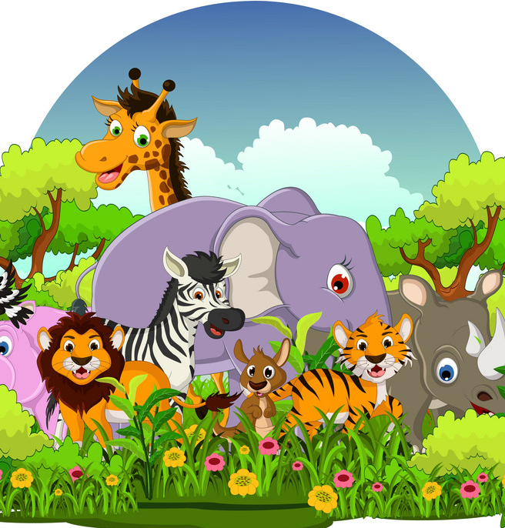
AI Wildlife Identifier
Building a CNN model (ResNet) to classify animal species from images.

Slide 2
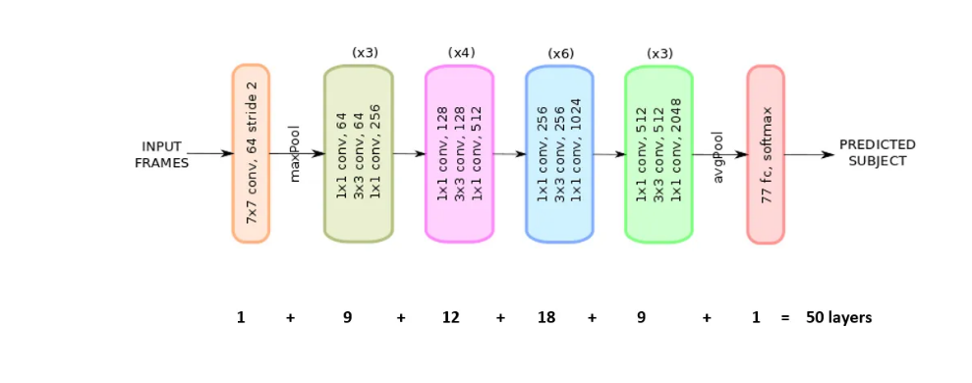
In this model, ResNet50 architecture is used to build a CNN for wildlife classification. ResNet50, a 50-layer deep network, utilizes residual learning to enhance feature extraction. The architecture of ResNet50 is shown below
ResNet Architecture :
ResNet (Residual Networks) is a deep CNN architecture developed by Microsoft.
Uses residual learning to overcome vanishing gradient problems in deep networks.
Key feature: skip connections (identity mappings) enable training very deep networks.

Slide 3
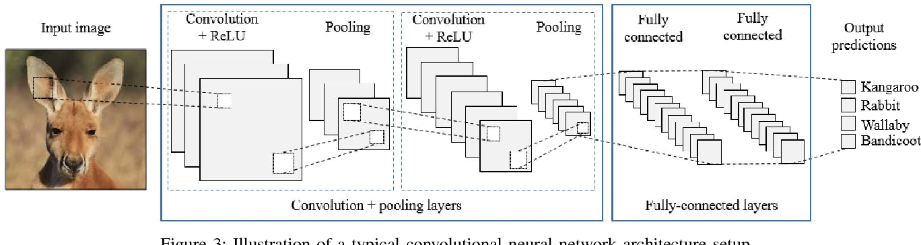
It is not just a classifier; it also includes
A Streamlit interface for wildlife classification model using ResNet50, Where you can upload image or url of image .
Integrated Generative AI to provide species information, fun facts, and insights.
Added an interactive Q&A feature for users to ask anything about the identified species.

Slide 4
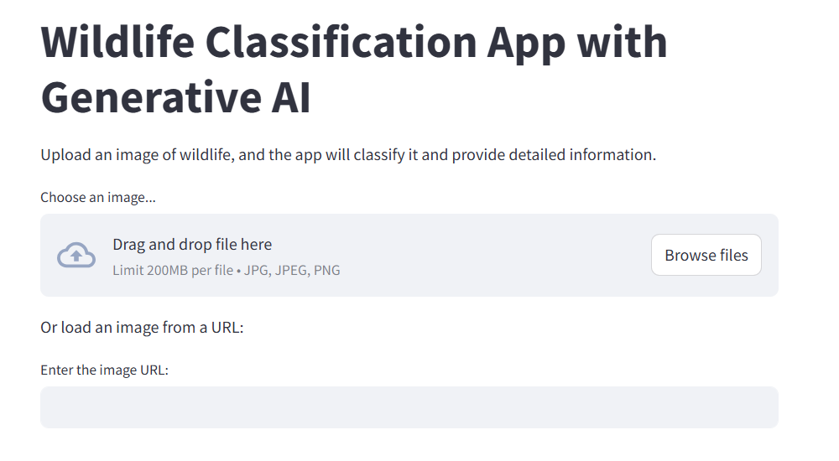
fig : Web interface using Streamlit
Conclusion
AI-powered wildlife classification enhances conservation efforts by providing accurate and efficient species identification. With ResNet50 and Generative AI, the model goes beyond classification by offering species insights, fun facts, and interactive Q&A. Future advancements will further improve real-time monitoring, aiding researchers and conservationists in protecting biodiversity.

