Slide 1

Price prediction for Used Cars
Group 5

Slide 2
Introduction:
Car price prediction especially when the car is used and not coming direct from the factory, is both a critical and important task. With increase in demand for used cars more and more vehicle buyer are finding alternatives of buying new cars.
There is need of accurate price prediction mechanism for the used cars. Prediction techniques of machine learning can be helpful in this regard.
Objective:
An online used car reselling company need to evaluate the used car condition & accordingly predict the reselling price of the car.

Slide 3
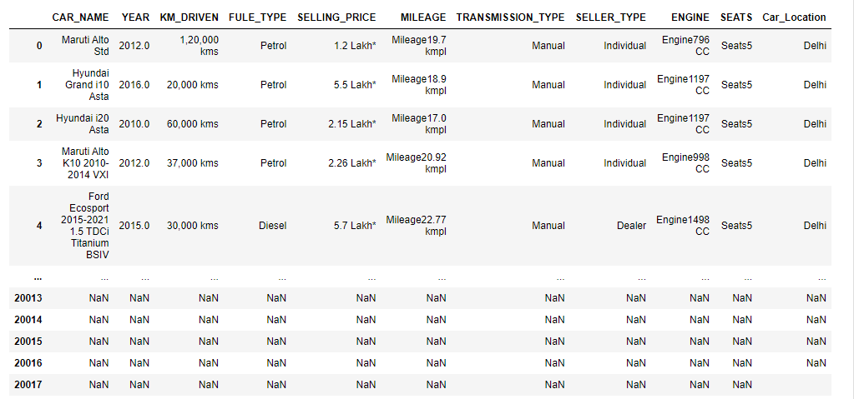
Data set details
The Dataset Contains contains 11 columns and more than 20k rows.

Slide 4
Exploratory Data Analysis (EDA)

Slide 5
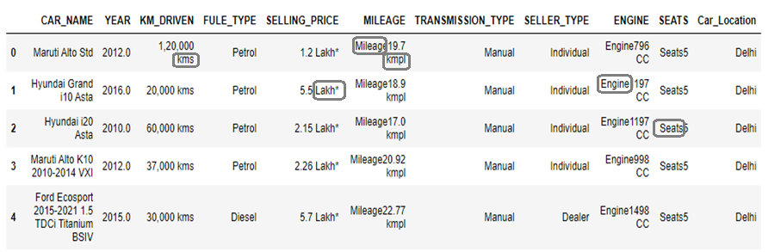
Data Cleaning
Inside columns, details like kms, Lakh*, Mileage kmpl, Engine CC and Seats words are removed for each row.

Slide 6
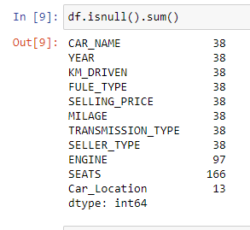
Checking the Missing values
A code is written to check if NaN values is present in the dataset or not with df.isnull().sum() function.

Slide 7
Handling of Missing values
If NaN values are found then drop the NaN from all the columns with df.dropna() function.

Slide 8
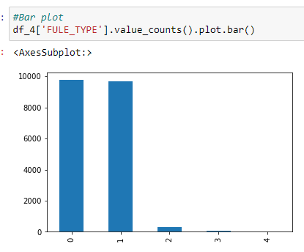
Data Visualization
Count of diesel and petrol is highest than CNG, LPG, Electric.

Slide 9
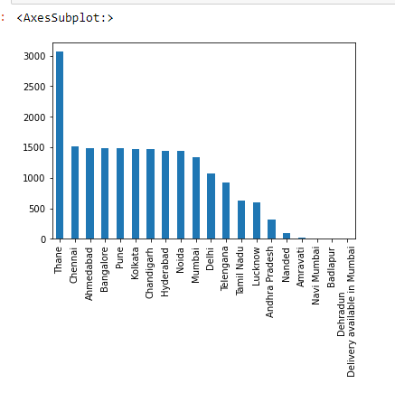
Data Visualization
In this diagram it shows Count of cars in Thane Location is highest.

Slide 10
Feature Engineering

Slide 11
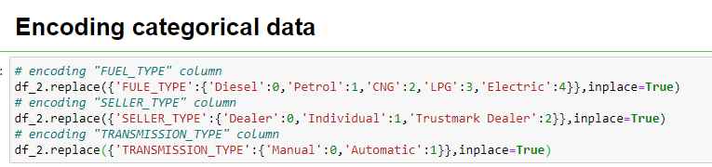
Substitution of categorical variable
To be able to use categorical data, we used label encoding.

Slide 12
Feature Selection

Slide 13
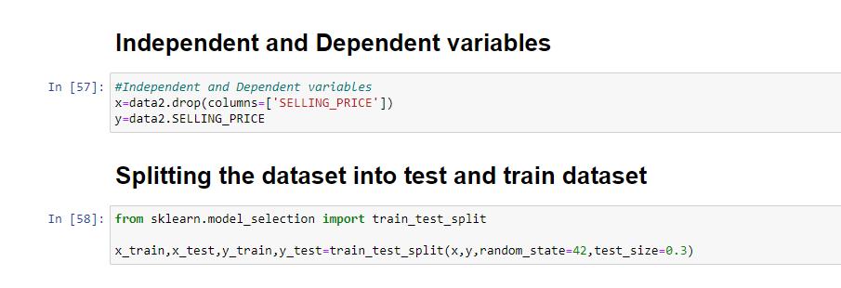
Train-test split
Train-test data splits were used. In this situation, we split the data into training and test sets, then fit models on the training set, evaluate and select them on the test set.

Slide 14
Model Building

Slide 15
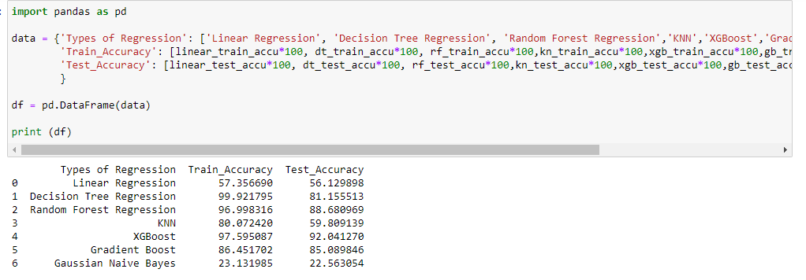
Model selection
Model selection is the process of choosing one among many models for a predictive modeling problem. After analyzing models we chose the XGBoost model as it is giving the highest accuracy.

Slide 16
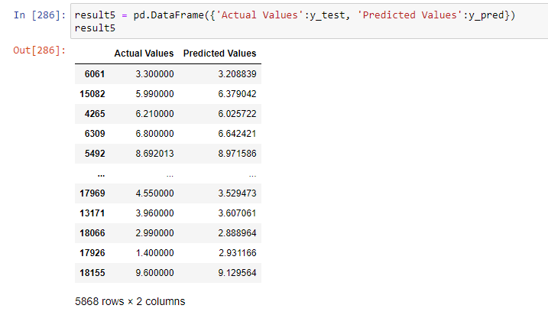
Model Predictions
Predictive modeling is a mathematical process used to predict future events or outcomes by analyzing patterns.

Slide 17

Save the Model
XGB model saved as .txt file for faster execution speed in future.

Slide 18
Model Deployment using Streamlit

Slide 19
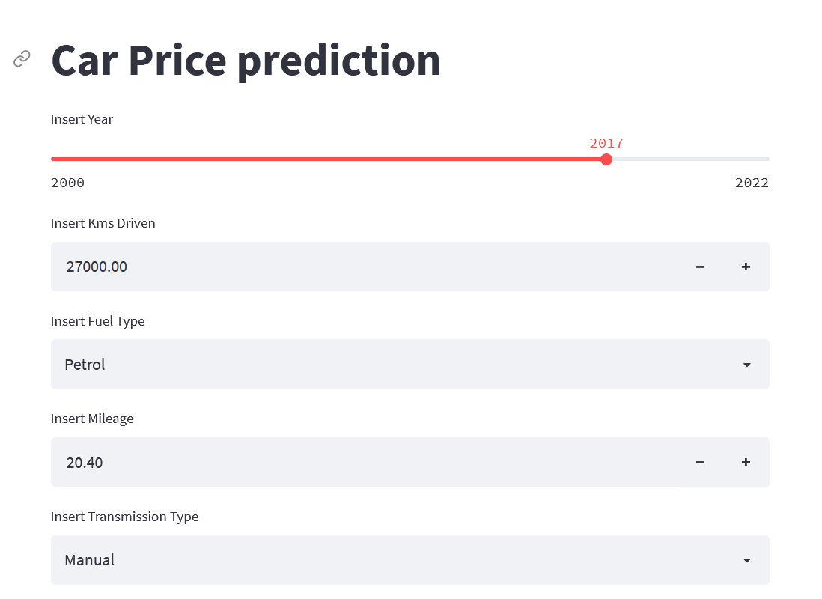
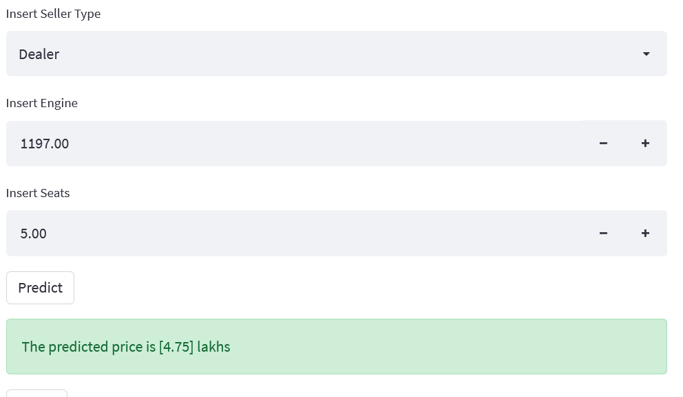
Model Deployment
We Have used Streamlit for Deployment of XGBoost Model
Here are the Screenshots :

Slide 20
Thank you

