Slide 1
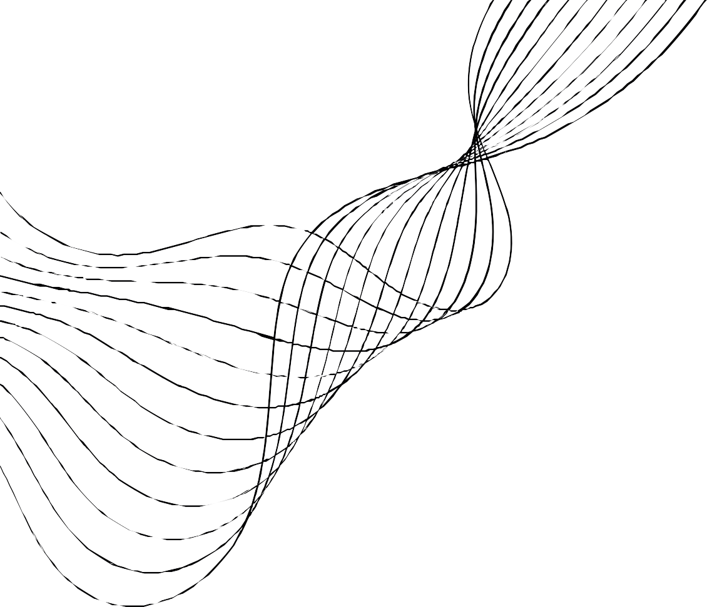
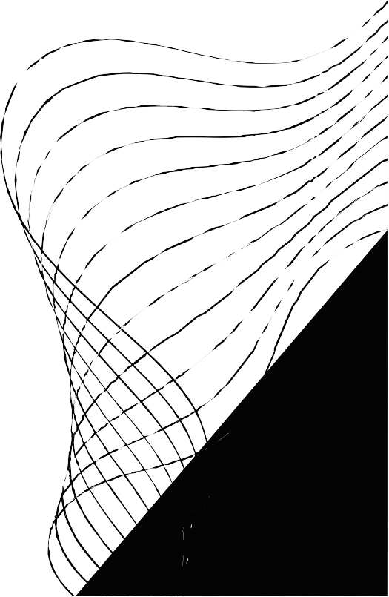
T E A M
SCB
13

Slide 2
HEART DISEASE PREDICTION
RANDOM FOREST ALGORITHM

Slide 3
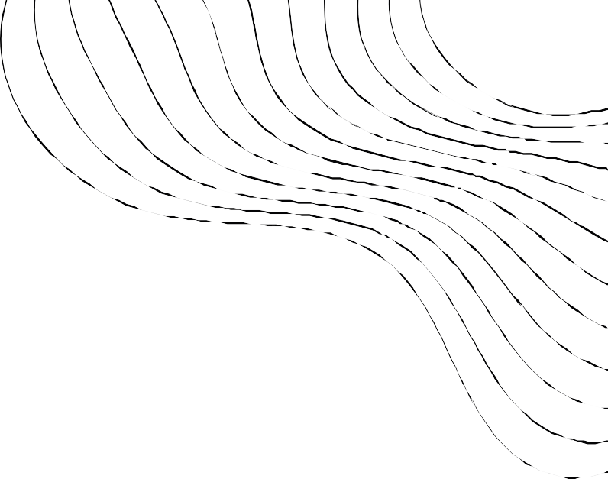
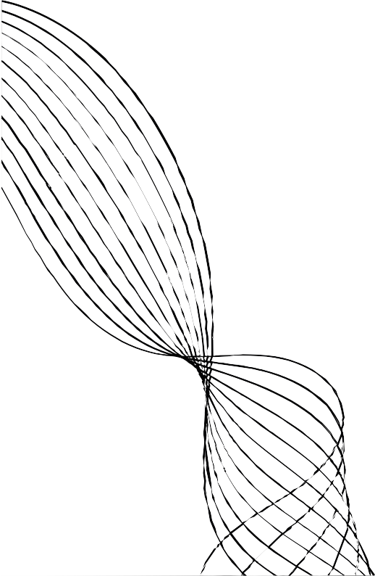
TECHNOLOGIES USED
MACHINE LEARNING
FLASK

Slide 4

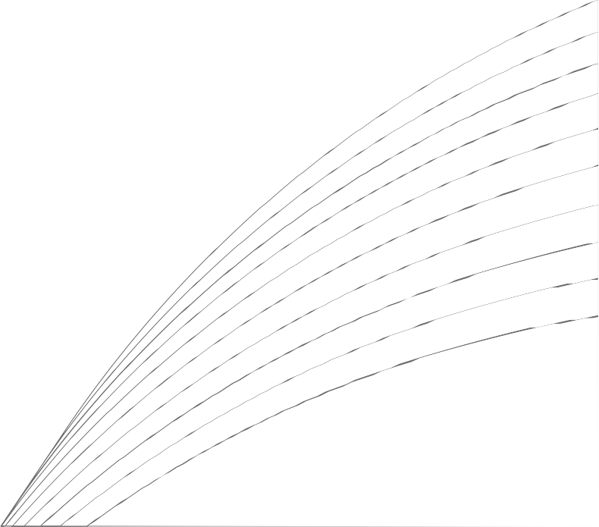
ML LIBRARIES
USED
02 03
01
04
SK LEARN
NUMPY
PANDAS
SEA BORN
MATPLOTLIB

Slide 5
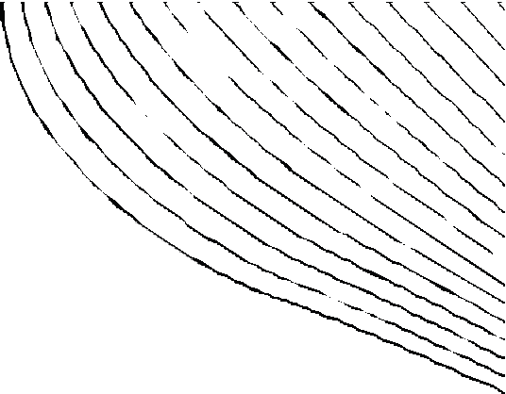
RANDOM FOREST ALGORITHM
01
02
03
04
05
06
07
PREDICTION OF COMBINATION OF
MULTIPLE DECISION TREES
COMPLETLY BEASED ON DECISIONS
IT' S AN SKLEARN ENSEMBLED METHOD
DECISION TREES SEEK TO FIND THE BEST SPLIT TO SUBSET THE DATA
IT WILL USE CONFUSION MATRIX TO FIND THE INCORRECT PREDICTIONS
REDUCED RISK OF OVERFITTING
MINIMAL ACCURACY IS GREATER THAN 90 % BY USING RANDOM FOREST

Slide 6





STRATEGIE
3 STEP PROCESS
TRAIN THE DATA
SPLIT THE PROCESS
TEST THE DATA

Slide 7
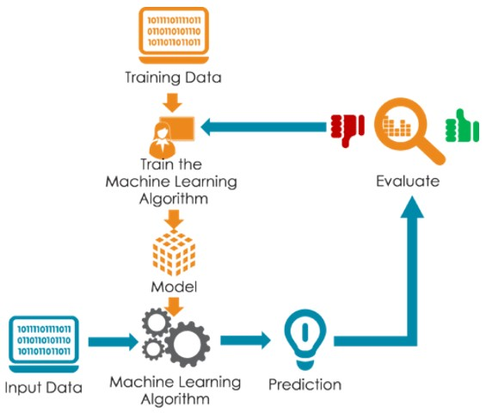
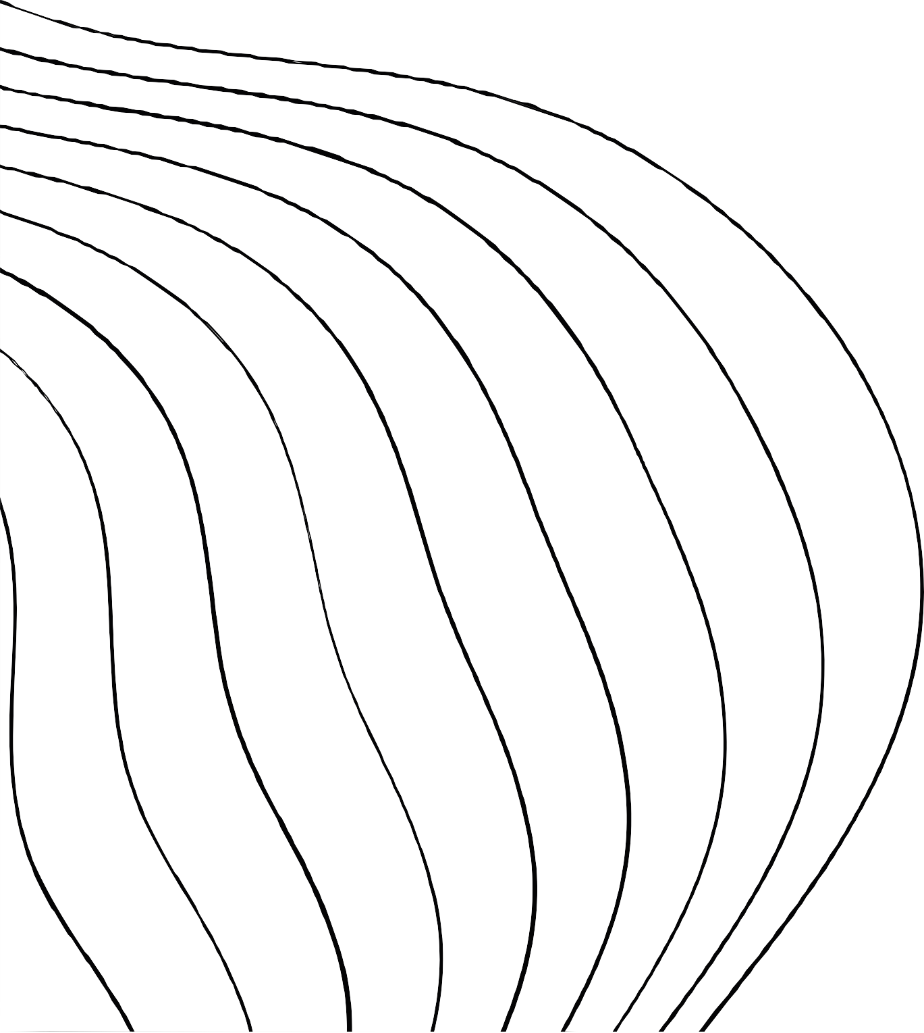
ALGORITHM

Slide 8

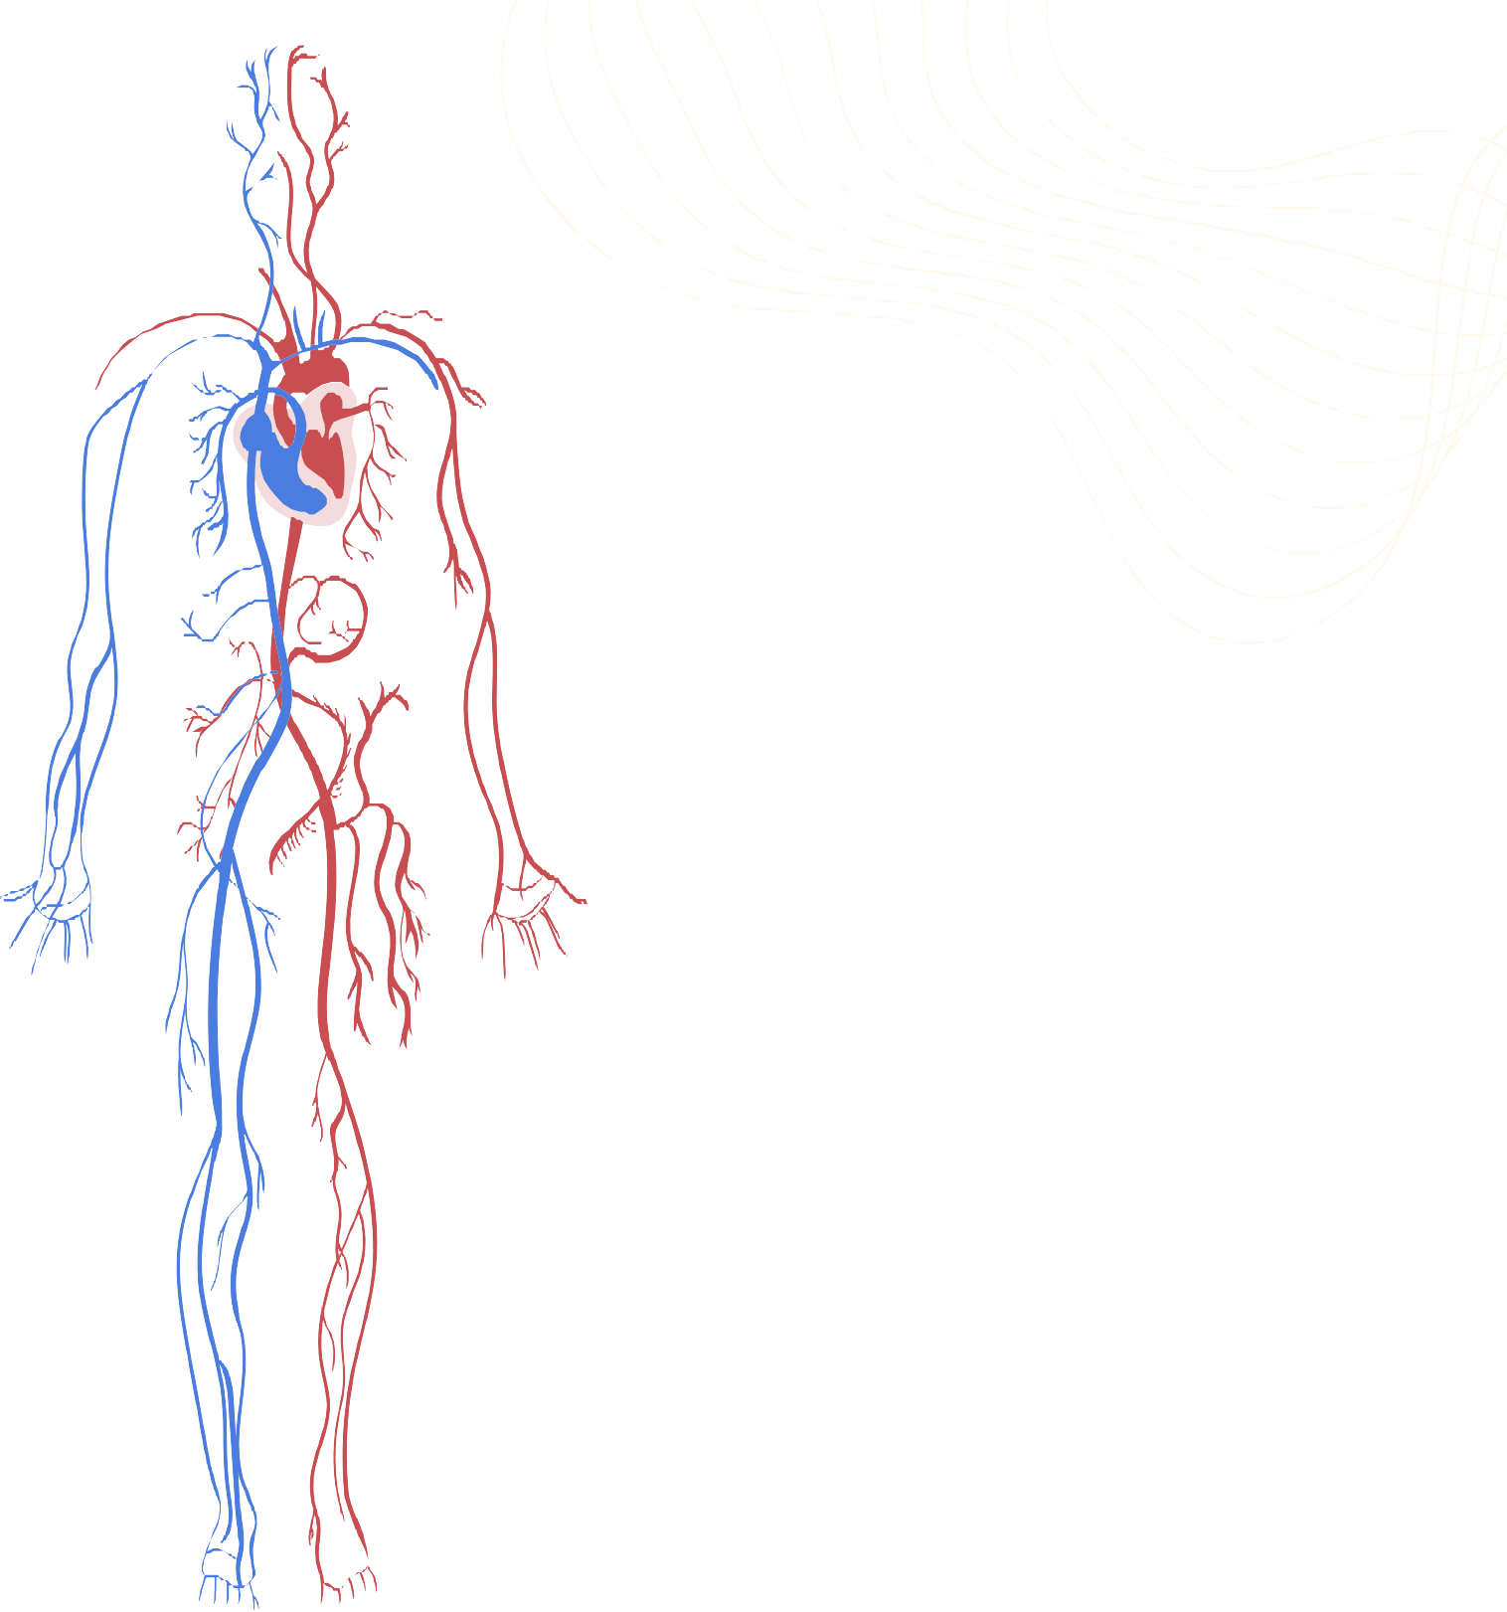
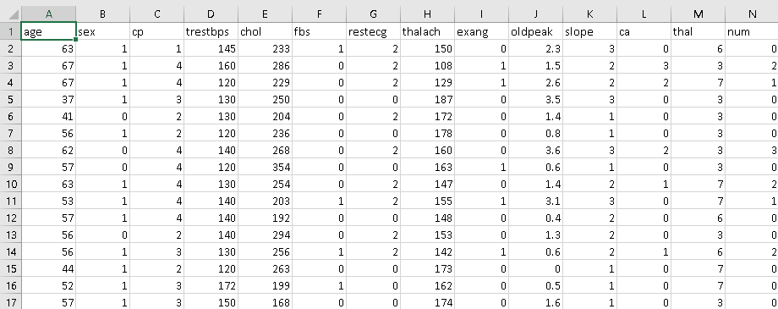
DATA SET

Slide 9

INTERFACE
heart disease prediction
AGE:
SEX:
ENTER THE VALUE
ENTER THE VALUE
CP:
TRESTBPS:
CHOL:
ENTER THE VALUE
PREDICTED RATE :
ENTER THE VALUE
ENTER THE VALUE
THALACH:
ENTER THE VALUE
CA:
ENTER THE VALUE

Slide 10

THANK YOU

