Slide 1




MISTRO
SERVICE ON STRESS GONE

Slide 2



JUSTIFICATION FOR SUSTAINABLE DEVELOPMENT GOAL
PRIMARY
SECONDARY
TERITARY
SAP080201 SAP080301 SAP080B01
SAP090101 SAP090202 SAP090501
SAP110101 SAP110301 SAP110A02

Slide 3


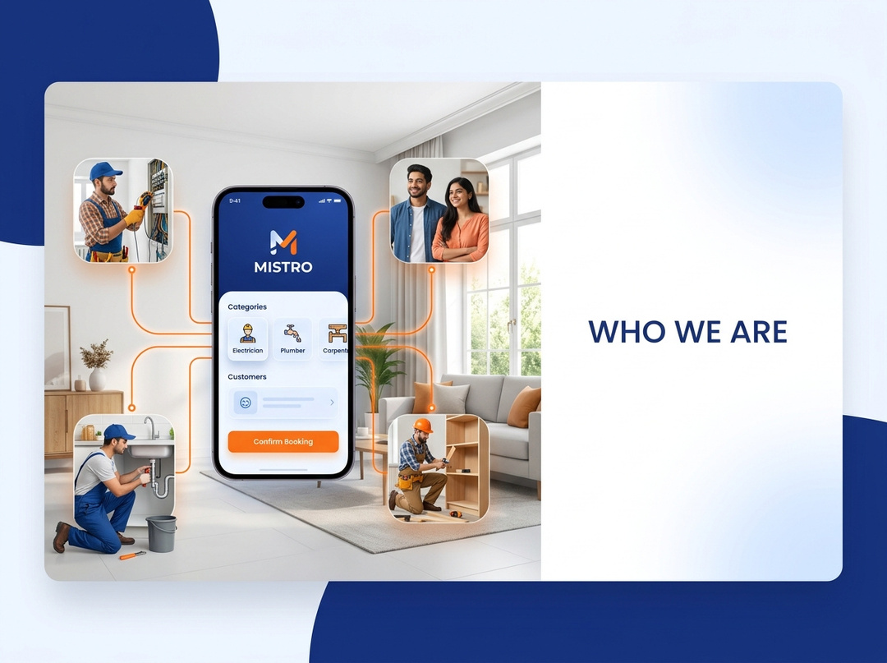


Why
WHO WE ARE ?
India's home services market is worth ₹5,07,000 crore (FY2025) — yet 99% of it runs on word-of-mouth, WhatsApp forwards, and unreliable middlemen. Skilled professionals earn below their potential while homeowners waste hours finding trustworthy help. The gap is massive. The timing is perfect.
What
Mistro is a mobile-first, two-sided marketplace — the Swiggy for home services — connecting homeowners with Aadhaar-verified electricians, plumbers, carpenters, painters, technicians, and cleaners. Book in 60 seconds. Track in real time. Pay securely in-app.
How
We match customers to professionals using skill, location, availability, and ratings. Professionals are KYC-verified with Aadhaar + trade license. Revenue comes from transaction commissions (15–20%), pro subscriptions (₹199/mo), featured listings (₹499/mo), and in-app advertising. Dual app ecosystem: Mistro(customers) + MistroCrew (professionals).

Slide 4
PROBLEM / OPPORTUNITY:
CONTEXT
THE PROBLEM
EXISTING ALTERNATIVES
CUSTOMERS
India's home services sector employs millions of skilled tradespeople — plumbers, electricians, carpenters — who wake up every morning not knowing if they'll get a single job. Meanwhile, homeowners facing a burst pipe at 9 PM have no reliable platform to find help fast.
There is no centralised, verified, and trust-first platform connecting skilled home service professionals with homeowners in India's Tier 1 and Tier 2 cities.
  Word-of-mouth recommendations → Inconsistent, limited reach
  Google searches → Time-consuming, no verification
  UrbanClap / Urban Company → Metro-only, premium-priced, employee model — not freelancer-first
  Fixee → No in-app transactions, unverified listings
  Homeowners & apartment renters seeking reliable, verified home services
  Freelance electricians, plumbers, carpenters, painters, and repair technicians seeking steady work
  Irregular, unpredictable income for 7.7M+ gig workers
  Customers paying inflated prices to unverified strangers
  No accountability, no recourse, no transparency

Slide 5
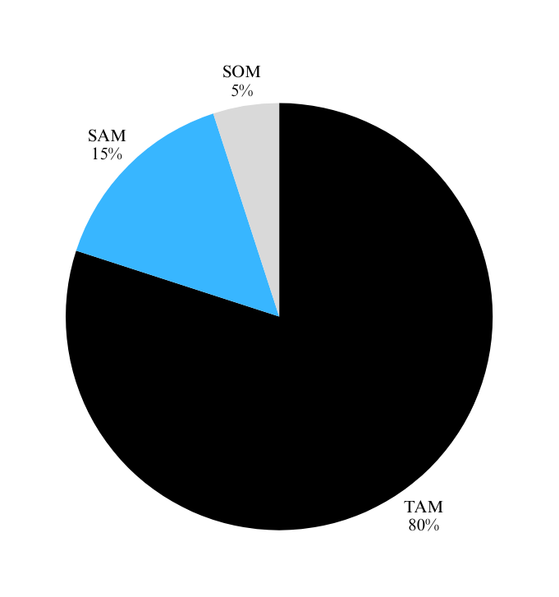
MARKET SIZE
Total Addressable Market (TAM)
  Total population in Tamil Nadu: 7.5 crore (2025 est.)
  50% households require home services annually
  TAM = 7.5 crore × 50%
  TAM = 3.7 crore households
Serviceable Available Market (SAM)
  Urban population ≈ 40% of Tamil Nadu
  7.5 crore × 40% = 3 crore
  ~25% actively seek professional services
  SAM = 3 crore × 25%
  SAM = 75 lakh households
Serviceable Obtainable Market (SOM)
  Target cities: Chennai, Coimbatore, Madurai, Trichy, Salem
  Initial capture: ~25% of SAM
  SOM = 75 lakh × 25%
  SOM = 18–19 lakh households

Slide 6
CUSTOMER PERSONAL
Persona B: Service Professional
Persona A: Homeowner / Renter
Age: 25–45 | Electrician / Plumber
Goals:
Steady income
More job opportunities
Build reputation
Frustrations:
Irregular bookings
No job/payment management system
Income instability
Ethos:
More jobs = more income | Better service = higher pay
Bio :
Skilled worker seeking consistent jobs & better earning opportunities
Quote:
“I have the skills. I just need the right platform.”
Age: 25–45 | Urban
Goals:
Fast & reliable service
Verified professionals
Fair pricing
Frustrations:
Time wasted searching (2–3 hrs)
Fear of overcharging
No post-service accountability
Ethos:
Willing to pay more for speed, trust & convenience
Quote:
“I need someone reliable — today, not next week.”

Slide 7
SOLUTION
OUR SOLUTION : MISTRO
The details of our offering
  Simplified Access — One app to browse, compare, and book any home service in seconds
  Efficient Scheduling — Real-time availability, flexible time slots, emergency same-day bookings
  Direct Communication — In-app chat and call with your assigned professional before they arrive
  Trust & Transparency — Aadhaar-verified profiles, trade license checks, photo ID, dual reviews
  Enhanced Management — Professionals manage jobs, track earnings, and build reputation — all in one place
BENEFITS OF OUR SOLUTION
  Efficiency & Convenience — From problem to booked professional in under 60 seconds
  Time-Saving — No more hours spent calling, comparing, and waiting for callbacks
  Improved Communication — Direct, transparent, in-app interaction before and during service
  Enhanced Trust — Every professional is government ID-verified before appearing on the platform
  Organised Scheduling — Real-time booking management for both customers and professionals

Slide 8
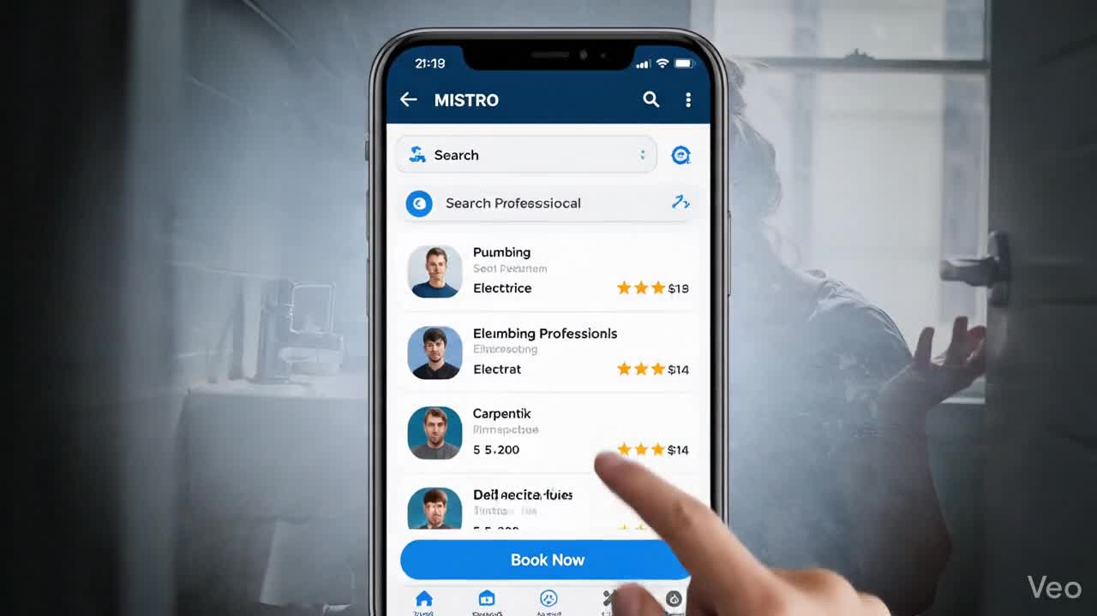

Slide 9
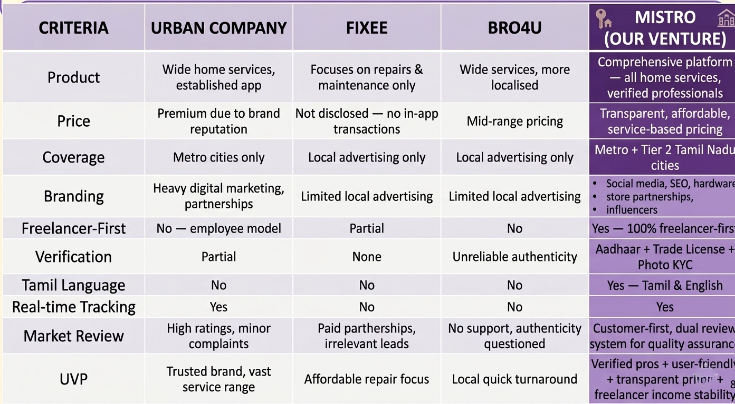
COMPETITORS

Slide 10
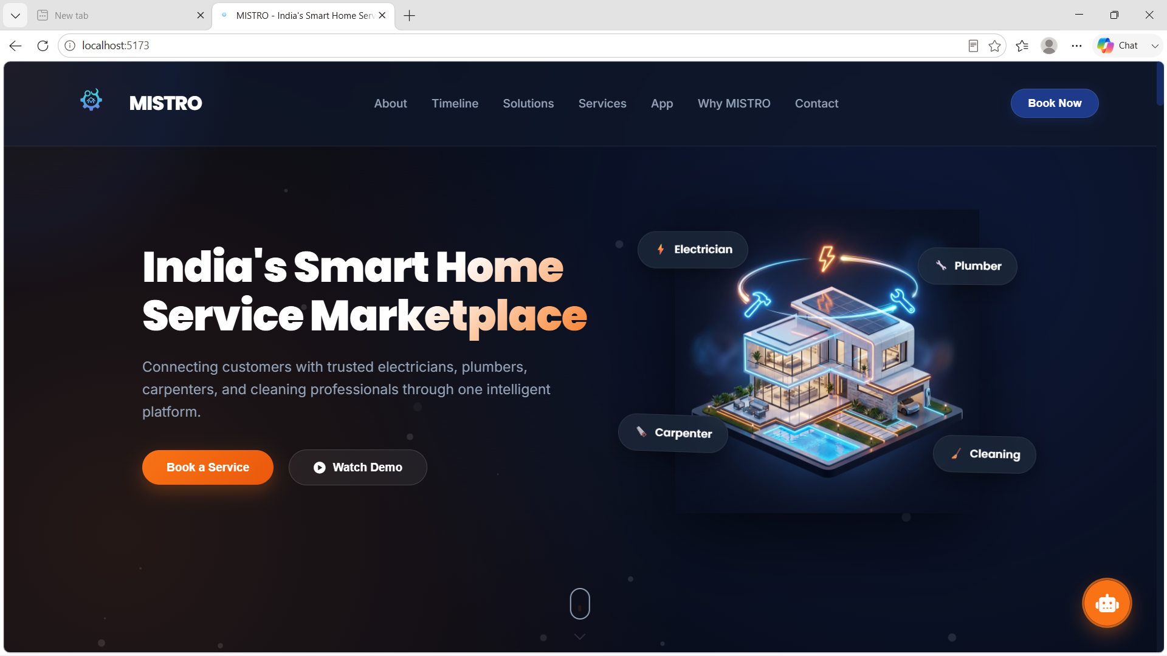
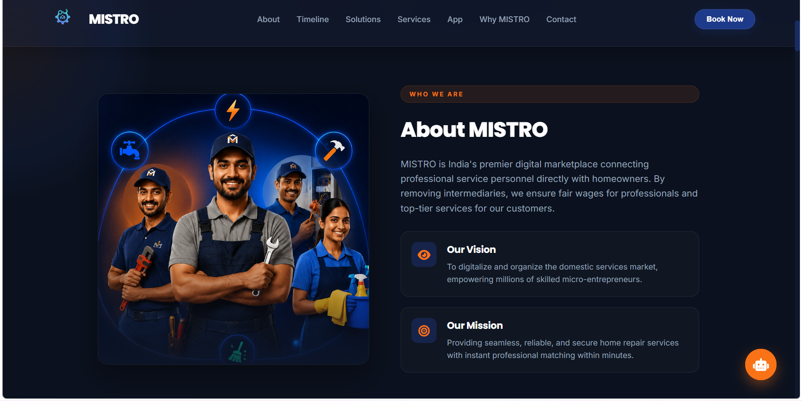
PROTOTYPE OVERVIEW
MISTRO

Slide 11
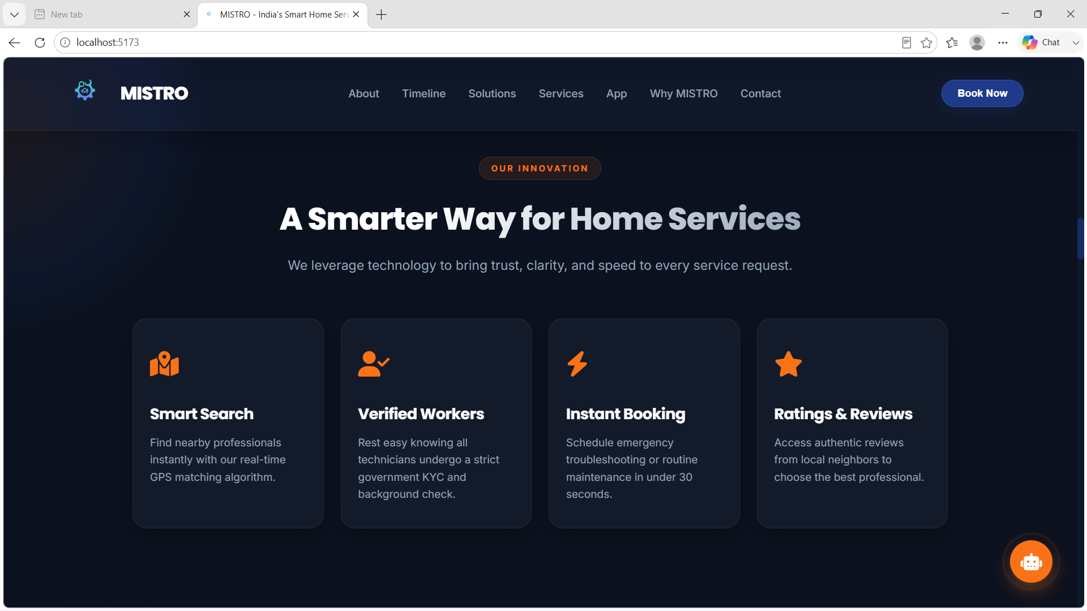
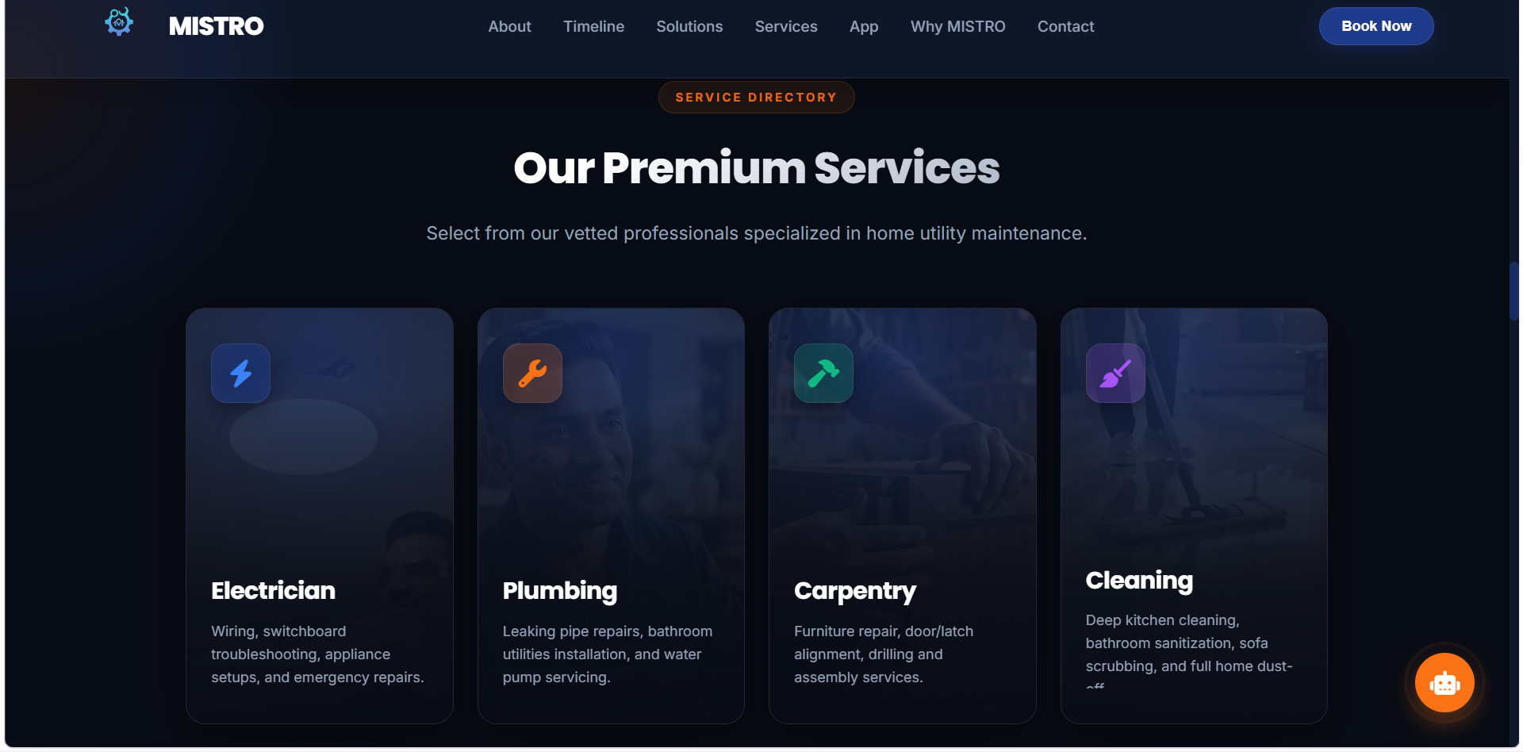
PROTOTYPE

Slide 12
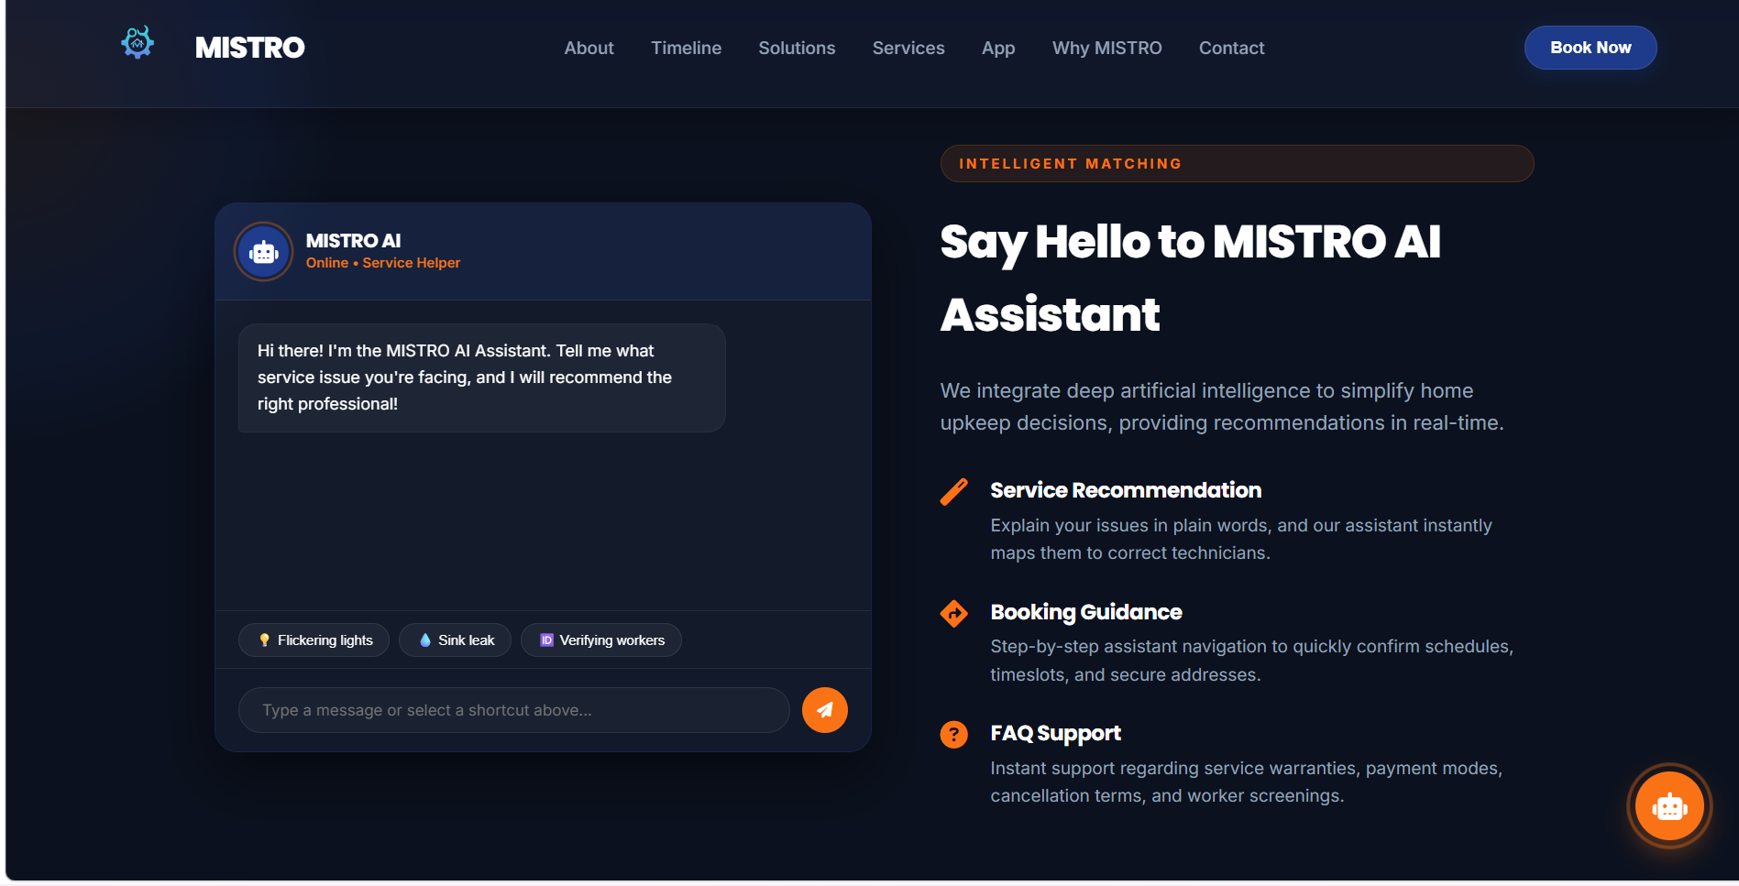
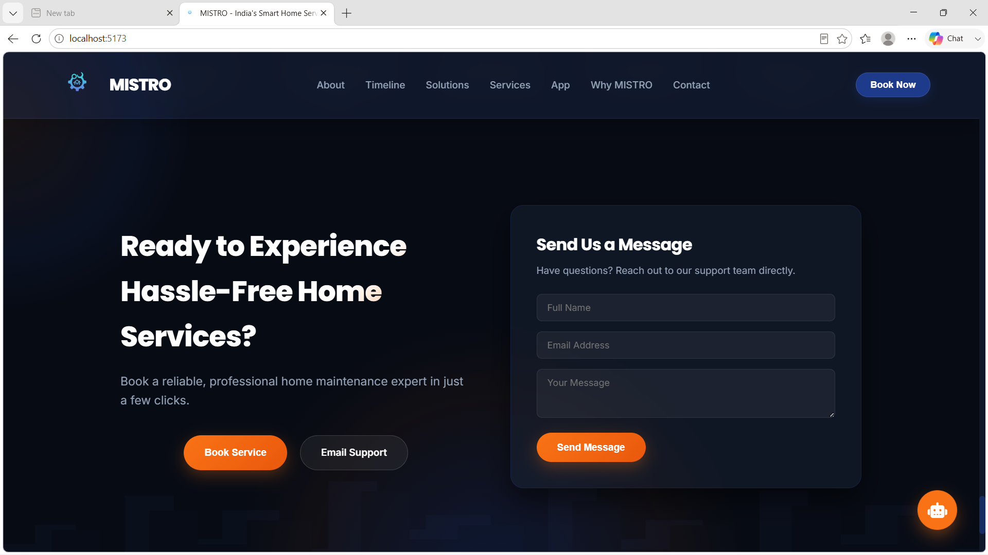
PROTOTYPE OVERVIEW

Slide 13
SALES PLAN
TARGET MARKET : 8,00,000
LEADS : 3,00,000
OPPURTUNITIES : 80,000
CUSTOMERS : 40,000
Sustainable Agreements

Slide 14
SALES PLAN
Target Number
Channel
EST Lead
Conversion Cost
Urban Homeowners
5,00,000
Social media ads, Google SEO, local business partnerships, digital campaigns
1,50,000
Moderate — digital marketing focused
Rural Homeowners
3,00,000
WhatsApp marketing, community outreach, local stores, community events
50,000
Low-moderate — community-based
Service Providers (Urban + Rural)
40,000
Trade community outreach, ITI/Polytechnic partnerships, referral incentives
10,000
Low — referral and local partnership focused

Slide 15



GO-TO-MARKET STRATEGY
SOCIAL MEDIA PRESENCE
Establish active, content-rich profiles on Instagram, YouTube, Facebook, LinkedIn, and X (Twitter). Content strategy: Home maintenance tips, before-after service stories, professional spotlights, customer testimonials, quick-fix reels
@mistro_india
@mistro_india
Mistro.india@gmail.com

Slide 16

GO-TO-MARKET STRATEGY
GOAL: 20,000 App Downloads Across Tamil Nadu in Year 1
Digital Marketing
Local Outreach
Instagram & YouTube reels (demo of quick booking)
Google Ads (location-based search)
Influencer collaborations (home & lifestyle creators)
WhatsApp community marketing
Local ads (newspapers, auto branding)
Apartment & housing society demos
Partnerships
Awareness Strategy
Hardware stores (QR code for app download)
ITI & Polytechnic institutes (professional onboarding)
Tool & paint brands (co-promotion)
First-booking discounts
Customer testimonials & success stories
Before–after service content

Slide 17

  Growth Path Steps
Each step on this path represents progress from idea creation toward sustainable lean startup growth.
LAUNCH
OPTIMISE
STEP
STEP
01
  MVP launch in 1–2 cities
  Initial user acquisition
  Feedback collection
04
  Improve retention
  Introduce referral programs
  Strengthen revenue model
VALIDATE
SCALE
STEP
STEP
02
  Improve matching & UX
  Build trust (reviews, verification)
  Optimize onboarding
05
  Expand across Tamil Nadu
  Enter new states
  Add more service categories
EXPAND
STEP
03
  Scale to major Tamil Nadu cities
  Increase marketing campaigns
  Partner with local businesses

Slide 18
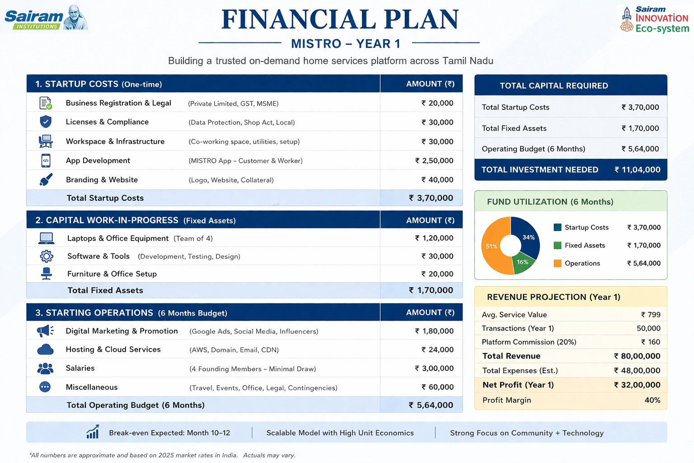
FINANCIAL PLAN

Slide 19
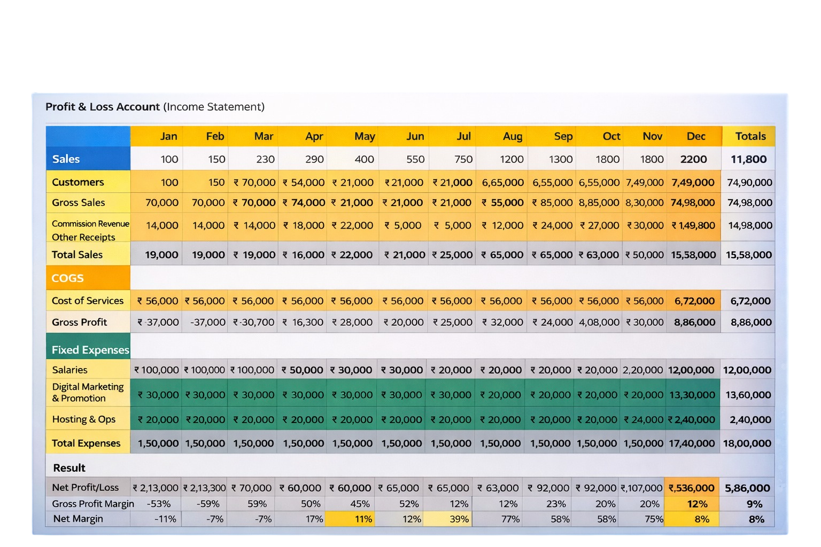
FORECAST OF P&L

Slide 20
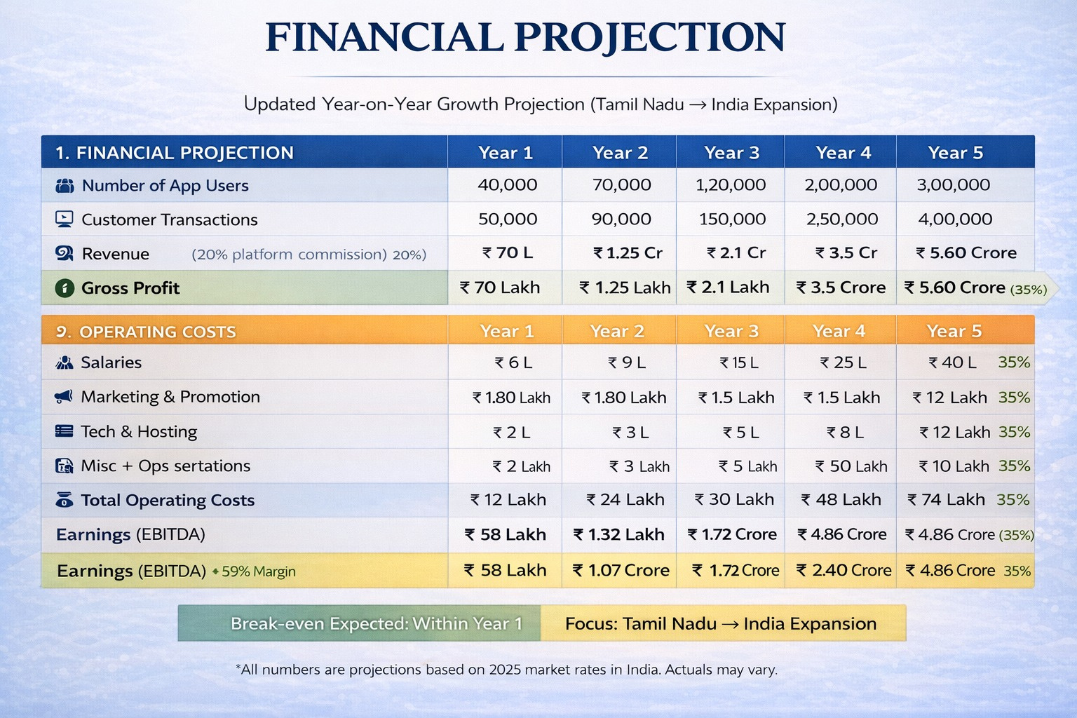
FINANCIAL PROJECTION

Slide 21
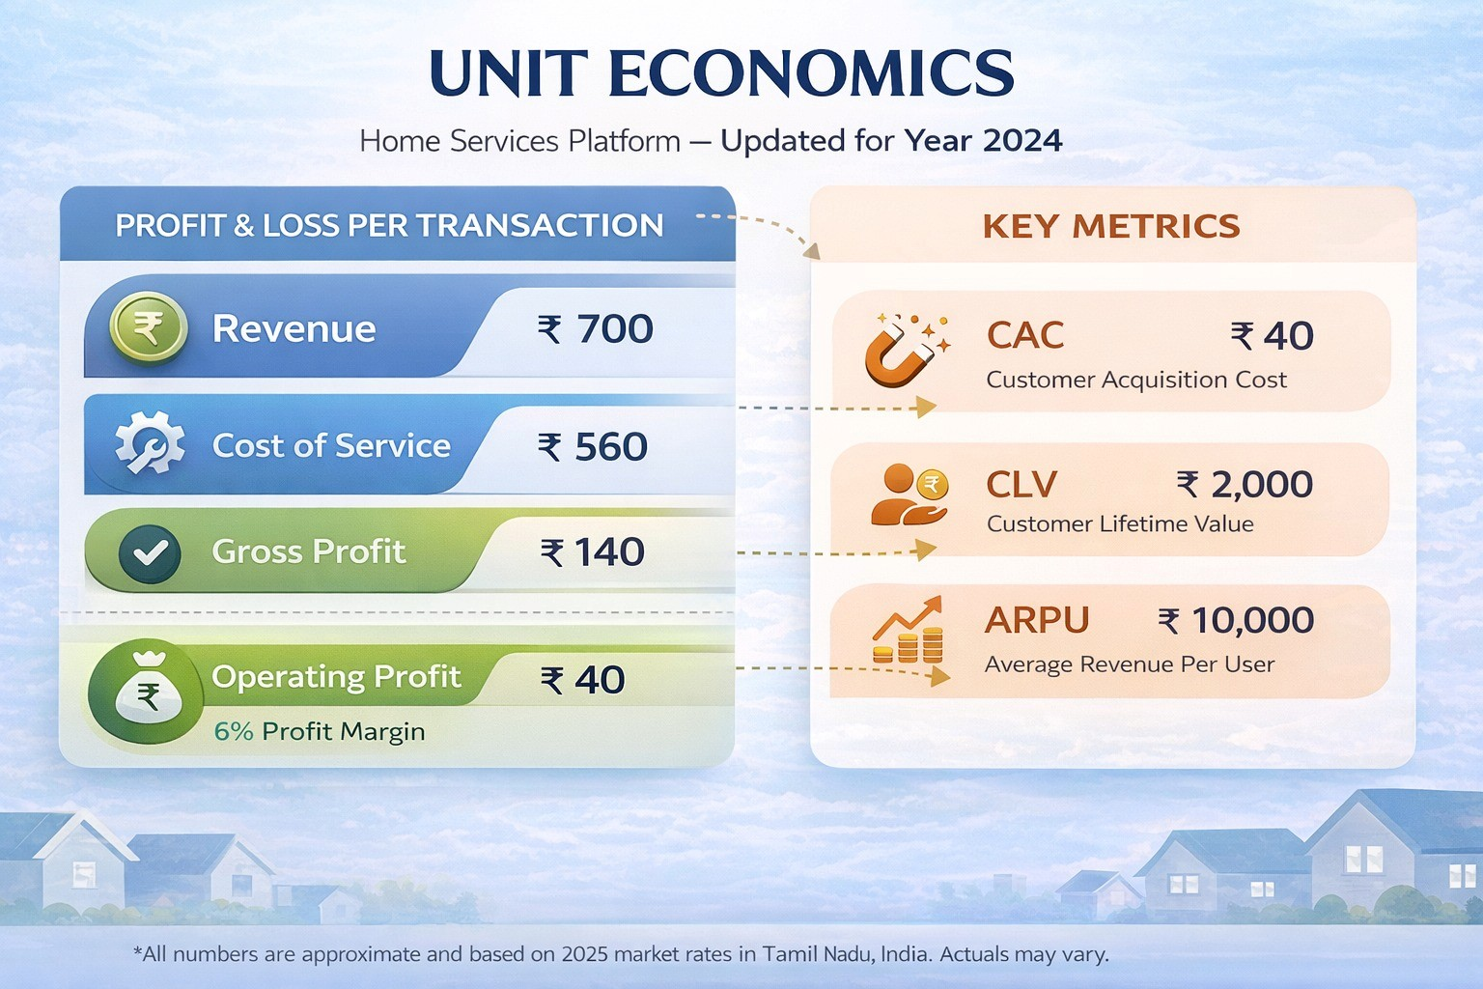
UNIT ECONOMICS

Slide 22
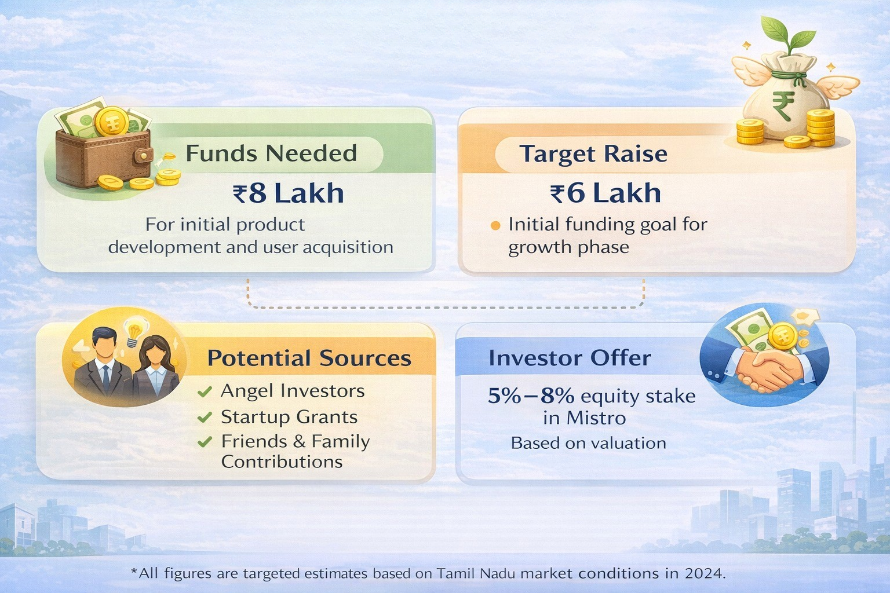
FUNDING PLAN

Slide 23
Thank You!

