Slide 1
MISTRO
SERVICE ON , STRESS GONE

Slide 2

INTRO
In many communities, skilled workers such as plumbers, electricians, and carpenters rely on word-of-mouth or local contacts to find jobs. This often leads to irregular work opportunities and limited visibility for their skills. At the same time, customers find it difficult to locate reliable and nearby service providers quickly. A digital platform can help bridge this gap by connecting skilled workers and customers in a simple and efficient way.

Slide 3
PROBLEM STATEMENT
Many skilled home repair workers such as plumbers, electricians, and carpenters face irregular job opportunities, which leads to unstable income. At the same time, customers often struggle to find reliable and nearby professionals for their service needs. Existing platforms are not always accessible or suitable for local workers.

Slide 4
project objective
Develop a web platform connecting customers with skilled workers.
Make it easy for users to search and find nearby service providers.
Provide better job opportunities for local workers.
Create a simple and user-friendly interface.
Improve accessibility and reliability of local services.

Slide 5

PROPOSED SOLUTION
Develop a web-based platform connecting customers and skilled workers.
Allow workers to register their skills and services on the website.
Enable customers to search for nearby professionals easily.
Provide worker profiles with service details.
Make the process of finding services faster and more convenient.

Slide 6

SYSTEM FEATURES
Worker Registration – Workers can create profiles and list their skills.
Service Search – Customers can find services based on their needs.
Worker Profiles – Users can view service details and information.
User-Friendly Interface – Simple and easy navigation for all users.
Quick Access to Services – Helps customers find professionals faster.

Slide 7
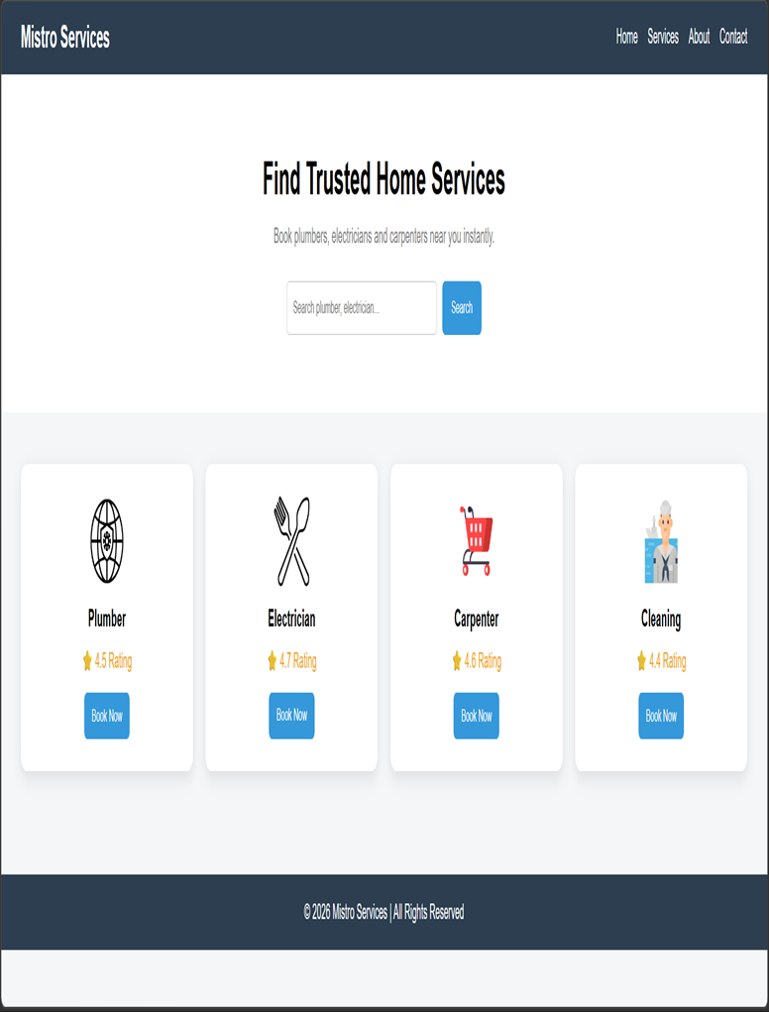
THE UI
The website is designed with a clean and simple user interface.
The home page allows users to explore available services easily.
The service listing page shows different skilled workers and their services.
The worker profile page displays service details and information.
The design focuses on easy navigation and user convenience

Slide 8
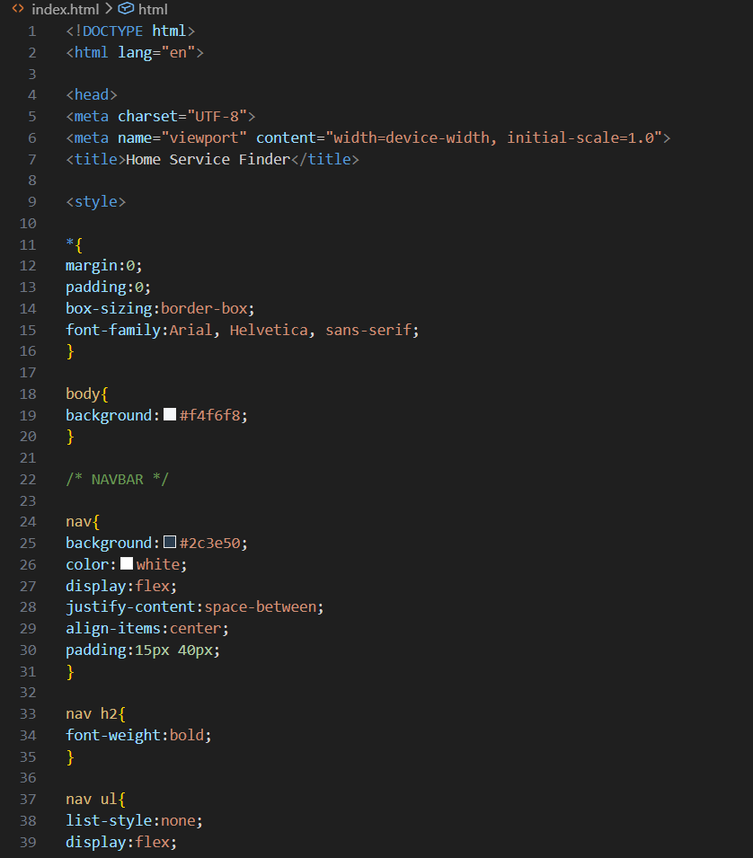
TOOLS USED
HTML – Used to create the structure of the website.
CSS – Used for styling and layout design.
JavaScript – Used for interactive elements.
Visual Studio Code – Used as the development environment.
Web Development Concepts – Used to design and implement the platform.

Slide 9

EXPECTED IMPACT
Helps skilled workers get more job opportunities.
Makes it easier for customers to find reliable service providers.
Saves time by quickly connecting customers and workers.
Supports community development and employment.

Slide 10
Market overview
Sno | Categories | Numbers | Current Problem | OPPURTUNITY
1. | Urban homes | 10 cr+ | Need frequent repair services | Large scope for digital platforms
2. | Skilled Workers | 2 cr+ | Irregular job opportunities | Online platforms simplify access
3. | Home Service Market | 50,000 cr | Mostly unorganized sector | Platform can increase job opportunities
4. | Internet Users | 80 cr | Hard to find trusted workers | High potential for online service marketplaces
Opportunity to build
Fully inclusive market
Total addressable market
Freedom to invent
Selectively inclusive market
Serviceable available market

Slide 11

Thank you
MITHILESH M
SANJAY S
KISHORE KUMAR S

