Slide 1
Client-Side Machine Learning with Tensorflow.js
Mohammad M. Khajah
Systems & Software Development Department
Kuwait Institute for Scientific Research

Slide 2
Artificial Intelligence (AI)
Automating tasks that require intelligence: recognizing speech, faces, objects in photos, playing games, etc.
Symbolic
Data-Driven
Explicit A->B rules
Expert systems:
If patient has symptom X -> Y
If Y -> order medication Z
Learns patterns in data
Neural networks, support vector machines, random forests, reinforcement learning, etc.
Machine Learning
Natural representation
Incapable of learning
Unable to deal with uncertainty
hard to know what the systems knows
Can learn new things or polices
Can handle uncertainty
Can require large amounts of data
Notes:
Big Data Analytics is the process of making sense of large sets of data.
You start with a large, noisy observations and you try to extract the fundamental insights from them.
Having Big Data alone is not enough.

Slide 3
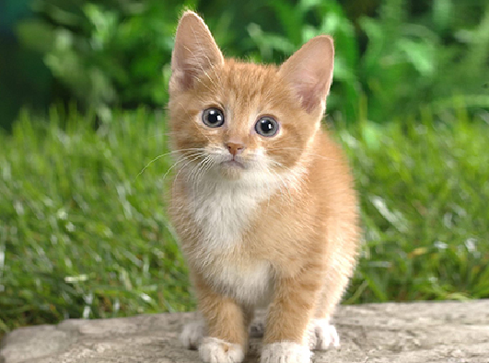
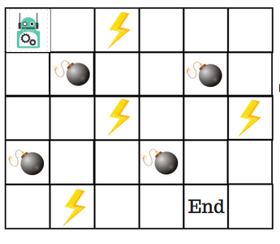
Types of Machine Learning
ML
Model
Supervised ML: data takes the form of (input, output) and the task is to predict the output given the input
Unsupervised ML: inputs without outputs, task is to find patterns or clusters in the data
Reinforcement Learning (RL): no input or output is given, have to learn a model of environment and how to optimally act in it
cat

Slide 4
Neural Networks

Slide 5
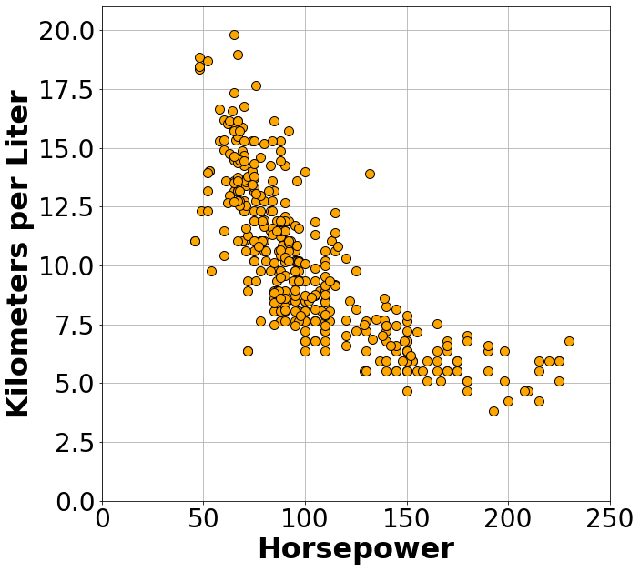
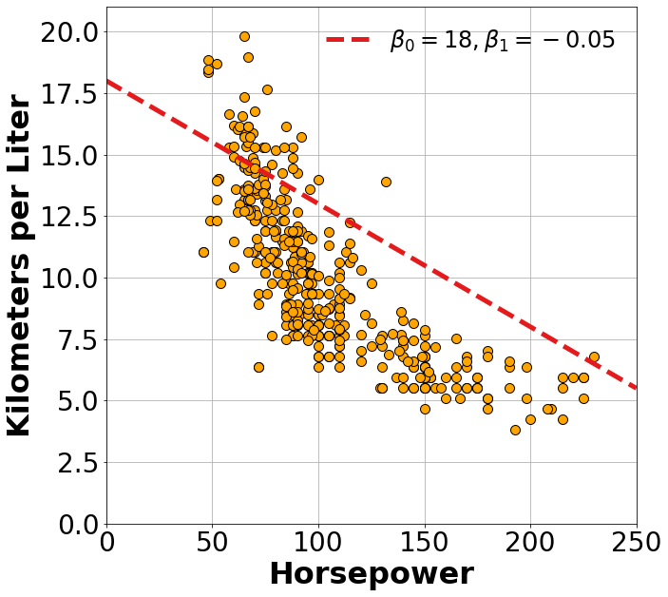
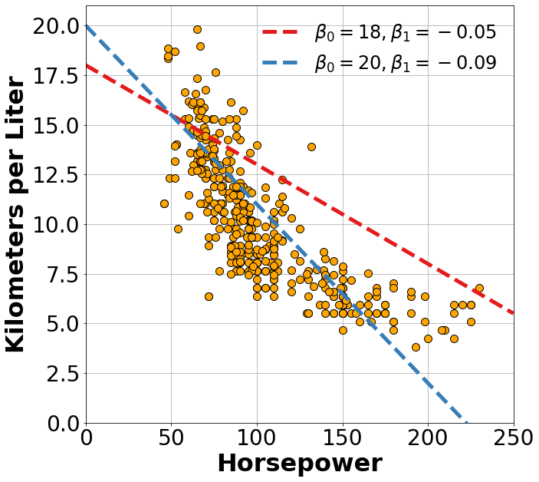
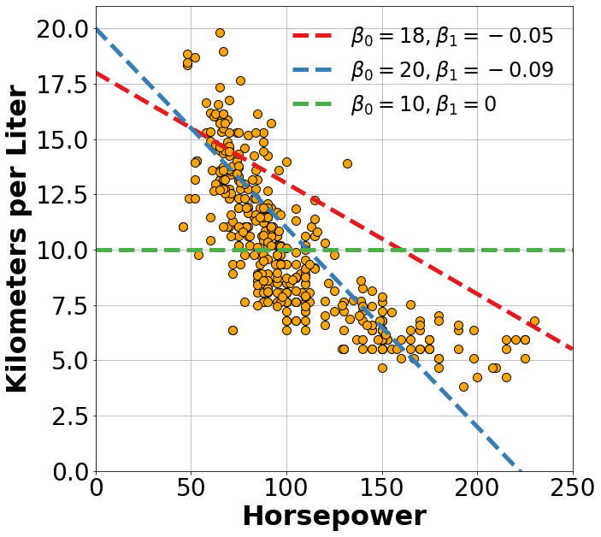
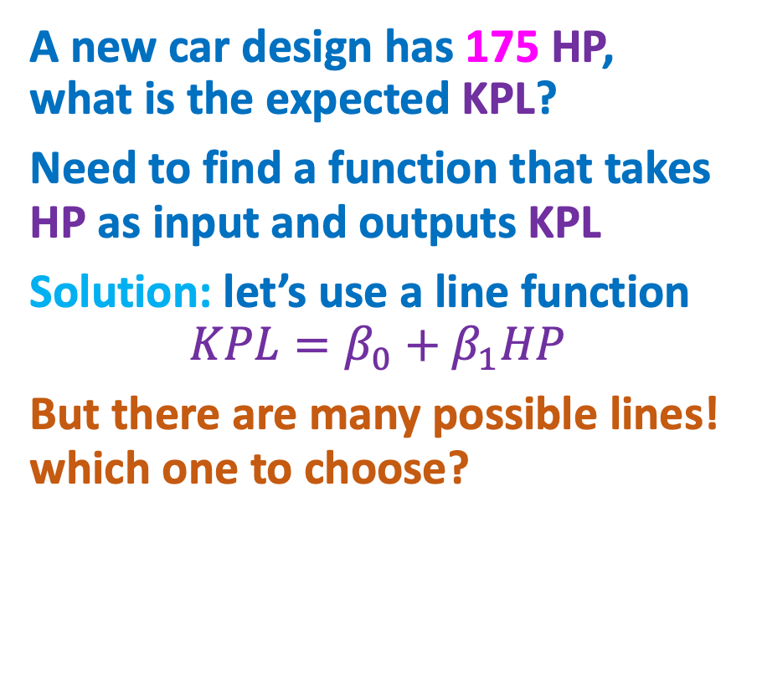
A Linear Neuron
A new car design has 175 HP, what is the expected KPL?
Need to find a function that takes HP as input and outputs KPL
Solution: let’s use a line function
$$KPL=β_{0}+β_{1}HP$$
But there are many possible lines! which one to choose?
Need an Objective Function

Slide 6
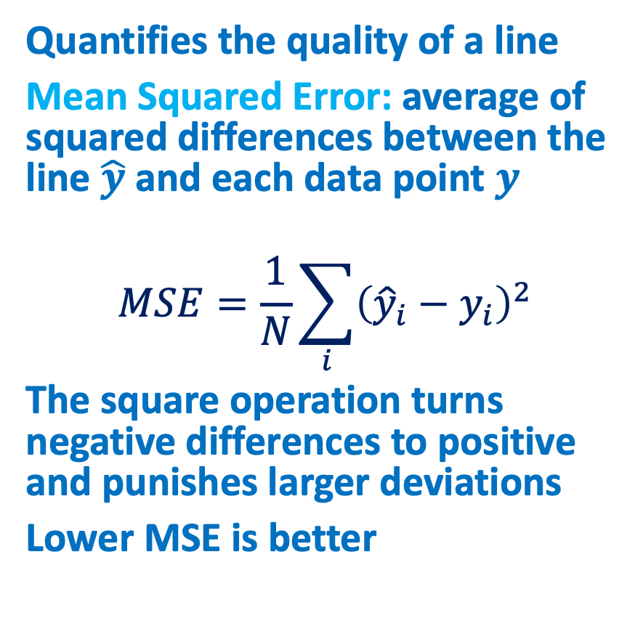
Objective Function
Quantifies the quality of a line
Mean Squared Error: average of squared differences between the line $\hat{y}$ and each data point $y$
$$MSE=\frac{1}{N}\sum_{i}{{\left({\hat{y}}_{i}−y_{i}\right)}^{2}}$$
The square operation turns negative differences to positive and punishes larger deviations
Lower MSE is better

Slide 7
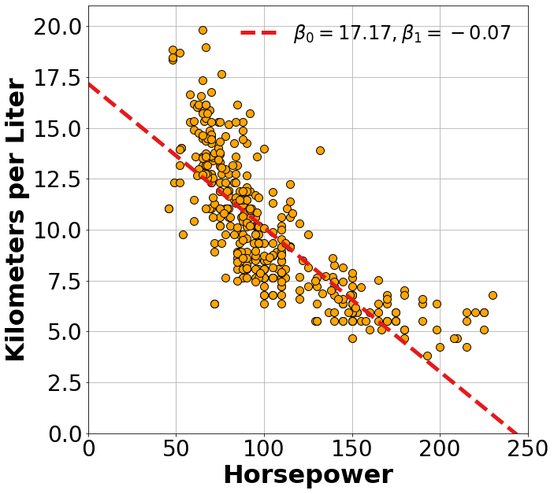
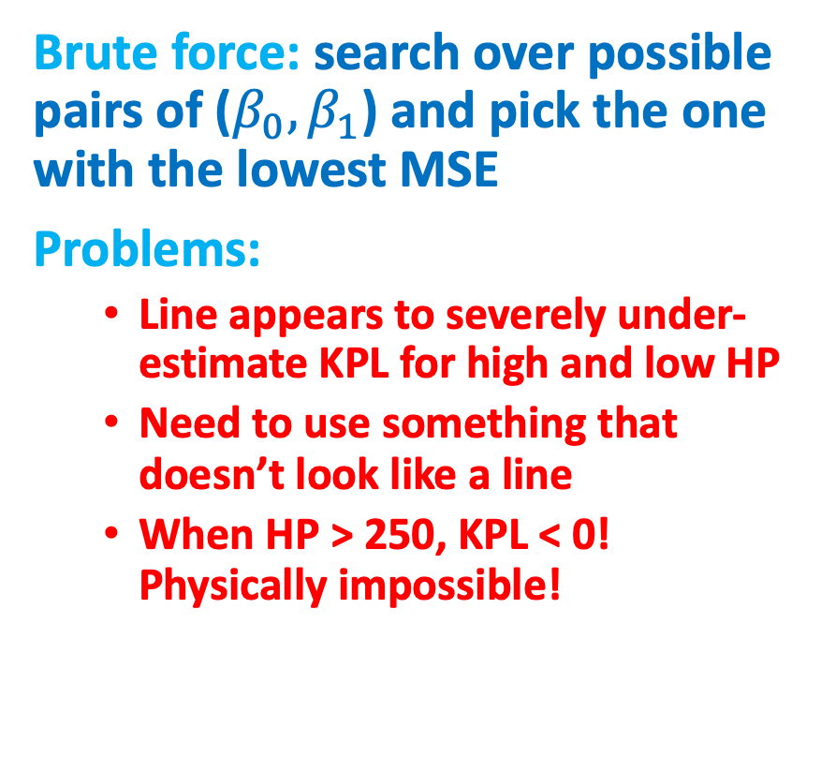
Putting it Together
Brute force: search over possible pairs of ($β_{0},β_{1}$) and pick the one with the lowest MSE
Problems:
Line appears to severely under-estimate KPL for high and low HP
Need to use something that doesn’t look like a line
When HP > 250, KPL < 0! Physically impossible!

Slide 8
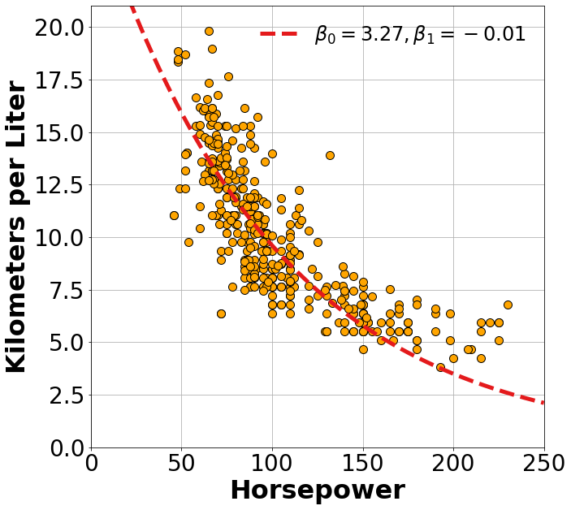
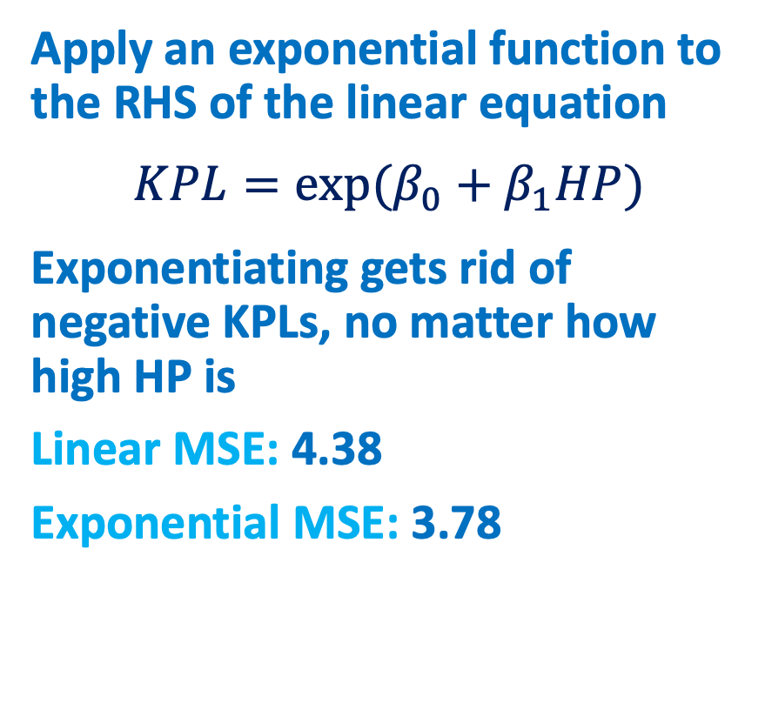
Exponential Neuron
Apply an exponential function to the RHS of the linear equation
$$KPL=exp⁡(β_{0}+β_{1}HP)$$
Exponentiating gets rid of negative KPLs, no matter how high HP is
Linear MSE: 4.38
Exponential MSE: 3.78

Slide 9
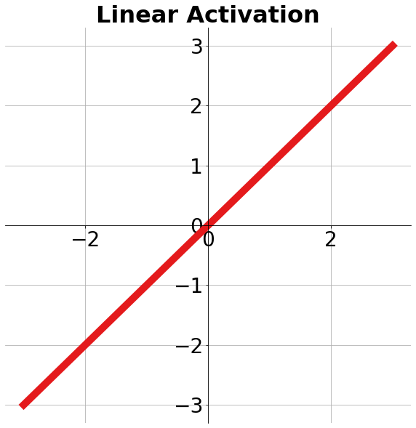
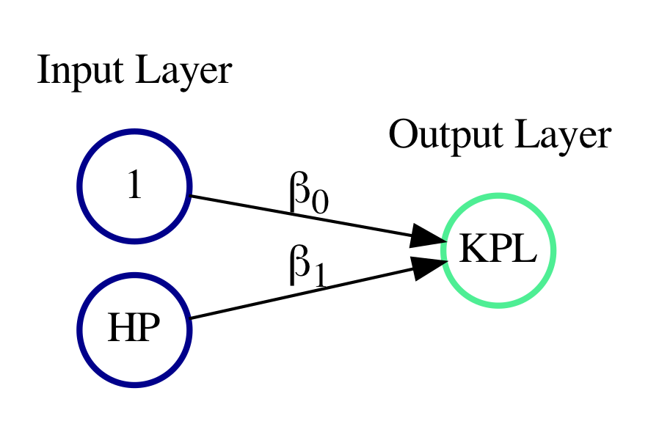
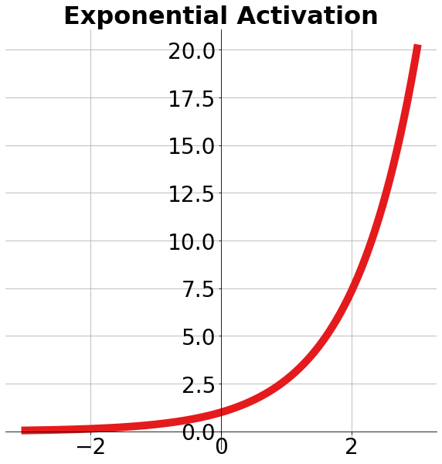
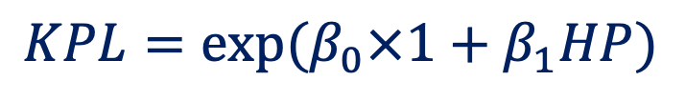
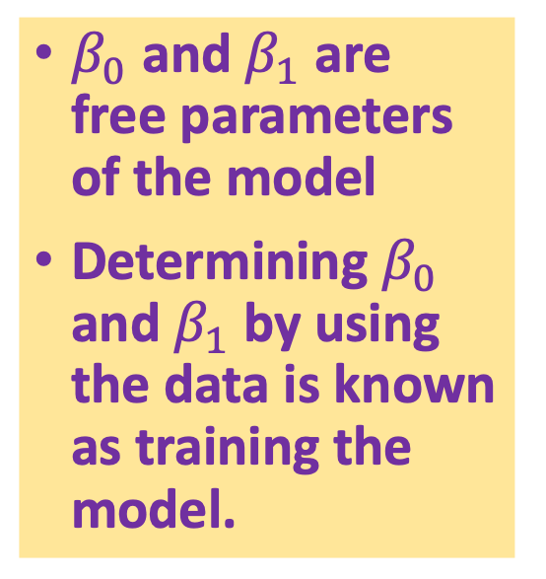
Recap
$β_{0}$ and $β_{1}$ are free parameters of the model
Determining $β_{0}$ and $β_{1}$ by using the data is known as training the model.
Bias
Input
$$KPL=exp⁡(β_{0}×1+β_{1}HP)$$
Activation

Slide 10
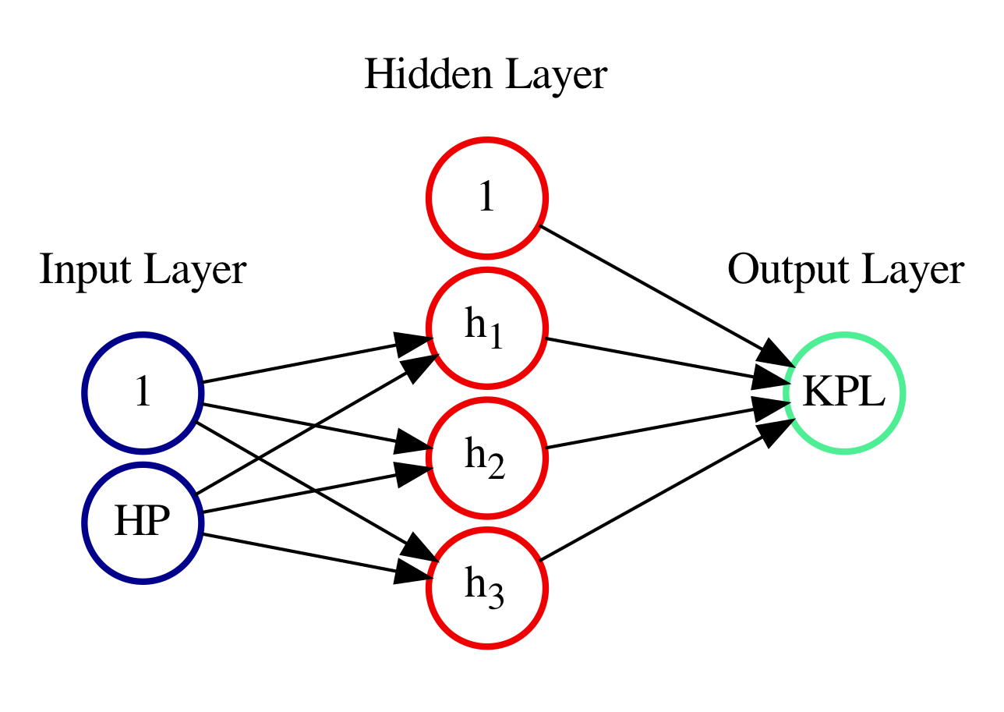
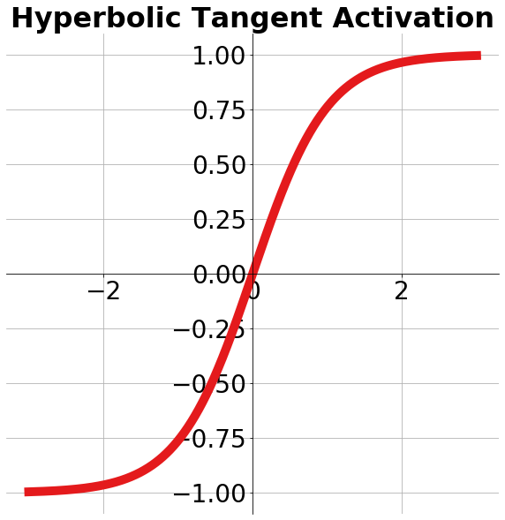
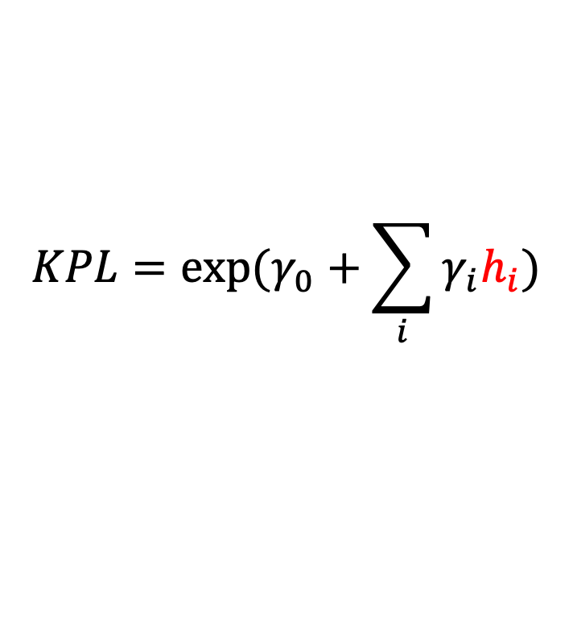

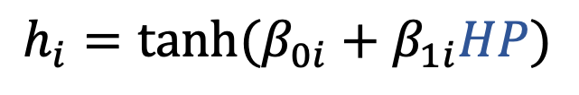
A Network of Neurons
$$KPL=exp⁡(γ_{0}+\sum_{i}{γ_{i}h_{i}})$$
Need to determine values of 10 free parameters
Brute force would result in combinatorial explosion! $10^{10}$
$$h_{i}=tanh⁡(β_{0i}+β_{1i}HP)$$

Slide 11
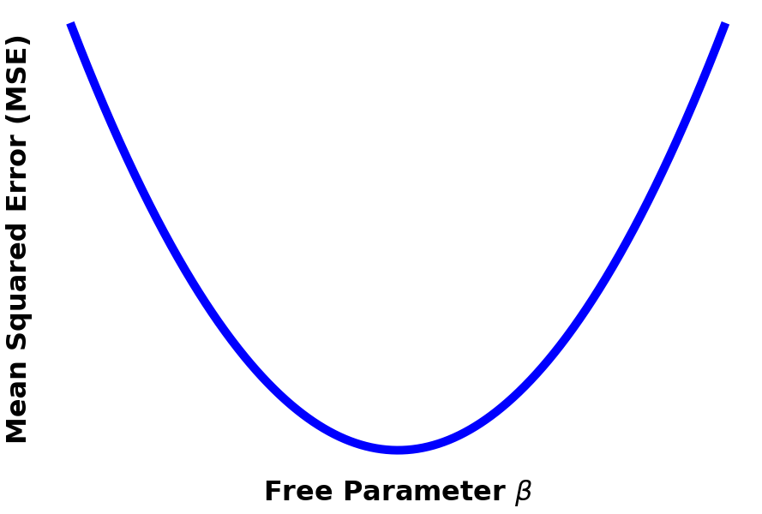
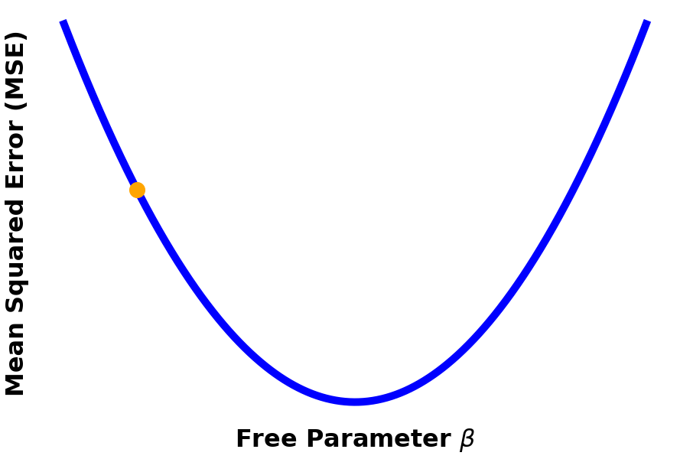
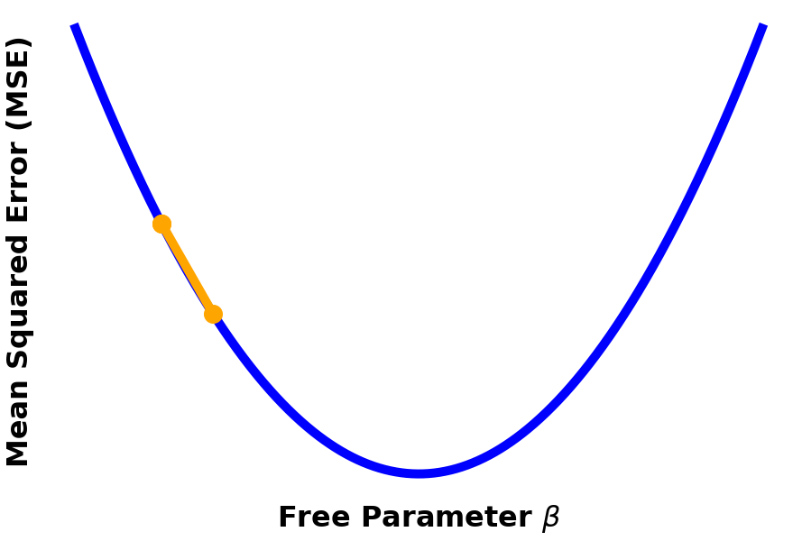
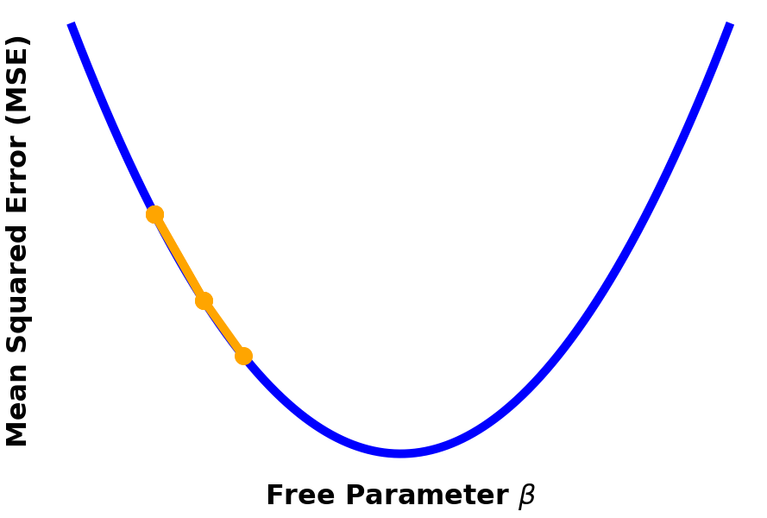
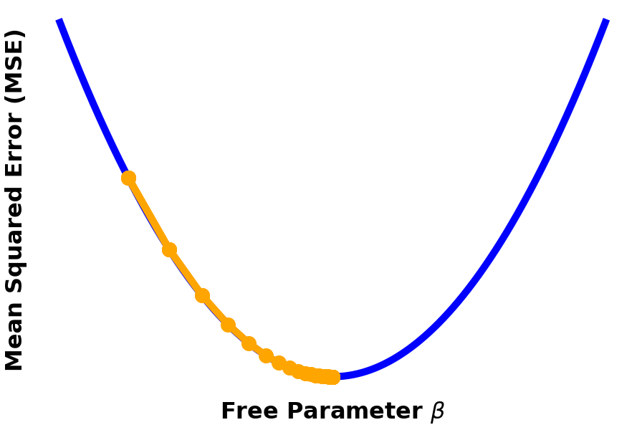
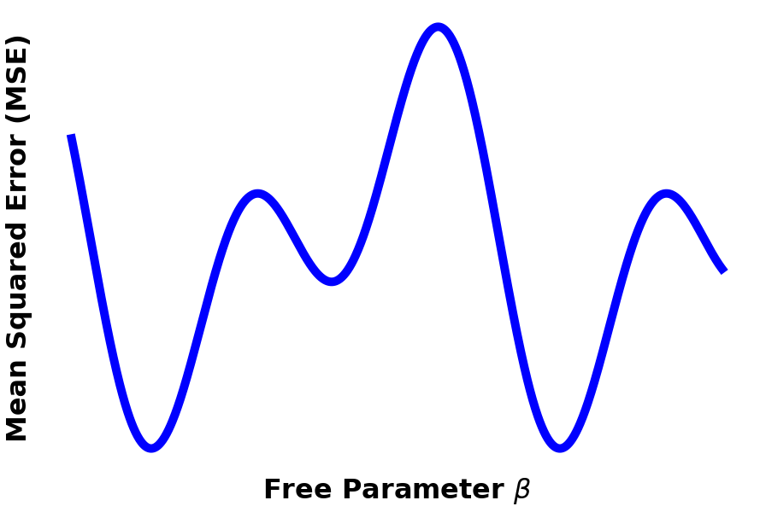
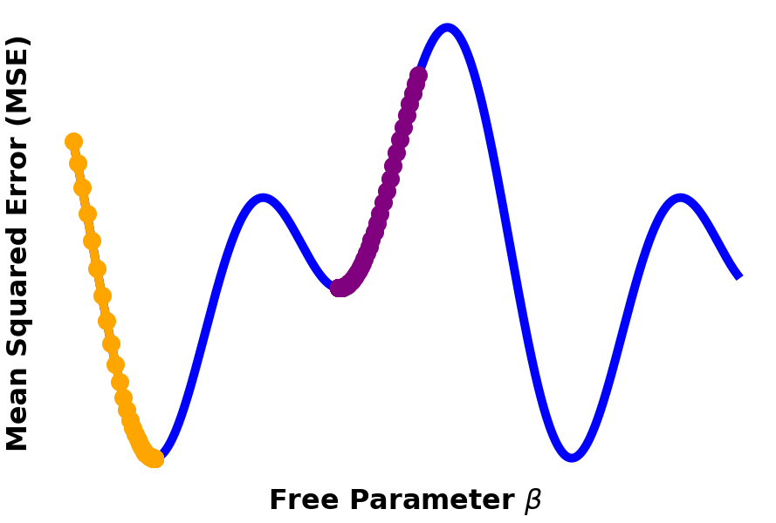
Training a Neural Net: Backpropagation
Intuition: start with random parameter values, then adjust the parameters in the direction that minimizes MSE
Needs calculus: to get the derivative of objective function with respect to free parameters
Non-convexity: reality is rarely this nice, your loss function will likely have multiple local minima
Global
Local

Slide 12
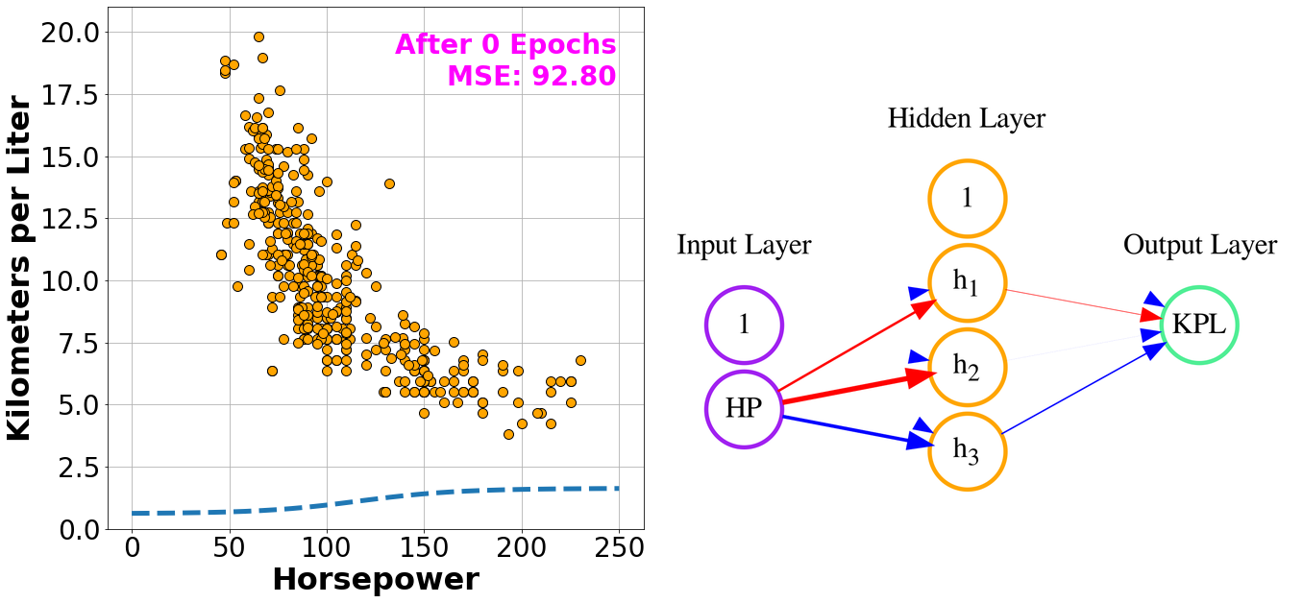
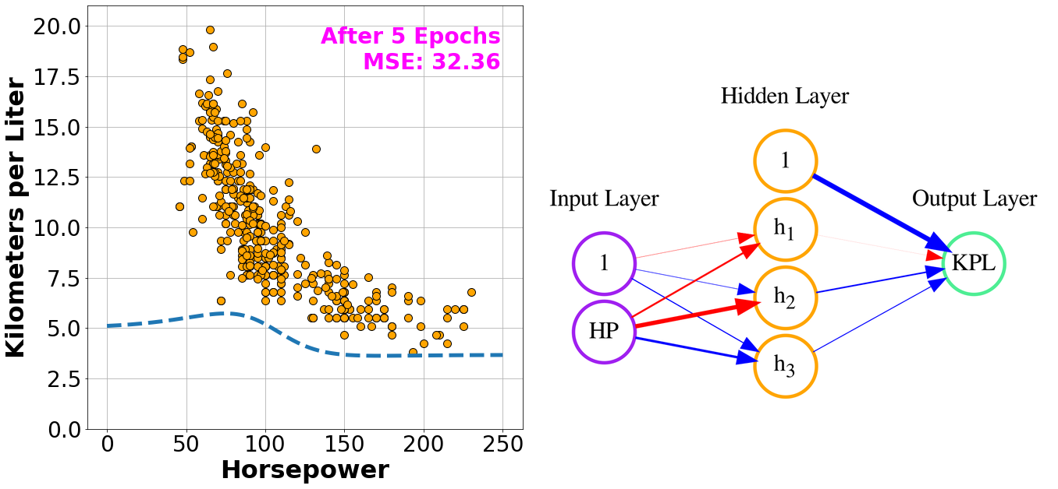
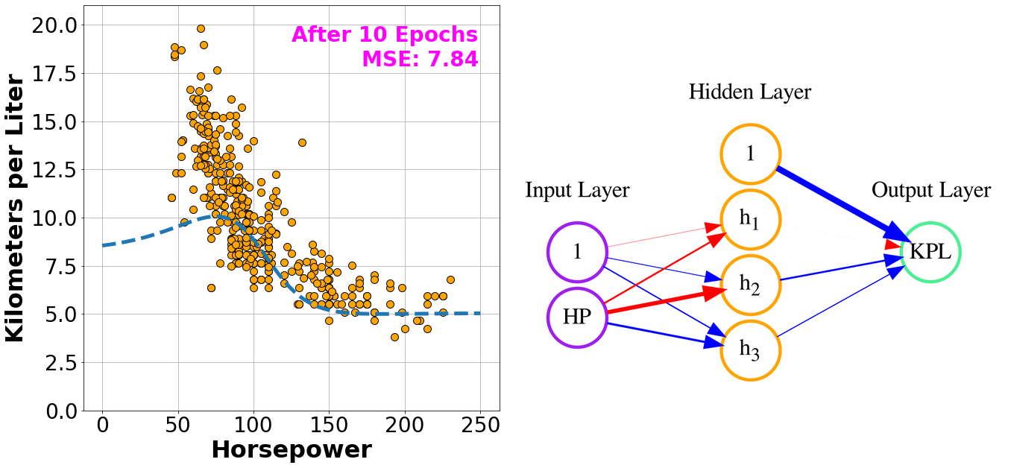
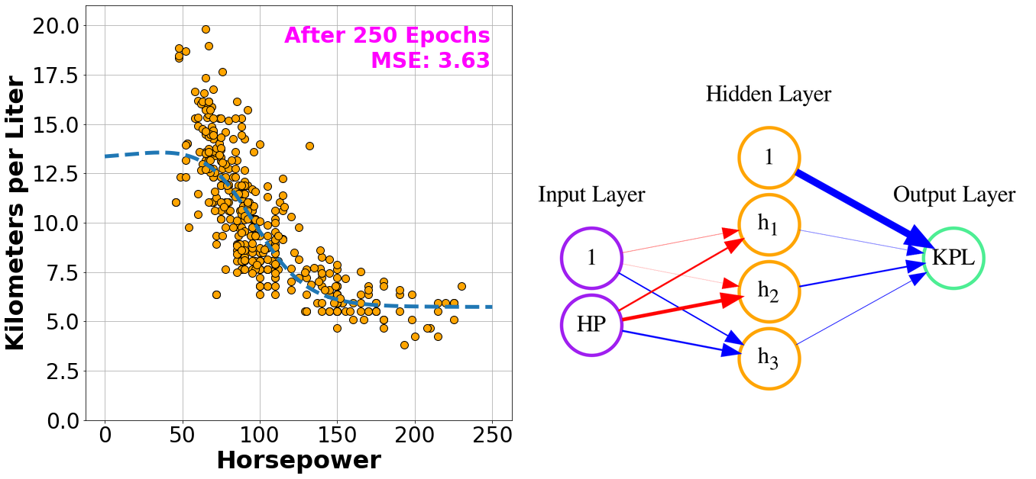
Fitting NN to the Cars Dataset

