Slide 1
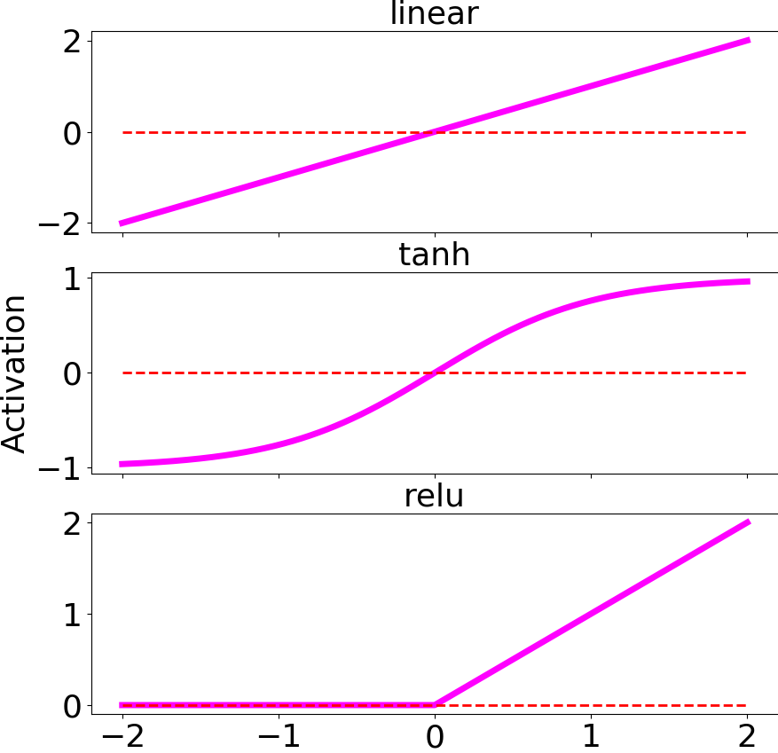
Activation Function
Input 1
w₁
Input 2
w₂
Σ
Neuron
Output
…
w_{N}
Input N

Slide 2
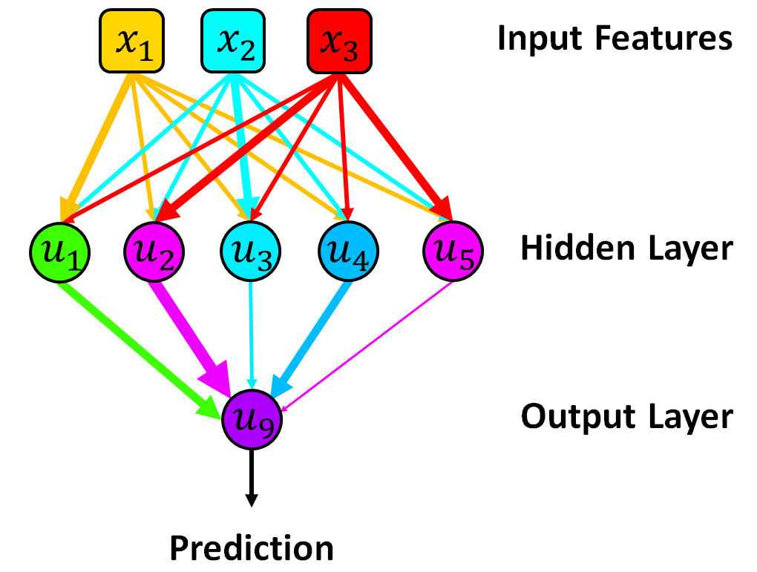
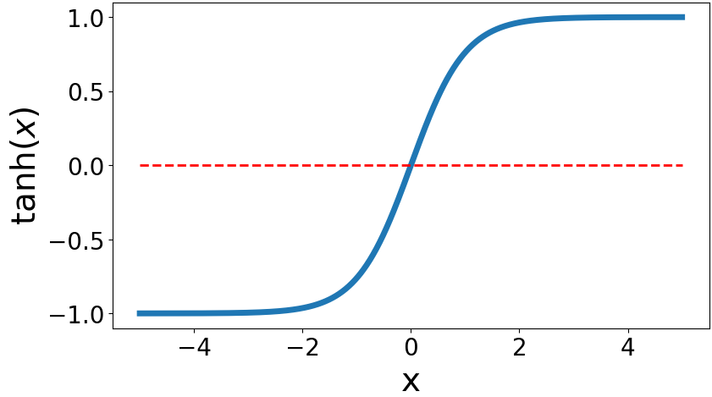
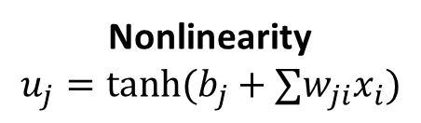
Nonlinearity
$$u_{j}=tanh⁡(b_{j}+∑w_{ji}x_{i})$$

Slide 3
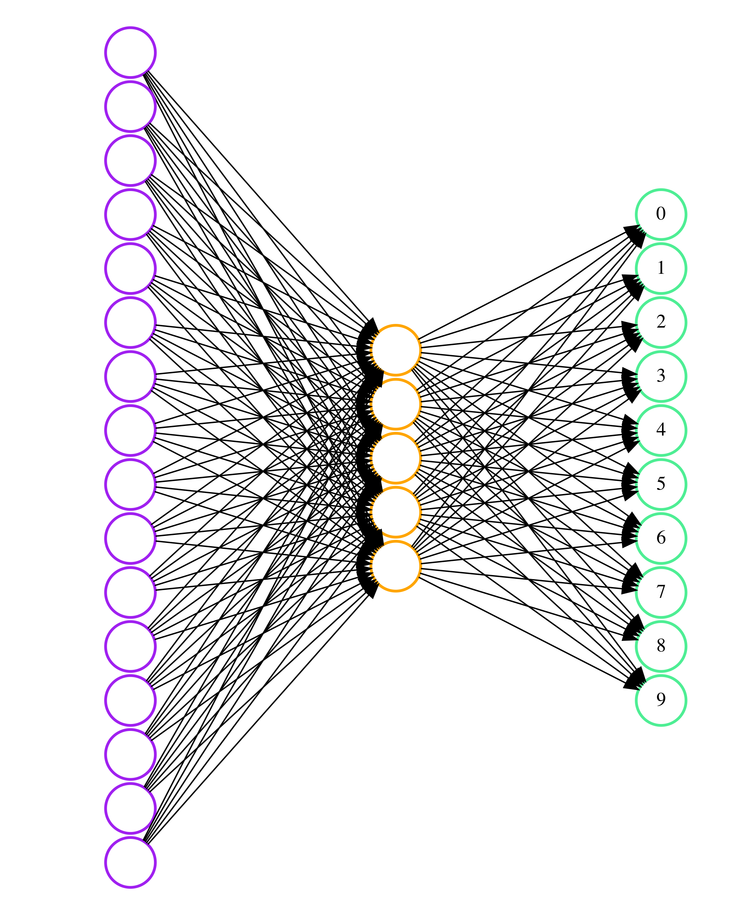
Input Image
(28x28)
Flatten
(1x784)
Predict
softmax units

Slide 4
1
0
2
3
…
1
0
2
3
…
1
0
2
3
…
0.5 0.5
0.5 0.5
0.5 0.5
0.5
0.5
1
0.5
1
2.5

