Slide 2
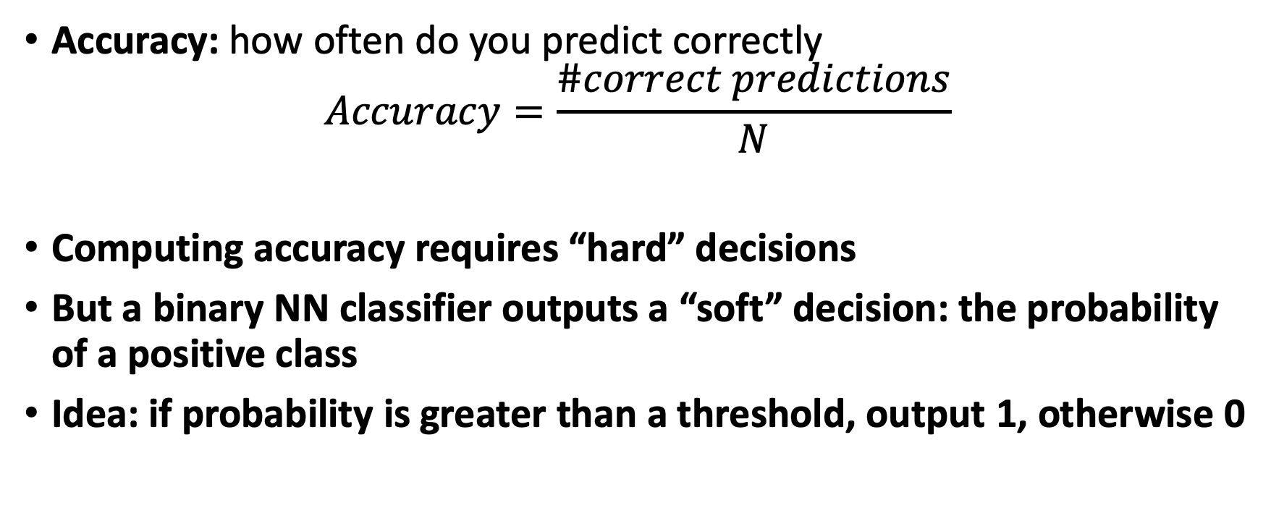
Evaluating the Binary Classifier
Accuracy: how often do you predict correctly
$$Accuracy=\frac{\#correct predictions}{N}$$
Computing accuracy requires “hard” decisions
But a binary NN classifier outputs a “soft” decision: the probability of a positive class
Idea: if probability is greater than a threshold, output 1, otherwise 0

Slide 3
Example
Truth | 0 | 1 | 1 | 0 | 1 | 1 | 0
Prediction | 0.08 | 0.85 | 0.95 | 0.84 | 0.45 | 0.62 | 0.33
Threshold @ 0.25 | 0 | 1 | 1 | 1 | 1 | 1 | 1
Threshold @ 0.5 | 0 | 1 | 1 | 1 | 0 | 1 | 0
Threshold @ 0.75 | 0 | 1 | 1 | 1 | 0 | 0 | 0
Accuracy @ 0.25 is 71%, @ 0.50 is 71%, and @ 0.75 is 57%
So how good is the classifier?
Idea: sweep the thresholds!

