Slide 1
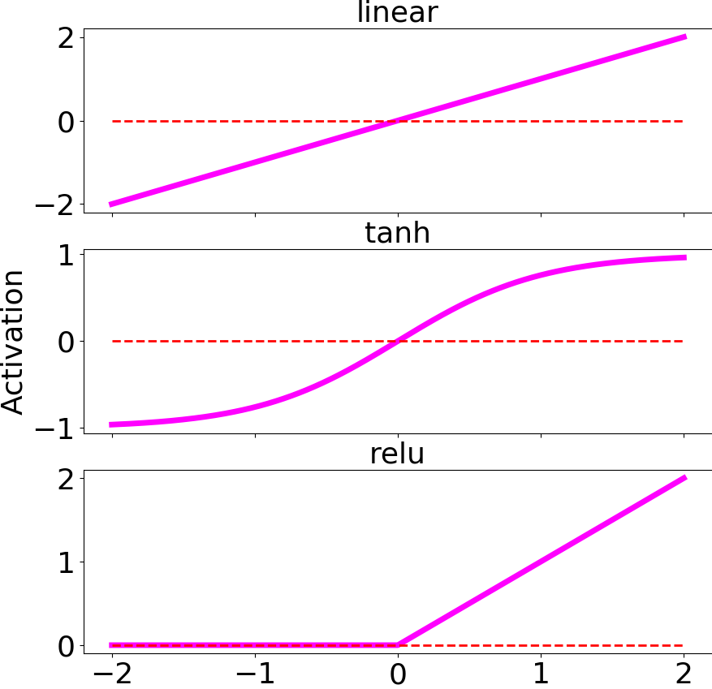
Activation Function
Input 1
w₁
Input 2
w₂
Σ
Neuron
Output
…
w_{N}
Input N

Slide 2
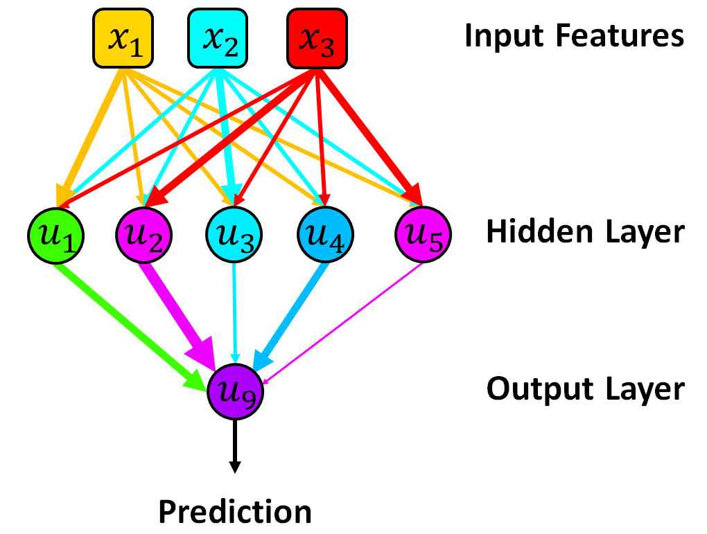
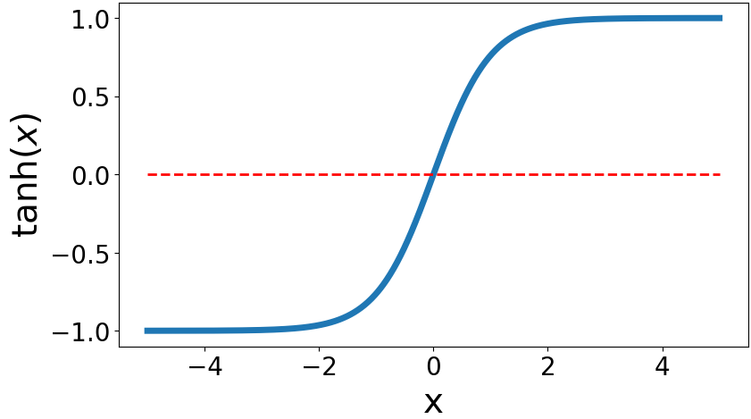
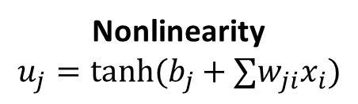
Nonlinearity
$$u_{j}=tanh⁡(b_{j}+∑w_{ji}x_{i})$$

