Slide 1
Block 5: Non-Linear Modeling
Mohammad M. Khajah
October 2025

Slide 2
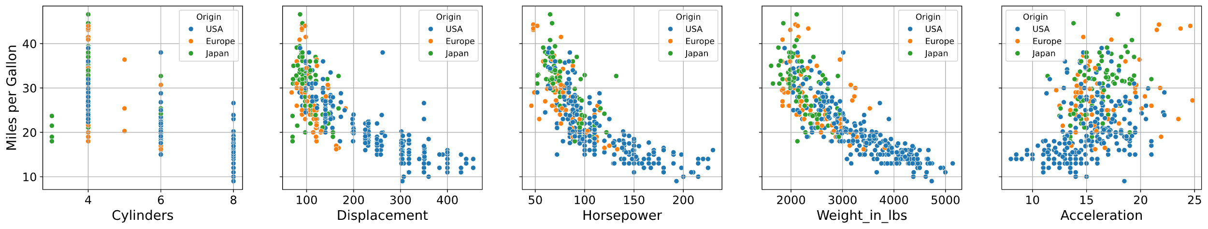
Relationship Looks Non-Linear
Can we use a better model without throwing away everything we have already?
MPG = exp(z)
z = b0 + b1 * HP + b2 * Displacement + ...

Slide 3
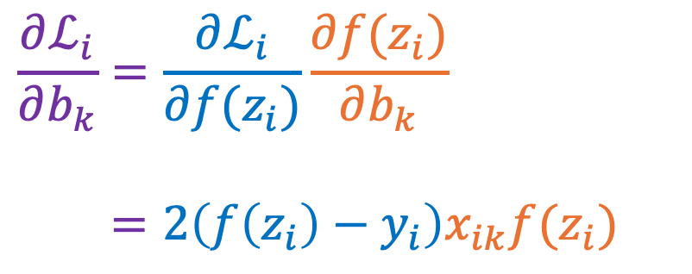
Chain Rule of Calculus
$ℒ_{i}={\left(f\left(z_{i}\right)−y_{i}\right)}^{2}$ $f\left(z_{i}\right)=\exp\left(z_{i}\right)$ $z_{i}=b_{0}+b_{1}x_{i1}+…$
$$\frac{∂ℒ_{i}}{∂b_{k}}=\frac{∂ℒ_{i}}{∂f(z_{i})}\frac{∂f(z_{i})}{∂b_{k}}$$
$=2\left(f\left(z_{i}\right)−y_{i}\right)x_{ik}f(z_{i})$

Slide 4
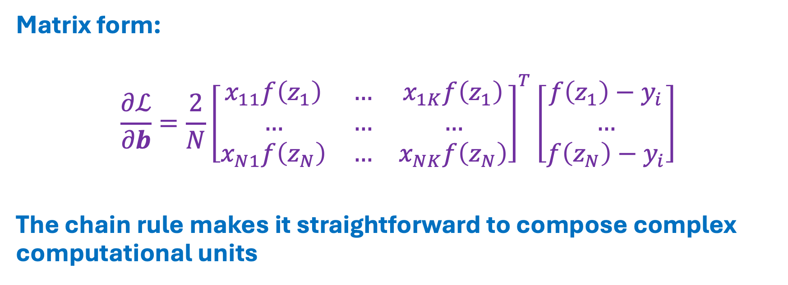
Gradient Calculation
Matrix form:
$${\frac{∂ℒ}{∂b}=\frac{2}{N}\left[\begin{matrix}x_{11}f\left(z_{1}\right) & … & x_{1K}f\left(z_{1}\right) \\ … & … & … \\ x_{N1}f\left(z_{N}\right) & … & x_{NK}f\left(z_{N}\right)\end{matrix}\right]}^{T}\left[\begin{matrix}f\left(z_{1}\right)−y_{i} \\ … \\ f\left(z_{N}\right)−y_{i}\end{matrix}\right]$$
The chain rule makes it straightforward to compose complex computational units

Slide 5
Cautionary Note
In our exponentiated multivariate model, training will diverge if we just z-score the inputs
This is because the gradient involves an exponential function which quickly blows up
Small learning rates won’t fix it as they don’t converge quickly
Solution: scale the inputs to have 0.1 standard deviation

Slide 6
Coding
Implement gradient descent for non-linear model
Optimize model with gradient descent
Plot the model fit

