Slide 1
Block 12: Fighting Overfitting
Mohammad M. Khajah
October 2025

Slide 2
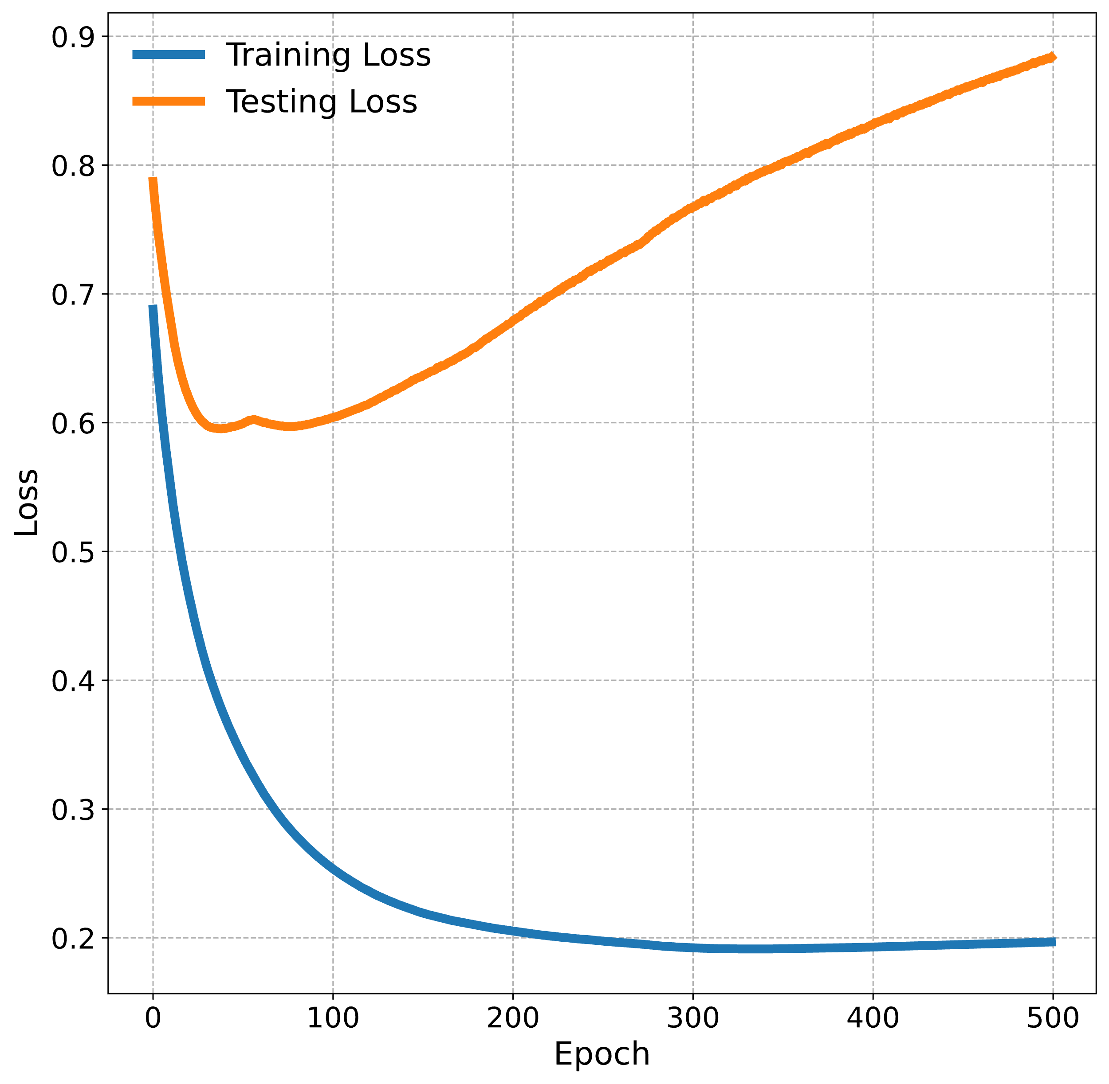
Overfitting Visualizated
If you take the parameter values here, the model will perform horribly
We trained an MLP on a binary classification dataset with 60 features
MLP has 10 hidden ReLU units
Dataset was split randomly into 80% training and 20% testing
After every epoch training and testing losses are recorded
Overfitting starts

Slide 3
Early-Stopping
Idea: why not just stop when the testing loss starts increasing?
Cheating: using test to optimize your model!
Better idea: split the training data into an optimization portion and a validation portion
Track the optimization and validation losses
Stop when the validation loss starts increasing
Does require enough data
Note: if you are doing cross validation, this means splitting each training portion into two portions

Slide 4
Early-Stopping
Next Epoch
Set loss as new best & remember parameters
Yes
New best loss?
Compute gradient
Update parameters
Calculate validation loss
No
No
Has it been N epochs since last new best validation loss?
Next Epoch
Yes
N is known as the patience
Early-Stopping
Stop and return last best parameters

Slide 5
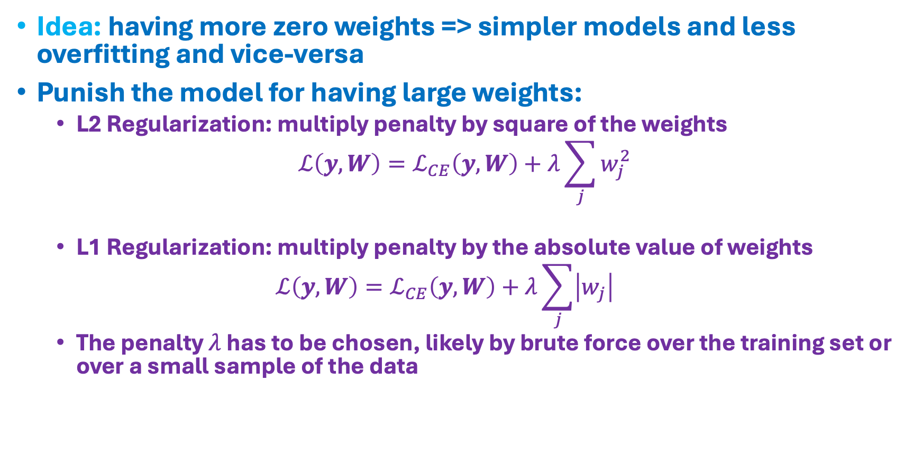
Regularization
Idea: having more zero weights => simpler models and less overfitting and vice-versa
Punish the model for having large weights:
L2 Regularization: multiply penalty by square of the weights
$$ℒ\left(y,W\right)=ℒ_{CE}\left(y,W\right)+λ\sum_{j}{w_{j}^{2}}$$
L1 Regularization: multiply penalty by the absolute value of weights
$$ℒ\left(y,W\right)=ℒ_{CE}\left(y,W\right)+λ\sum_{j}{\left|w_{j}\right|}$$
The penalty $λ$ has to be chosen, likely by brute force over the training set or over a small sample of the data
Penalty term

Slide 6
Hyperparameters
In the course, we have seen examples of model parameters:
The betas in linear regression
The weight matrices in the MLP
We have also seen examples of hyperparameters:
Input features into the linear regression
Learning rate
Number of hidden layers & neurons within each layer
Activation functions
Penalty term is also a hyperparameter
Hyperparameters are things that cannot be optimized with the learning algorithm directly (i.e., loss is not differentiable with respect to them)
Typically you determine them based on the training set using techniques like brute force or Bayesian optimization

Slide 7
Coding
Implement early-stopping and L1/L2 regularization
Evaluate result and compare to no vanilla model

