Slide 1
Block 9: Logistic Regression
Mohammad M. Khajah
October 2025

Slide 2
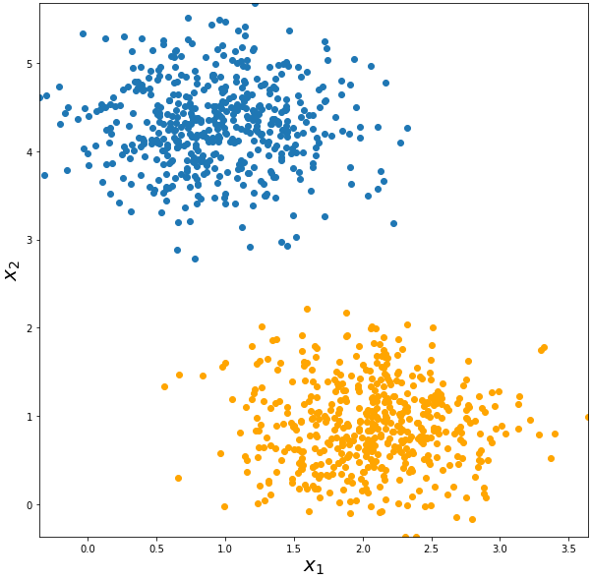
Regression vs. Classification
Regression: predict a continous value
Classification: predict the category of something (cat, dog, etc.)
Binary classification: two categories only (is cat or not)
Example: classifying blue versus orange points

Slide 3
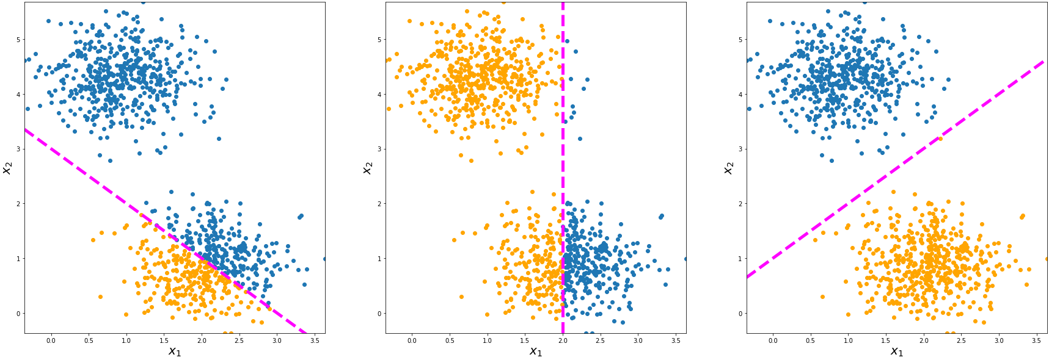
Regression vs. Classification
A classification model tries to separate the training data neatly

Slide 4
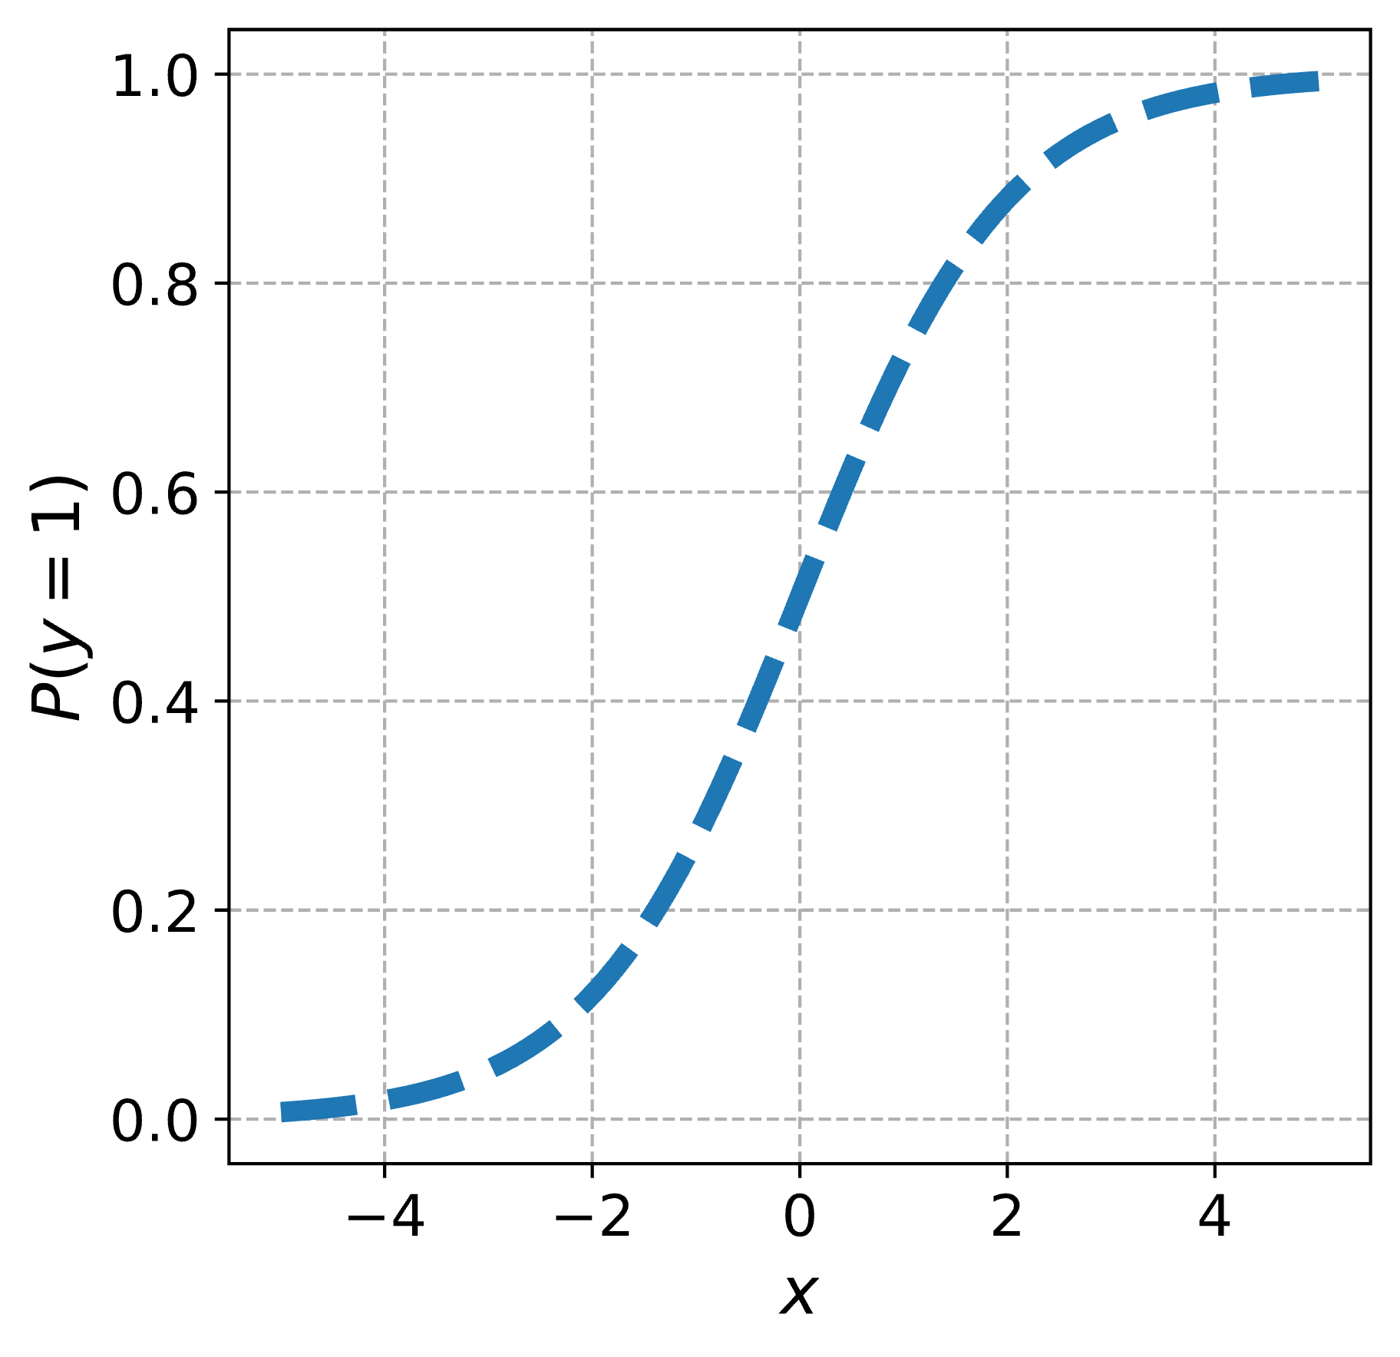
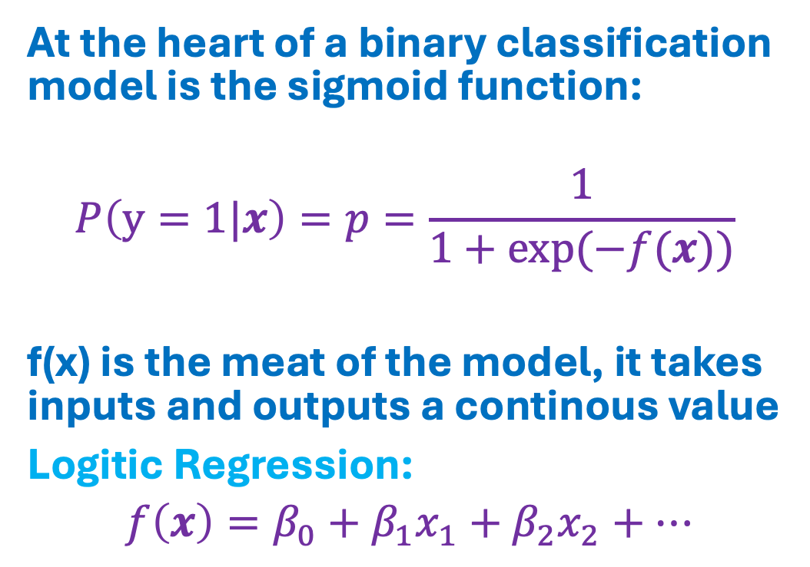
The Sigmoid Function
At the heart of a binary classification model is the sigmoid function:
$$P\left(y=1|x\right)=p=\frac{1}{1+\exp{(−f(x))}}$$
f(x) is the meat of the model, it takes inputs and outputs a continous value
Logitic Regression:
$f\left(x\right)=β_{0}+β_{1}x_{1}+β_{2}x_{2}+…$

Slide 5
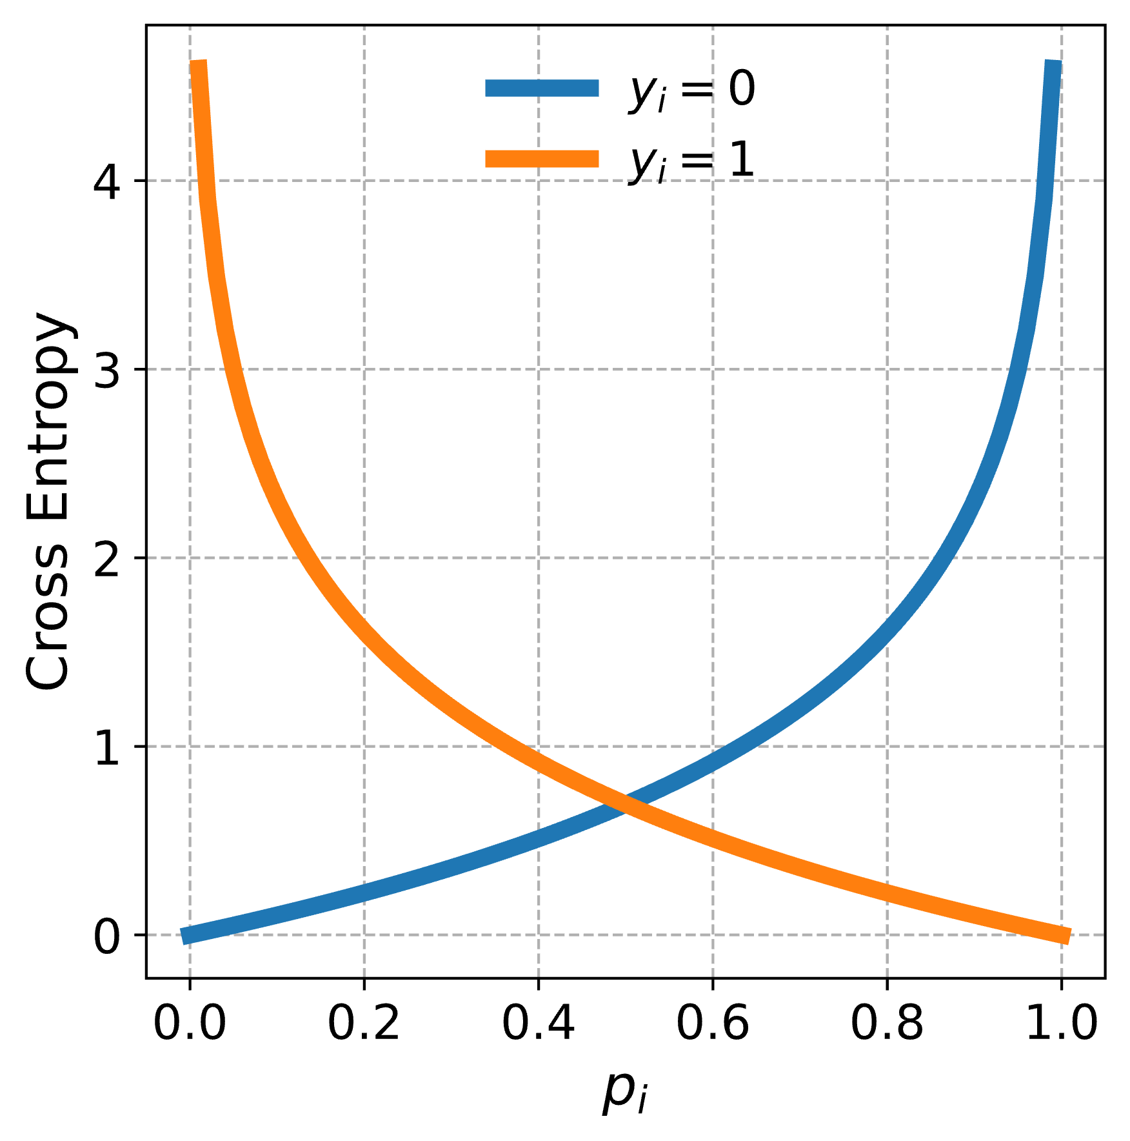
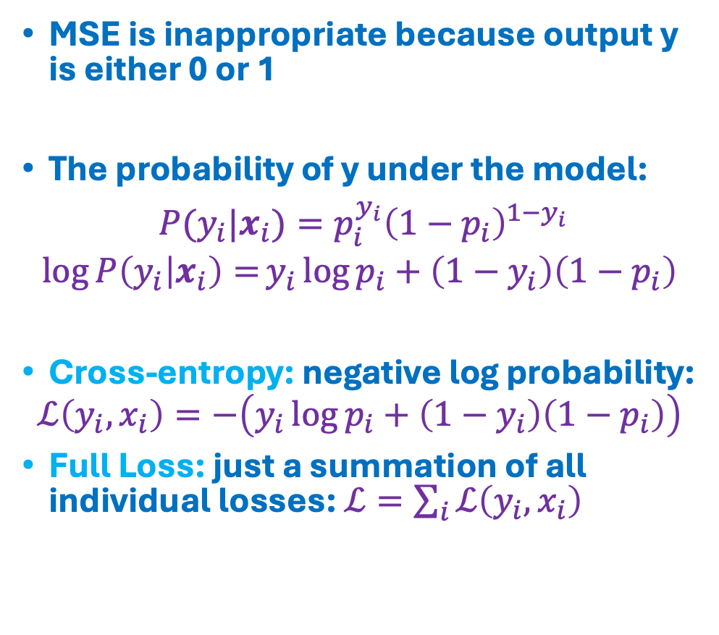
Loss Function
MSE is inappropriate because output y is either 0 or 1
The probability of y under the model:
$P(y_{i}|x_{i})=p_{i}^{y_{i}}{\left(1−p_{i}\right)}^{1−y_{i}}$
$${\log{P\left(y_{i} | x_{i}\right)=}y}_{i}\log{p_{i}}+\left(1−y_{i}\right)\left(1−p_{i}\right)$$
Cross-entropy: negative log probability:
$$ℒ\left(y_{i},x_{i}\right)=−\left(y_{i}\log{p_{i}}+\left(1−y_{i}\right)\left(1−p_{i}\right)\right)$$
Full Loss: just a summation of all individual losses: $ℒ=\sum_{i}{ℒ\left(y_{i},x_{i}\right)}$

Slide 6
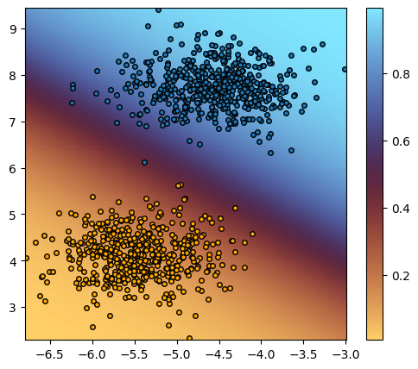
Separable Dataset Example
Color indicates the probability that the point is blue
Model is most uncertain in the middle
Accuracy = 99.5%
(Proportion of dataset that was correctly predicted)

Slide 7
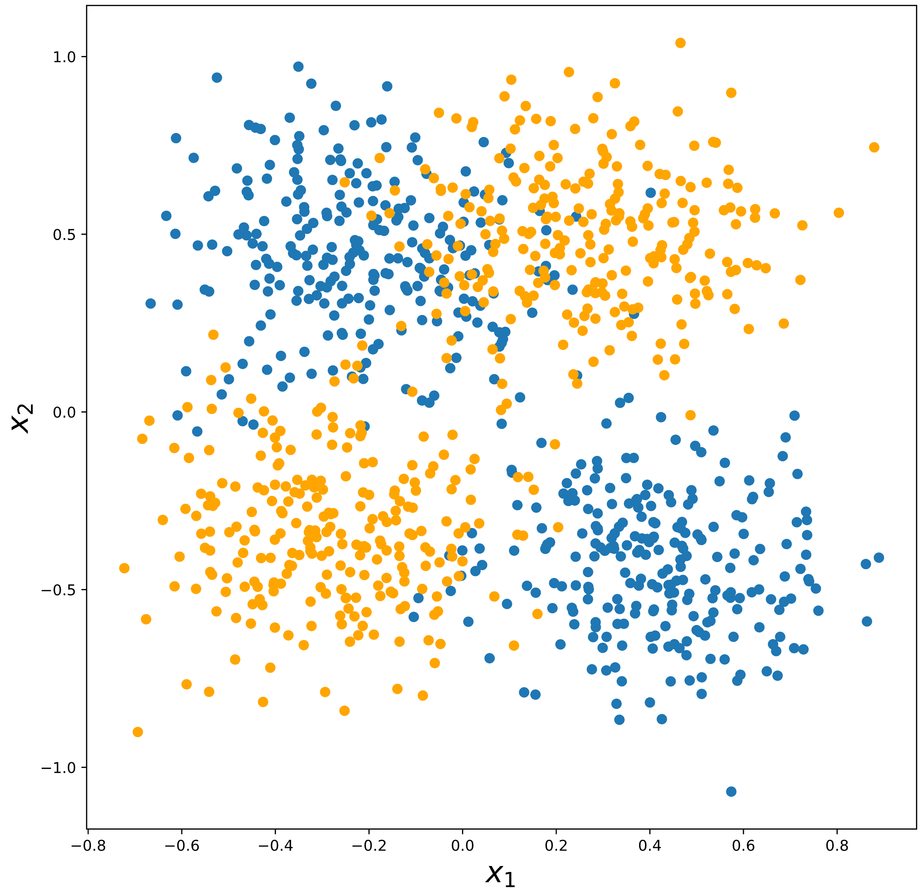
Can Logistic Regression Handle This?

Slide 8
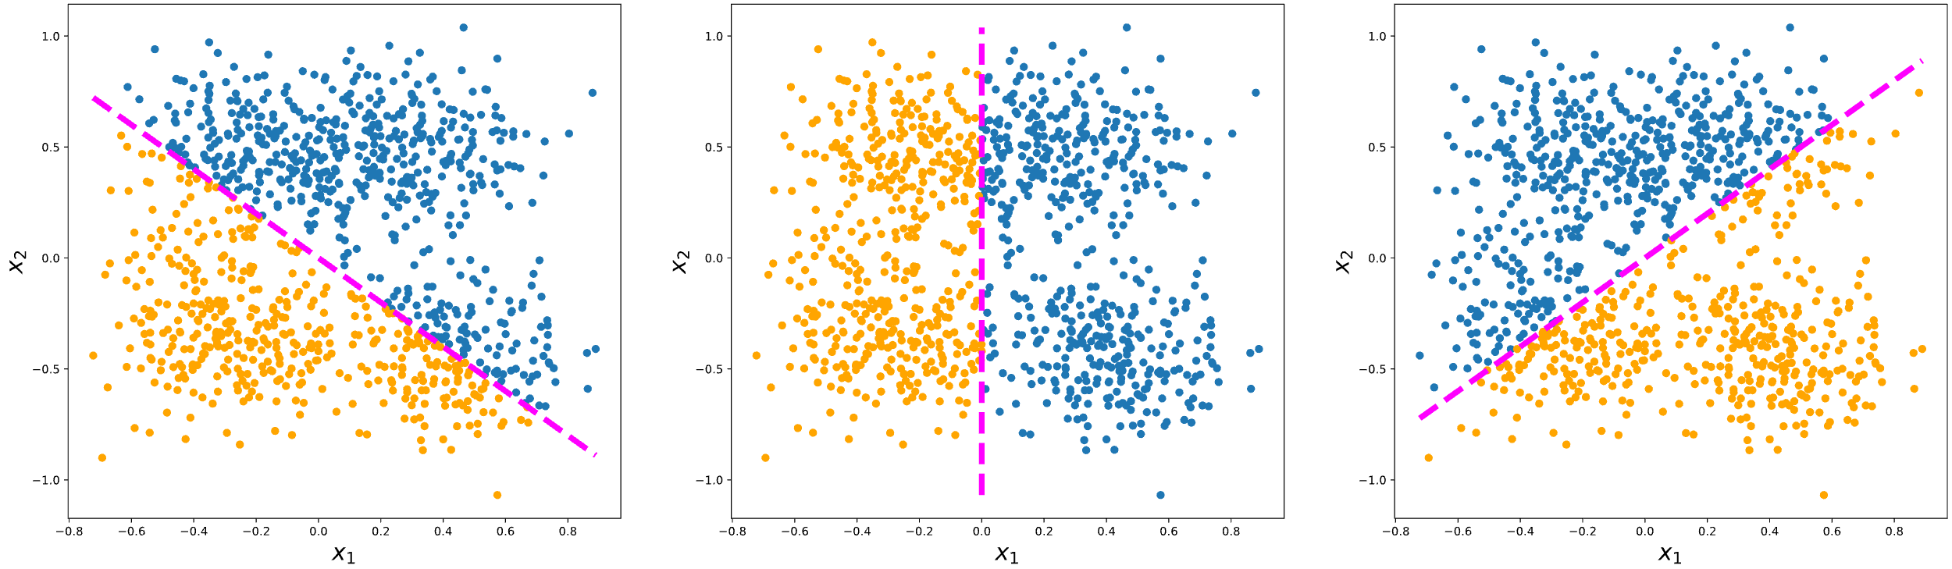
Can Logistic Regression Handle This?
No line can neatly separate the two classes

Slide 9
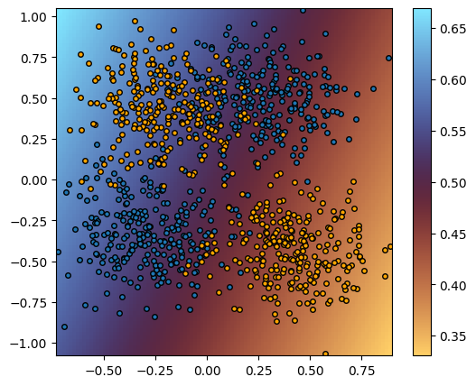
Non-Separable Dataset Example
Model can’t find a way to properly separate the classes
Accuracy = 55.4%

Slide 10
Coding
Implement linear binary classification with JAX
Train model on two blobs dataset
Plot the model fit

