Slide 1
Block 10: Evaluating Binary Classifiers
Mohammad M. Khajah
October 2025

Slide 2
Confusion Matrix
Predicted
You can get an overview of the performance of a classifier with the confusion matrix
TN: True Negatives
FP: False Positives
FN: False Negatives
TP: True Positives
Evaluation measurements are based on various quantities in this matrix
Perfect Performance: FP and FN = 0
0
1
Actual
0
TN
FP
1
FN
TP

Slide 3
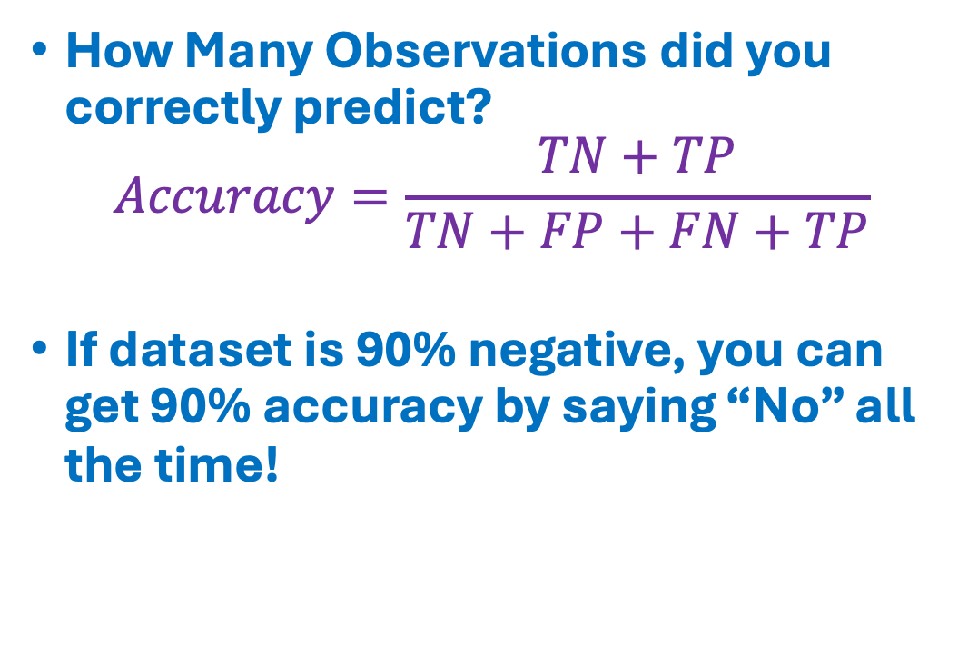
Accuracy
Predicted
How Many Observations did you correctly predict?
$$Accuracy=\frac{TN+TP}{TN+FP+FN+TP}$$
If dataset is 90% negative, you can get 90% accuracy by saying “No” all the time!
0
1
Actual
0
TN
FP
1
FN
TP

Slide 4
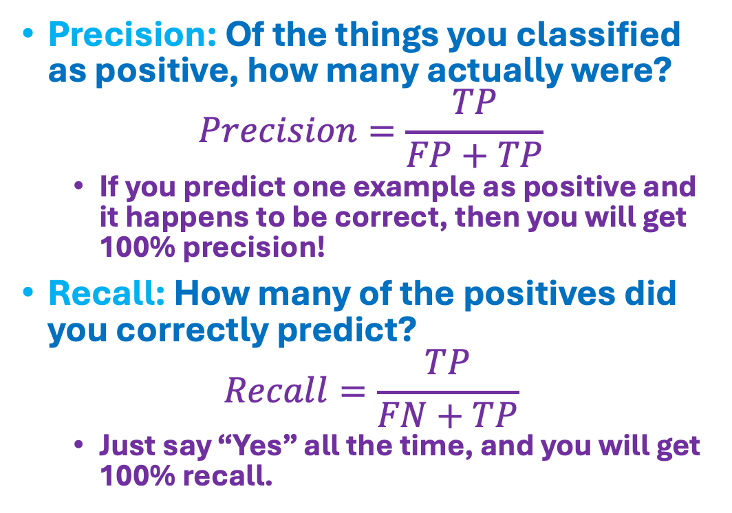
Precision & Recall
Predicted
Precision: Of the things you classified as positive, how many actually were?
$$Precision=\frac{TP}{FP+TP}$$
If you predict one example as positive and it happens to be correct, then you will get 100% precision!
Recall: How many of the positives did you correctly predict?
$$Recall=\frac{TP}{FN+TP}$$
Just say “Yes” all the time, and you will get 100% recall.
0
1
Actual
0
TN
FP
1
FN
TP
Precision
Recall

Slide 5
General Defense: Null Model
Report Null Model: in general always include a baseline “null” model to ensure that your model is not doing something trivial
Null Model: predict proportion of positives on the training set
Always play “devil’s advocate” against your models!
Example:
Model achieves 95% accuracy, awesome!
Null model achieves 94% accuracy, because dataset is 94% negative
Model doesn’t look that good anymore!

Slide 6
Alternatives – Balanced Accuracy
Predicted
Normalize each row in the matrix to sum to one
TNR = TN/(TN+FP)
FPR = 1 – TNR
TPR = TP / (FN + TP)
FNR = 1 – TPR
Balanced Accuracy: (TNR + TPR)/2
If you say “No” all the time, TNR = 1 but TPR = 0, so balanced accuracy = 0.5
By default, assumes errors on negative and positive instances are equally bad, but you can assign different weights
0
1
Actual
0
TNR
FPR
1
FNR
TPR

Slide 7
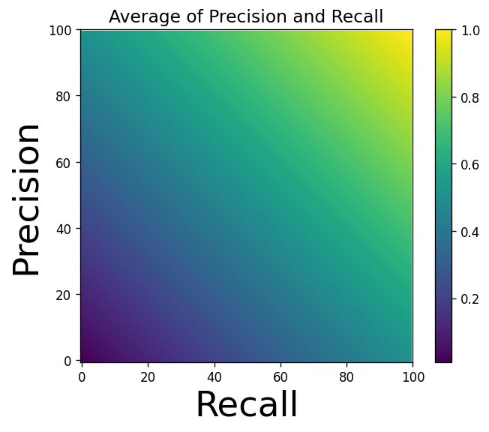
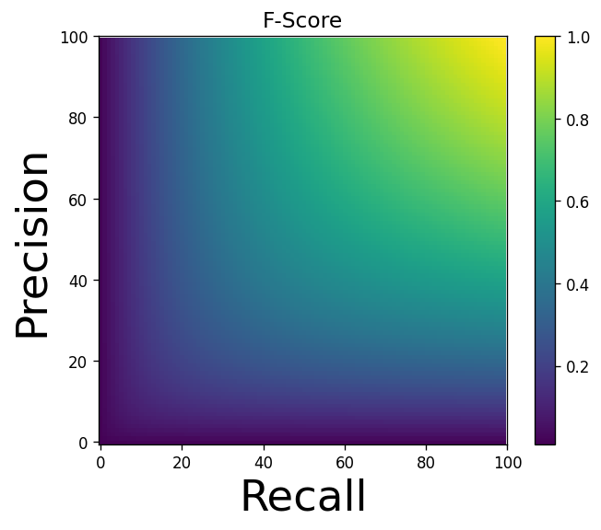
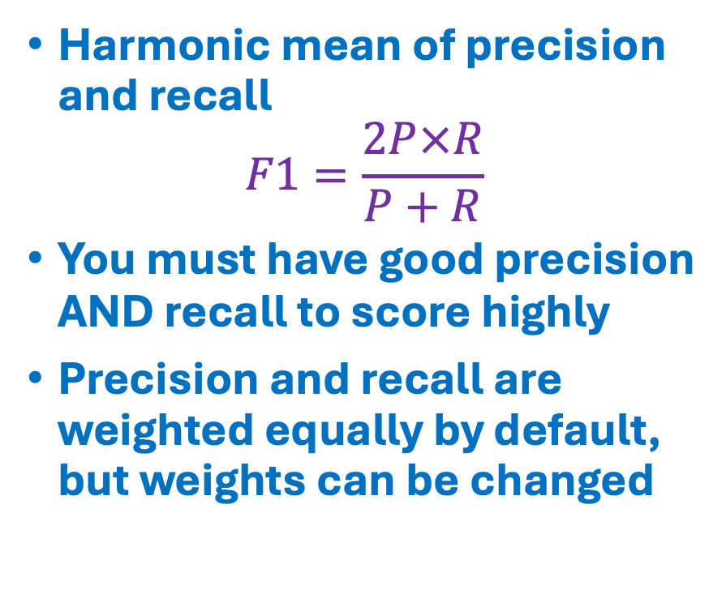
Alternatives – F1 Score
Harmonic mean of precision and recall
$$F1=\frac{2P×R}{P+R}$$
You must have good precision AND recall to score highly
Precision and recall are weighted equally by default, but weights can be changed

Slide 8
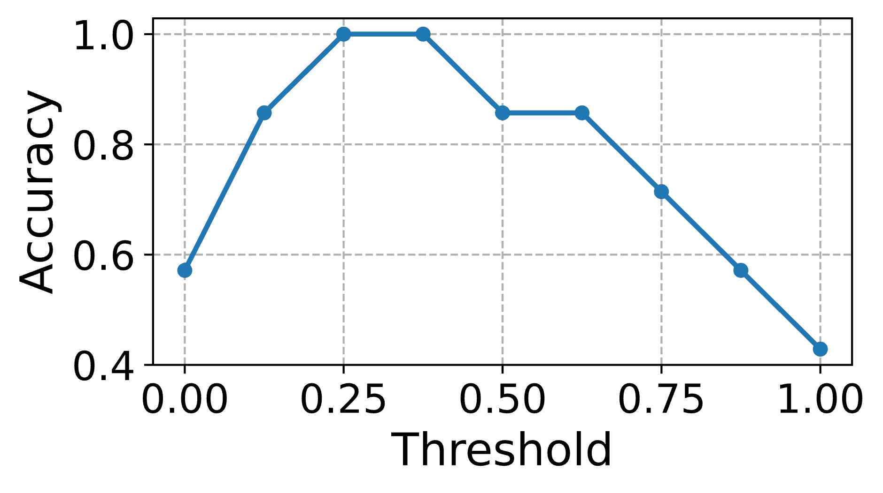
Hard vs. Soft Decisions
Hard decisions: all previous metrics assume classifier produces “yes” or “no” outputs
Soft decisions: but logistic regression outputs a probability, not a hard decision
Common solution:
Thresholding: if output > 0.5, then “yes”, otherwise “no”
Threshold value could also be chosen based on the training set
Evaluation performance depends on where you set the threshold
Actual | 0 | 1 | 1 | 0 | 1 | 1 | 0
Prediction | 0.06 | 0.92 | 0.86 | 0.03 | 0.40 | 0.70 | 0.23

Slide 9
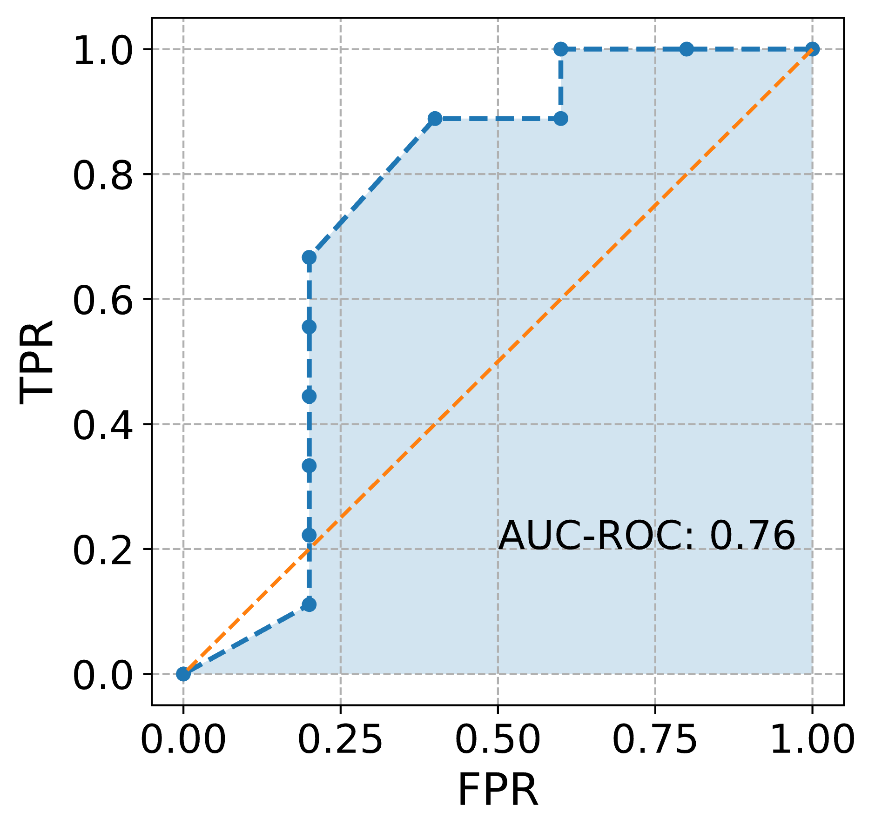
Area Under the Receiver Operating Characteristic Curve (AUC-ROC)
Idea: summarize classifier performance at different thresholds with a single number
Compute FPR versus TPR (Recall) @ different thresholds
This will produce points (FPR, TPR)
Construct a curve from the points
AUC-ROC: area under this curve
Null Model: AUC-ROC = 0.5 (diagonal line)
Issue: AUC-ROC can be overoptimistic when dataset is mostly negative

Slide 10
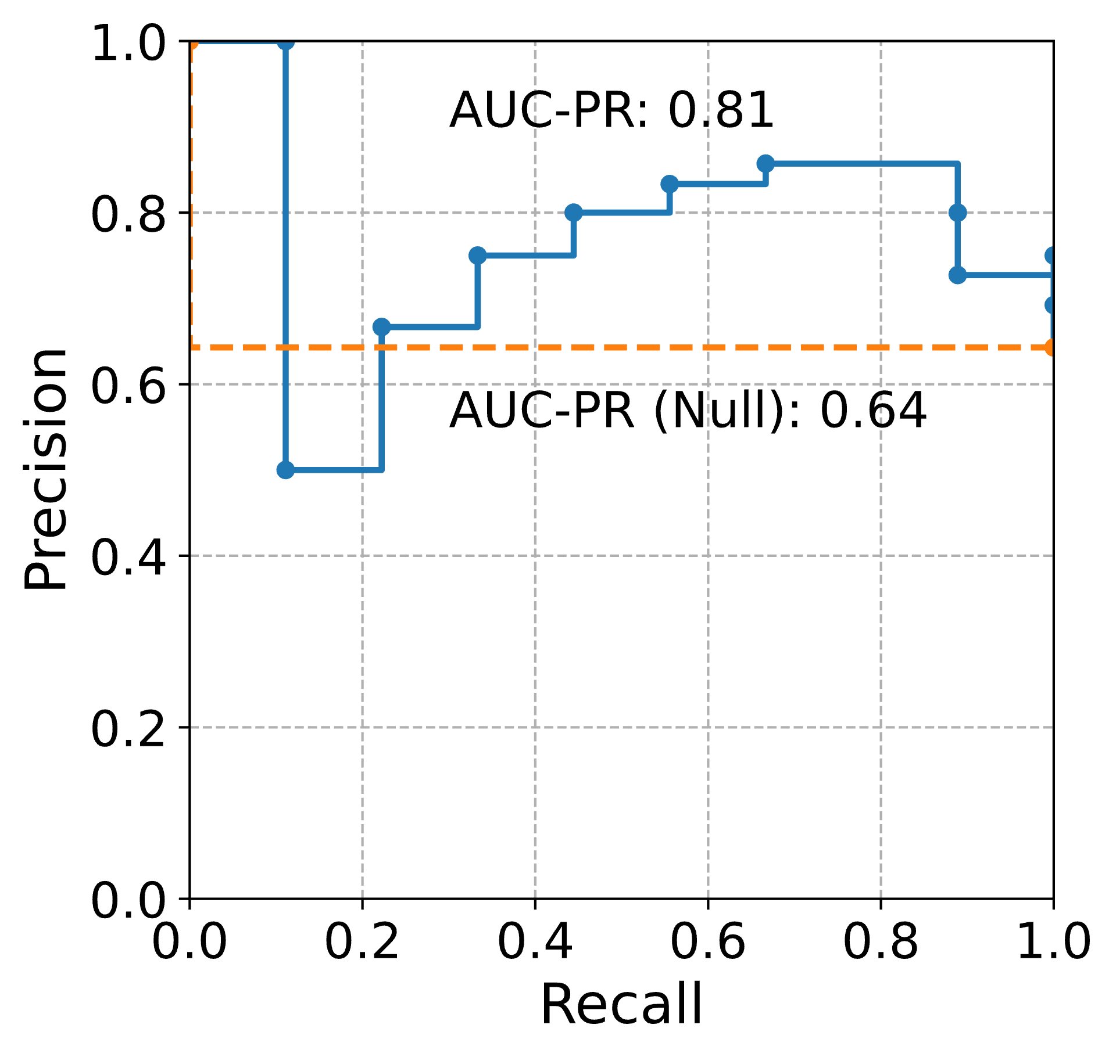
Area Under the Precision-Recall Curve (AUC-PR)
Idea: similar to AUC-ROC, but plot the recall versus precision @ various thresholds
Null model: you have to include a baseline “chance” model, usually this is just the proportion of positives
Good for when you have an imbalanced dataset with few positives

Slide 11
Coding
Examine the issues with various metrics
Apply metrics to the logistic regression model

