Slide 1
Block 7: Linear Model Interpretation
Mohammad M. Khajah
October 2025

Slide 2
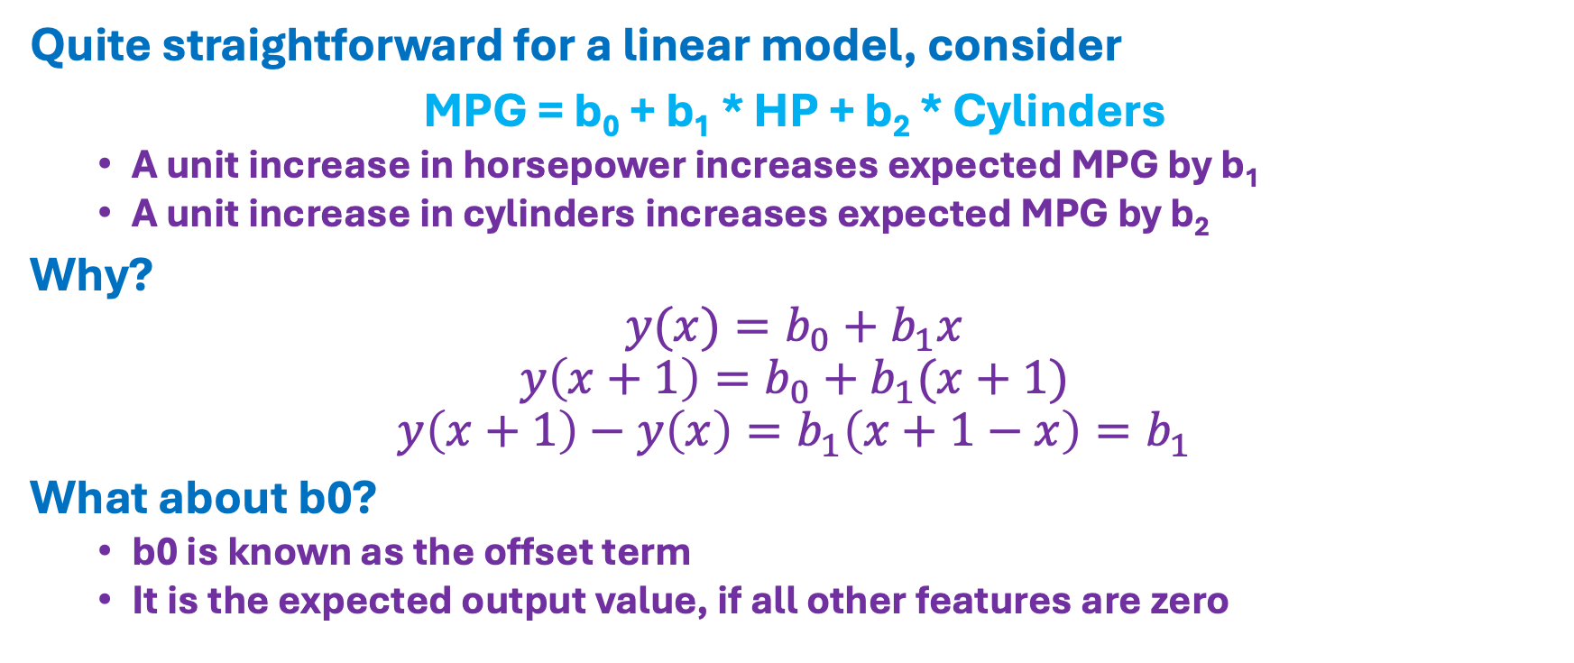
Effect of Features on Output?
Quite straightforward for a linear model, consider
MPG = b₀ + b₁ * HP + b₂ * Cylinders
A unit increase in horsepower increases expected MPG by b₁
A unit increase in cylinders increases expected MPG by b₂
Why?
$$y(x)=b_{0}+b_{1}x$$
$$y\left(x+1\right)=b_{0}+b_{1}(x+1)$$
$$y\left(x+1\right)−y\left(x\right)=b_{1}\left(x+1−x\right)=b_{1}$$
What about b0?
b0 is known as the offset term
It is the expected output value, if all other features are zero

Slide 3
Categorical Features
Care needs to be taken with categorical features
If a feature has 3 categories, usually one of them is set aside as a reference and folded into b0:
MPG = b₀ + b₁ * is_USA + b₂ * is_Europe
If a car is made in the US, MPG increases by b₁ RELATIVE to a car made in Japan
b₀ is now the expected MPG for cars made in Japan
Without this technique, interpretation is a bit harder:
MPG = b₀ + b₁ * is_USA + b₂ * is_Europe + b₃ * is_Japan
If a car is made in the US, MPG increases by b₁ relative to cars made outside the USA, Europe, and Japan

Slide 4
Interaction Terms
Reminder: interaction terms are those in which two or more features are multiplied
Price = b₀ + b₁ * Width * Height
If width increases by one unit, then the price increases by b₁ * height
If height increases by one unit, then the price increases by b₁ * width
This is why it is an “interaction term”: the effect of increasing width depends on the value of height, and vice versa.

Slide 5
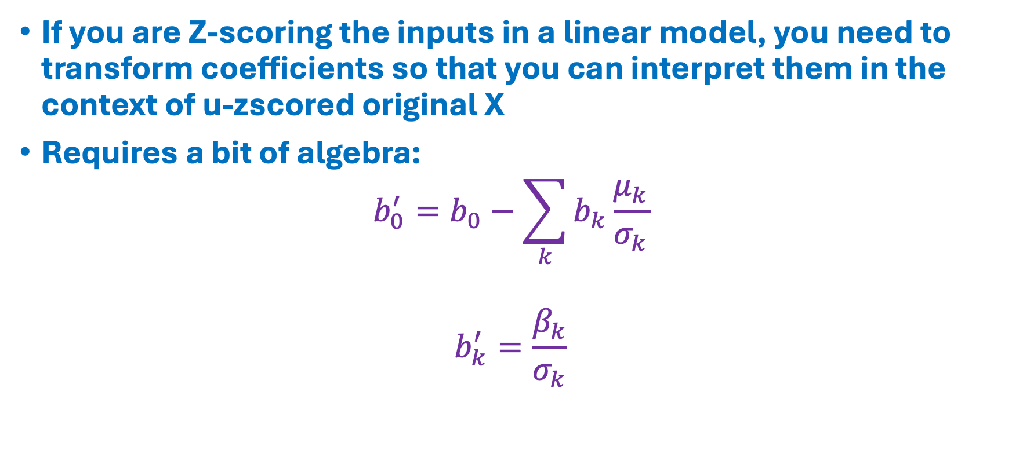
Z-Scoring
If you are Z-scoring the inputs in a linear model, you need to transform coefficients so that you can interpret them in the context of u-zscored original X
Requires a bit of algebra:
$$b_{0}^{′}=b_{0}−\sum_{k}{b_{k}\frac{μ_{k}}{σ_{k}}}$$
$$b_{k}^{′}=\frac{β_{k}}{σ_{k}}$$

