Slide 1
Block 1: What is Machine Learning?
Mohammad M. Khajah
October 2025

Slide 2
Spectrum of AI
AI algorithms range from symbolic to pure data-driven methods
Expert Systems
Probabilistic Graphical Models
Somewhat flexible
Open box
Neural networks
Flexible
Opaque box
Can incorporate prior knowledge
Random forests, SVMs, GBs
Flexible
Black box
Explicit A->B rules
Expert systems:
If patient has symptom X -> Y
If Y -> order medication Z
Machine Learning
Opaque/nonsensical representation
Learns from data
Deals with uncertainty
Understandable representation
Incapable of learning
Unable to deal with uncertainty

Slide 3
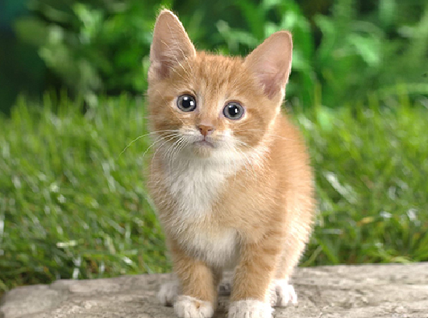
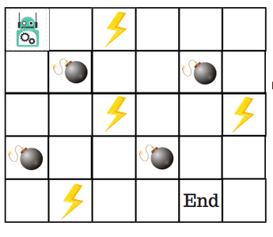
Types of Machine Learning
Supervised ML: predict an output given an input
Unsupervised ML: find structure in the data
Reinforcement Learning (RL): how to optimally act in an environment
Each method has specific data requirements
ML
Model
cat

Slide 4
Supervised ML
Requires: pairs of inputs and outputs
Doesn’t have to be tabular!
Input Features,
Explanatory variables
# | Lot (m2) | Floors | Built | Area | Price
1 | 500 | 3 | 1995 | Mishrif | 600K
2 | 750 | 2 | 1980 | Abdullah Al-Salem | 1.5M
… | … | … | … | … | …
Samples,
Instances,
Pairs
Output,
Dependent variable

Slide 5
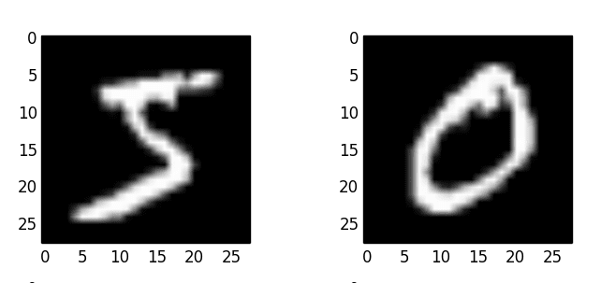
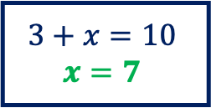
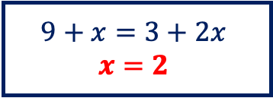

Supervised ML
$$3+x=10$$
$$x=7$$
$$9+x=3+2x$$
$$x=2$$
$$4x=5$$
Predicting student performance: given practice history, predict performance on next question
Predicting effects of removal of genes: given gene’s coprescipation, phosphorylation, gene ontology terms, predict whether the organism will be dead, sick, or healthy if it is knocked out (Al Anzi, et al. 2022)
Labeling an image: predict the object within an image
✓
✗
???
5 0

Slide 6
Unsupervised ML
Requires: inputs only (no dependent variables)
# | Sepal Length (cm) | Sepal Width (cm) | Petal Length (cm) | Petal Width (cm)
1 | 5.1 | 3.5 | 1.40 | 0.2
2 | 4.9 | 3.00 | 1.40 | 0.2
… | … | … | … | …

Slide 7
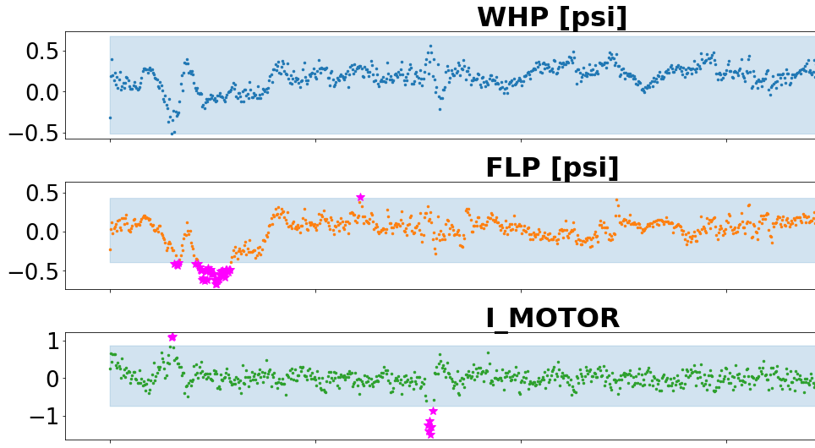
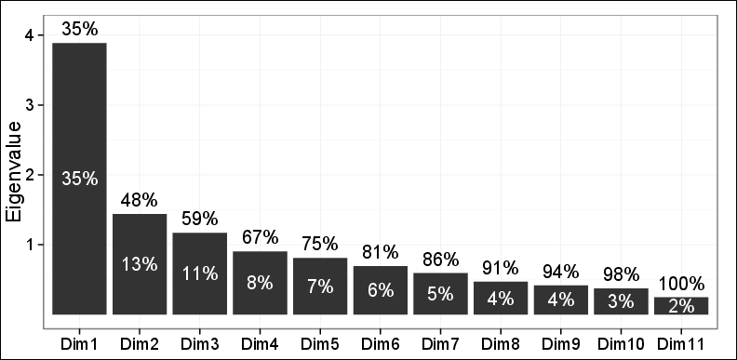
Unsupervised ML
Clustering: what are the most likely groupings of a set of documents?
Dimension Reduction: which features explain most of the variability in house features?
Anamoly Detection: is the electric submersible pump (ESP) operating normally?
Principal Components Analysis (PCA)
Sepal Width (cm)
Petal Length (cm)
Pretraining LLMs: LLMs are trained to predict next token given the previous token

Slide 8
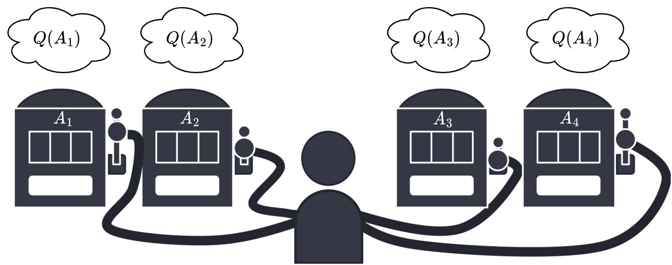
Reinforcement Learning
Requires an environment and a reward function
K-armed bandits: you got 4 machines, each time you play one machine you get a reward with some mean and variance. Which machine to play to maximize reward?
Maze navigation: what is the optimal action to take in any given state, to reach a goal?
LLM Alignment: what should the LLM output to ensure that the output is not offensive?

Slide 9
Typical ML Pipeline
Be REALLY Careful here!
Data Acquisition
Modeling
Training
Evaluation
Model?
Linear regression
Gaussian process
Neural Network
Features?
Which ones?
Pre-transform?
Objective function?
MSE, MAE, CE, …
Optimization algorithm?
GD, SGD, NADAM, …
Prevent Overfitting?
L1/L2 regularization, early-stopping
Evaluation Metric?
MSE, MAE, F1, AUC-ROC,…
Evaluation Setup?
Random train/test, cross-validation, etc.
Notes:
MSE: Mean Squared Error
MAE: Mean Absolute Error
CE: Cross Entropy
GD: Gradient Descent
SGD: Stochastic Gradient Descent
NADAM: Nestrov-Accelerated Adam Optimizer
AUC-ROC: Area Under ROC curve

Slide 10
Why Python?
A scripting language lets you explicitly define the whole data processing & modeling pipeline => better for reproducability
There are multiple scripting languages to choose from: Python, R, Matlab, Julia, etc.
Most of these are either commercial (vendor lock-in) or not general-purpose so you can only do one thing in them.
Python has strong ML and scientific computing libraries AND it is a general purpose programming language
You can code a website AND the ML pipeline in the same language
Example: https://ssdd.kisr.edu.kw/gi_pred/search_gi

Slide 11
Installing Python
Install the uv tool on your system (https://docs.astral.sh/uv)
Open up a new terminal or command prompt:
Install Python 3.12: uv python install 3.1
Create virtual environment: uv venv --python 3.12
Activate virtual environment:
On Windows: .venv\Scripts\activate
On Mac/Linux: . .venv/bin/activate
Install required libraries: uv pip install numpy pandas matplotlib seaborn jupyterlab scikit-learn jax statsmodels

Slide 12
Jupyter Notebook
An interactive Python interpreter where you can mix documentation + code
Web-based interface
To launch on Windows:
Right click on the windows logo in the taskbar
Click “Command Prompt”
Activate virtual environment: .venv\scripts\activate
Run Jupyter: jupyter lab
The browser should launch after a few seconds

Slide 13
Coding Exercise
Quick overview of numpy & pandas
Load a dataset
Visualize it

