Slide 1
Block 6: Feature Selection
Mohammad M. Khajah
October 2025

Slide 2
Do We Need All Features?
Not all features may be necessary:
Some might be correlated with each other
Some might not be informative
Some might lead to overfitting
We’ll cover two strategies to deal with this:
Brute-force: consider all possible combinations of input feature sets
Greedy: sequentially add the “next best” input feature

Slide 3
Brute-Force Feature Selection
If you have K possible input features, there are 2^{K} – 1 possible input feature sets
So we need to train & evlauate 2^{K} – 1 models
For each possible input set, evaluate the performance (more on this later)
Pick the input set that yields best performance
Guaranteed to be optimal but scales poorly as the features increase
Horsepower | Displacement | Cylinders
0 | 0 | 1
0 | 1 | 0
0 | 1 | 1
1 | 0 | 0
1 | 0 | 1
1 | 1 | 0
1 | 1 | 1

Slide 4
Greedy Feature Selection
Empty Set
Pick the best feature
Given the picked feature, pick the best remaining feature that improves by at least x%
Repeat until there are no features to add
Efficient but not guaranteed to be optimal
Step 1
F1
F2
F3
F4
F5
Step 2
F1
F2
F4
F5
Step 3
F1
F4
F5
No feature improves sufficiently, STOP
Best : F3 and F2

Slide 5
Unifying Both Approaches
No
Next candidate?
Yes
New Best Score?
Evaluate
No
Set Feature Set as New Best
Yes
Stop
Brute Force would enumerate all possible candidates
Greedy would select according to previous slide

Slide 6
But, How to Evaluate a Feature Set?
No
Next candidate?
Yes
New Best Score?
Get MSE from Cross Validation
No
Set Feature Set as New Best
Yes
Stop

Slide 7
But, How to Evaluate a Feature Set?
No
Next candidate?
Yes
New Best Score?
Get MSE from Cross Validation
No
Set Feature Set as New Best
Yes
Stop
Bad Idea! we are peaking at the average CV scores to pick the best feature (like cheating on an exam!)

Slide 8
Correct Approach
Feature selection must be done on the training set only
Select best model
based on the training Set
(inner loop)
Train best model on training set
Evaluate best model on the test set
Next Training and Testing Sets
Selection step can done on the training set using the approach in the previous slide => this is called nested cross validation

Slide 9
But I Want ONE Feature Set!
Nested CV yields 5 feature sets, one per training/testing fold, which one to pick?
Evaluate using nested CV
If average MSE is good, run the feature selection process on the whole dataset
You will get one feature set as the outcome of this process
Why? nested CV is used to show that model+feature selection can generalize well, so we can trust the selected features

Slide 10
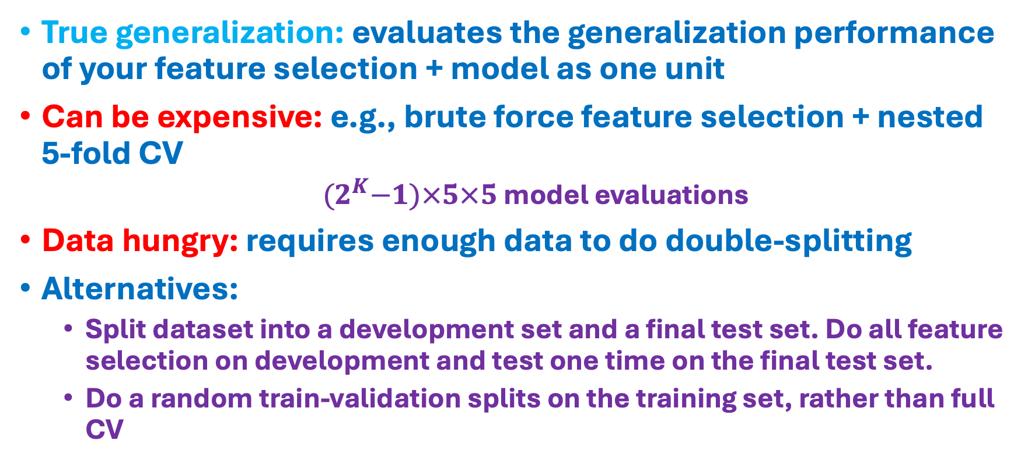
Pros and Cons
True generalization: evaluates the generalization performance of your feature selection + model as one unit
Can be expensive: e.g., brute force feature selection + nested 5-fold CV
${(2}^{K}−1)×5×5$ model evaluations
Data hungry: requires enough data to do double-splitting
Alternatives:
Split dataset into a development set and a final test set. Do all feature selection on development and test one time on the final test set.
Do a random train-validation splits on the training set, rather than full CV

Slide 11
Examples of Both
Bader F Al-Anzi, Mohammad Khajah, Saja A Fakhraldeen, Predicting and explaining the impact of genetic disruptions and interactions on organismal viability, Bioinformatics, Volume 38, Issue 17, September 2022, Pages 4088–4099.
Hesham A Almansouri, Mohammad M Khajah, Nasser B Alsnayen, Machine learning model for predicting cyber-criminal characteristics, Kuwait Journal of Science, Volume 53, Issue 1, 2025.

Slide 12
Coding
Brute force feature selection
Greedy feature selection
Apply to our model

