Slide 1
Block 11: Multi Layer Perceptron
Mohammad M. Khajah
October 2025

Slide 2
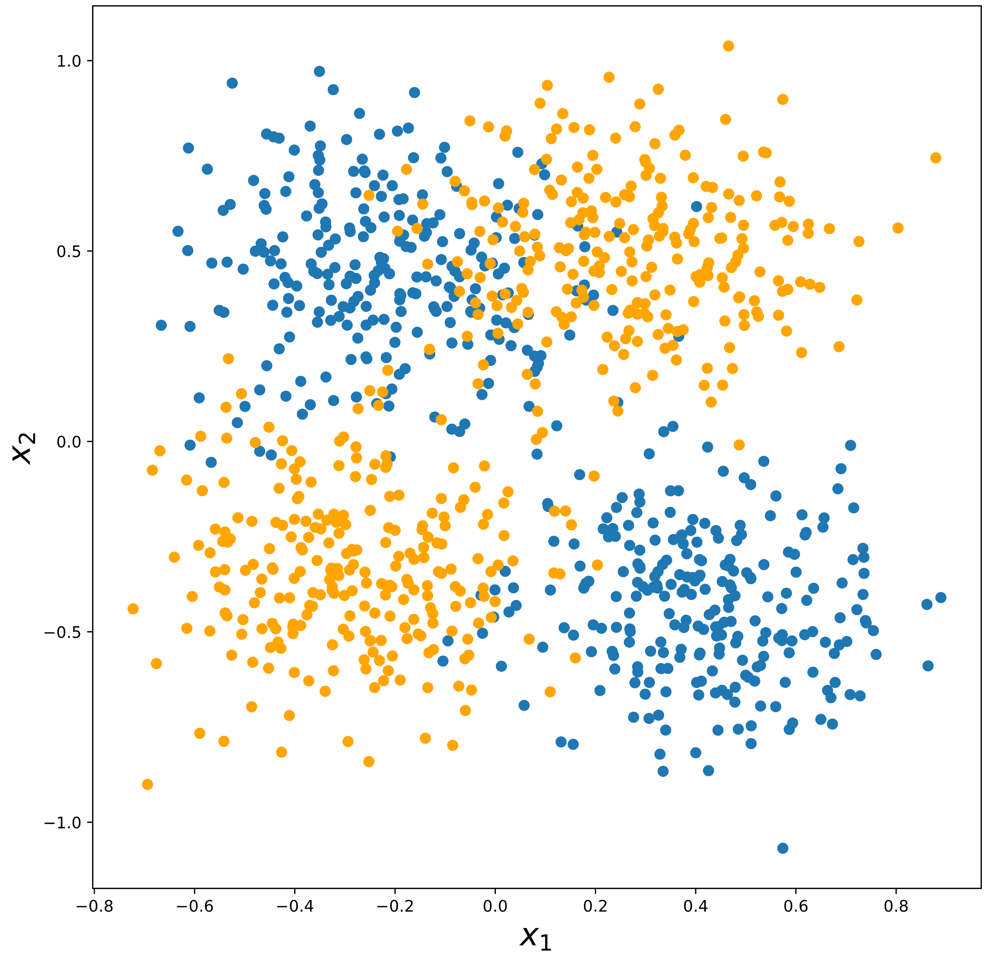
Can Logistic Regression Handle This?

Slide 3
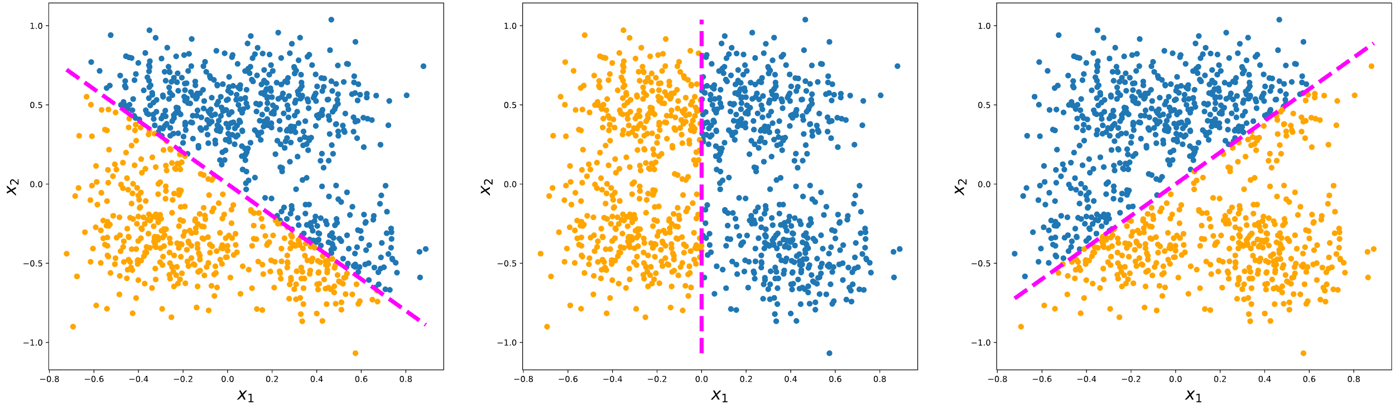
Can Logistic Regression Handle This?
No line can neatly separate the two classes

Slide 4
Solution: Introduce Non-Linearities
1
b₀
b₁
Σ
x₁
P(Blue Point)
x₂
b₂
This is our current logistic regression setup

Slide 5
Solution: Introduce Non-Linearities
Hidden Layer
1
Hidden Unit
Σ
x₁
Σ
P(Blue Point)
Σ
x₂
1
Multilayer Perceptron (MLP) – Your First Neural Net!

Slide 6
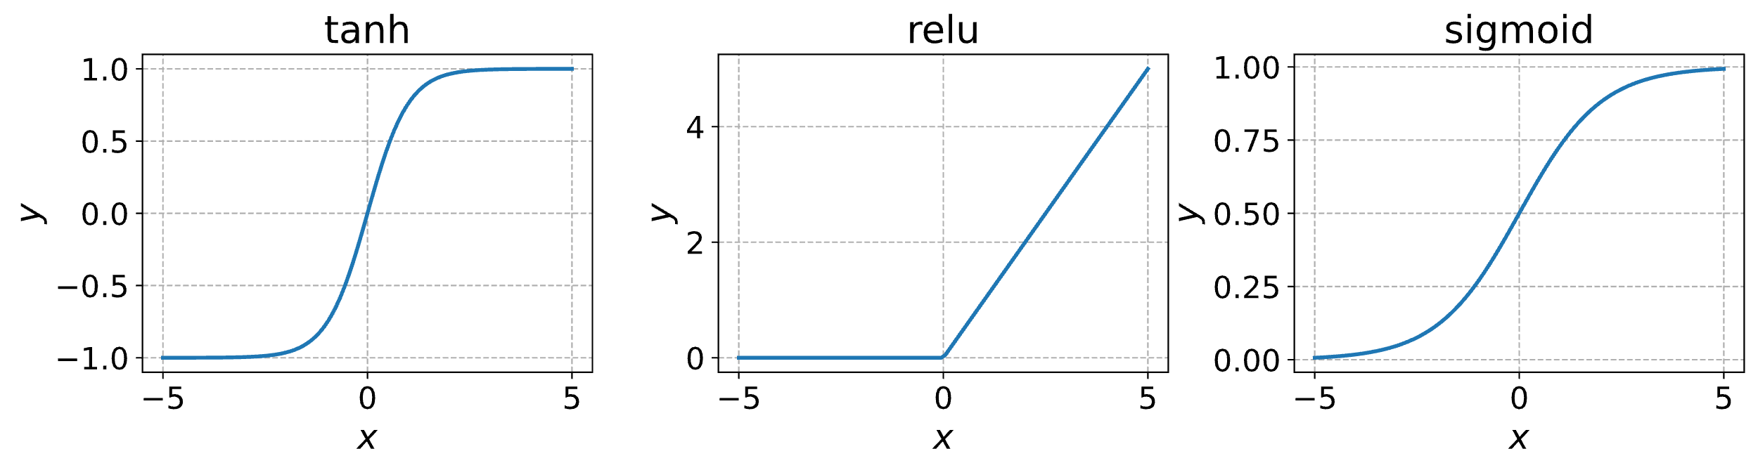
What Kind of Non-Linearities?

Slide 7
Gradient Calculation
1
Σ
H_2
x₁
Σ
P(Blue Point)
Σ
o
x₂
1
Notes:
Excellent source: https://visionbook.mit.edu/backpropagation.html

Slide 8
Weight Initialization Matters!
At the start of training, network weights are randomly initialized
Say the initialization is from a distribution with mean 0 and variance 1
If a hidden unit is taking inputs from N units in the previous layer, each multiplied by a randomly initialized weight, the summation will have variance N! => Blowing up forward pass
Strategies have been developed to counteract this, the most obvious one is LeCun initialization:
Draw weights from the distribution such that the variance of a weight is 1/N

Slide 9
Coding
Get an intuition for the kinds of functions MLP can represent
Implement MLP
Train on the nonseparable data and evaluate
Visualize results

