Slide 1
Block 11: Multi Layer Perceptron
Mohammad M. Khajah
October 2025

Slide 2
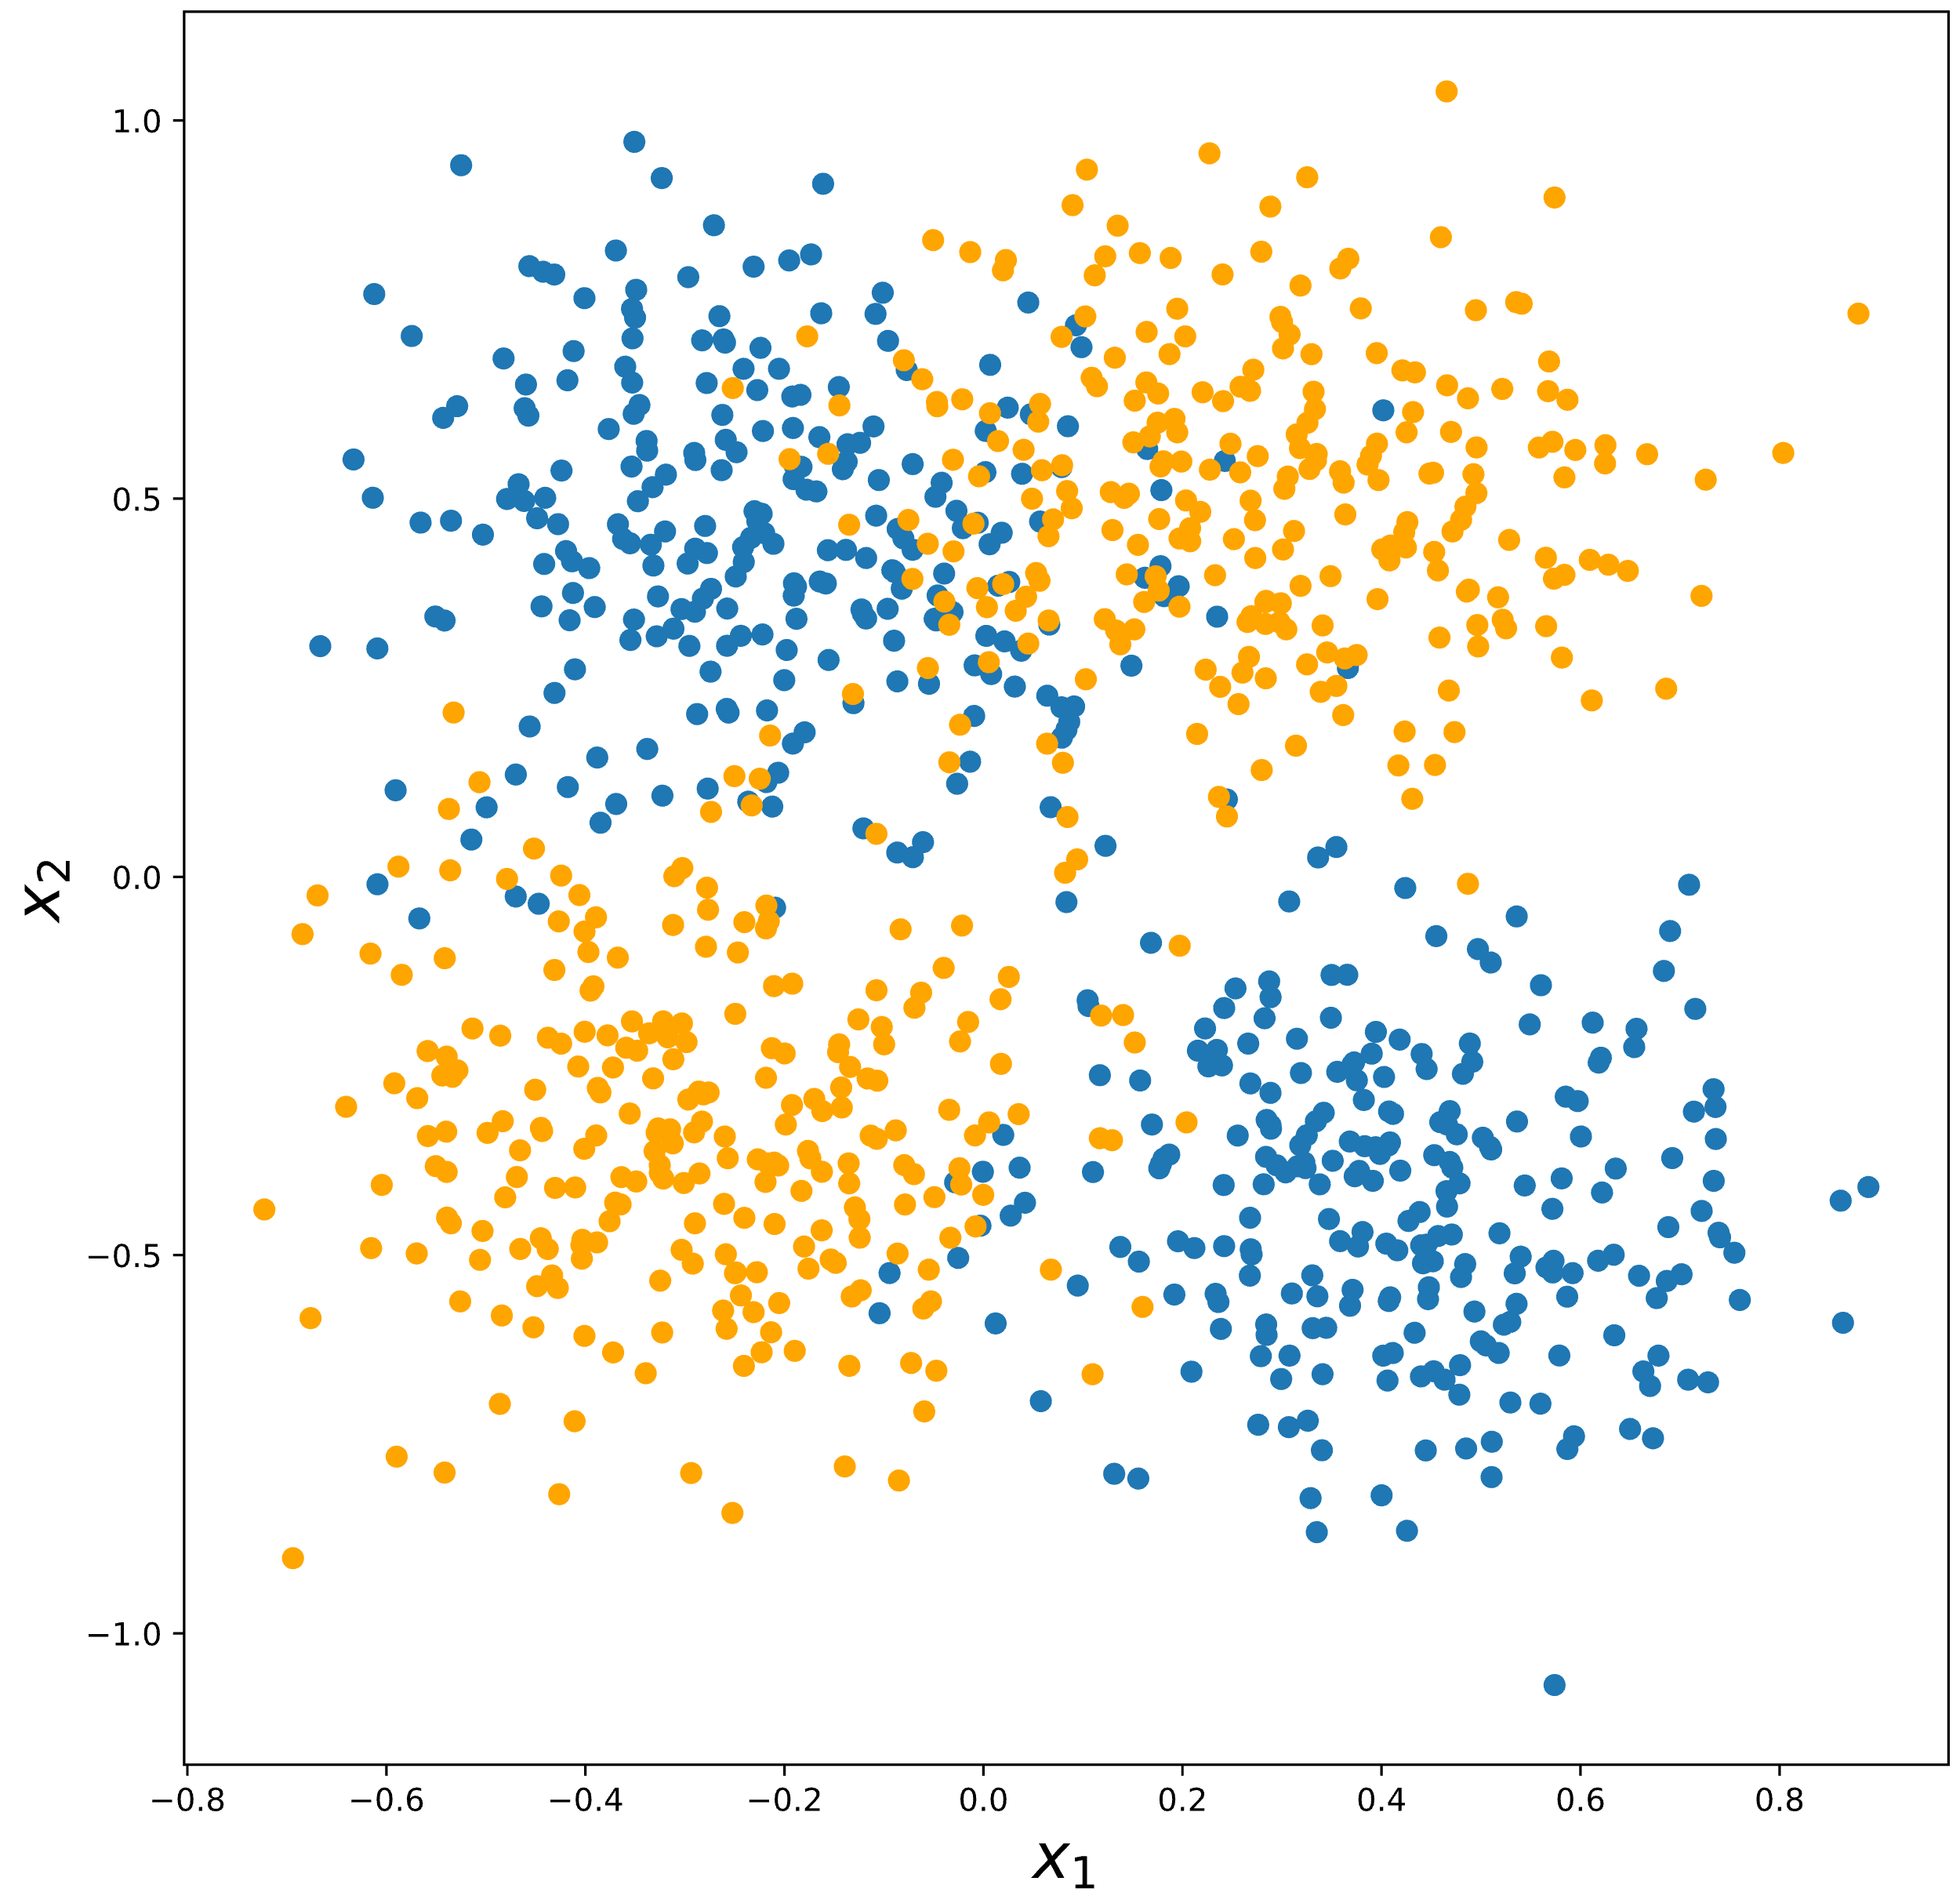
Can Logistic Regression Handle This?

Slide 3
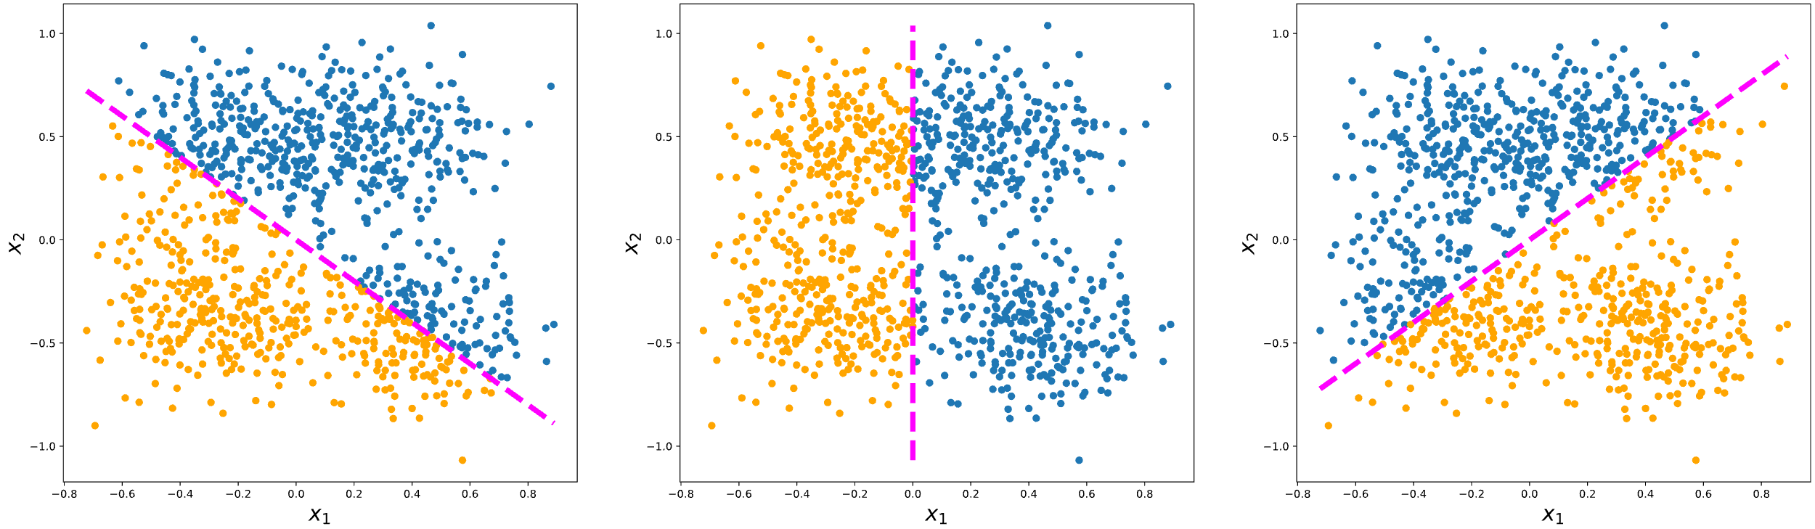
Can Logistic Regression Handle This?
No line can neatly separate the two classes
History: this problem caused the first AI winter in the 1970s

Slide 4

Logistic Regression Diagram
1
b₀
b₁
Σ
x₁
P(Blue Point)
x₂
b₂
P(Blue Point) = $\frac{1}{1+exp\left(−(β_{0}+β_{1}x_{1}+β_{2}x_{2})\right)}$

Slide 5
Solution: Introduce Non-Linearities
Hidden Layer
1
Hidden Unit
Σ
x₁
Σ
P(Blue Point)
Σ
x₂
1
Activations
Activation
Function
Multilayer Perceptron (MLP) – Your First Neural Net!

Slide 6
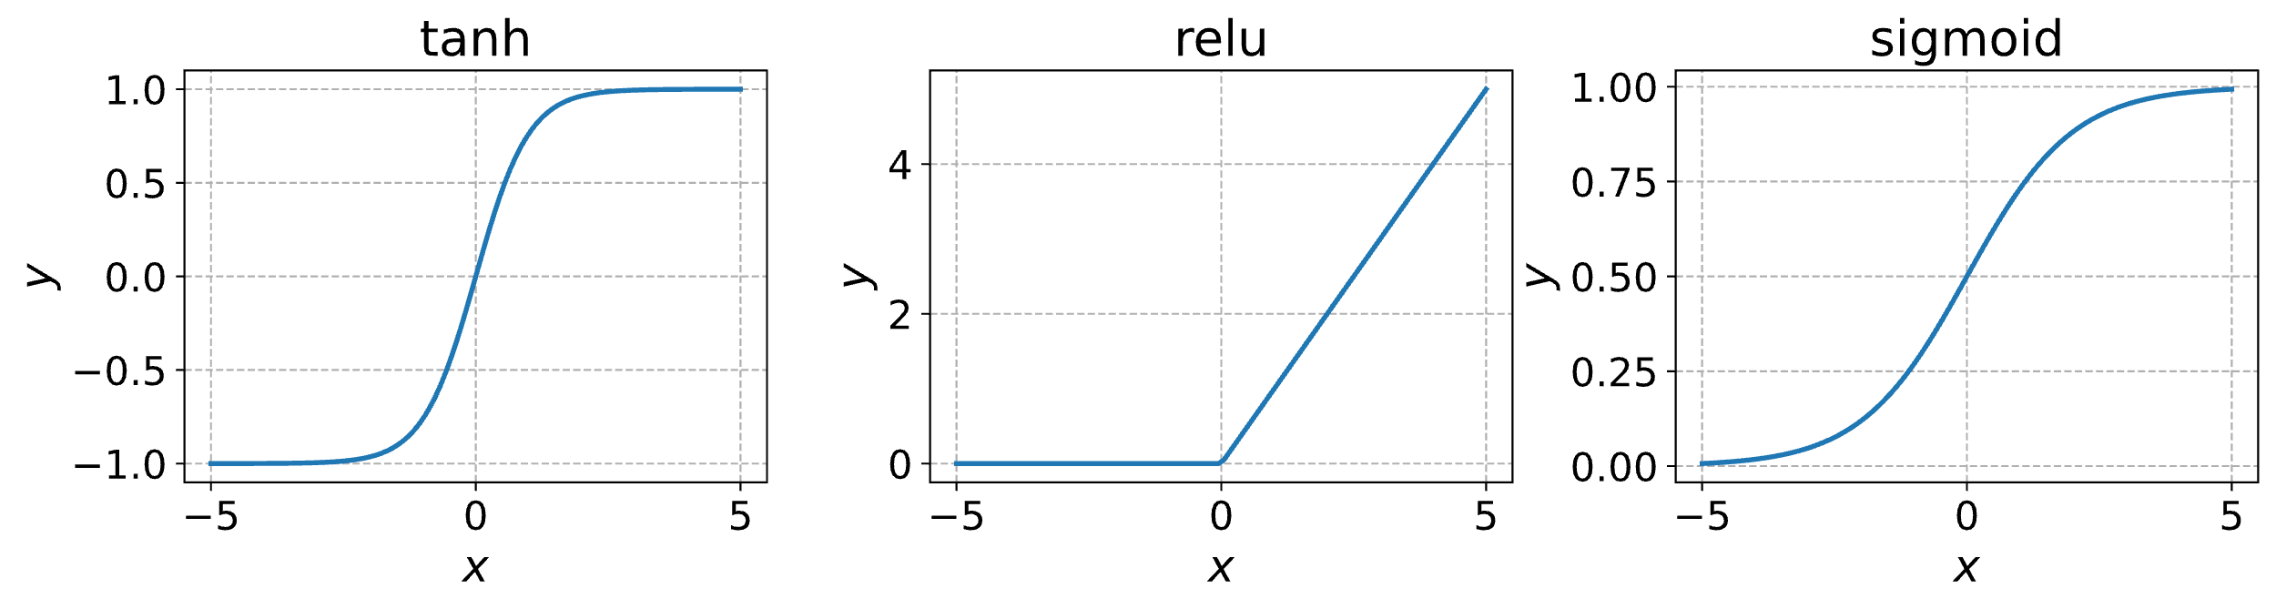
Common Non-Linear Activation Functions

Slide 7
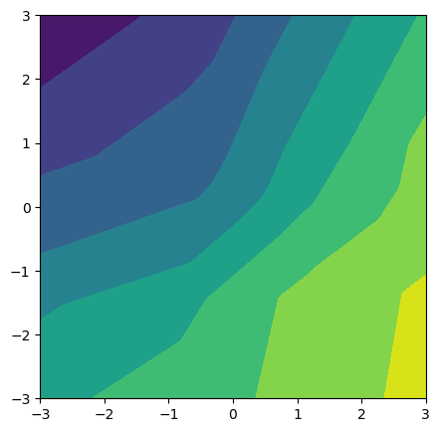
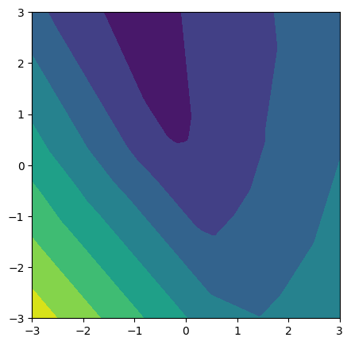
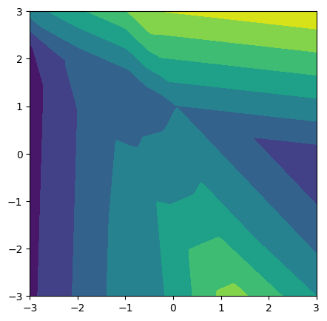
Why Non-Linearities?
MLP can represent more complex input – output relationships
Examples of randomly initialized MLP with 2 inputs, and 20 hidden ReLU units
Changing weights => different functions

Slide 8
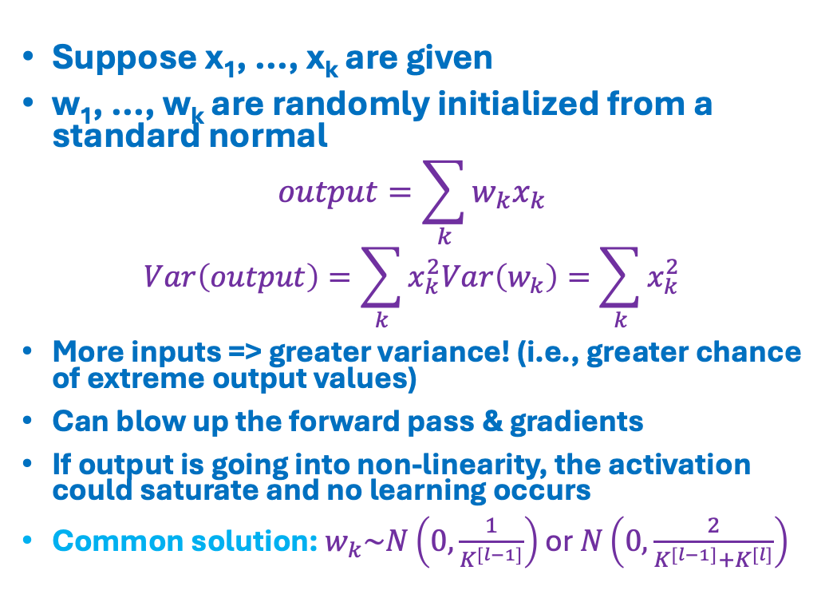
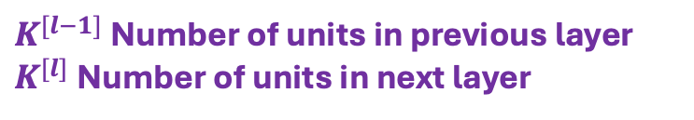

Weight Initialization Matters
x₁
Suppose x₁, ..., x_{k} are given
w₁, ..., w_{k} are randomly initialized from a standard normal
$$output=\sum_{k}{w_{k}x_{k}}$$
$$Var\left(output\right)=\sum_{k}{x_{k}^{2}Var\left(w_{k}\right)=\sum_{k}{x_{k}^{2}}}$$
More inputs => greater variance! (i.e., greater chance of extreme output values)
Can blow up the forward pass & gradients
If output is going into non-linearity, the activation could saturate and no learning occurs
Common solution: $w_{k}\sim N\left(0,\frac{1}{K^{[l−1]}}\right)$ or $N\left(0,\frac{2}{K^{[l−1]}+K^{[l]}}\right)$
w₁
x₂
x₃
Σ
x₄
output
…
$$w_{K^{[l−1]}}$$
x_{K}
$K^{[l−1]}$ Number of units in previous layer
$K^{[l]}$ Number of units in next layer
Notes:
Backprop: Excellent source: https://visionbook.mit.edu/backpropagation.html
Extended expalanation: https://www.deeplearning.ai/ai-notes/initialization/index.html

Slide 9
Coding
Get an intuition for the kinds of functions MLP can represent
Implement MLP
Train on the nonseparable data and evaluate
Visualize results

