Slide 1
Block 3: Gradient Descent
Mohammad M. Khajah
October 19 2025

Slide 2
Scalability of Brute Force Optimization
We used brute force to find b0 in b1 in:
MPG = b0 + b1 * HP
Considered a grid of 100x100 values of b0 and b1
Curse of dimensionality: 10,000 combinations for just two params!
Large Language Models have billions of parameters!
Use gradiant descent

Slide 3
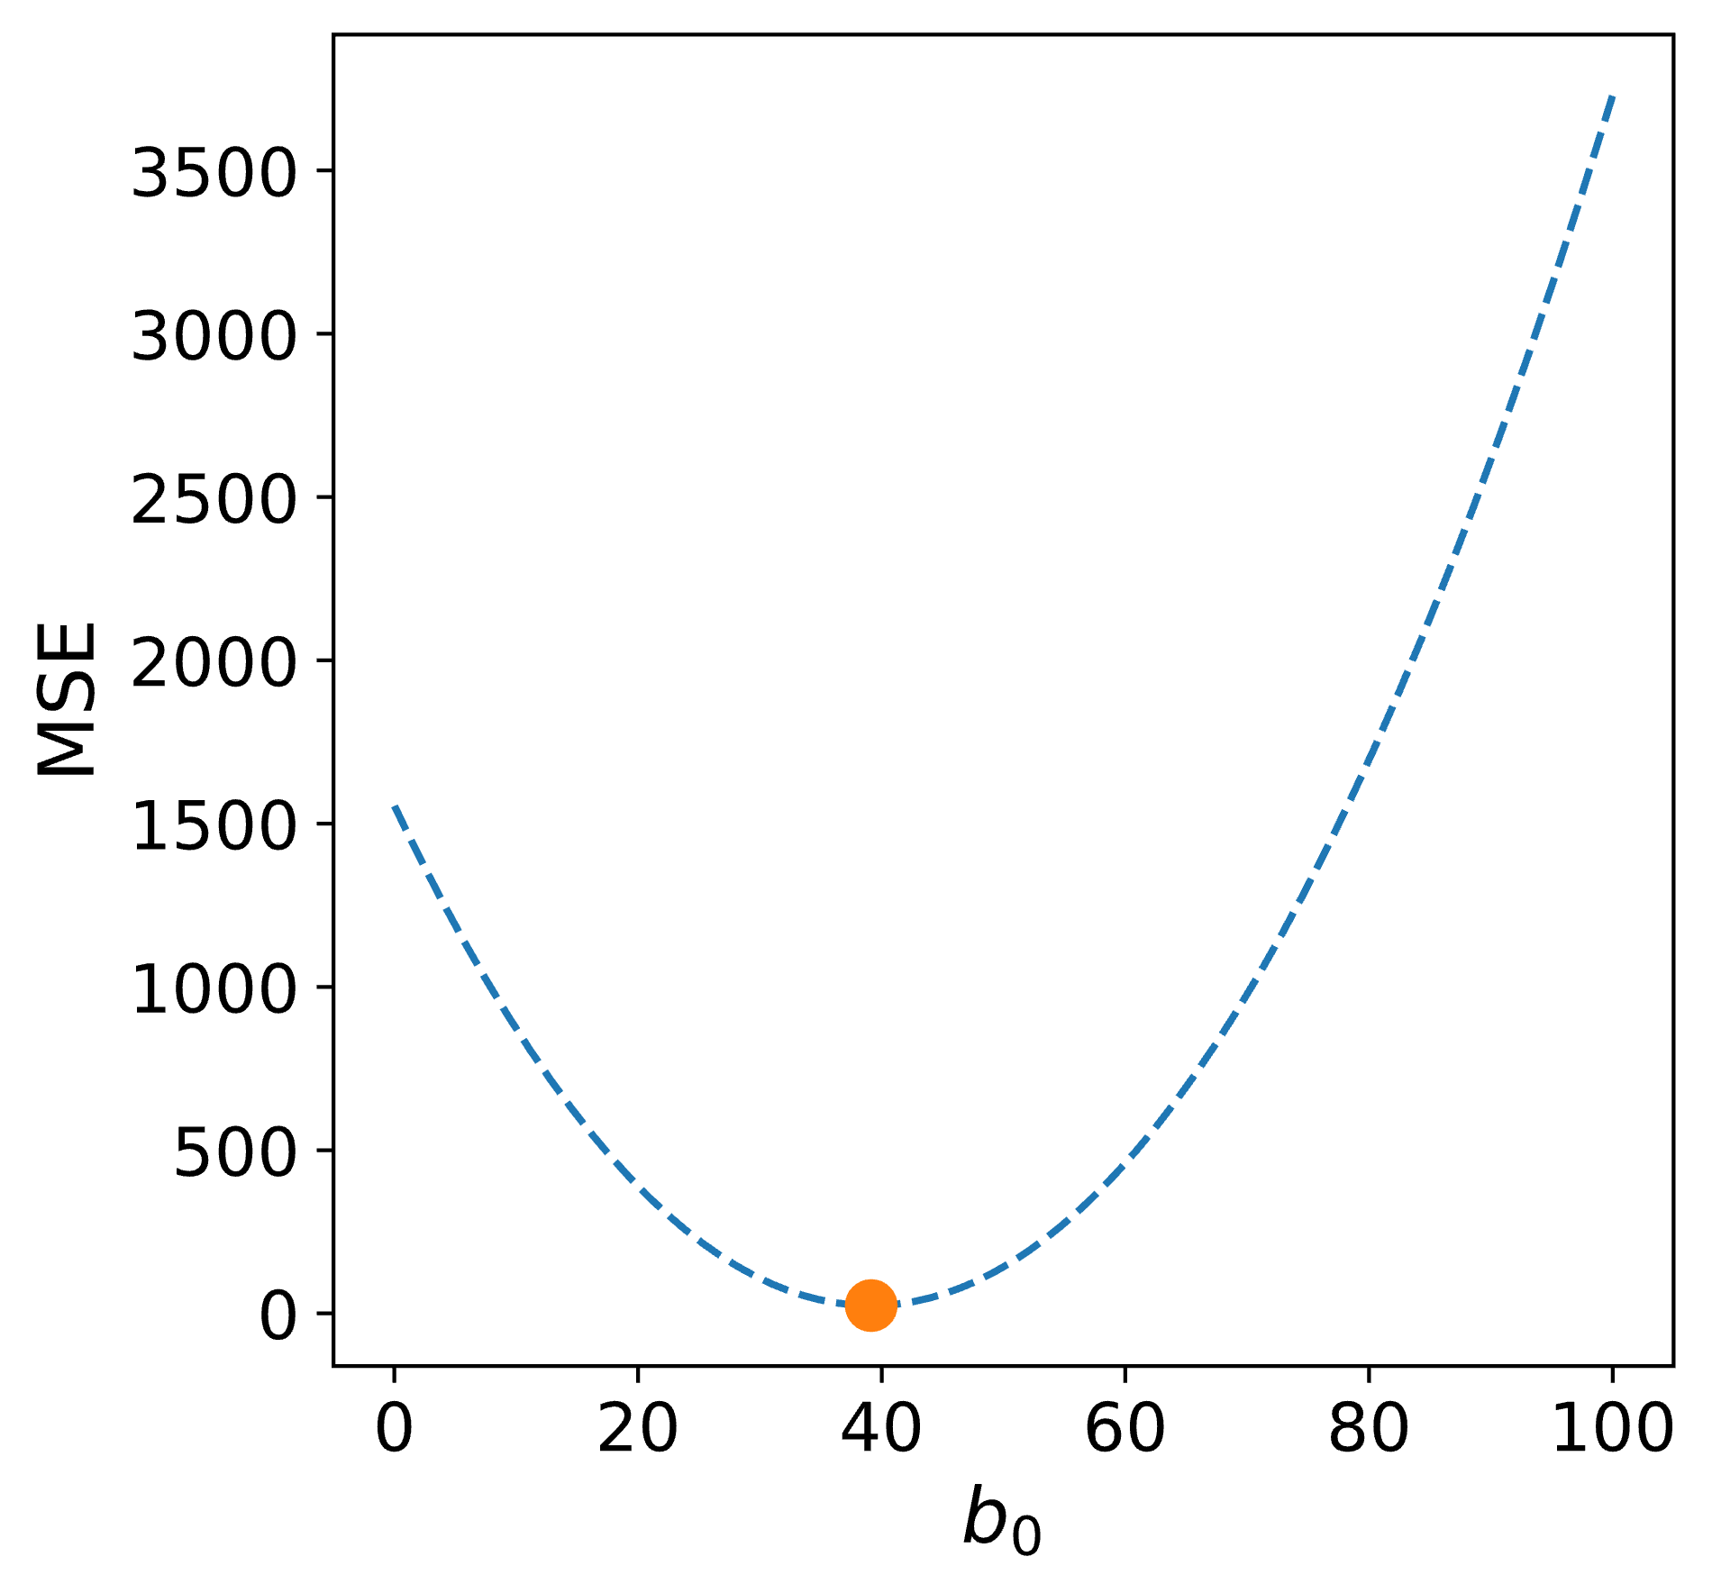
Gradient Descent
Start at some random point
Evaluate loss at that point
Take a step in the downward direction
Repeat until you hit the minimum
How to find the “downward direction?”

Slide 4
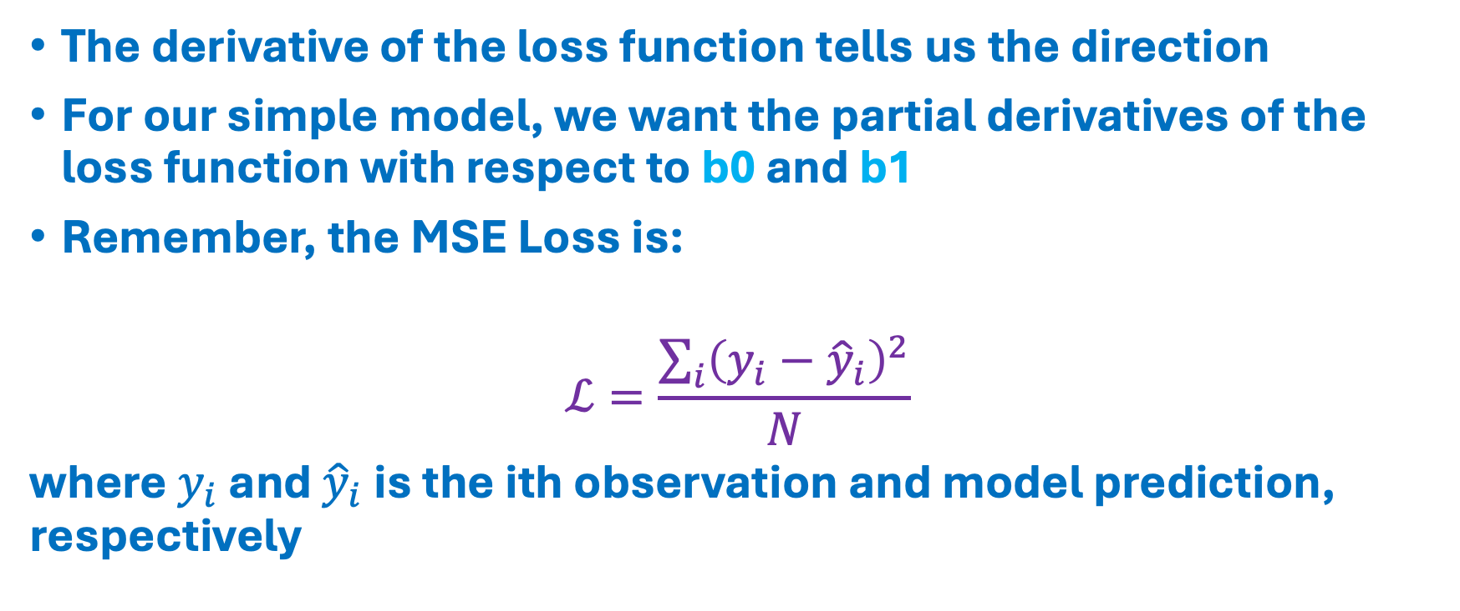
Calculus 101
The derivative of the loss function tells us the direction
For our simple model, we want the partial derivatives of the loss function with respect to b0 and b1
Remember, the MSE Loss is:
$$ℒ=\frac{\sum_{i}{{\left(y_{i}−{\hat{y}}_{i}\right)}^{2}}}{N}$$
where $y_{i}$ and ${\hat{y}}_{i}$ is the ith observation and model prediction, respectively

Slide 5
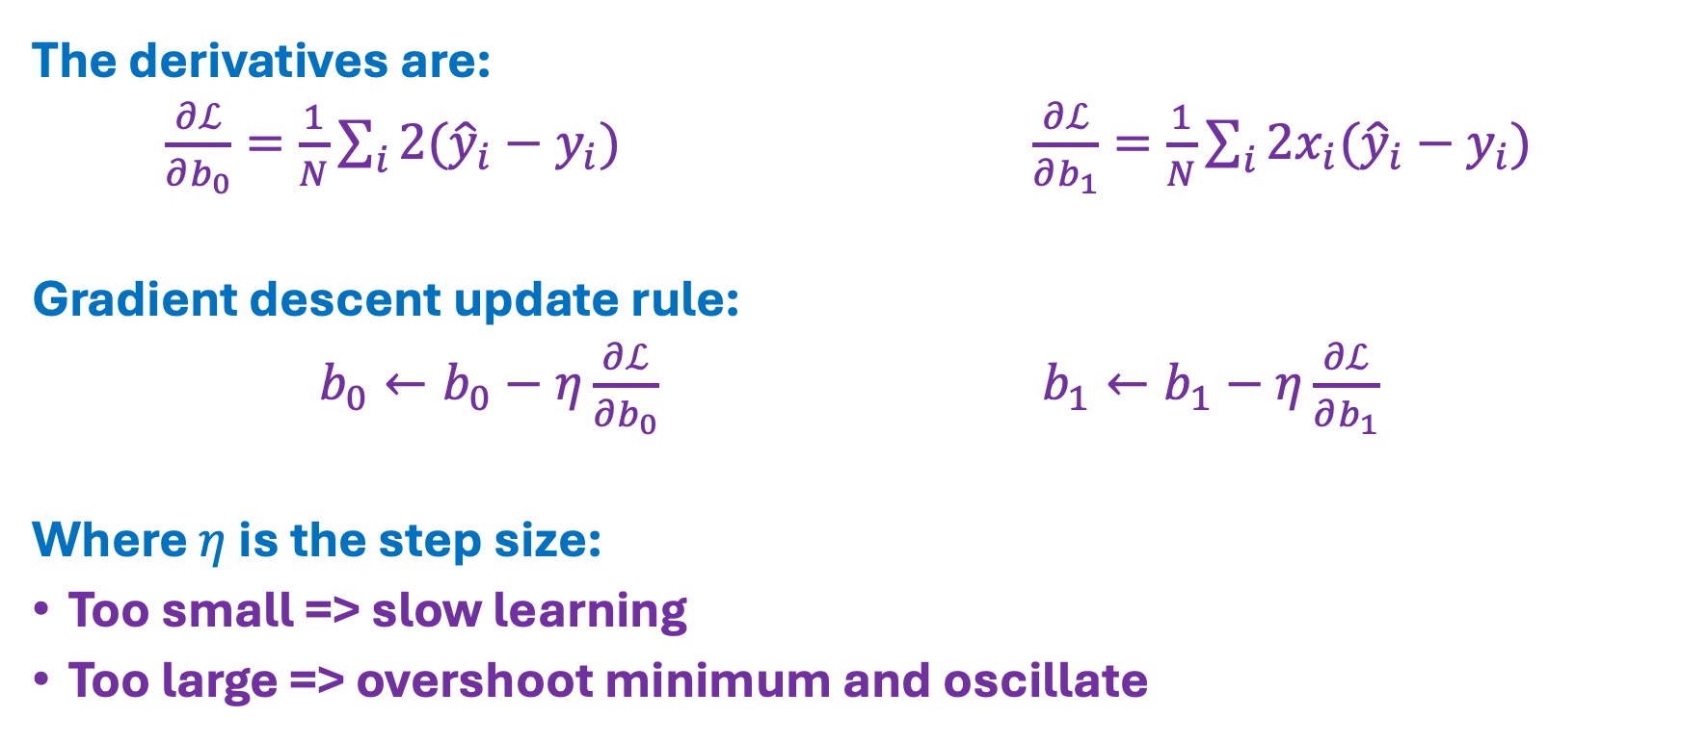
Calculus 101
The derivatives are:
$\frac{∂ℒ}{∂b_{0}}=\frac{1}{N}\sum_{i}{2({\hat{y}}_{i}}−y_{i})$ $\frac{∂ℒ}{∂b_{1}}=\frac{1}{N}\sum_{i}{2x_{i}({\hat{y}}_{i}}−y_{i})$
Gradient descent update rule:
$b_{0}←b_{0}−η\frac{∂ℒ}{∂b_{0}}$ $b_{1}←b_{1}−η\frac{∂ℒ}{∂b_{1}}$
Where $η$ is the step size:
Too small => slow learning
Too large => overshoot minimum and oscillate

Slide 6
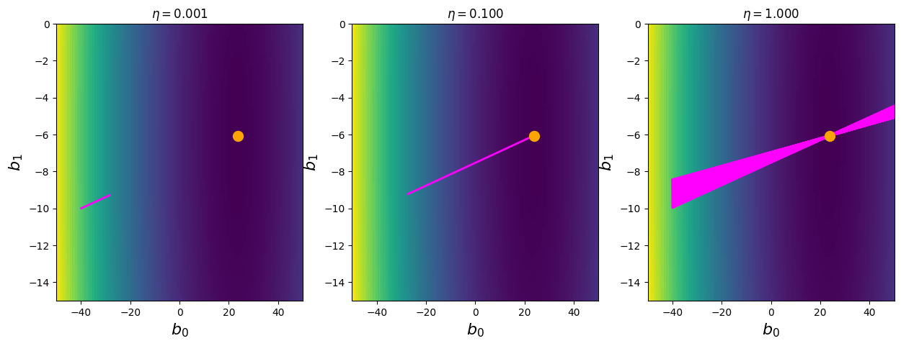
Example

Slide 7
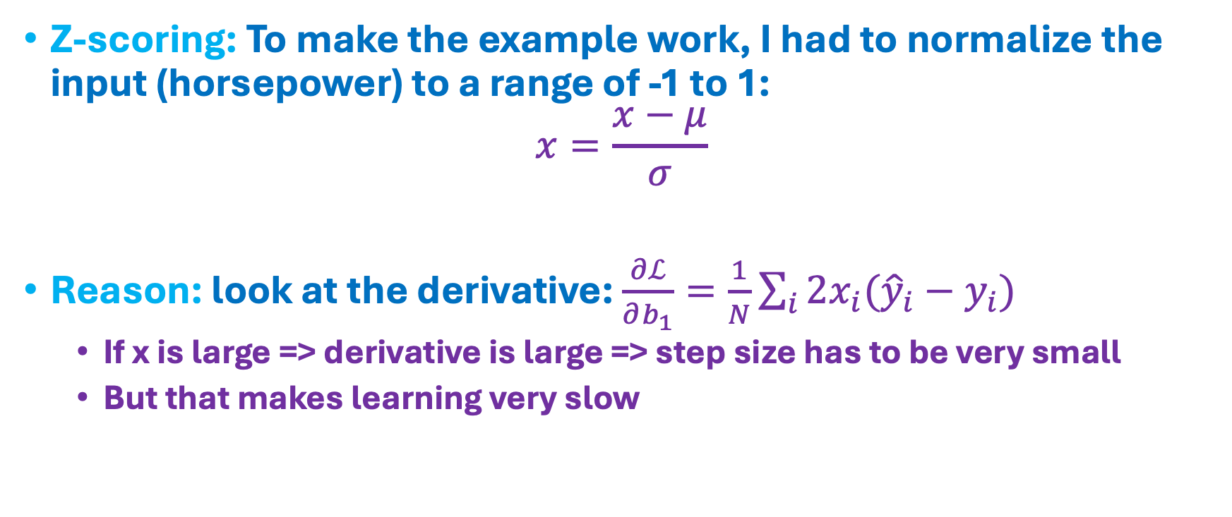
Cautionary Note
Z-scoring: To make the example work, I had to normalize the input (horsepower) to a range of -1 to 1:
$$x=\frac{x−μ}{σ}$$
Reason: look at the derivative: $\frac{∂ℒ}{∂b_{1}}=\frac{1}{N}\sum_{i}{2x_{i}({\hat{y}}_{i}}−y_{i})$
If x is large => derivative is large => step size has to be very small
But that makes learning very slow

Slide 8
Coding
Load dataset
Z-score inputs
Optimize model with gradient descent
Try different input features

