Slide 1
Block 4: Multivariate Linear Regression
Mohammad M. Khajah
October 19 2025

Slide 2
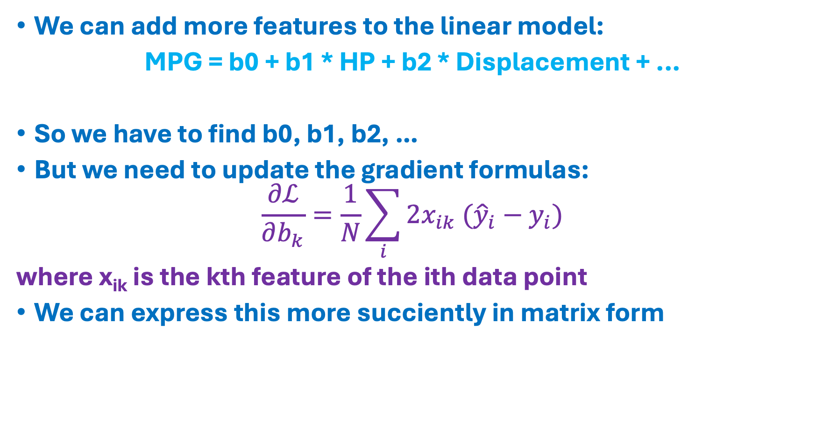
Why Just One Feature?
We can add more features to the linear model:
MPG = b0 + b1 * HP + b2 * Displacement + ...
So we have to find b0, b1, b2, …
But we need to update the gradient formulas:
$$\frac{∂ℒ}{∂b_{k}}=\frac{1}{N}\sum_{i}{2x_{ik} ({\hat{y}}_{i}}−y_{i})$$
where x_{ik} is the kth feature of the ith data point
We can express this more succiently in matrix form

Slide 3
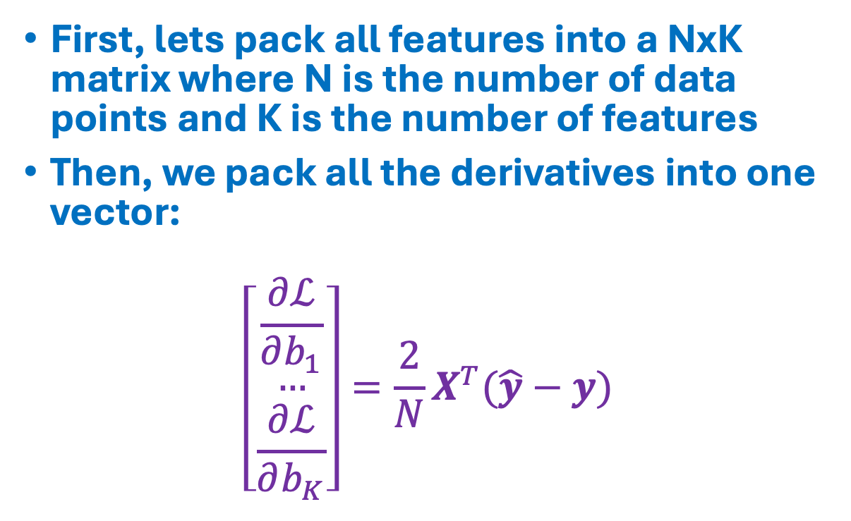
Gradient Formulas
First, lets pack all features into a NxK matrix where N is the number of data points and K is the number of features
Then, we pack all the derivatives into one vector:
$$\left[\begin{matrix}\frac{∂ℒ}{∂b_{1}} \\ … \\ \frac{∂ℒ}{∂b_{K}}\end{matrix}\right]=\frac{2}{N}X^{T}(\hat{y}−y)$$
x₀₀
x₀₁
x_{0K}
…
x₁₀
x₁₁
x_{1K}
…
…
x_{N0}
x_{N1}
…
x_{NK}
Nx1
KxN

Slide 4
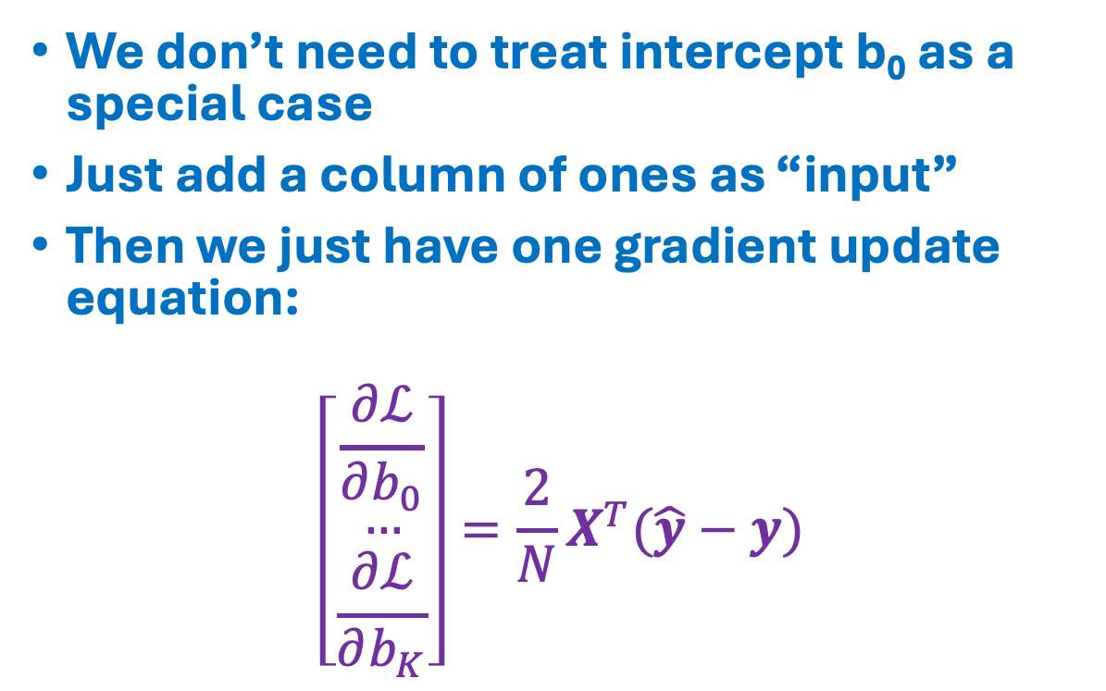
Gradient Formulas
We don’t need to treat intercept b₀ as a special case
Just add a column of ones as “input”
Then we just have one gradient update equation:
$$\left[\begin{matrix}\frac{∂ℒ}{∂b_{0}} \\ … \\ \frac{∂ℒ}{∂b_{K}}\end{matrix}\right]=\frac{2}{N}X^{T}(\hat{y}−y)$$
1
x₀₀
x₀₁
x_{0K}
…
1
x₁₀
x₁₁
x_{1K}
…
…
1
x_{N0}
x_{N1}
…
x_{NK}
Nx1
(K+1)xN

Slide 5
What About Nominal Features?
Some features are not numeric, e.g., country of origin
Solution: one-hot encoding
Convert to binary vector of length L
Each element maps to a particular value (country)
In statistical literature, features could also be converted into vector of length L-1, with one value being set aside as a “reference”
Features
USA
1
0
0
Europe
0
1
0
Japan
0
0
1

Slide 6
How About Feature Transformations?
Example: a house’s price depends on the combination of length and width of the area, not on either one alone
Price = b0 + b1 * Length + b2 * Width + b3 * Width * Height
Example: response times are typically modeled logarithmaclly (differences in small values matter, whereas differences in large values do not)
Success Rate = b0 + b1 * Log(response time)
With linear regression, you do all your feature transformations before you feed them into the model
Interaction Term

Slide 7
Coding
One-hot encoding of categorical features
Implement gradient descent for multiple features
Optimize model with gradient descent

