Slide 1
Block 5: Evaluation
Mohammad M. Khajah
October 2025

Slide 2
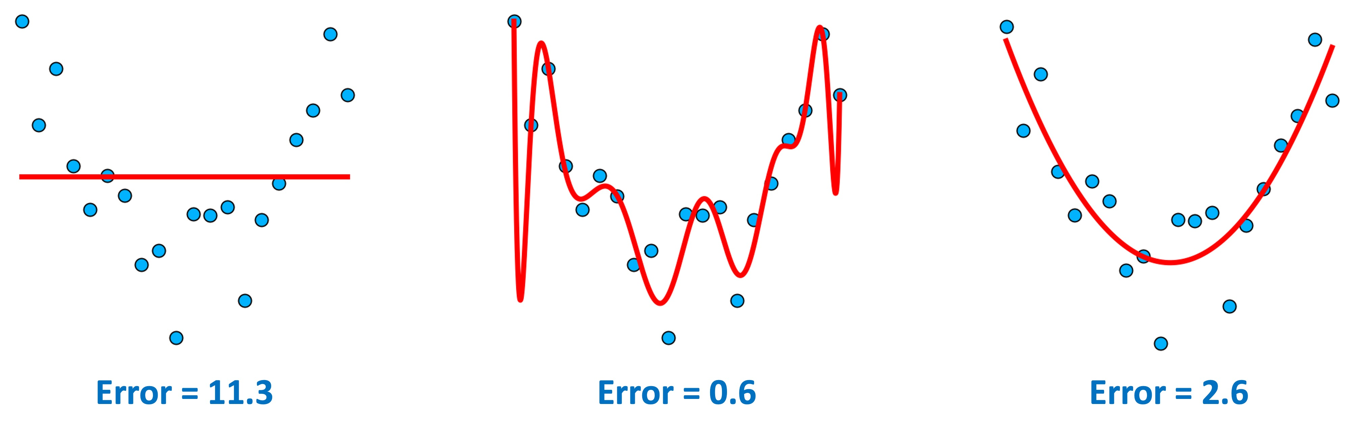
Evaluating on All Data
So this is best, right?

Slide 3
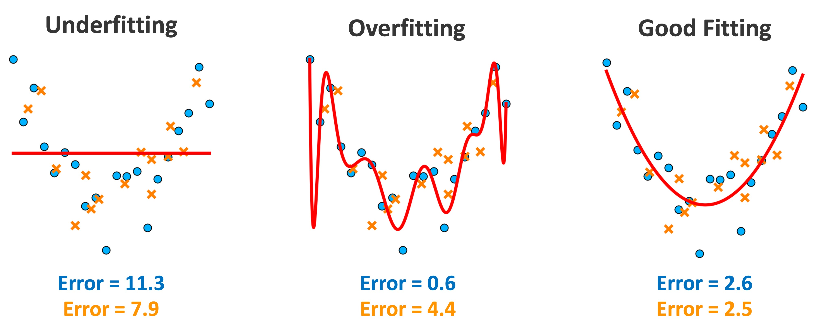
The Problem: Testing on New Data
Evaluation MUST be done on data the model has not been trained on

Slide 4
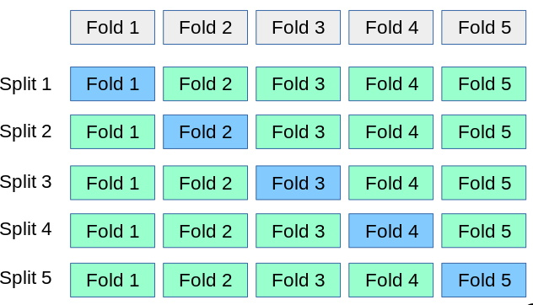
Generalization to New Data
One solution: random training/testing split
Split data randomly into training and testing
Train on training dataset and evaluate MSE on testing
Repeat multiple times and average the MSEs
Better: cross-validation (CV)
Shuffle and split into N folds
Train on N-1 folds (green boxes) and test on the blue box
Average MSEs from blue boxes

Slide 5
Coding
Demonstrate how K-fold validation works
Modify our code to train on some dataset and evaluate some other dataset
Apply CV to obtain the average MSE and standard error

