Slide 1
Block 2: Univariate Linear Regression
Mohammad M. Khajah
October 19 2025

Slide 2
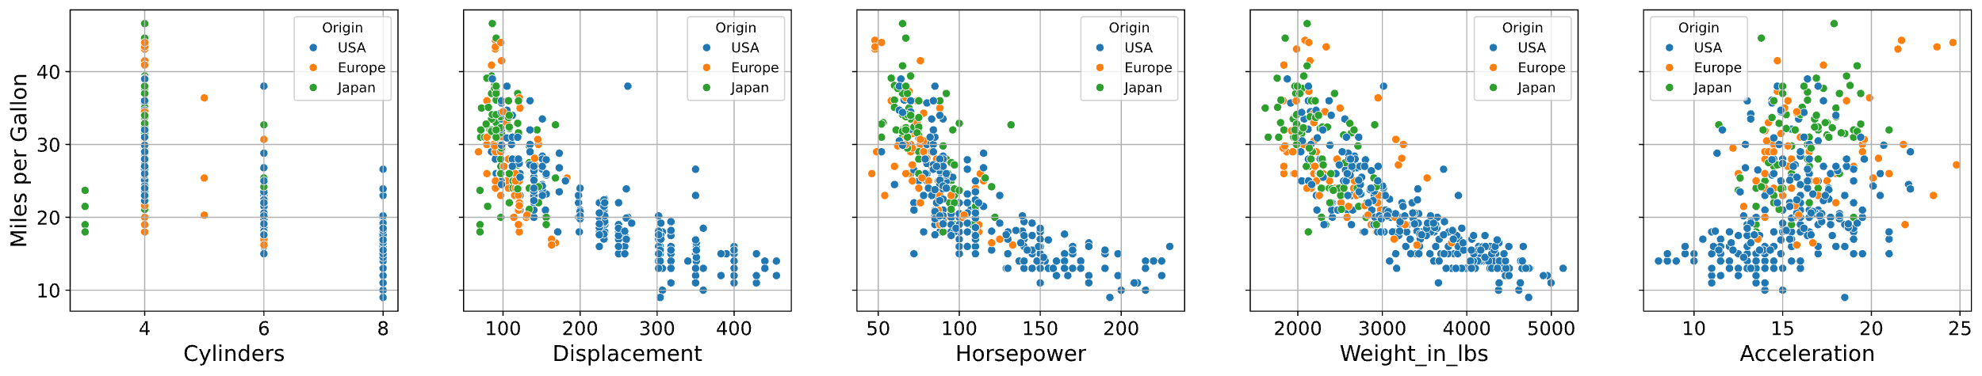
Predicting Fuel Economy
Let’s try predicting fuel economy based on horsepower

Slide 3
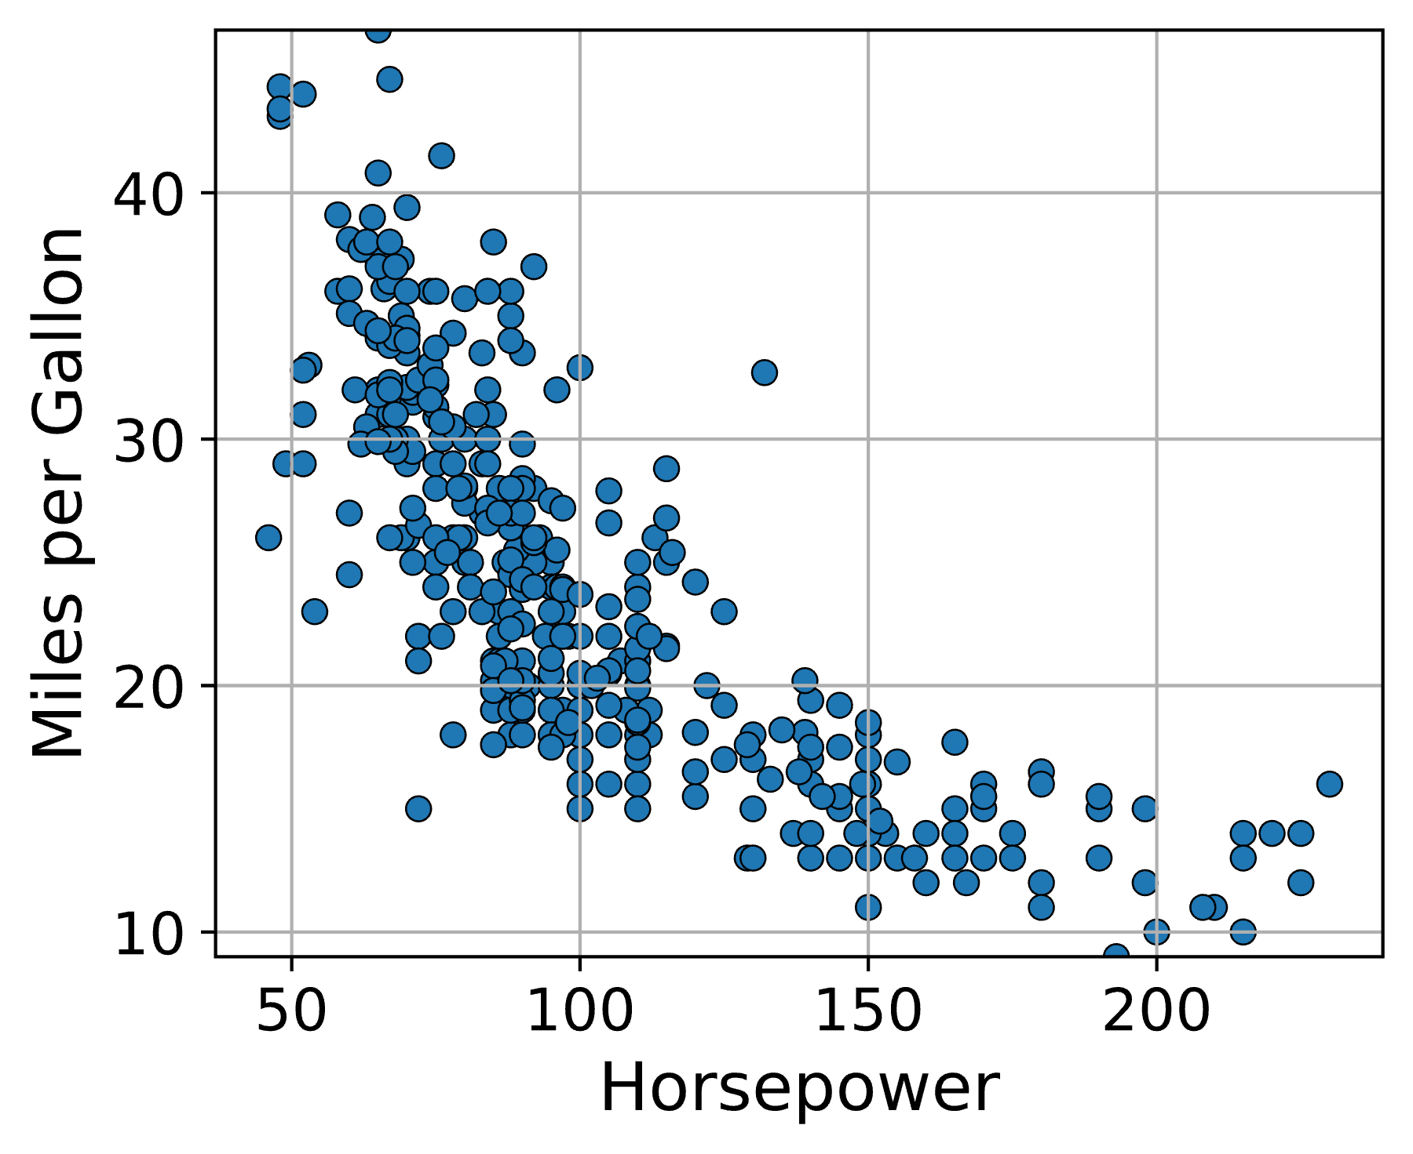
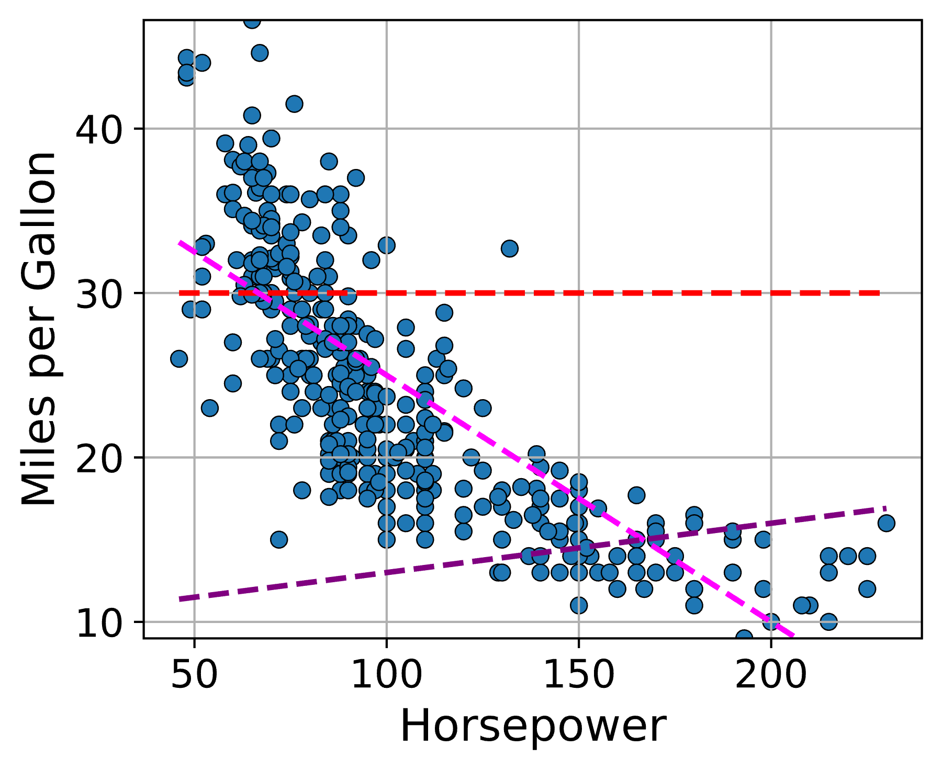
Univariate Linear Model
We will use a linear model:
MPG = b0 + b1 * HP
b0 and b1 are the free parameters of the model
There are inifintely many possible choices!
Which one to pick?

Slide 4
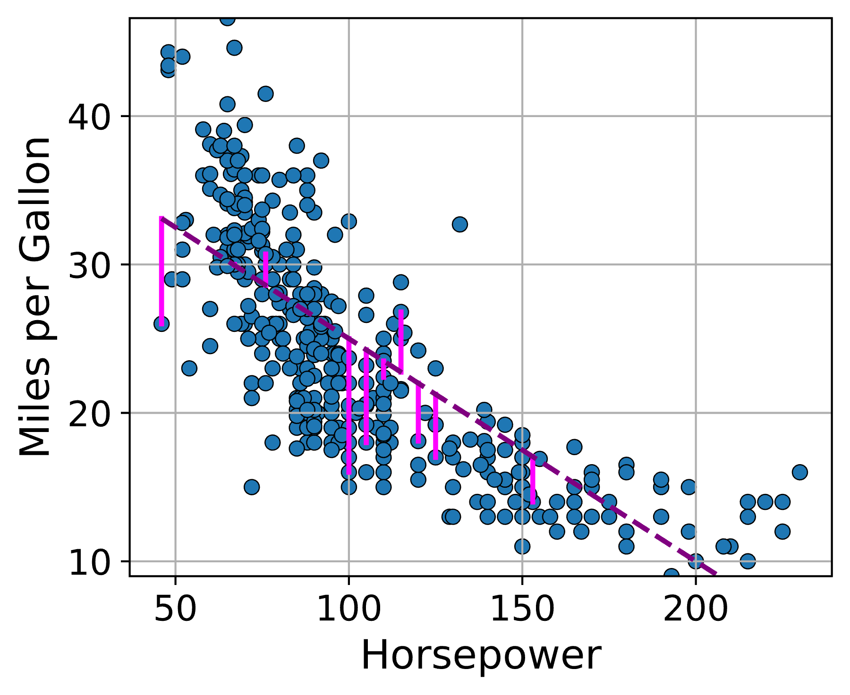
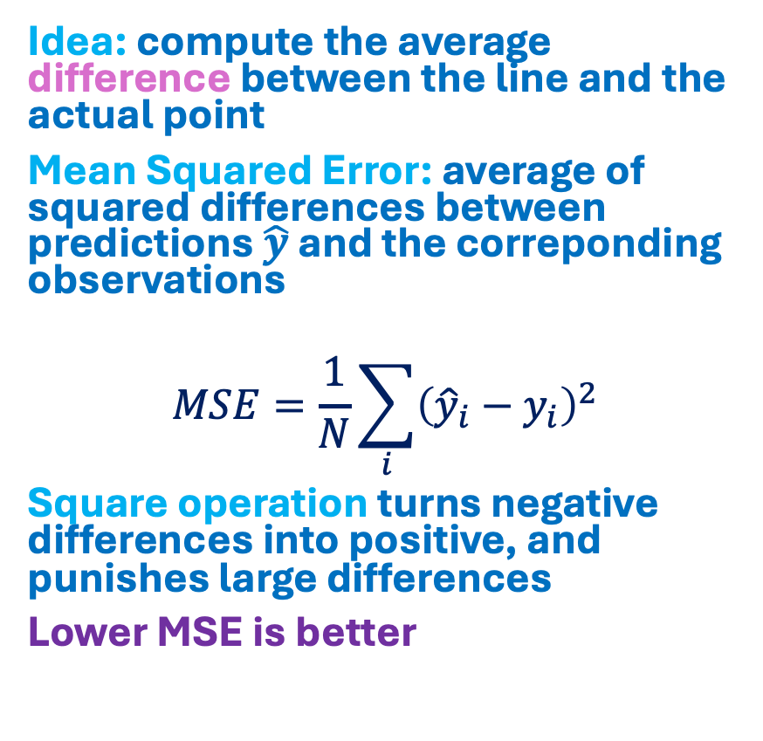
Loss Function
Idea: compute the average difference between the line and the actual point
Mean Squared Error: average of squared differences between predictions $\hat{y}$ and the correponding observations
$$MSE=\frac{1}{N}\sum_{i}{{\left({\hat{y}}_{i}−y_{i}\right)}^{2}}$$
Square operation turns negative differences into positive, and punishes large differences
Lower MSE is better

Slide 5
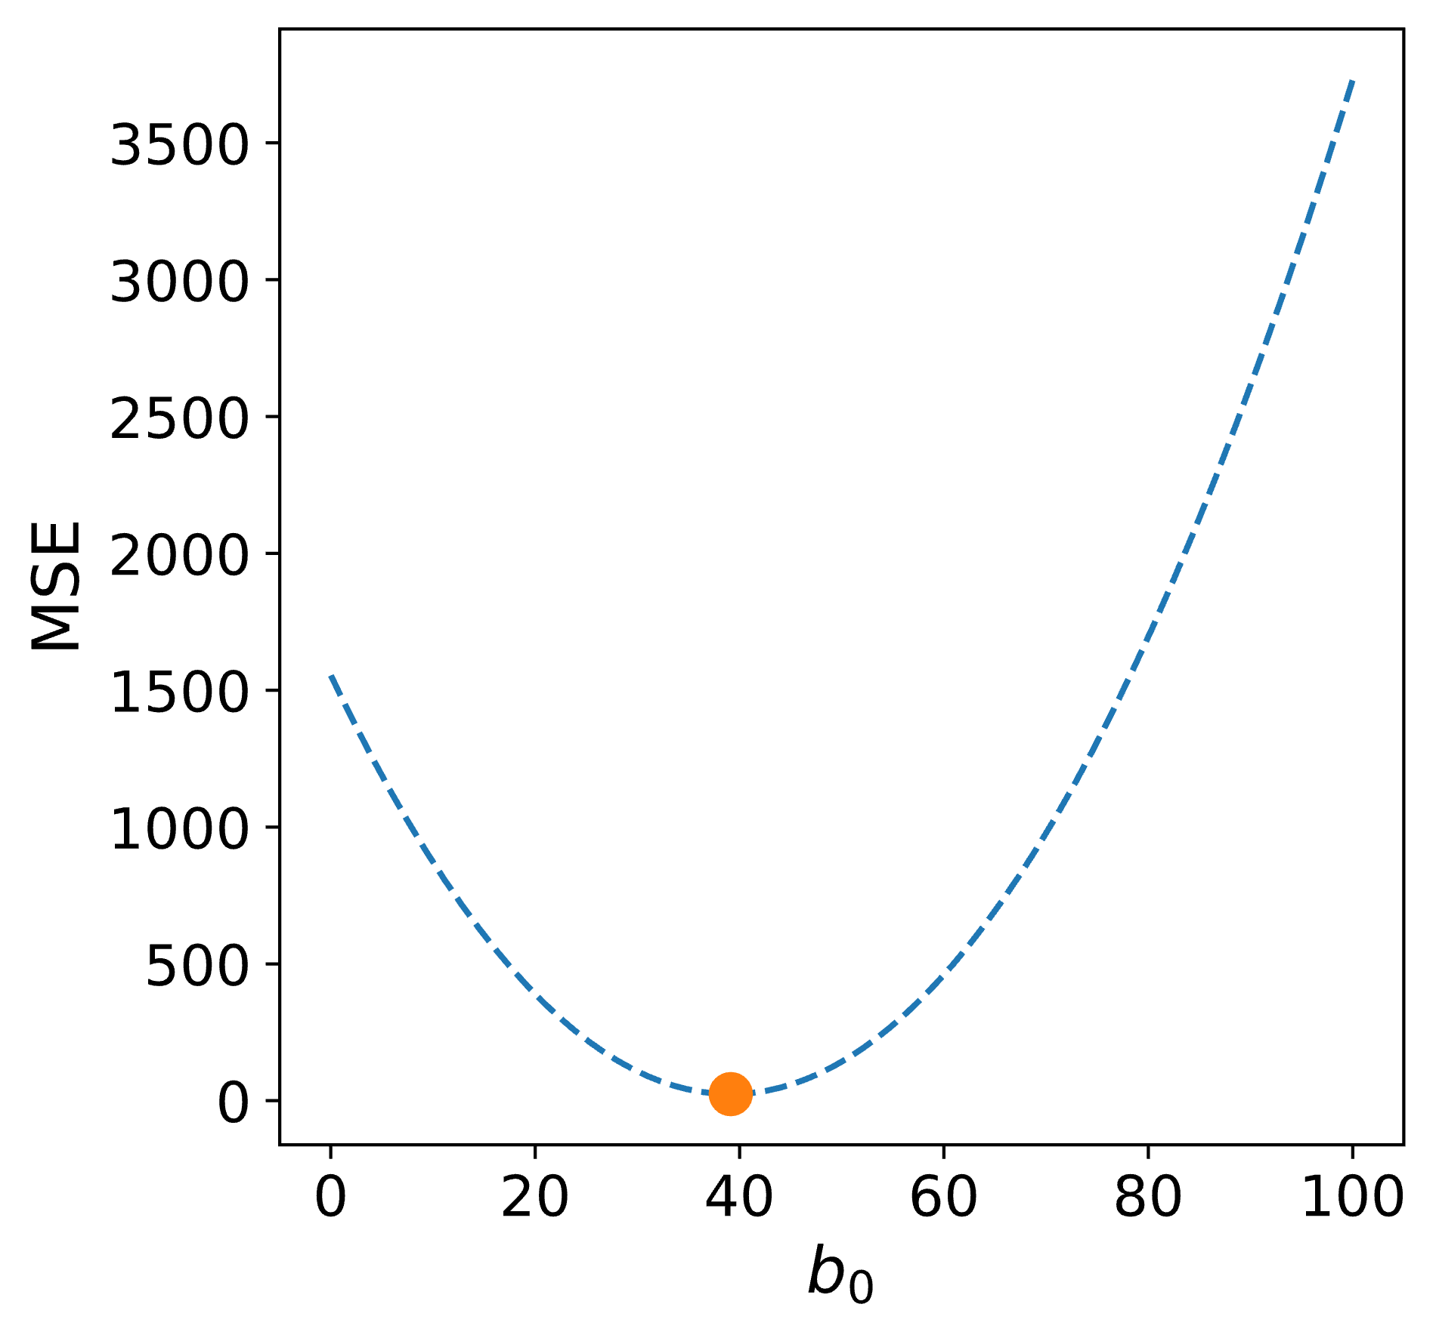
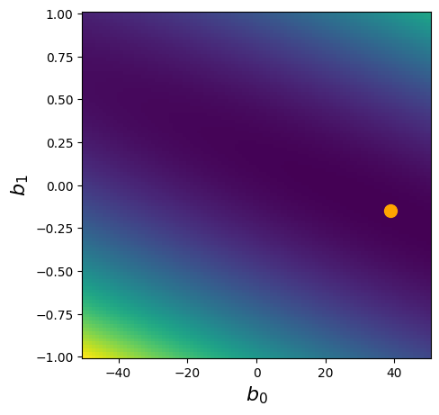
Loss Surface
1D Loss Curve (b1 = -0.15)
Full 2D Surface

Slide 6
Code Exercise: Brute Force Optimization
Grid search: try every possible combination of b0 and b1 and pick the one with the lowest MSE
Load dataset
Find the best fitting line with grid search
Plot result

Slide 7
Flat to 2D Index
0
1
2
3
0
0
(0,0)
1
(0,1)
2
(0,2)
3
(0,3)
1
4
(1,0)
5
(1,1)
6
(1,2)
7
(1,3)
2
8
(2,0)
9
(2,1)
10
(2,2)
11
(2,3)

