Slide 1


DANGER BESIDE
Jiranuwat Jaiyen, Patcharapon Hemtanon,
Jakapong Boonyai
Faculty of Informatics, Burapha University, Thailand

Slide 2
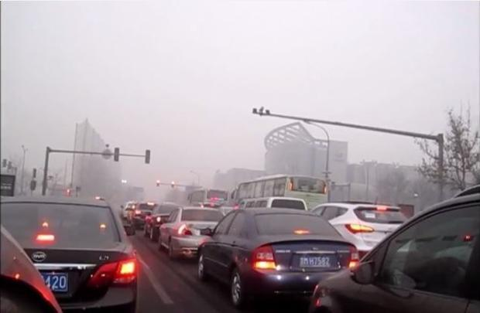

Overview
A number of cars
near 21 million
https://i.pinimg.com/originals/7f/84/0e/7f840ed0abaab4e103eae5b47e0cb974.jpg
Notes:
In 2015, The number of motor vehicles increased at its fastest rate in 12 years to reach around 21 million

Slide 3
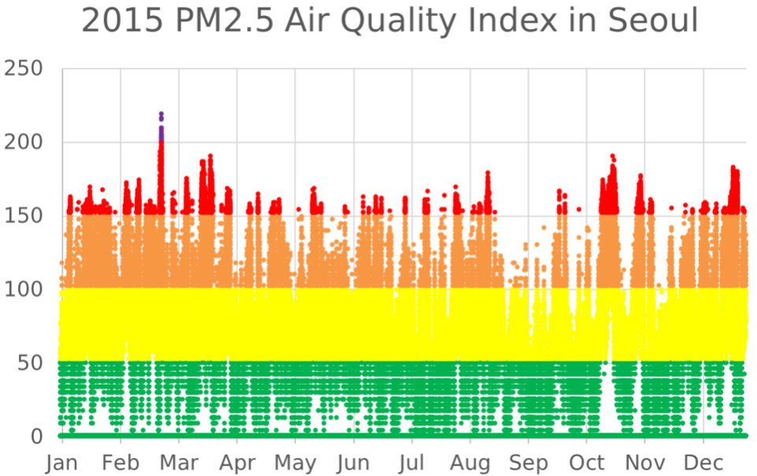
Health in South Korea
Air pollution :
https://en.wikipedia.org/wiki/Health_in_South_Korea

Slide 4
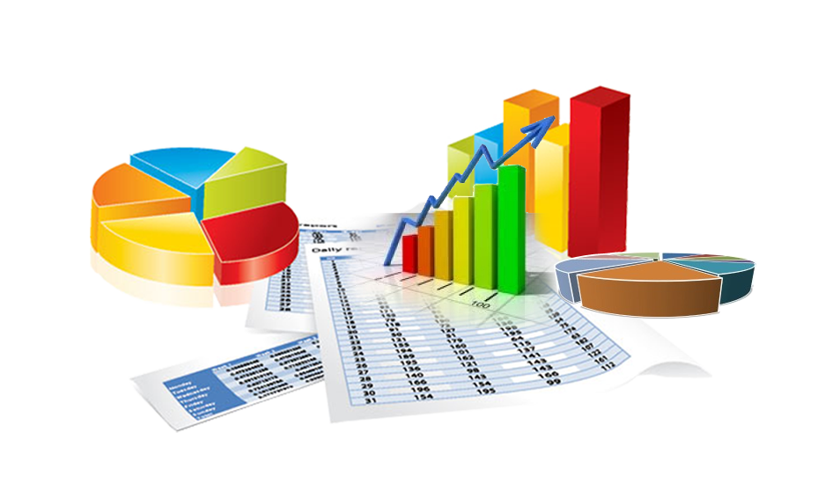

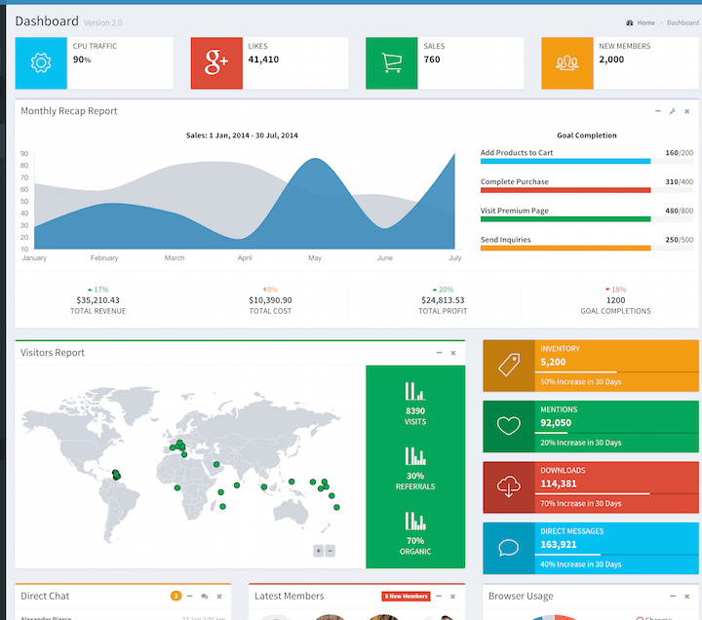
Storyboard
Data
Data Analytics
Visualization

Slide 5
Thank you

