Slide 1


Successive Urban Sensing Data Prediction using Convolutional Neural Network
INFORM@BUU-3

Slide 2
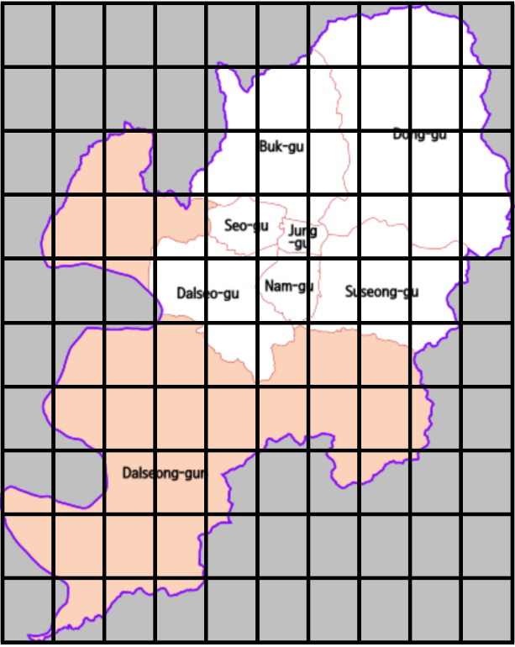
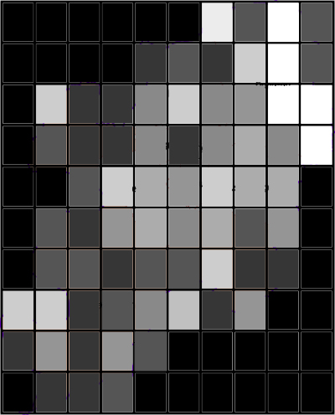
What?

Slide 3
Why?
To provide the near future sensing data.
Other people will be able to analyze our predicted data.
Also to build on its top such as building a predictive model.

Slide 4
How?
Sensing Map Generation
Coverage Duration Selection
Map Prediction
Fill Sensing Data into the Maps
Consecutive Map Pairing
Model Evaluation
Train All pairs using CNN
Mean-absolute percentage error
R-squared error

Slide 5
Thanks for Attention

