Slide 1


Successive Urban Sensing Data Prediction using Convolutional Neural Network
INFORM@BUU-3

Slide 2
Purpose
To predict future sensing data from provided sensing data.
Provide predicted sensing data to other applications.

Slide 3
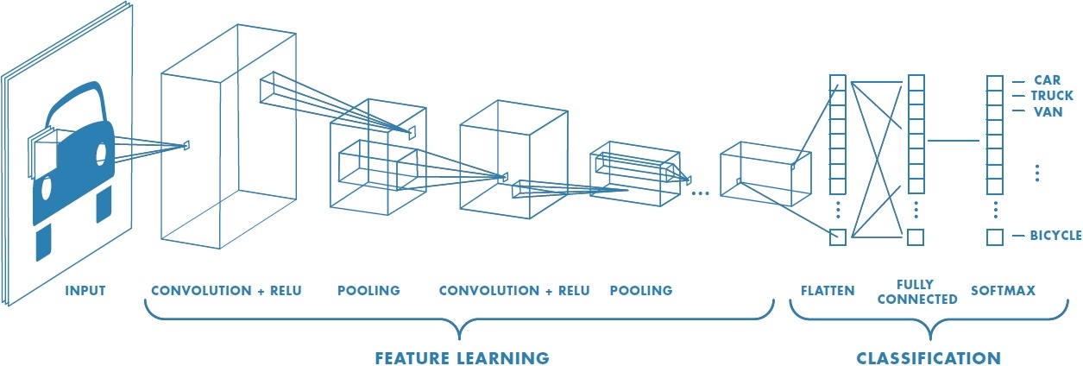

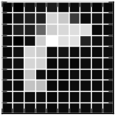
Purpose

Slide 4
Methodology
Pre-processing
Data Cleaning
Model building
Features Selection
Data conversion
Consecutive Map Pairing
Train All pairs using CNN
Model Evaluation
Mean-absolute percentage error
R-squared error

Slide 5
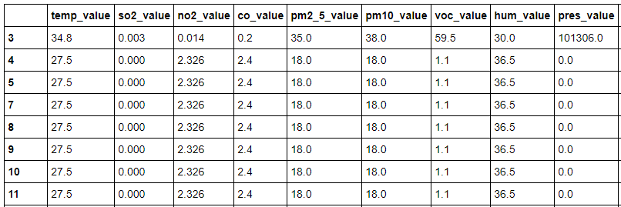
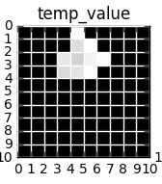
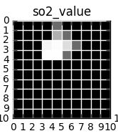
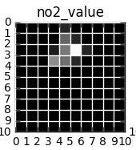
Methodology

Slide 6
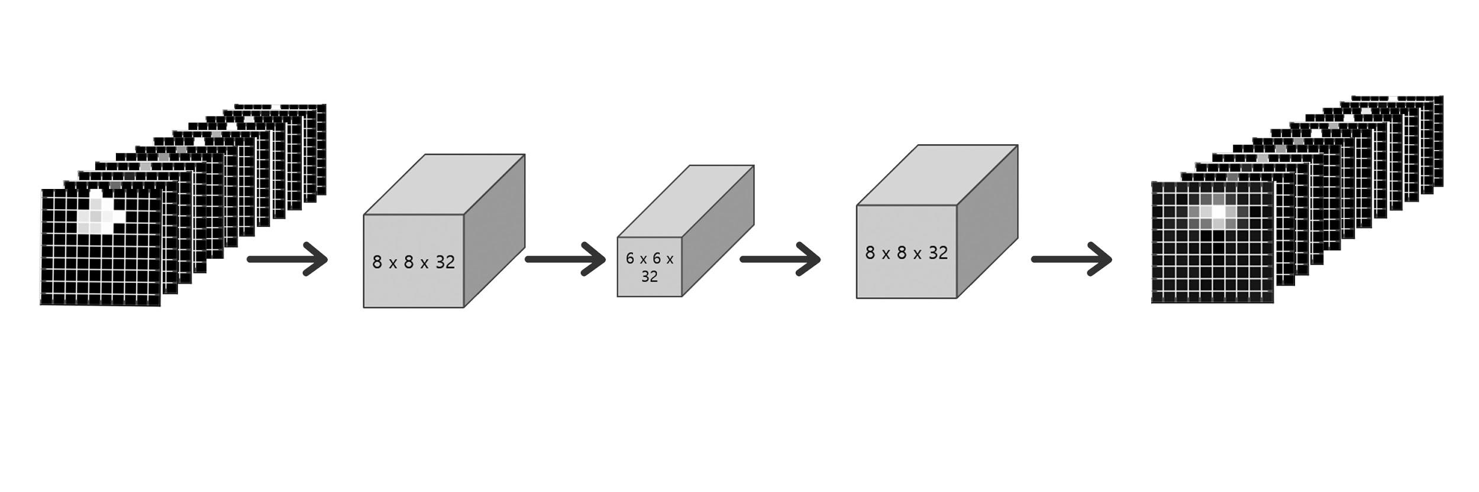
Methodology
3x3
3x3
3x3
3x3

Slide 7
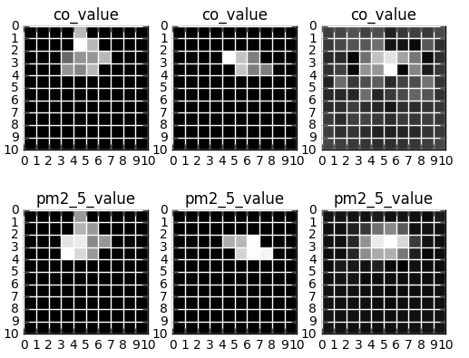
Experimental Result
Mean-squared error value and R-Squared error value of the proposed model are reached 0.32 and 0.60 sequently.

Slide 8
Benefits
Use map stack to predict something useful
rain a new predictive model on all sensing records, with labels like good/bad, asthma/not-asthma, etc
given past sensing map stack, predict successive sensing map stack

Slide 9
Benefits
Use map stack to predict something useful
feed each sensing slot of the successive map stack into the new predictive model
use labels predicted on all slots to help assist in making decisions

Slide 10
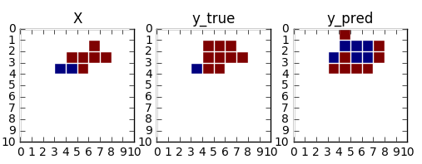
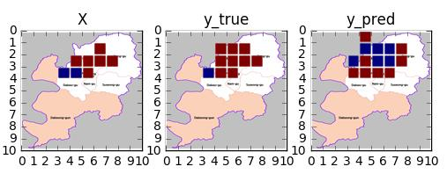
Benefits

Slide 11
Q&A

