Slide 1

Bus Stop automatic
waiting line setting system
IT’s
Lee, Kim, Shin

Slide 2
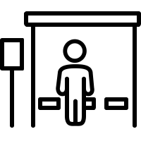


No many People
No many Bus
Many People
Many Bus
Safe!
Have a problem!

Slide 3


Dangerous!
Not observed !

Slide 4

100 | Soon | low floor
162 | 1분
152 | 3분
Bus arrival board
100
Just know
Bus arrive time

Slide 5

100 | Soon | Low floor
162 | 1분
152 | 5분
First arrival
Second arrival
100
Soon low floor
162
1minute
Bus arrival board
100
162
The bus comes
at similar time

Slide 6

Thank you!

