Slide 1
Searching Unusual events system by using Buzz tweets And Noise data -BUSAN-
Team : SUMILAB
Tetsuo Ogino
Kentaro Narikawa
Toshinori Hayashi(absence because of cold)
Notes:
Hello, I’m Kentaro Narikawa, master course of graduate student of Kwansei Gakuin University in Japan.
And he is Mr. Tetsuo Ogino. Another member, Toshinori Hayashi is absent because he got a cold in Japan.
We’d like to propose the system Searching Unusual events system by using Buzz tweets And Noise data, what we call, BUSAN system.
The name of BUSAN is what are arranged the first letters for it.

Slide 2
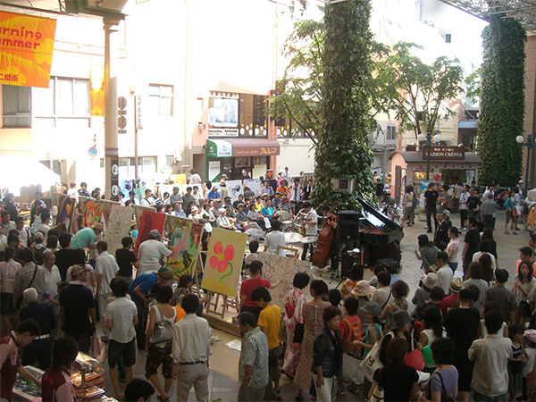
Do you like noisy place?
Notes:
First of all, do you like noisy place?
Some people like noisy place, but other people dislike there.
I think whether you want to go to the noisy place is depending on your feelings.

Slide 3
Something different suddenly happen as unusual event in the city
Ex) Street live show, Big accident, etc.
To detect unusual signs, BUSAN system needs several kinds of sensing data
Notes:
In the noisy place, we think something different suddenly happen as unusual event in the city.
For instance, beginning street live show, and big accident, and so on…
In order to detect such unusual signs, BUSAN system needs several kinds of sensing data.

Slide 4
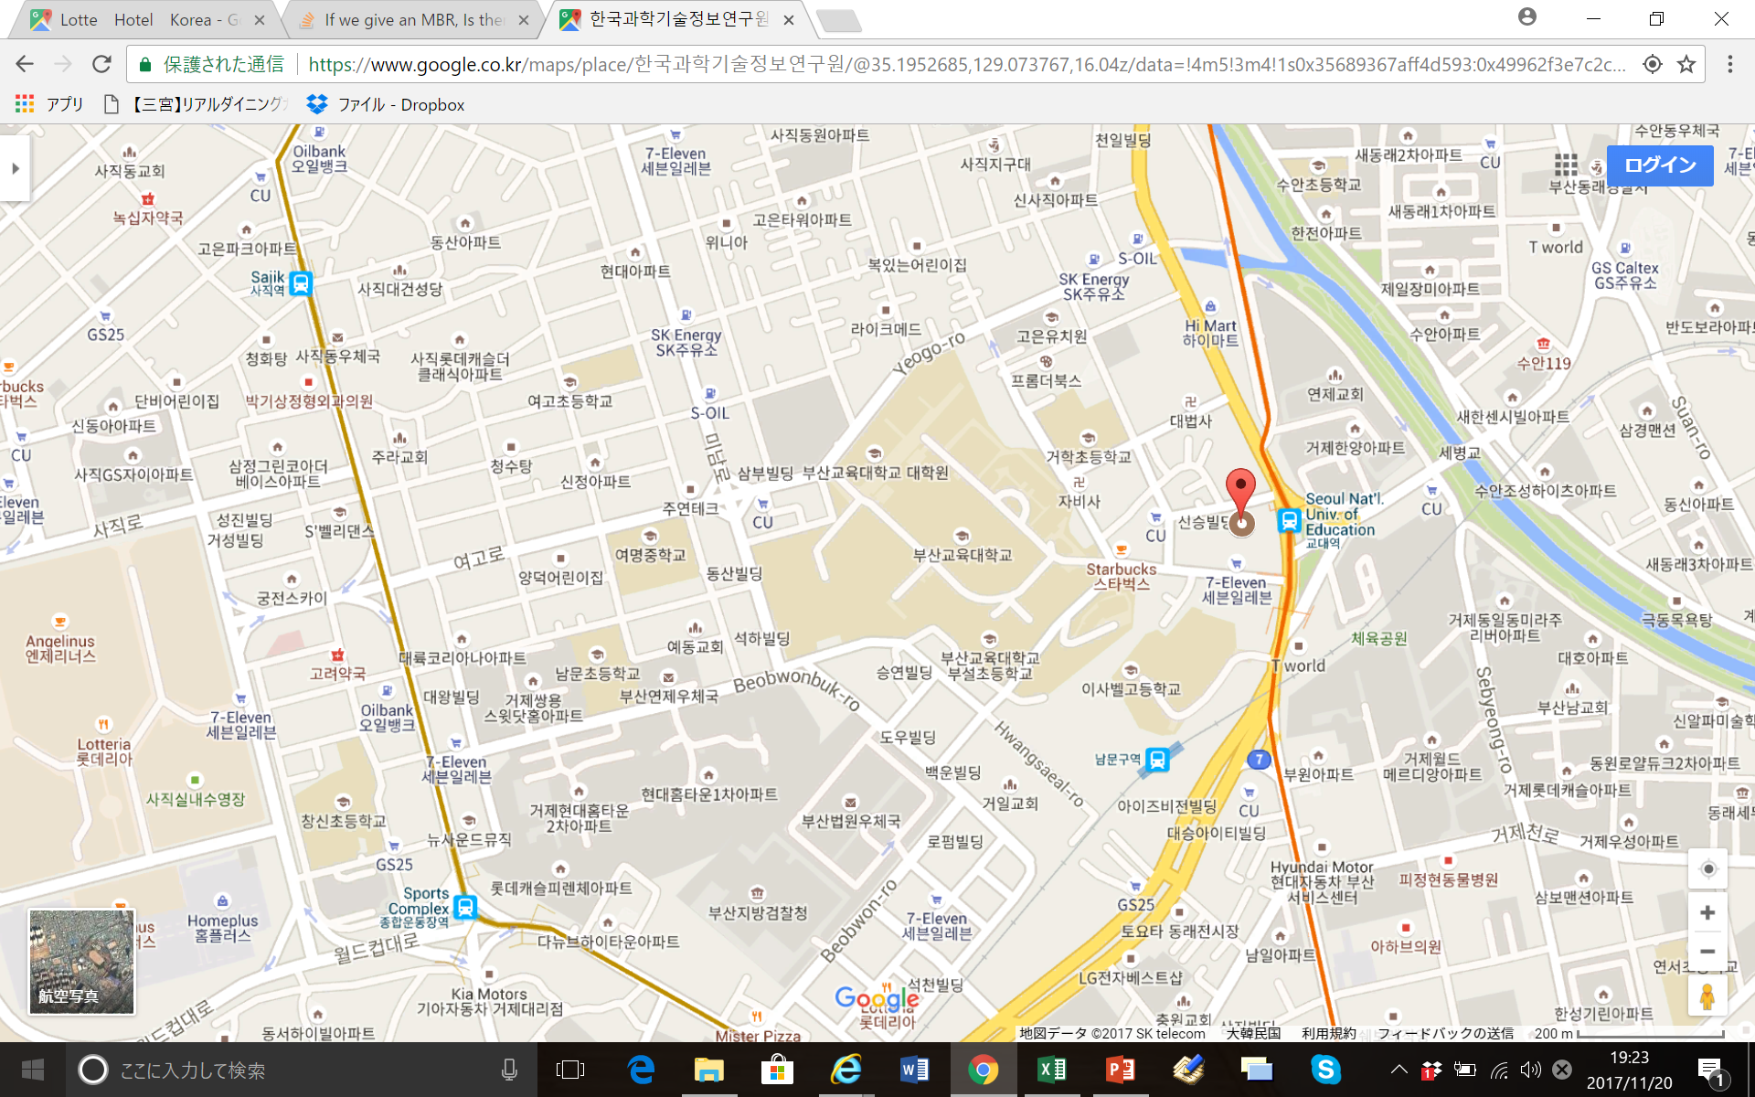



Latitude
Longitude
Time
Noise
On fire
Car accident
Latitude
Longitude
Time
Tweet
Street show
Song Ji-Hyo is walking
The place which noise is louder than usual
Notes:
To develop this system, We used sensing data from taxis and Tweet data.
Based on these data, the system plot pins and represent tweets to each place which noise is louder than usual on google map.

Slide 5
Latitude
Longitude
Time
Noise
Latitude
Longitude
Time
Tweet
Pick the sensing data and tweets which noise is louder than usual
We can get to know what happened at the noisy area
Something unusual is happening
Notes:
As I mentioned before, the BUSAN system pick the sensing data and tweets which noise is louder than usual.
After using this system, we can get to know what happened at the noisy area.
So, you can decide whether you may go or not.

Slide 6

From now,
BUSAN program works actually
Notes:
From now, BUSAN program works actually operated by Mr. Ogino.

