Slide 1
Safety Route Leading System SUMILAB
Tetsuo Ogino
Kentarou Narikawa
Toshinori Hayashi

Slide 2
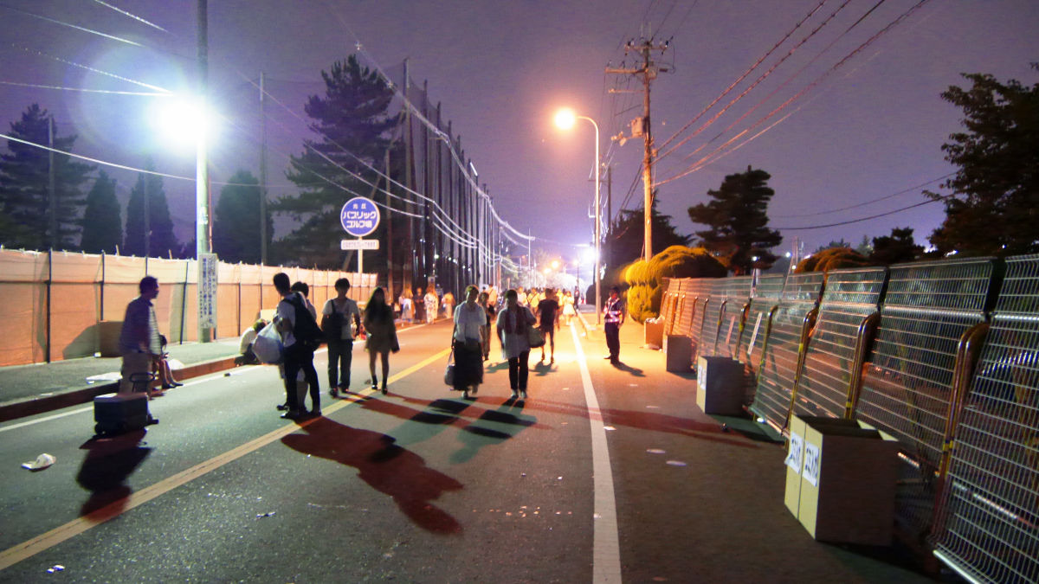
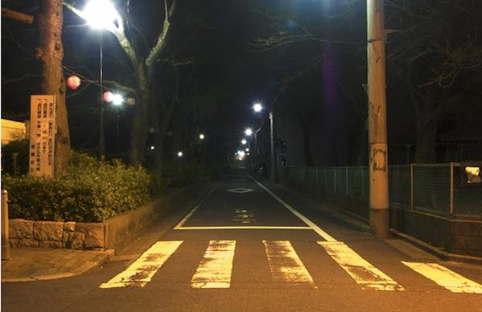
Which way would you like to choose for the way back home?
Bright and lively way
Or
Dark and quiet way

Slide 3
Going home on the dark way is
Sometime dangerous

Slide 4
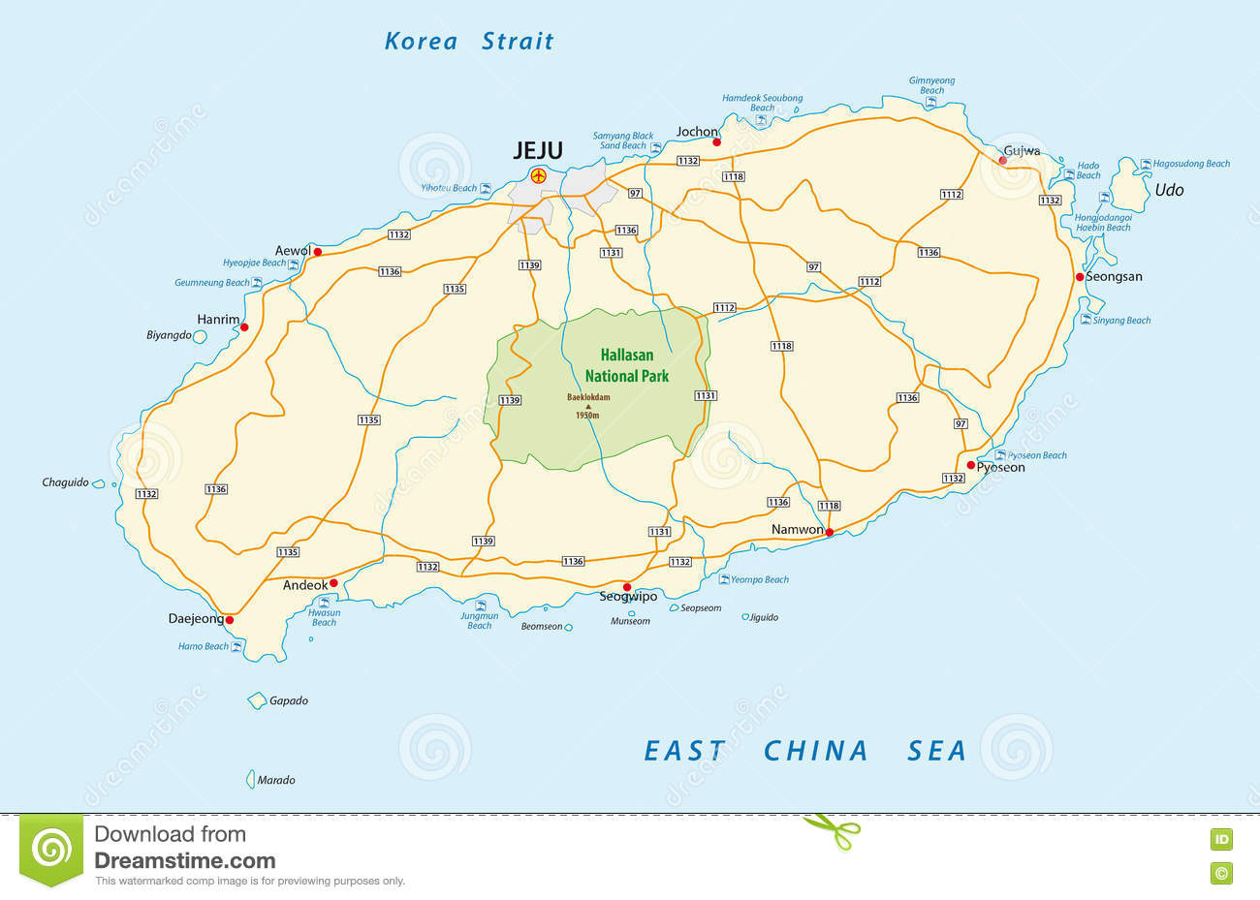

We will make the System that shows safe ways.

Slide 5






Location
LUX
Noise
temperature
 | Noisy | Quiet
Bright
Dark

Slide 6




Slide 7



For the place where people can watch beautiful stars, this maps shows special icon

Slide 8
Now,
Still on Process
Thank you!

