Slide 1


“AIR FOR ALL”
Whale Rider

Slide 2
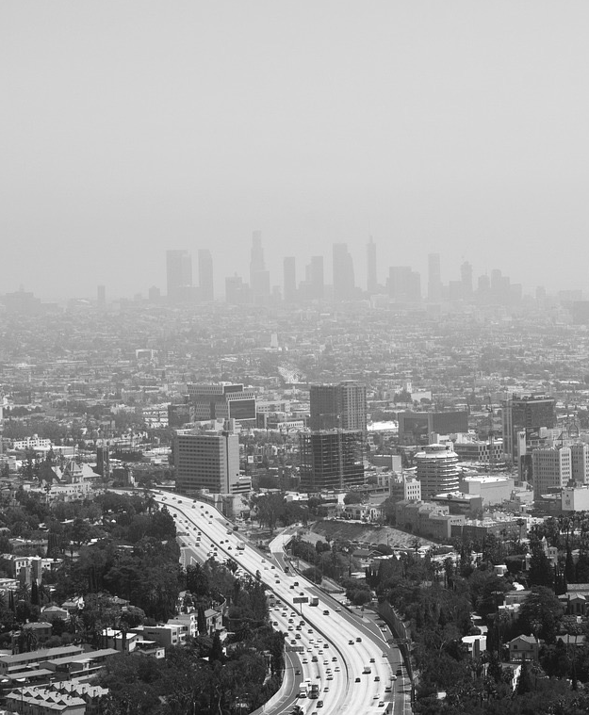

Begin with
“Air For All”
Many countries awareness of the monitoring and controlling air pollution.
Air pollution affects human health.
Consciousness and avoidance air pollution is very important.
So, “AFA: Air For All” is developed for everyone.

Slide 3
Step #3
THE RATE OF POPULATION
3,000,000+
350,000+
Handicap
Blind person

Slide 4
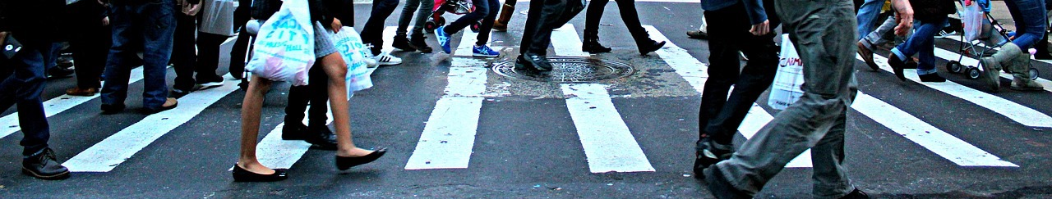



Our Features
Recommend the ROUTE
For BLIND person
EASY to use

Slide 5


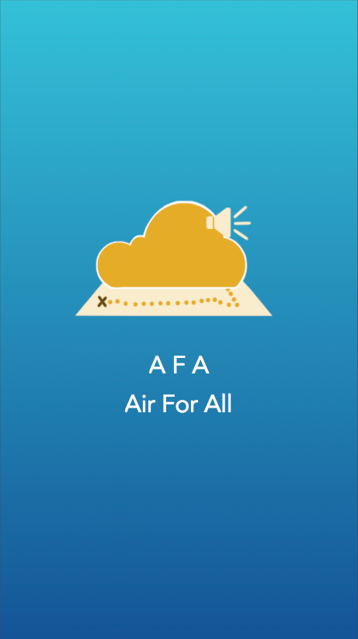


Operating System

Slide 6
“AFA IS THE BEST WAY TO FIND
YOUR ROUTE”

Slide 7
Thank you

