Slide 1

Blockchain-Based Digital Certificate Management in Modular Automation Systems
Tobias Schill, Institute of Control Systems, 23.03.2026 - Final Presentation - Masterthesis

Slide 2
Motivation and Problem
Chapter
01

Slide 3




Problem Statement Benefits of Modular Automation Architecture
Plant
Orchestration
Emerging threat and regulatory environment:
Interface
Process Modules
Cyber security act
Services
Services
PLC
OPC-UA
HMI
Procedures
Procedures
Network and information systems (NIS2)
Parameters
Parameters
Process values
Profinet
Modbus
Process values
Sensors
Modular architecture provides standardized interfaces
[1] German association of engineers (VDI) (2022). Modulare Anlagen
[2] Federal office for information security (BSI) (2026). Acts and regulations

Slide 4



Problem Statement Public Key Infrastructure (PKI)
Certificate Authority
Certificate Revocation List
CA
CRL
Validity approved
Validity check
Certificate
Signing request
?
?
User A
User B
Signed
Message
Centralized system structure
[3] Boeyen et al. (2008). Internet X.509 Public Key Infrastructure Certificate and Certificate Revocation List (CRL) Profile

Slide 5
Problem Statement Given Modular Environment
Plant
Secured Environment
Root CA
Orchestration
Interface
Process Module
PLC
OPC-UA
HMI
Profinet
Modbus
Sensors
Modular architecture conflicts with traditional certificate management
[4] Madsen and Barth (2025). Decentralized industrial security architecture for heterogeneous automation system

Slide 6
Problem Statement Given Modular Environment
Plant
Secured Environment
Root CA
Orchestration
Interface
Process Module
PLC
OPC-UA
HMI
Profinet
Modbus
Sensors
Build a decoupled certificate management for the individual modules
[4] Madsen and Barth (2025). Decentralized industrial security architecture for heterogeneous automation system
Notes:
Übergang zu blockchain mehr hervorheben und motivieren Requirements

Slide 7
Problem Statement Proposed Blockchain Solution
Process Module
PLC
HMI
Sensors
Goals for the modules certificate management:
Compatible with PKI standards
Self-sufficient
Automated
Resource-efficient
No centralized root of trust (outside of a secured environment)
Notes:
Übergang zu blockchain mehr hervorheben und motivieren Requirements

Slide 8
Fundamentals
Chapter
02
Notes:
How this is actually achieved can be seen more clearly in the fundamentals how the blockchain actually works

Slide 9
Fundamentals Blockchain Structure
Block n-1
Block n
Block n+1
Header
Header
Header
Previous hash
Previous hash
Previous hash
Metadata
Metadata
Metadata
Content
Content
Content
Transaction data
Transaction data
Transaction data
Ensures consistency through hashes (digital fingerprints of data)
[5] Nakamoto (2008). Bitcoin: A peer-to-peer electronic cash system

Slide 10
Immutability
Fundamentals
Block n-1
Block n
Block n+1
Header
Header
Header
Previous hash
Previous hash
Previous hash
Metadata
Metadata
Metadata
Content
Content
Content
Transaction data
Transaction data
Transaction data
A falsified block leads to an error in the verification of the subsequent block
[5] Nakamoto (2008). Bitcoin: A peer-to-peer electronic cash system

Slide 11
Fundamentals Execute-Order-Validate Model
Chaincode (Smart Contracts)
Installed on
Requester
Endorsing Peers
Orderer
Invoke chaincode
Endorse transaction
Simulate execution
Check policy
Submit transaction
Package transactions
Submit blocks
Validation
Deterministic ledger states through validation model and endorsement
[6] Buterin (2014). Ethereum: A next-generation smart contract and decentralized application platform [7] Androulaki et al. (2018). Hyperledger Fabric: A distributed operating system for permissioned blockchains

Slide 12
Fundamentals Practical Example
Ledger
Chaincode
Block
World State
Smart Contract
TX
TX
Database
function vote
if voter in members
recordVote(decision)
R/W
Proposal
VotesFor | 0
VotesAgainst | 0
R/W
1
R/W
Produces a database with decentralized audited execution of predefined functions
[7] Androulaki et al. (2018). Hyperledger Fabric: A distributed operating system for permissioned blockchains

Slide 13
State of the Art
Chapter
03

Slide 14
State of the Art Structured Literature Research
Goal:
Analyze blockchain based solutions for certificate management in the IT domain
Identify architectures that could be transferred to modular automation
Result to categorize publications:
Five general system structures
Scholar (364)
KIT (851)
Others (21)
IEEE (177)
Scopus (369)
Screening process based on requirements
Type 1
(27)
Type 2
(13)
Type 3
(9)
Type 4
(13)
Type 5
(20)
Notes:
Mehr fokus und erklären was genau gemacht und woher

Slide 15
State of the Art Blockchain-Based PKI Variants
Type 1-3:
Still CA based with increasing auditing function of the blockchain network
Compatible with PKI standards
Self-sufficient
No centralized root of trust
CA
Manages certificates
Queries ledger
Nodes

Slide 16
State of the Art Blockchain-Based PKI Variants
Type 1-3:
Still CA based with increasing auditing function of the blockchain network
Compatible with PKI standards
Self-sufficient
No centralized root of trust
Interface
PLC
CA
HMI
Applicable as a replacement for revocation lists with added auditing functions
Sensors

Slide 17
State of the Art Blockchain-Based PKI Variants
Full decentralization:
The whole network needs to approve nodes
Compatible with PKI standards
Self-sufficient
No centralized root of trust
New Node
?
?
?
?
?
?
Transmits join request
Existing Nodes
Approves and provides certificate

Slide 18
State of the Art Blockchain Based PKI Variants
Full decentralization:
The whole network needs to approve nodes
Compatible with PKI standards
Self-sufficient
No centralized root of trust
?
Interface
PLC
HMI
Every node is completely integrated into certificate operations
Sensors

Slide 19
State of the Art Blockchain-Based PKI Variants
Hierarchical separation :
Only privileged nodes need to approve
Compatible with PKI standards
Self-sufficient
No centralized root of trust
New Node
?
?
?
Transmits join request
Existing Nodes
Can only query ledger
?
Approves and provides certificate

Slide 20
State of the Art Blockchain-Based PKI Variants
Hierarchical separation :
Only privileged nodes need to approve
Compatible with PKI standards
Self-sufficient
No centralized root of trust
?
Interface
PLC
HMI
Allows for hierarchical separation of nodes in an automation context
Greater flexibility in how devices can be integrated
Sensors

Slide 21
Concept
Chapter
04
Notes:
After examining the relevant solutions i developed a generic base system that can be later adapted in certain aspects to reflect selected solutions from the literature.

Slide 22
Concept Synthesized Adopted System
Combination of aspects from multiple proposals:
PLC
HMI
Sensor
Enrollment certificate
?
?
?
Enters
n
Join request
New Device
Ledger
Holds operational certificates

Slide 23
Concept Synthesized Adopted System
Combination of aspects from multiple proposals:
PLC
HMI
Sensor
Submits certificate and endorsements
n
Certificates are generated using threshold signatures
New Device
X
Orderer
Ledger
Holds operational certificates

Slide 24


Concept Technical Implementation Concept
PI 1
PI 2
PI 3
PI 4
PI 5
Orderer
Orderer
Peer
Peer
Peer
Peer
Peer
API
Node Logic
Node Logic
Node Logic
Node Logic
Node Logic
Gossip protocol (Blockchain)
Direct mesh (Threshold signatures)
Separation between blockchain and logical entities as well as communication

Slide 25
Concept Used Certificate and Governance Operations
Certificate Issuance
Revocation
CA-Join
CA-Removal
1. Certification proposal
1. Revocation proposal
1. Join proposal
1. Removal proposal
2. Voting on proposal
2. Voting on revocation
2. Voting on join
2. Voting on removal
3. Threshold reached?
3. Threshold reached?
3. Threshold reached?
3. Threshold reached?
4. Signing session
4. Execute revocation
4. Registration into CA
4. Removal from CA
5. Certificate registration
5. Key reshare
5. Key reshare
6. Reshare finished
6. Reshare finished
All steps audited through network consensus and chaincode

Slide 26
Benchmarks
Chapter
05

Slide 27
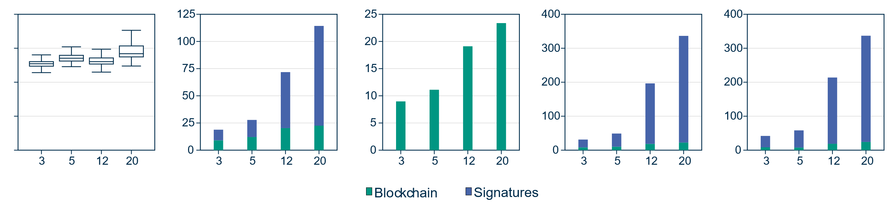
Benchmarks System Latency
Certificate Query
Certificate Issuance
Certificate Revocation
CA Removal
CA Join
20
15
Latency [ms]
Latency [s]
10
5
0
Certificates
Signer nodes
Signer nodes
Signer nodes
Signer nodes
Blockchain
Signatures and key distribution
Query times scale efficiently
Operation times, especially the signing part scales significantly worse

Slide 28
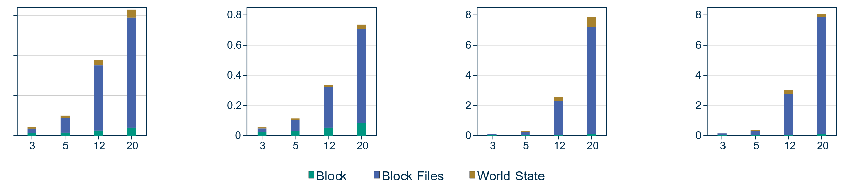
Benchmarks Storage Consumption per Operation
Per Certificate Issuance
Per Certificate Revocation
Per CA Removal
Per CA Join
1.5
1.0
Storage [MB]
0.5
0
Signer nodes
Signer nodes
Signer nodes
Signer nodes
Block
Endorsements and metadata
World state
Storage consumption is concerning due to its additive per-device growth
Actual block is small in comparison to per-block overhead

Slide 29
Discussion
Chapter
06

Slide 30
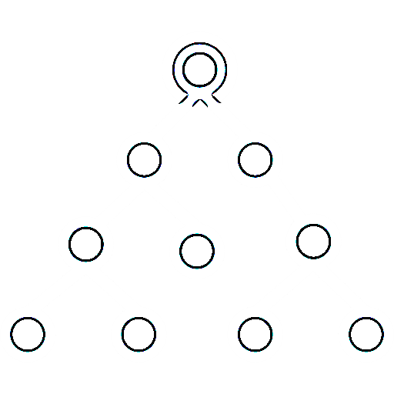
Discussion Suitability for OT
Achieved goals:
Compatible with regular PKI
PLC
HMI
Self-sufficient
Automated
/ Resource-efficient
?
Sensors
No centralized root of trust
Hierarchical separation of devices still makes sense
All-encompassing blockchain approach may not be reasonable
[8] Dykcik et al. (2018). BlockPKI: An automated, resilient, and transparent public-key infrastructure [9] Cloudflare (2025). Keeping the internet fast and secure: introducing Merkle tree certificates

Slide 31
Demonstration
Chapter
07

Slide 32
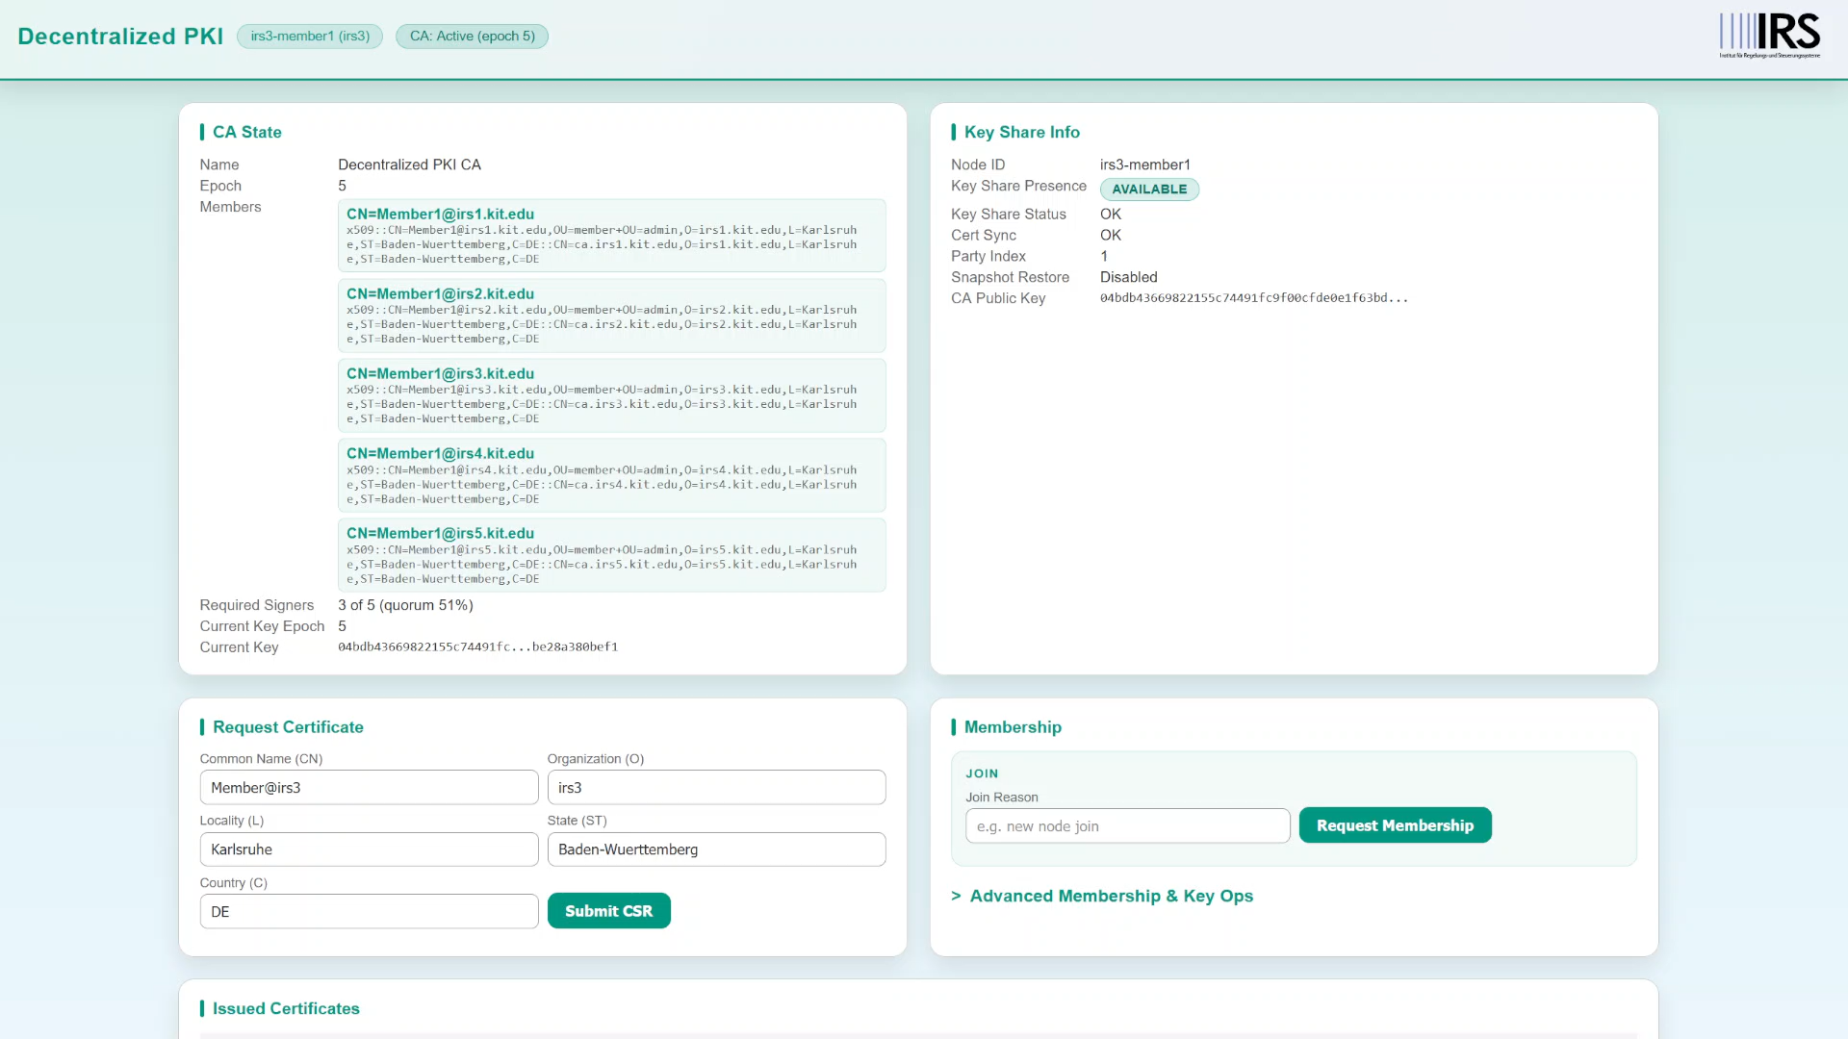

Slide 33
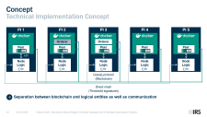
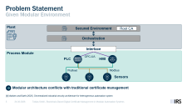
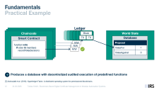
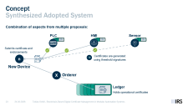
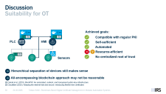
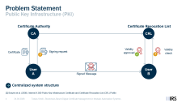
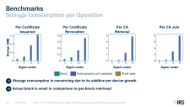
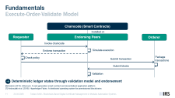
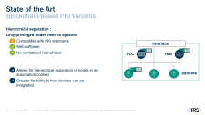
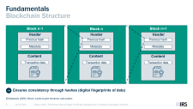
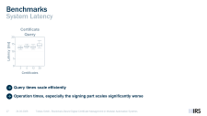
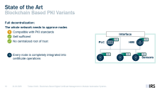
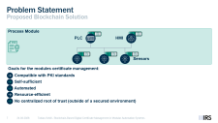
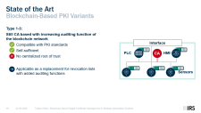
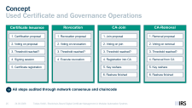
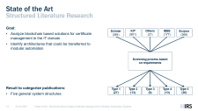

Slide 35
Fundamentals Basic Blockchain Consensus (PoW)
Peer
Peer
Peer
Peer
Collection of transactions
Competition in a computation problem
Success
Transmission of solution
Append block if correct
Consensus is achieved if the majority of peers append the block → No deterministic ledger states
[5] Nakamoto (2008). Bitcoin: A peer-to-peer electronic cash system

Slide 36
State of the Art Blockchain-Based PKI Variants
Type 2:
Auditing functions built into the network
Certificate lifecycle roughly identical
Improved certificate auditing
Additional checks for honest behaviour
Still mostly centralized with a CA
CA
Gov
Manages certificates
Manages policies
Queries their copy of the chain
Nodes
Notes:
The second types integrates a governance entity into the system that manages policies. How this is used varies from solution to solution, but generally, the CA manages the certificates and the governmental entity checks defines how the trust is anchored into those certificates. An easy example would be a black/whitelist.

Slide 37
State of the Art Blockchain-Based PKI Variants
Type 2:
Auditing functions built into the network
Certificate lifecycle roughly identical
Improved certificate auditing
Additional checks for honest behaviour
Still mostly centralized with a CA
CA
Gov
PLC
HMI
Applicable as a replacement for CRLs and additional CA sanity checks
Redundancy with trust placed in governing entity
Sensors

Slide 38
State of the Art Blockchain Based PKI Variants
Type 3:
CA certificates are checked by consensus
Trust decentralized in the network
Still reliant on a CA
CA
Signs
New Node
Broadcasts join request
Existing Nodes
Approves join request and stores certificate
Notes:
Type three now actually decentralizes the trust. Already CA issued certificates are accepted of denied using blockchain consensus.

Slide 39

State of the Art Blockchain-Based PKI Variants
Type 3:
CA certificates are checked by consensus
Trust decentralized in the network
Still reliant on a CA
New Node
Robot
PLC
HMI
Applicable as a decentralized safeguard for compromised CAs
Can‘t perform PKI functions on its own
Sensors
Notes:
Lets say the new node would be a robot with an already issued certificate. The network can now decide on it‘s own.
However, we still need an entity that actually issues certificates as they are only managed inside the consensus but not created.

Slide 40
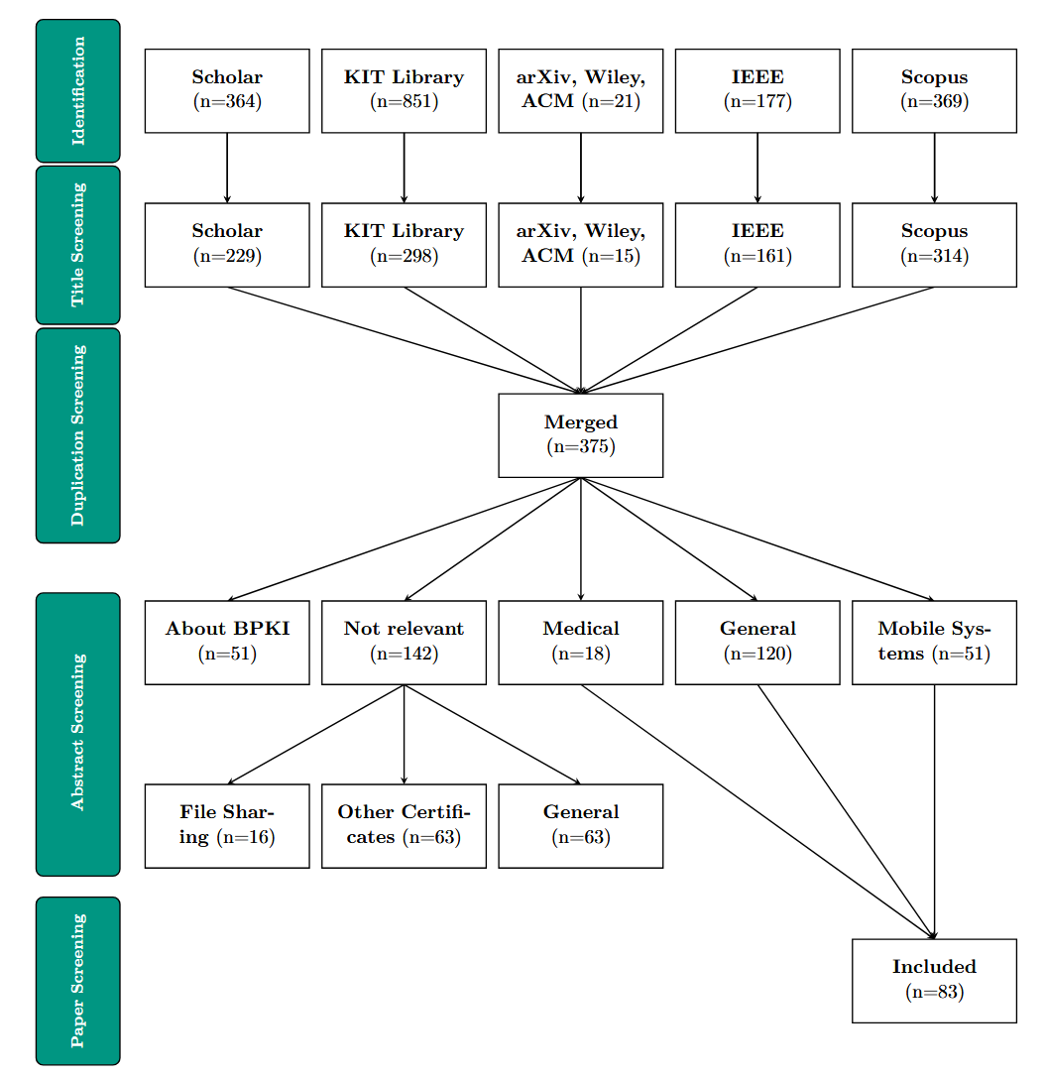
State of the Art Structured Literature Research

Slide 41
State of the Art Structured Literature Research

Slide 42
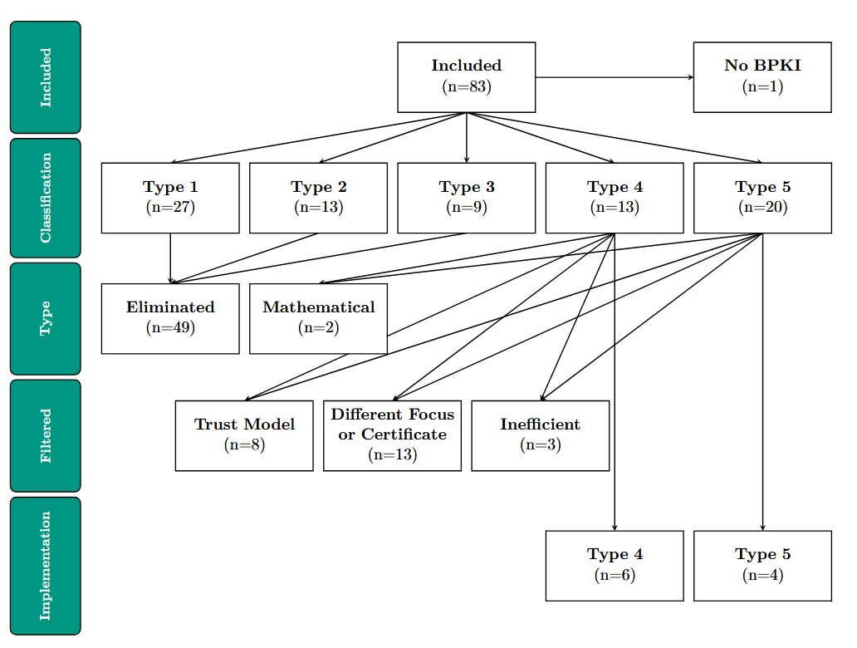
State of the Art Structured Literature Research

