Slide 1
Power
Area
Neg-weight-robust-66.72u
Neg-weight–51.25u
tanh_robust:67.73u
Tanh_faulty:57.33u
P-sigm-robust:14.42u
Faulty: 12.81u
P-relu-robust 36.3u
P-relu-faulty 30.8u
p-CR-robust 2.429u
p–CR-faulty 1.452u

Slide 2
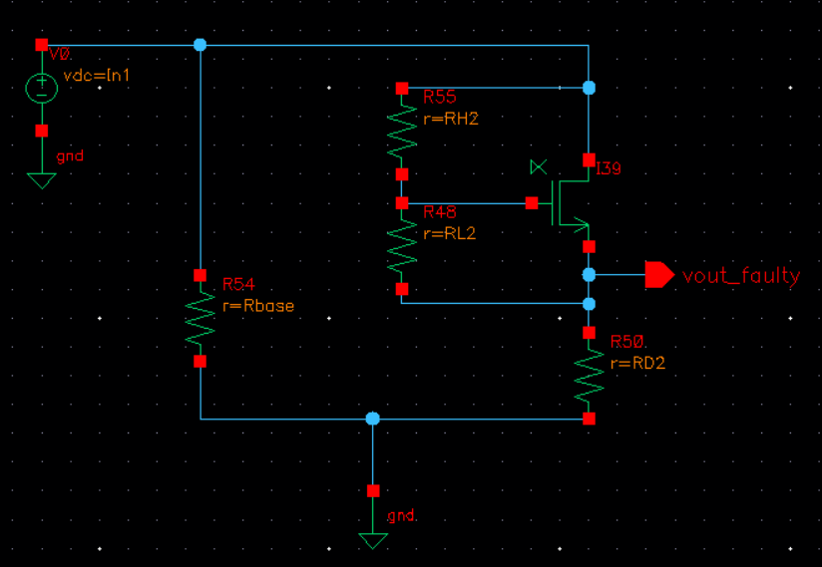
Redundancy of components in the circuit and connect through Transistor
as a Switch (Tswitch) so, not multiple components are connected in case
of no-fault condition
- Pass the outputs in algorithm (Fault-tolerant and Fault-sensitive)
- 4- Fault-tolerant and 4-Fault-sensitive version for 4 ACT circuits
- Implement in NAS algorithm

Slide 3
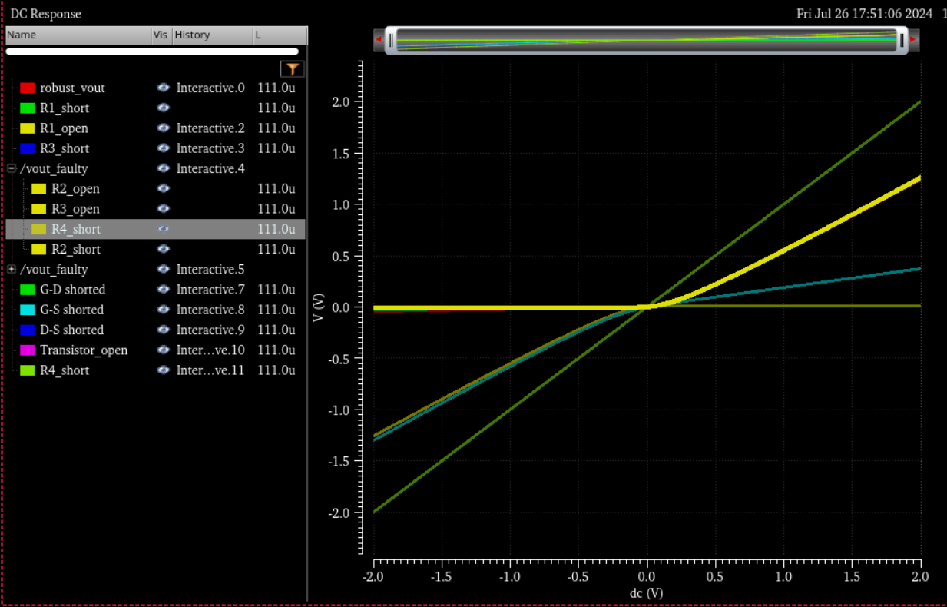

Slide 4
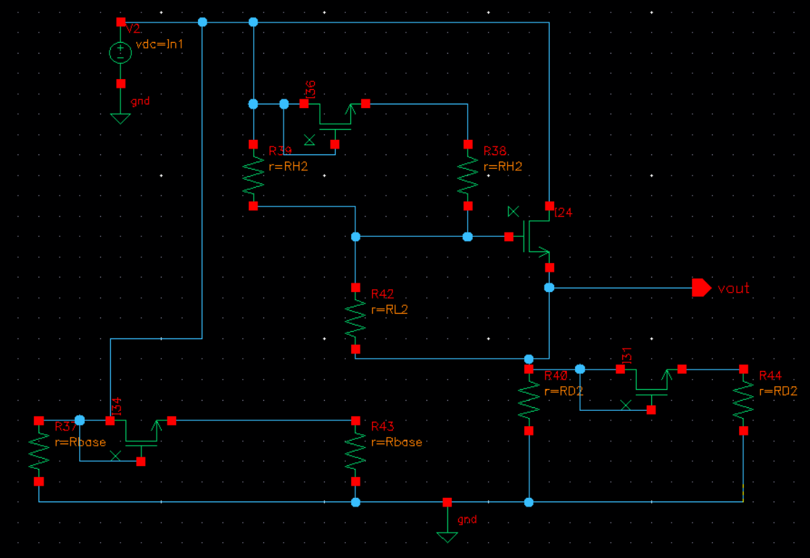
Robust p-ReLU

Slide 5
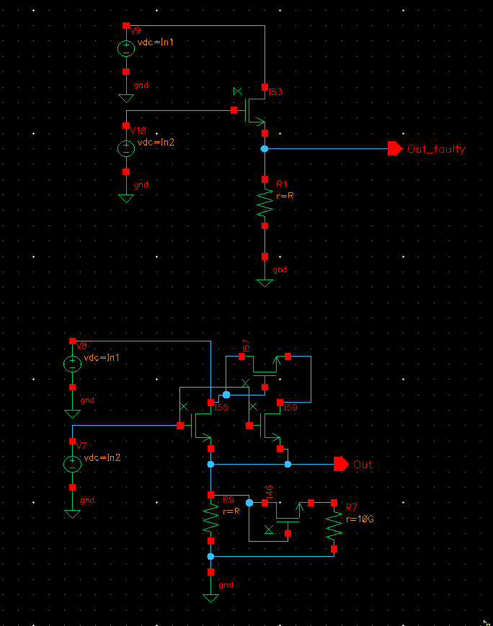
p-CR-ReLU

Slide 6
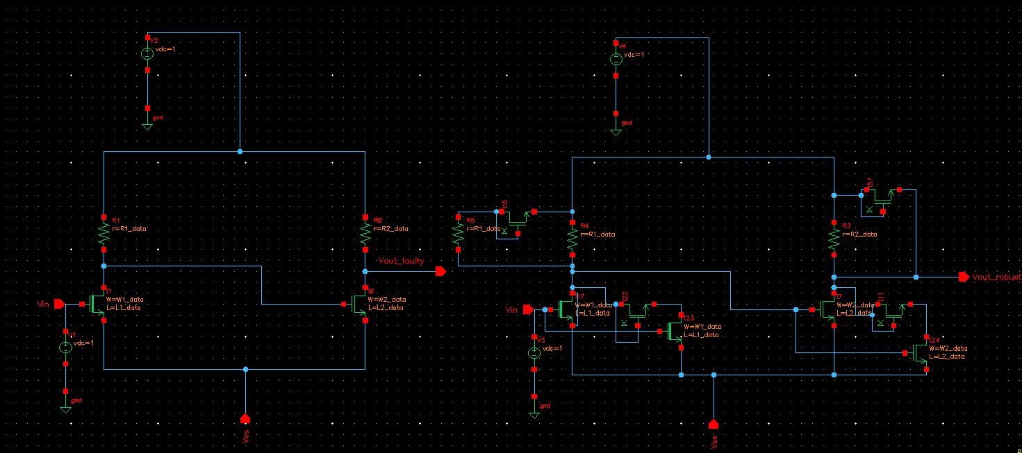
ptanh

Slide 7
To Count no. of devices from below slides

Slide 8
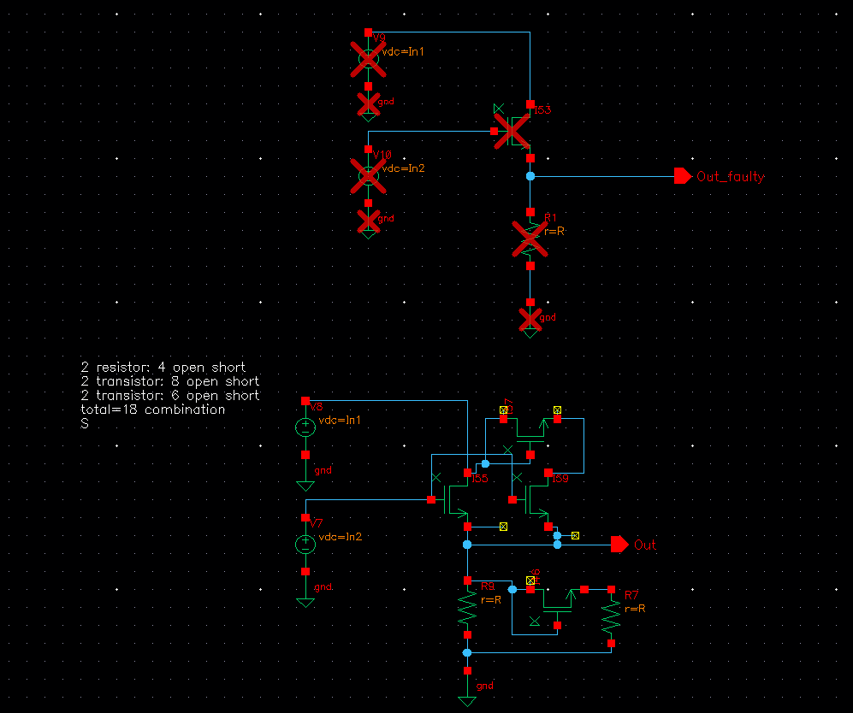
CR

Slide 9
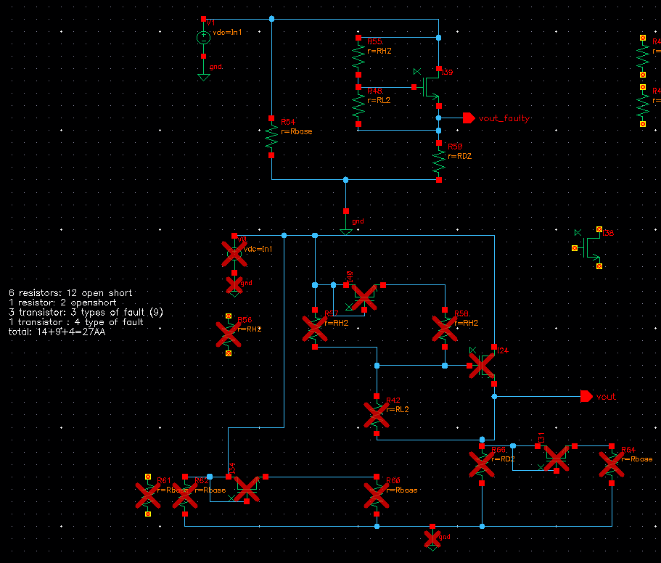
ReLU

Slide 10
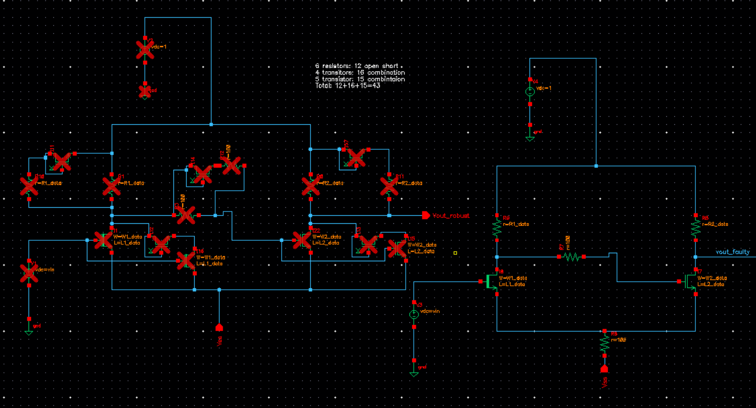
p-sigmoid

Slide 11
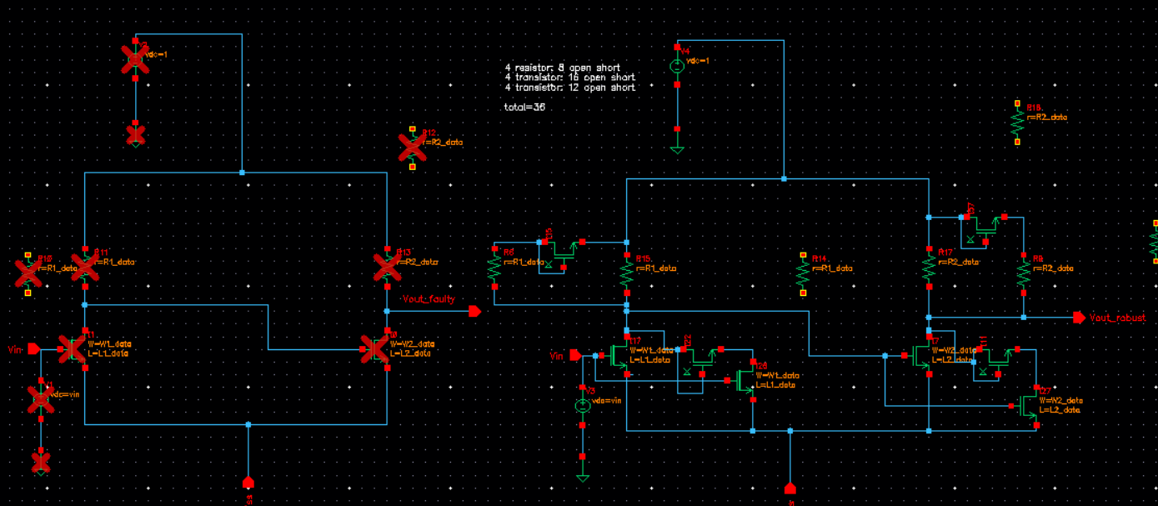
p-tanh

Slide 12
Power | uW
1.R1_short | 91.23
2.R1_open | 0.00399
3.R1_redundant_short | 51.56
4.R1_redundant_open | 51.25
5.R2_short | 5.341
6.R2_open | 84.41
7.R2_redundant_short | 42.99
8.R2_redundant_open | 51.25
9.R3_short | 51.25
10.R3_open | 51.25
11.R3_redundant_short
12.R3_redundant_open
13.M1_open_D | 91.23
14.M1_G-S_short | 66.555
15.M1_G-D_short | 66.55
16.M1_D-S_short | 11.42
17.M2_open_D | 5.19
18.M2_G-S_short | 11.42
19.M2_G-D_short | 73.398
20.M2_D-S_short | 8.8681f
Power | uW
21.M3_open
22.M3_G-S_short | 105.191
23.M3_G-D_short | 65.14
24.M3_D-S_short | 51.245
25.M1_redundant_open
26.M1_redundant_G-S_short
27.M1_redundant_G-D_short
28.M1_redundant_D-S_short
29.M2_redundant_open
30.M2_redundant_G-S
31.M2_redundant_G-D
32.M2_redundant_D-S
33.M3_redundant_open
34.M3_redundant_G-S
35..M3_redundant_G-D
36.M3_redundant_D-S
37.M1_switch_G-D
38.M1_switch_D-S
39.M1_switch_open&M1 is faulty
40.M2_switch_G-D
41.M2_switch_D-S
42.M2_switch_open&M2 is faulty
Power | uW
43.M3_switch_G-D
44.M3_switch_D-S
45.M3_switch_open&M3 is faulty
46.M_R1_switch_G-D
47.M_R1_switch_D-S
48.M_R1_switch_open&M_R1 is faulty
49.M_R2_switch_G-D
50.M_R2_witch_D-S
51.M_R2_switch_open&M_R2_ is faulty
52M_R3_switch_G-D
53.M_R3_switch_D-S
54.M_R3_switch_open&M2 is faulty
Neg_weight

