Slide 1


Skill-Based Verification of Cyber-Physical Systems
Alexander Knüppel, Inga Jatzkowski, Marcus Nolte, Thomas Thüm, Tobias Runge, and Ina Schaefer
FASE‘2021
(accepted at FASE’20)

Slide 2
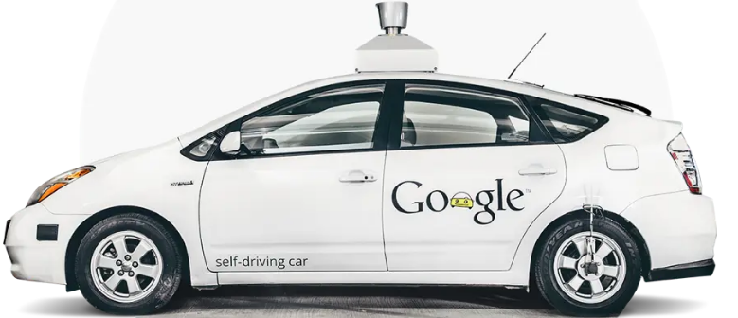


Motivation: Cyber-Physical Systems
https://waymo.com/journey/
Automation
„I really consider autonomous driving a solved problem. […] I think we are probably less than two years away […]”
Elon Musk at Code 2016
Correct and reusable

Slide 3


Fundamental Research Questions Remain
Why formal?
Non-conformance
Bugs
Ensuring functional safety/correctness is indispensable!
SE
But…
Scalability
Expertise
…
Q: How to integrate functional safety & provably correct function development for safe behavior into software engineering processes?

Slide 4
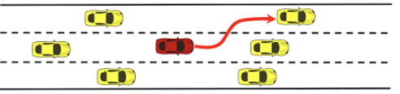

Maneuver-Centric Formal Engineering Approach
Customer
Informal Specification
Formal
Verification
Contributions of this work:
Modelling notation for maneuvers based on Skill Graphs
Formal underpinning for correctness proofs based on Hybrid Programs
Tool support (SKEDITOR)
Analysis
Formal Specification
Modelling
Correctness Proofs
Modification
Refinement
Conformity
Code (Generation)
Impl.
Design
Choices
Improvement
Correctness Proofs
Virtual Prototype
Real World
Output
Input
Simulation

Slide 5
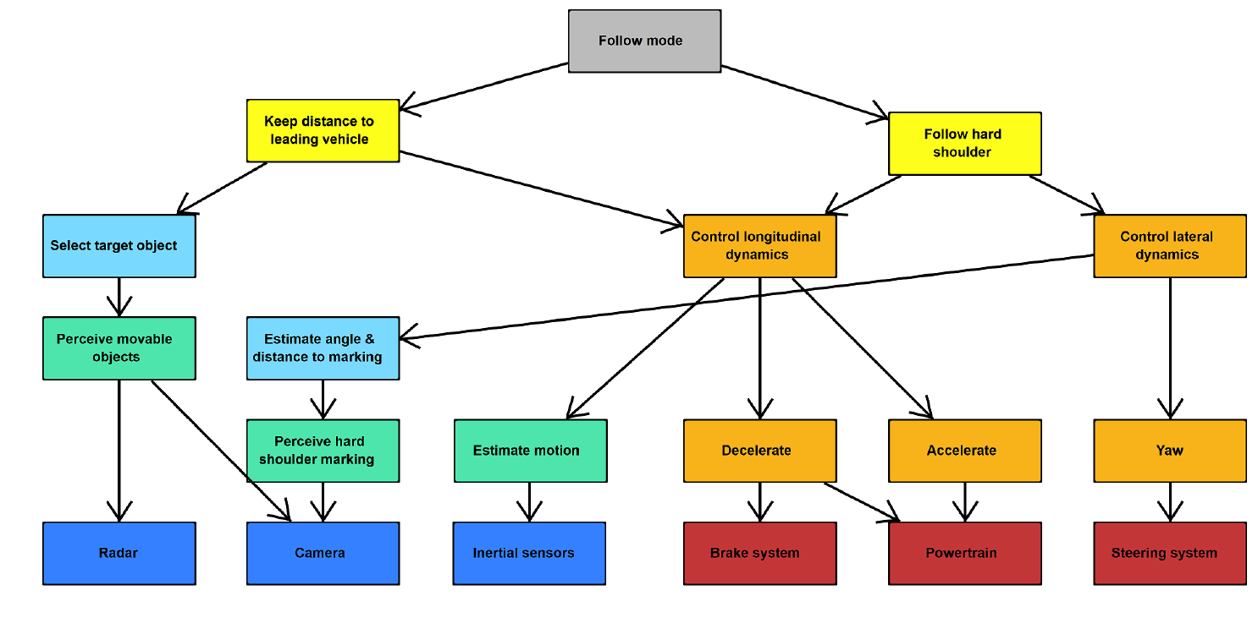
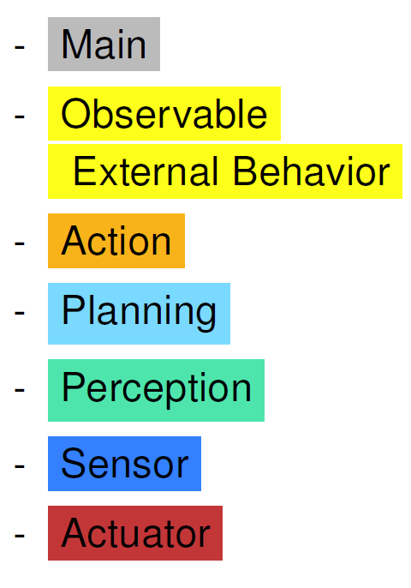
Modelling Foundation: Skill Graphs
Source
Controller
Sink
Graph-based representation for functional dependencies (nodes: skills, edges: dependencies) (A. Reschka et al., 2015)
“What activities must the system perform to fulfill its goals?“
Skill Graph: - Used during system design - Mapping between safety goals & skills
Controller
Software
Hardware
A. Reschka, G. Bagschik, S. Ulbrich, M. Nolte and M. Maurer: „Ability and skill graphs for system modeling, online monitoring, and decision support for vehicle guidance systems“ In: 2015 IEEE Intelligent Vehicles Symposium (IV 2015), Seoul, South Korea, 2015, pp. 933-939

Slide 6
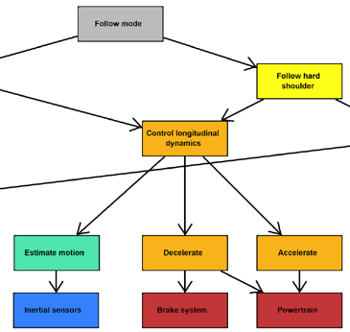











Skill Description
Symbol | Description | Content
 | Defined variables or prameters
 | Required variables or prameters
 | Hybrid program
 | Type | action
 | Safety obligation
 | Precondition
Contract-based design methodology
Skill ID | Name |  | Requirements / Safety Obligation
… | … | … | …
S4 | “Control longitudinal dynamics“ | R1 | “Vehicle speed must not exceed 2.7 m/s“
… | … | … | …

Slide 7
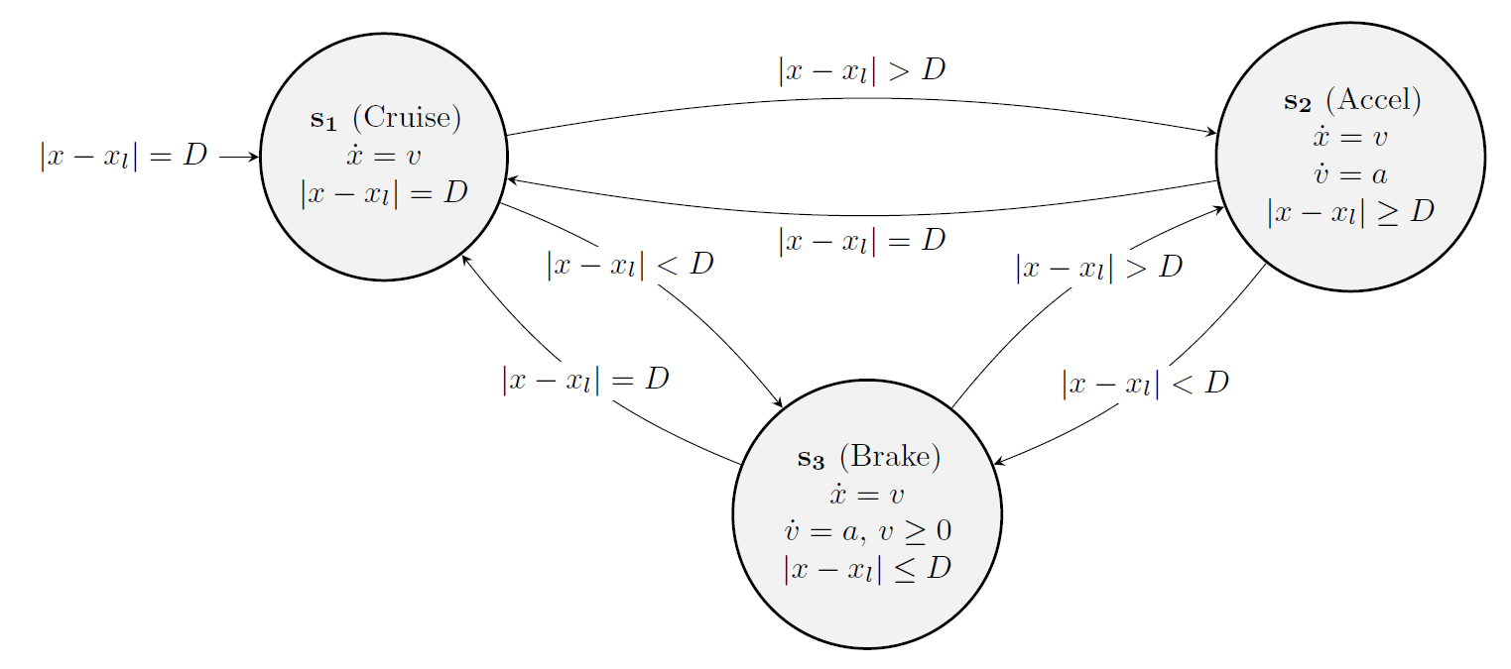
Hybrid Systems as a Mathematical Foundation for CPSs
Mixed modeling of continious and discrete dynamics

Slide 8

Hybrid Programs and Differential Dynamic Logic
Differential Dynamic Logic:
Hybrid Program:
Verification by validity checking of
Seq. Compose
Nondet. Choice
Nondet. Repeat
Discrete
Assignment
Diff. Equation
Test Condition
André Platzer, “Differential dynamic logic for verifying parametric hybrid systems“, TABLEAUX 2007, Springer

Slide 9
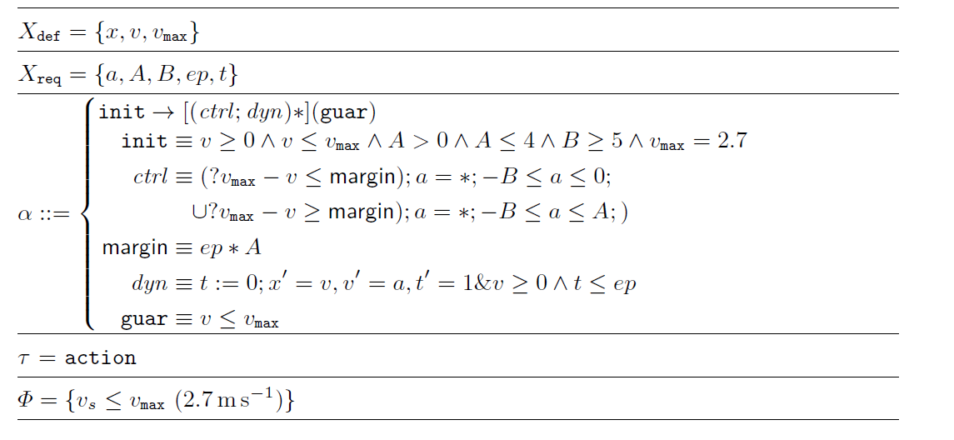
Example: Hybrid Program of Control Longitudinal Dynamics

Slide 10





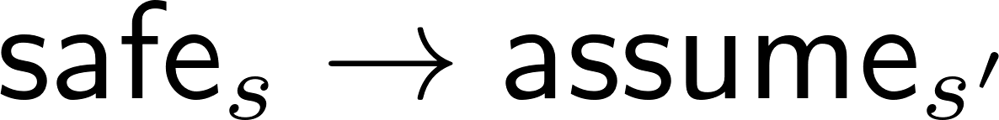



Verification Condition Generation
Global contract
Theorem:
1.
for all s in { }
2.
for all s and s‘ iff s in { } and
3.
for all s in { }
4.
depends on hybrid programs defined in - skills, which can be integrated via method calling
Side note: dynamic systems are modeled in action-skills and propagated to the top.

Slide 11
Controller Assembly
Requires program independence at the moment, i.e.,
then
Follow hard shoulder may use controller implementations of child skills
Modularity + reusability + saves verification effort

Slide 12
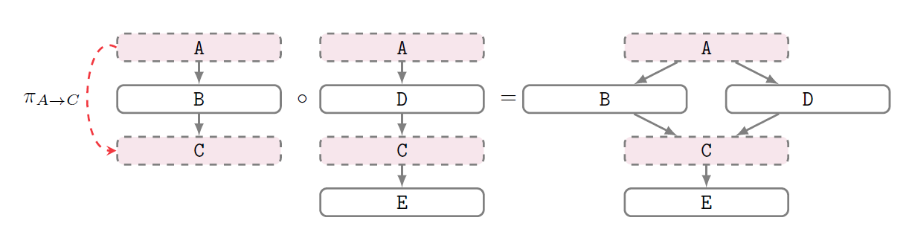
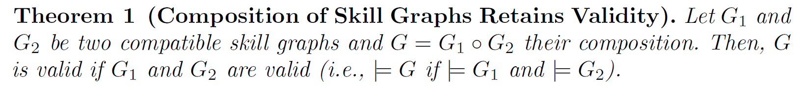
On Compositionanility of Skill Graphs

Slide 13
On Compositionanility of Skill Graphs
=

Slide 14

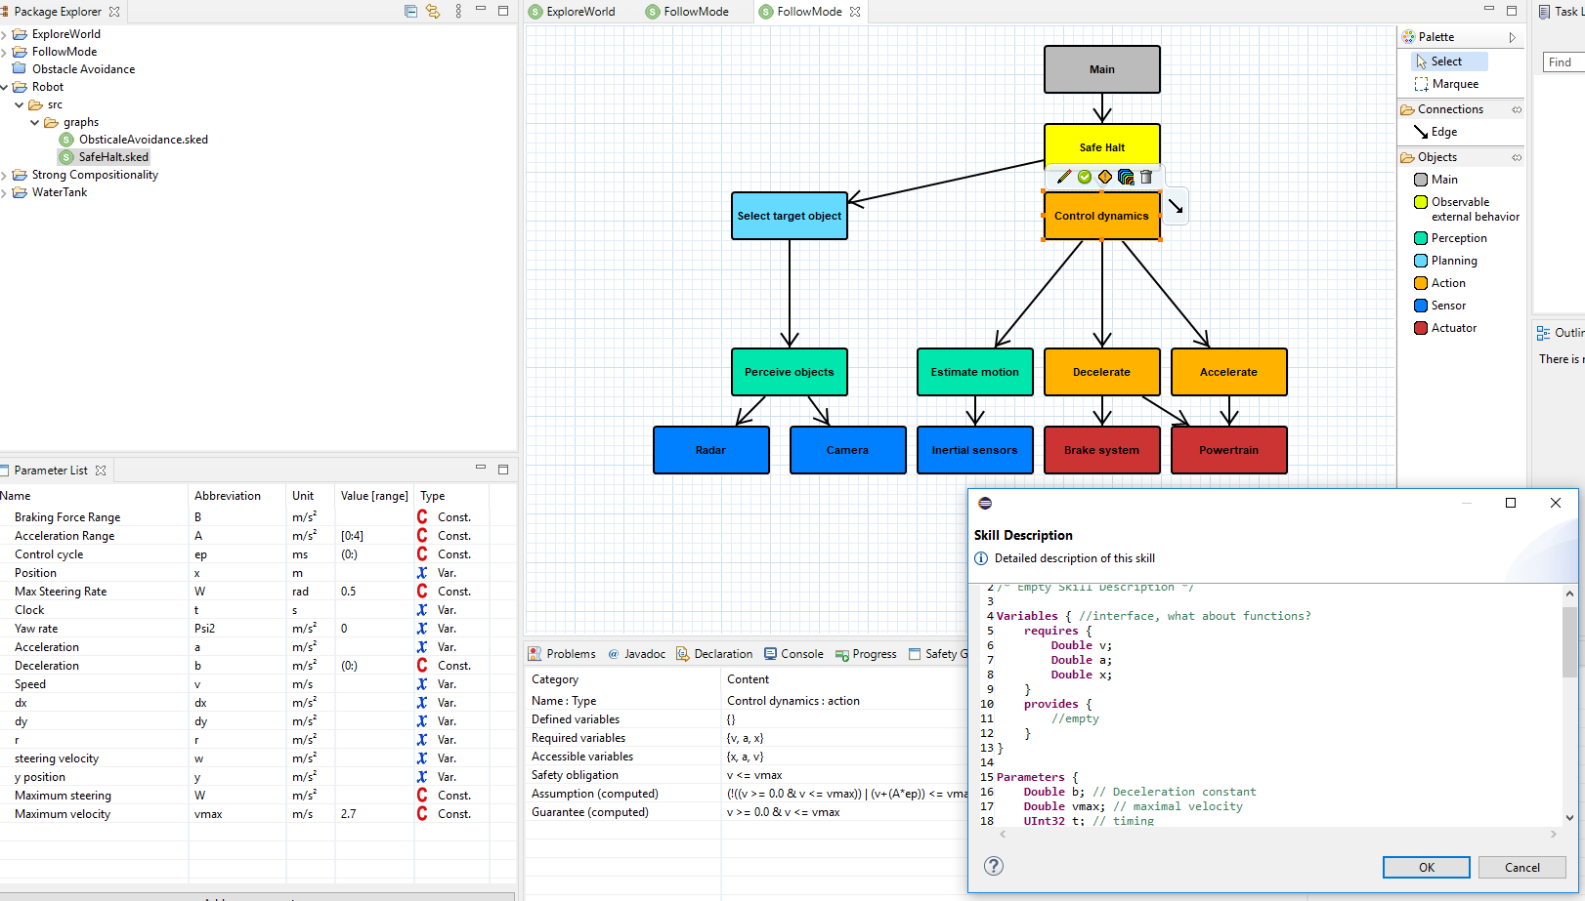
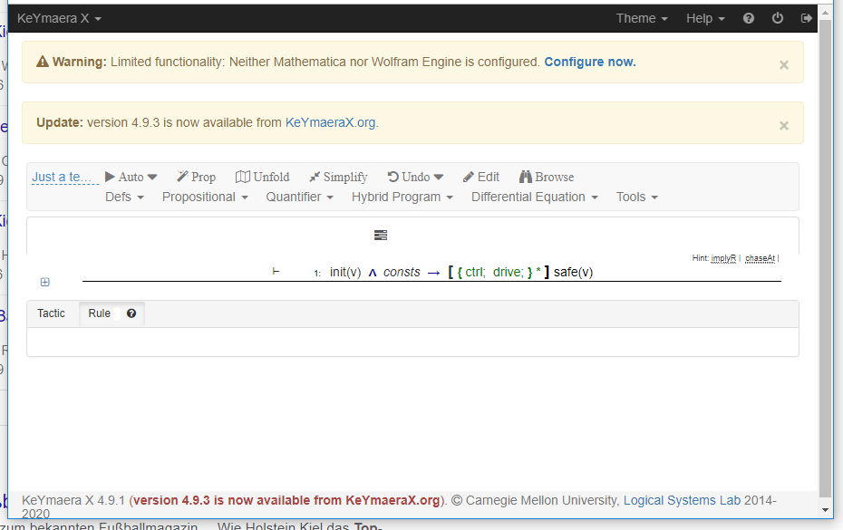
Tool Support: Skeditor
https://github.com/TUBS-ISF/Skeditor

Slide 15
Reducing Verification Effort through Composition – Eval.
RQ: To what extent can skill-based compositional verification reduce
the verification effort?
=
G1
G2
G3 = G1 G2

Slide 16
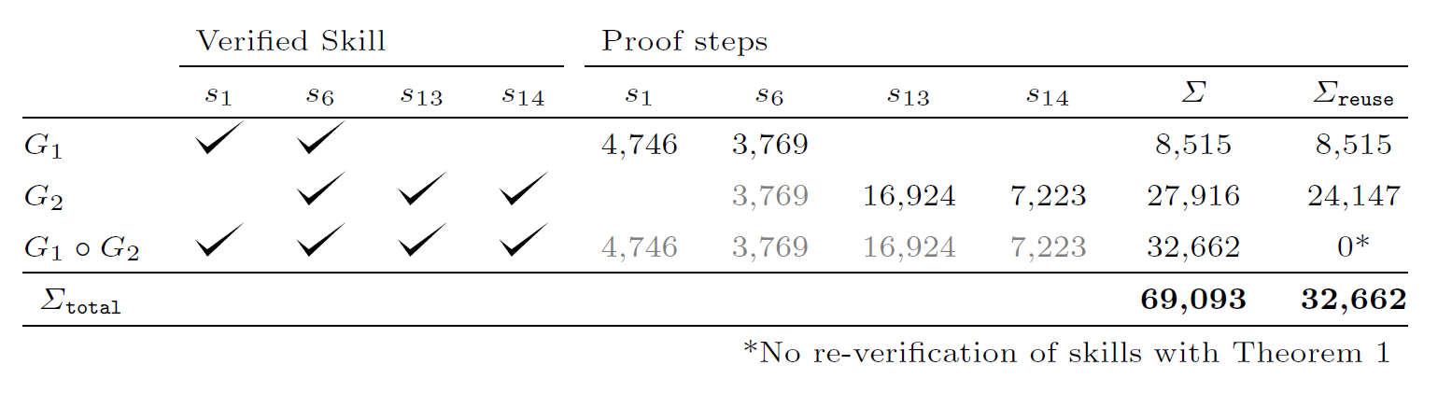
Reducing Verification Effort through Composition - Results
RQ: To what extent can skill-based compositional verification reduce
the verification effort?
Approximately 53%

Slide 17
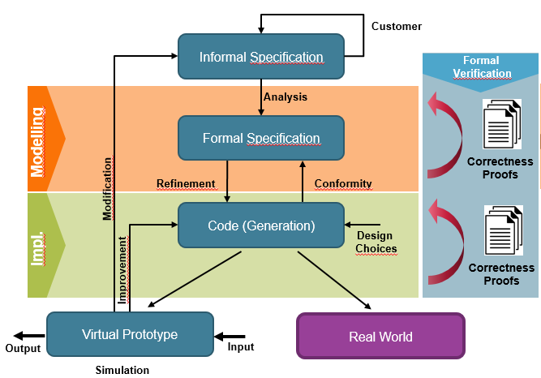
Summary
https://github.com/TUBS-ISF/Skeditor
a.knueppel@tu-bs.de
+
Current/Future Work:
Case Studies/modelled maneuvers
Code generation + ROS/AirSim Simulation
and more…

Slide 18
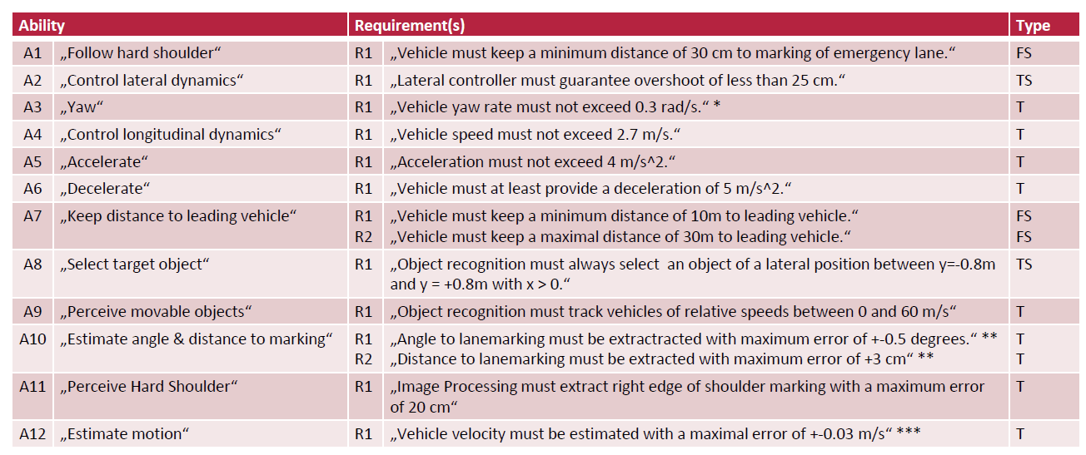
Informal Safety Requirements for a Vehicle

Slide 19
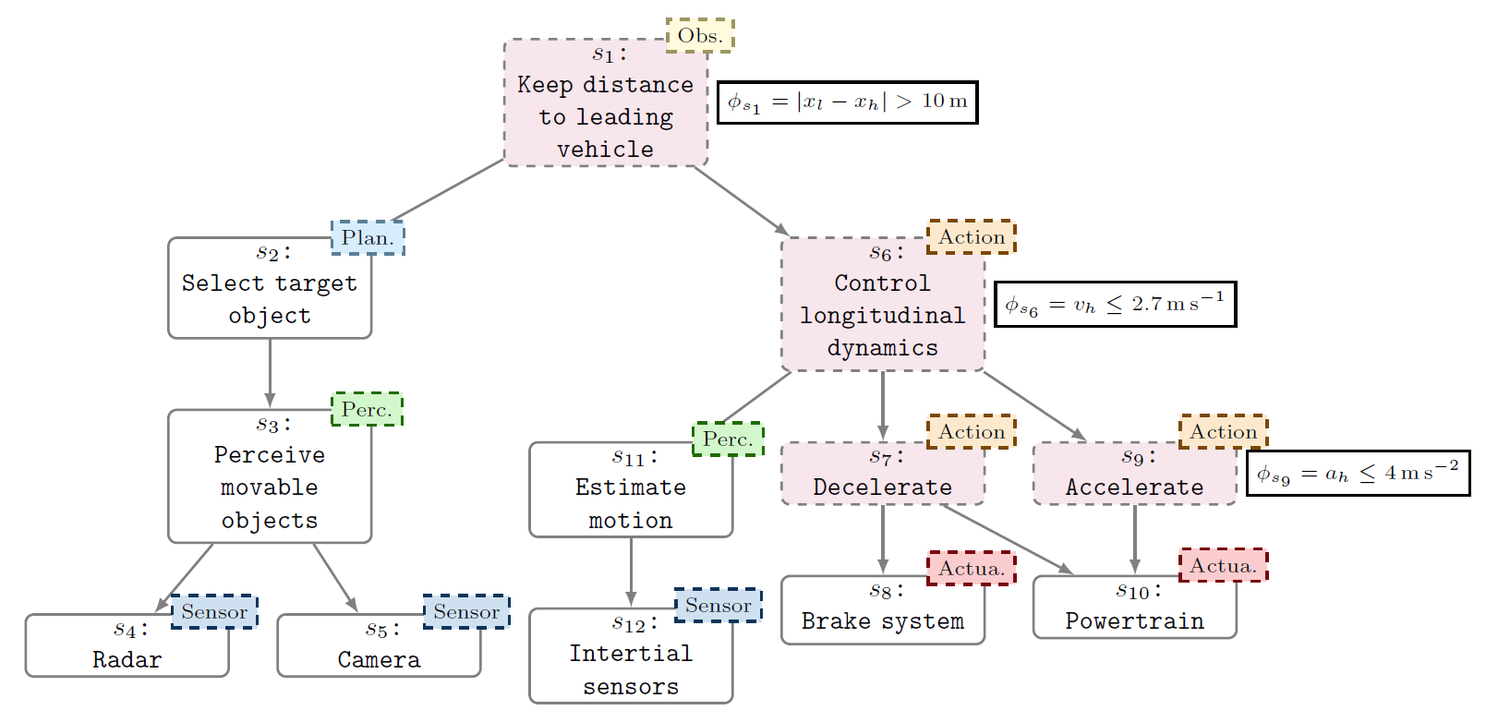
Feature List / Current Progress
Explicit interfaces
Implementing skills with HPs
Adopted Assume/Guarantee-Resoning (contracts)
Environmental constraints
Means for redundant modelling
Dempster-Shafer Theory for modelling sensor uncertainty
Synthesis
SPLs with Scenarios

