Slide 1


Qiskit Hackathon@World of Quantum
Domenik Eichhorn
Joshua Ammermann
Rinor Kelmendi
…

Slide 2
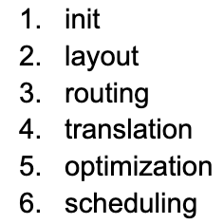
Ideen
Notes:
As computer scientists, we tried to find a topic that utilized our strengts and reduced the deep quantum knowledge, that for instance physics have
At first we thought of looking into optimization of connectivity graphs through optimization methods. This is part of layout and routing transpiler stage
We then brainstormed which stage could be easiest to play with - meaning which Pass Manager has most passes to play with, with least mandatory dependencies to allow us to experiment easily.
The answer was the optimization layer. Seeing that IBM has already implemented reinforcement learning for a few of the passes in this stage, we thought we could move one abstraction layer up, and create machine learning model which learns the best passes configurations for each of the circuits instead of relying on hardcoded preset configurations which qiskit offers.
At the same time, not sure if our approach will yield results, we have split our time into two groups, one with Joshua and Rinor and the second one consisting of Domenik, Nick and me.

Slide 3
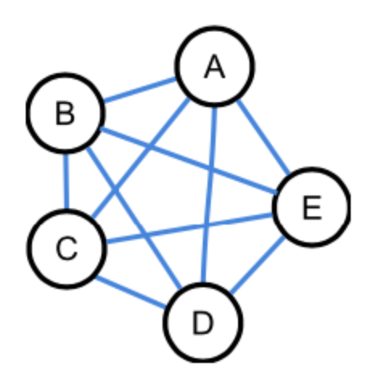
Ideen
Notes:
As computer scientists, we tried to find a topic that utilized our strengts and reduced the deep quantum knowledge, that for instance physics have
At first we thought of looking into optimization of connectivity graphs through optimization methods. This is part of layout and routing transpiler stage
We then brainstormed which stage could be easiest to play with - meaning which Pass Manager has most passes to play with, with least mandatory dependencies to allow us to experiment easily.
The answer was the optimization layer. Seeing that IBM has already implemented reinforcement learning for a few of the passes in this stage, we thought we could move one abstraction layer up, and create machine learning model which learns the best passes configurations for each of the circuits instead of relying on hardcoded preset configurations which qiskit offers.
At the same time, not sure if our approach will yield results, we have split our time into two groups, one with Joshua and Rinor and the second one consisting of Domenik, Nick and me.

Slide 4
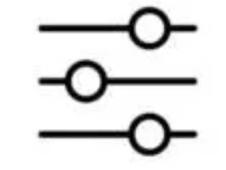
Ideen
Notes:
As computer scientists, we tried to find a topic that utilized our strengts and reduced the deep quantum knowledge, that for instance physics have
At first we thought of looking into optimization of connectivity graphs through optimization methods. This is part of layout and routing transpiler stage
We then brainstormed which stage could be easiest to play with - meaning which Pass Manager has most passes to play with, with least mandatory dependencies to allow us to experiment easily.
The answer was the optimization layer. Seeing that IBM has already implemented reinforcement learning for a few of the passes in this stage, we thought we could move one abstraction layer up, and create machine learning model which learns the best passes configurations for each of the circuits instead of relying on hardcoded preset configurations which qiskit offers.
At the same time, not sure if our approach will yield results, we have split our time into two groups, one with Joshua and Rinor and the second one consisting of Domenik, Nick and me.

Slide 5
Challenge
Optimize …

Slide 6
Optimization 1
Optimize …

Slide 7
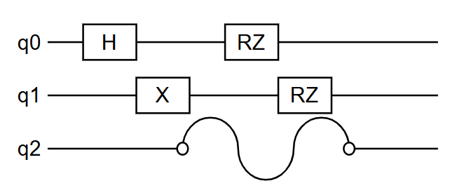
Optimization 2: Error Supression
Problem: Idle qubits tend to disturb nearby qubits. (Cross-Talking)

Slide 8
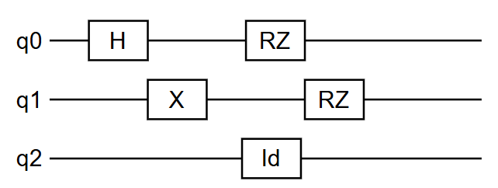
Dynamic Decoupling
Solution: Dynamic Decoupling
Use identity gates to keep idle qubits busy

Slide 9
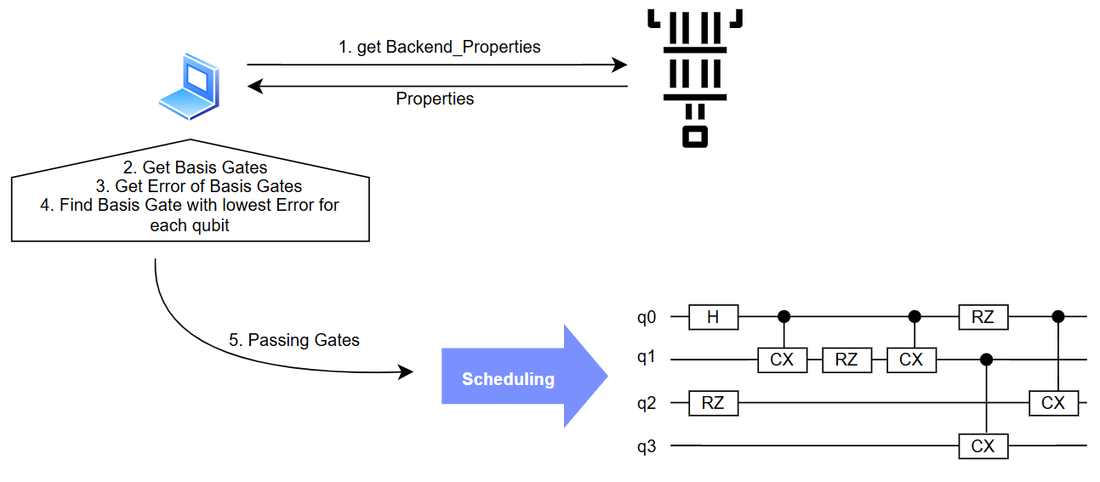
Dynamic Decoupling Optimization
Optimization: Create identity gates with lowest error basis gate for each qubit

Slide 10
Dynamic Decoupling Optimization
Optimization: Create identity gates with lowest error basis gate for each qubit

Slide 11
Dynamic Decoupling Optimization
Optimization: Create identity gates with lowest error basis gate for each qubit

Slide 12
Dynamic Decoupling Optimization
Optimization: Create identity gates with lowest error basis gate for each qubit

Slide 13
Dynamic Decoupling Optimization
Optimization: Create identity gates with lowest error basis gate for each qubit

Slide 14
Dynamic Decoupling Optimization
Optimization: Create identity gates with lowest error basis gate for each qubit

Slide 15
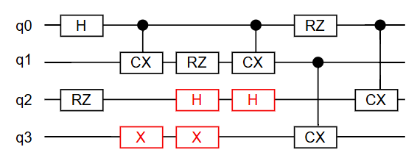
Dynamic Decoupling Optimization
Optimization: Create identity gates with lowest error basis gate for each qubit

Slide 16
Results
We are able to optimize dynamic decoupling for arbitrary backend

Slide 17
Summary

Slide 18
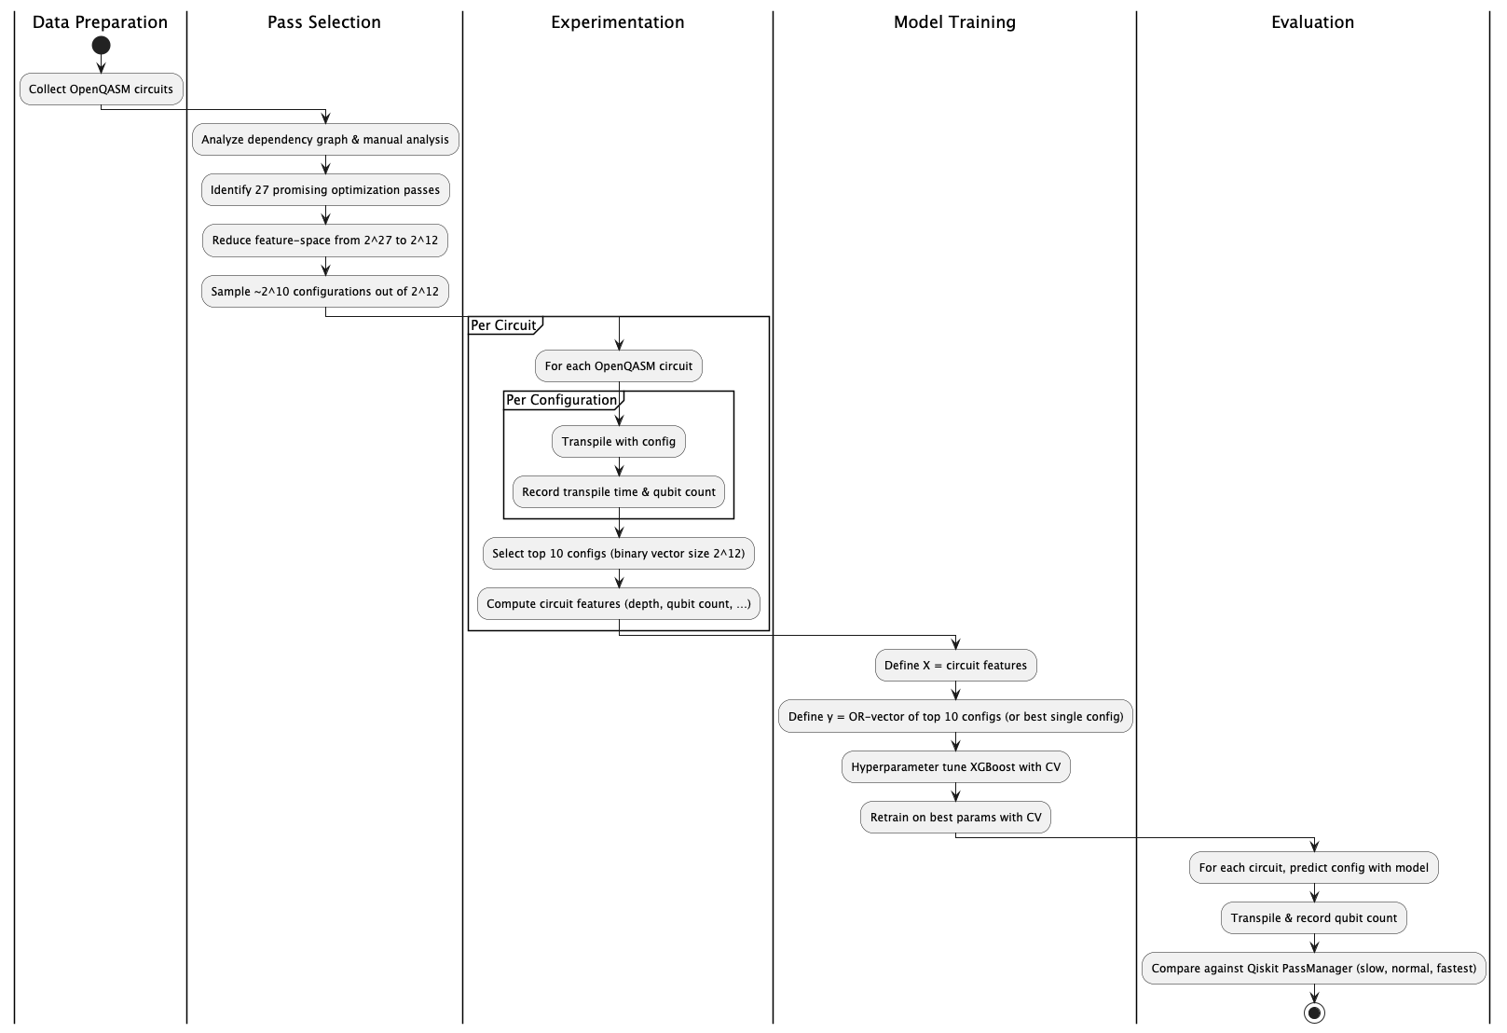
Optimization Configurator

Slide 19
Evaluation & Learnings

Slide 20
Jupyter Notebooks

