Slide 1


Qiskit Hackathon@World of Quantum
Domenik Eichhorn
Joshua Ammermann
Rinor Kelmendi
…

Slide 2
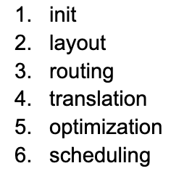
Ideen
Notes:
As computer scientists, we tried to find a topic that utilized our strengts and reduced the deep quantum knowledge, that for instance physics have
At first we thought of looking into optimization of connectivity graphs through optimization methods. This is part of layout and routing transpiler stage
We then brainstormed which stage could be easiest to play with - meaning which Pass Manager has most passes to play with, with least mandatory dependencies to allow us to experiment easily.
The answer was the optimization layer. Seeing that IBM has already implemented reinforcement learning for a few of the passes in this stage, we thought we could move one abstraction layer up, and create machine learning model which learns the best passes configurations for each of the circuits instead of relying on hardcoded preset configurations which qiskit offers.
At the same time, not sure if our approach will yield results, we have split our time into two groups, one with Joshua and Rinor and the second one consisting of Domenik, Nick and me.

Slide 3
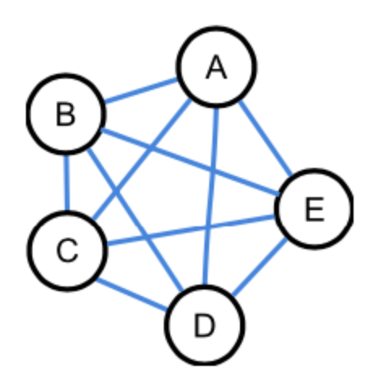
Ideen
Notes:
As computer scientists, we tried to find a topic that utilized our strengts and reduced the deep quantum knowledge, that for instance physics have
At first we thought of looking into optimization of connectivity graphs through optimization methods. This is part of layout and routing transpiler stage
We then brainstormed which stage could be easiest to play with - meaning which Pass Manager has most passes to play with, with least mandatory dependencies to allow us to experiment easily.
The answer was the optimization layer. Seeing that IBM has already implemented reinforcement learning for a few of the passes in this stage, we thought we could move one abstraction layer up, and create machine learning model which learns the best passes configurations for each of the circuits instead of relying on hardcoded preset configurations which qiskit offers.
At the same time, not sure if our approach will yield results, we have split our time into two groups, one with Joshua and Rinor and the second one consisting of Domenik, Nick and me.

Slide 4
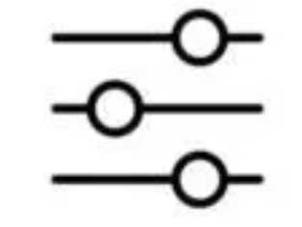
Ideen
Notes:
As computer scientists, we tried to find a topic that utilized our strengts and reduced the deep quantum knowledge, that for instance physics have
At first we thought of looking into optimization of connectivity graphs through optimization methods. This is part of layout and routing transpiler stage
We then brainstormed which stage could be easiest to play with - meaning which Pass Manager has most passes to play with, with least mandatory dependencies to allow us to experiment easily.
The answer was the optimization layer. Seeing that IBM has already implemented reinforcement learning for a few of the passes in this stage, we thought we could move one abstraction layer up, and create machine learning model which learns the best passes configurations for each of the circuits instead of relying on hardcoded preset configurations which qiskit offers.
At the same time, not sure if our approach will yield results, we have split our time into two groups, one with Joshua and Rinor and the second one consisting of Domenik, Nick and me.

Slide 5
Challenge
Optimize …

Slide 6
Optimization 1
Optimize …

Slide 7
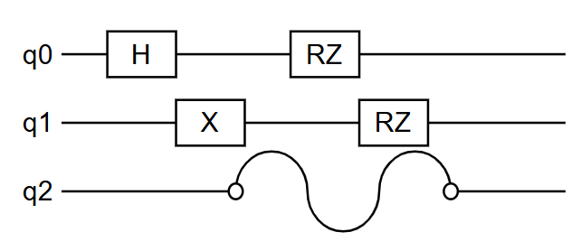
Optimization 2: Error Supression
Problem: Idle qubits tend to disturb nearby qubits.

Slide 8
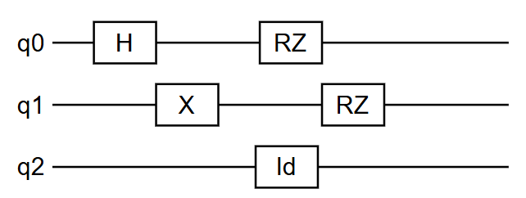
Dynamic Decoupling
Solution: Dynamic Decoupling
Use identity gates to keep idle qubits busy

Slide 9
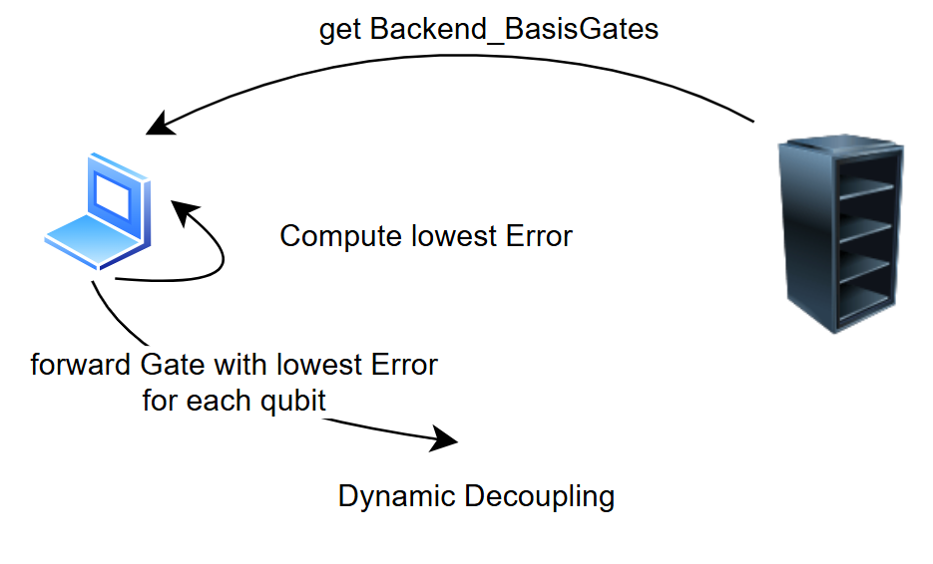
Dynamic Decoupling Optimization
Optimization: Create identity gate with lowest error basis gate.
Steps
Ask for Basis Gates from Backend
Compute Error of each Basis Gate
Find Basis Gate with Minimum Error for each qubit
Use Minimum Error Basis Gate for specific qubit

Slide 10
Results
We are able to optimize dynamic decoupling for arbitrary backend

Slide 11
Summary

Slide 12
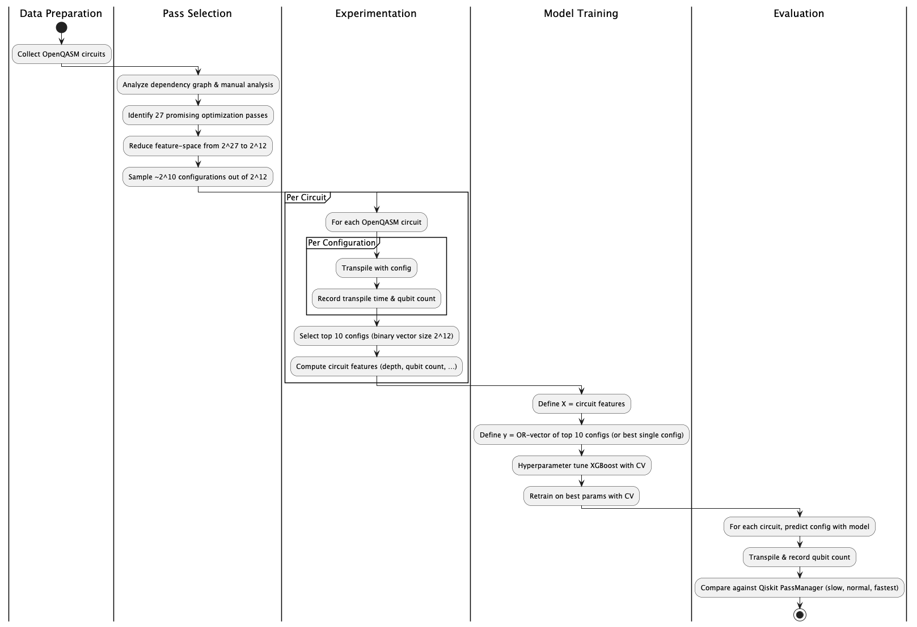
Optimization Configurator

Slide 13
Evaluation & Learnings

Slide 14
Jupyter Notebooks

