Slide 1

Qiskit Hackathon@World of Quantum
Domenik Eichhorn
Joshua Ammermann
Rinor Kelmendi
…

Slide 2
Challenge
Optimize …

Slide 3
Optimization 1
Optimize …

Slide 4
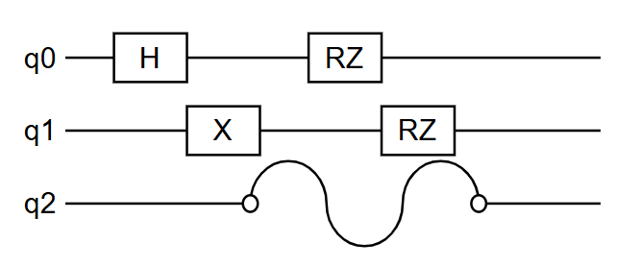
Optimization 2: Error Supression
Problem: Idle qubits tend to disturb nearby qubits.

Slide 5
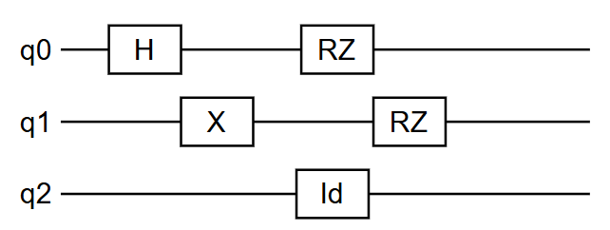
Dynamic Decoupling
Solution: Dynamic Decoupling
Use identity gates to keep idle qubits busy

Slide 6
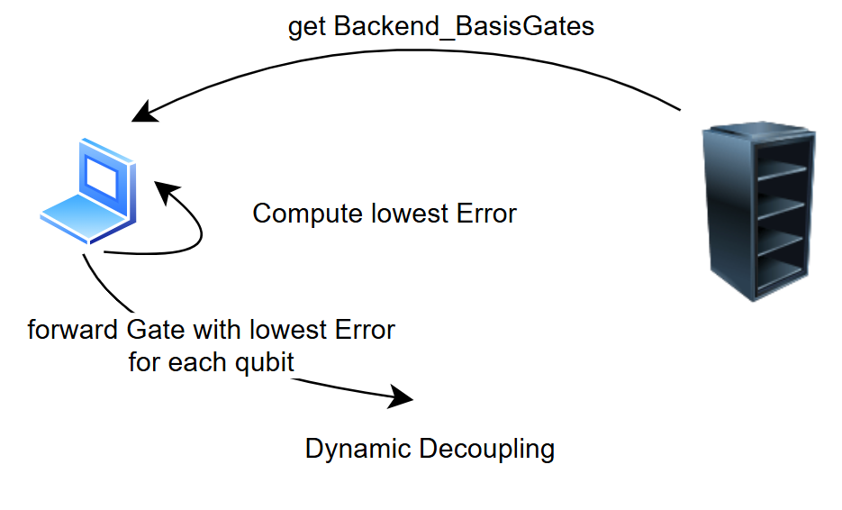
Dynamic Decoupling Optimization
Optimization: Create identity gate with lowest error basis gate.
Steps
Ask for Basis Gates from Backend
Compute Error of each Basis Gate
Find Basis Gate with Minimum Error for each qubit
Use Minimum Error Basis Gate for specific qubit

Slide 7
Results
We are able to optimize dynamic decoupling for arbitrary backend

Slide 8
Summary

