Slide 1
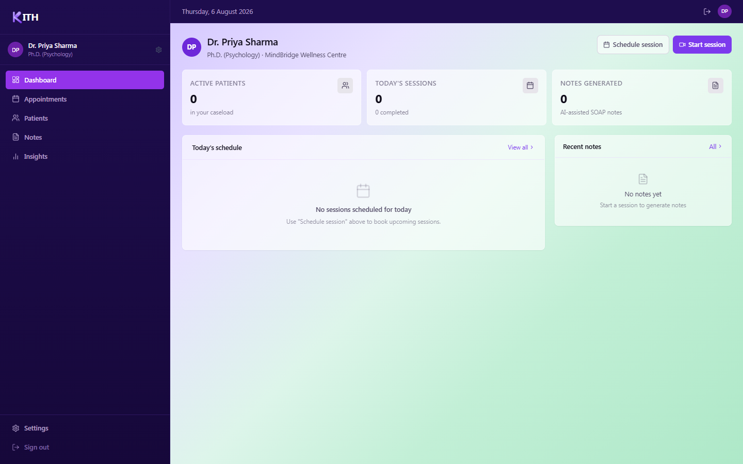
KITH
CLINICIAN USER GUIDE
Getting Started with Kith
A step-by-step walkthrough of account setup, guided onboarding, and your everyday workspace — with a screenshot for every step.
KITH

Slide 2
OVERVIEW
What this guide covers
Three phases take you from a blank sign-up form to a fully configured clinical workspace.
1
2
3
Create your account
Guided workspace setup
Your everyday workspace
A 4-step sign-up: account, practice details, photo, and importing any existing bookings.
A 6-step wizard confirms your profile, connects your calendar, imports patients, and sets your plan.
A tour of the Dashboard, Patients, Appointments, and Settings — where you’ll spend most of your time.
4 screens
6 screens
6 screens
KITH

Slide 3
KITH
PART 1 OF 3
Create Your Account
Four short screens — email and password, your practice details, an optional photo, and bringing in existing bookings.

Slide 4
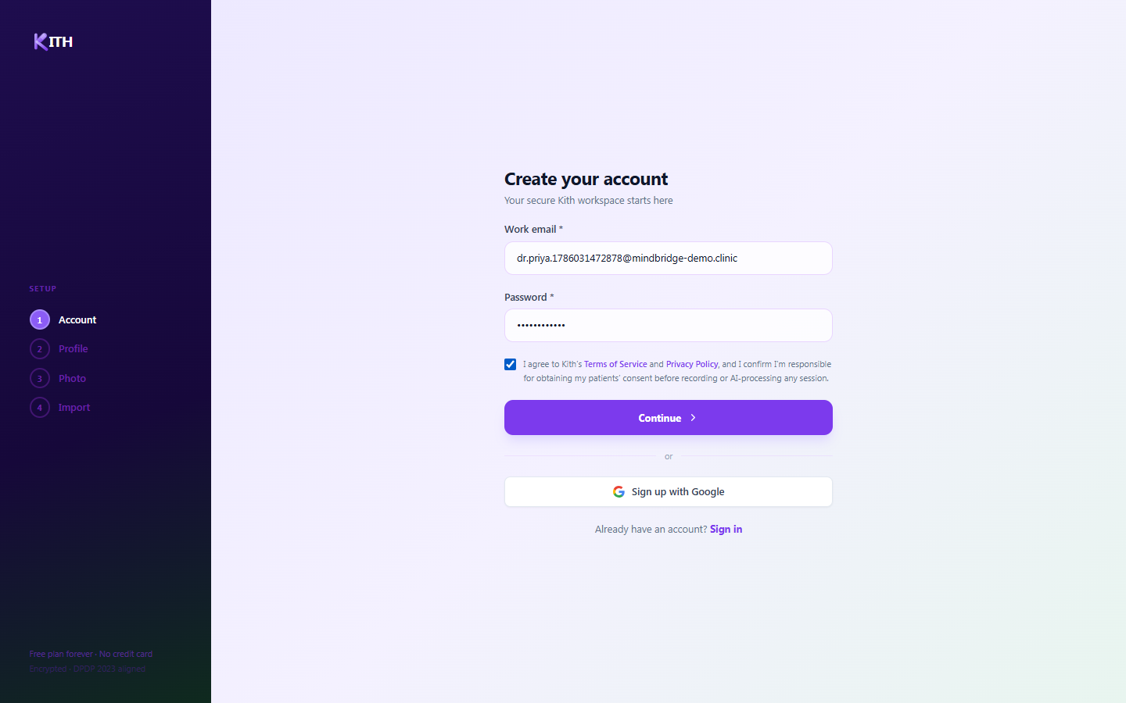
1
CREATE ACCOUNT · STEP 1 OF 4
Create your account
Start your secure Kith workspace in under a minute.
Enter your work email address
Choose a password (minimum 8 characters)
Agree to the Terms of Service & Privacy Policy — this confirms you’ll obtain patient consent before recording or AI-processing sessions
Or skip ahead with "Sign up with Google"
KITH

Slide 5
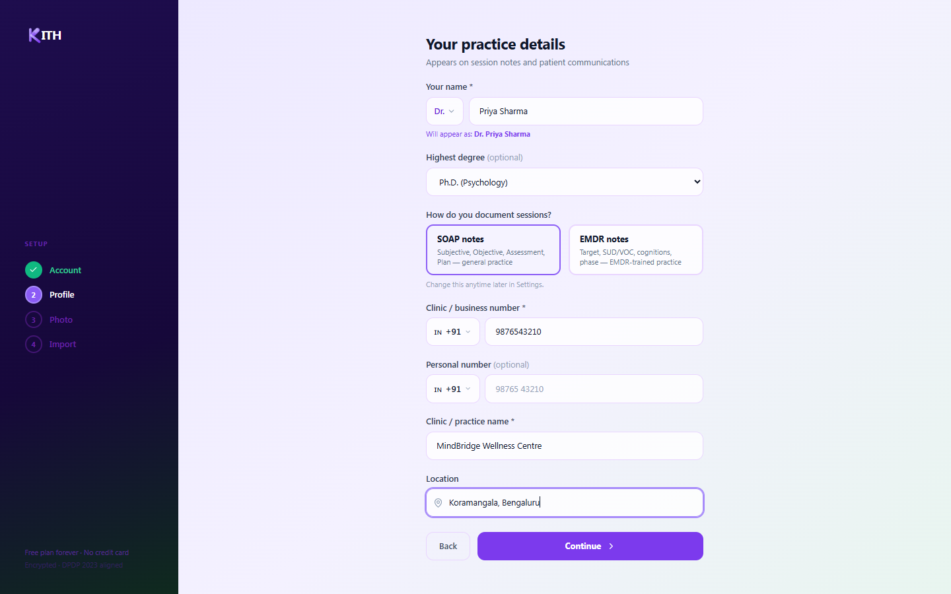
2
CREATE ACCOUNT · STEP 2 OF 4
Add your practice details
This information appears on your AI-generated session notes and patient communications.
Enter your name and title (Dr., Prof., etc.)
Select your highest degree (optional)
Choose your note format — SOAP or EMDR
Add your clinic/business phone number and practice name
Set your clinic location
KITH

Slide 6
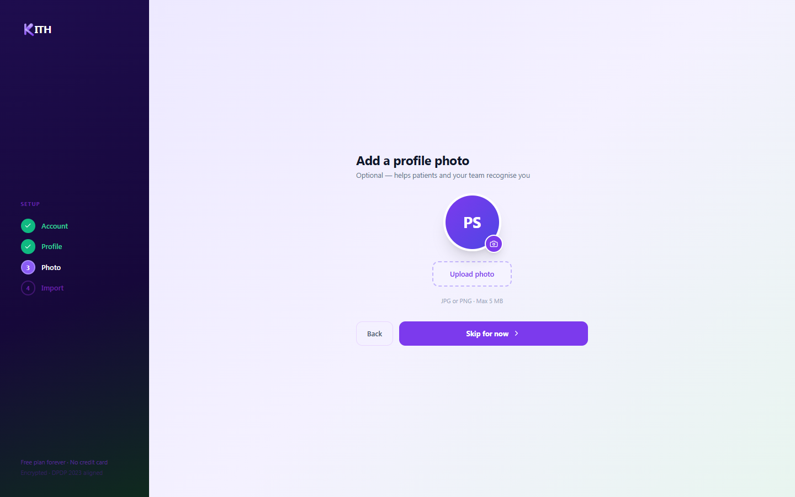
3
CREATE ACCOUNT · STEP 3 OF 4
Add a profile photo
Optional — helps patients and your team recognize you at a glance.
Click "Upload photo" to select a JPG or PNG (max 5 MB)
Or select "Skip for now" — you can add one anytime from Settings
KITH

Slide 7
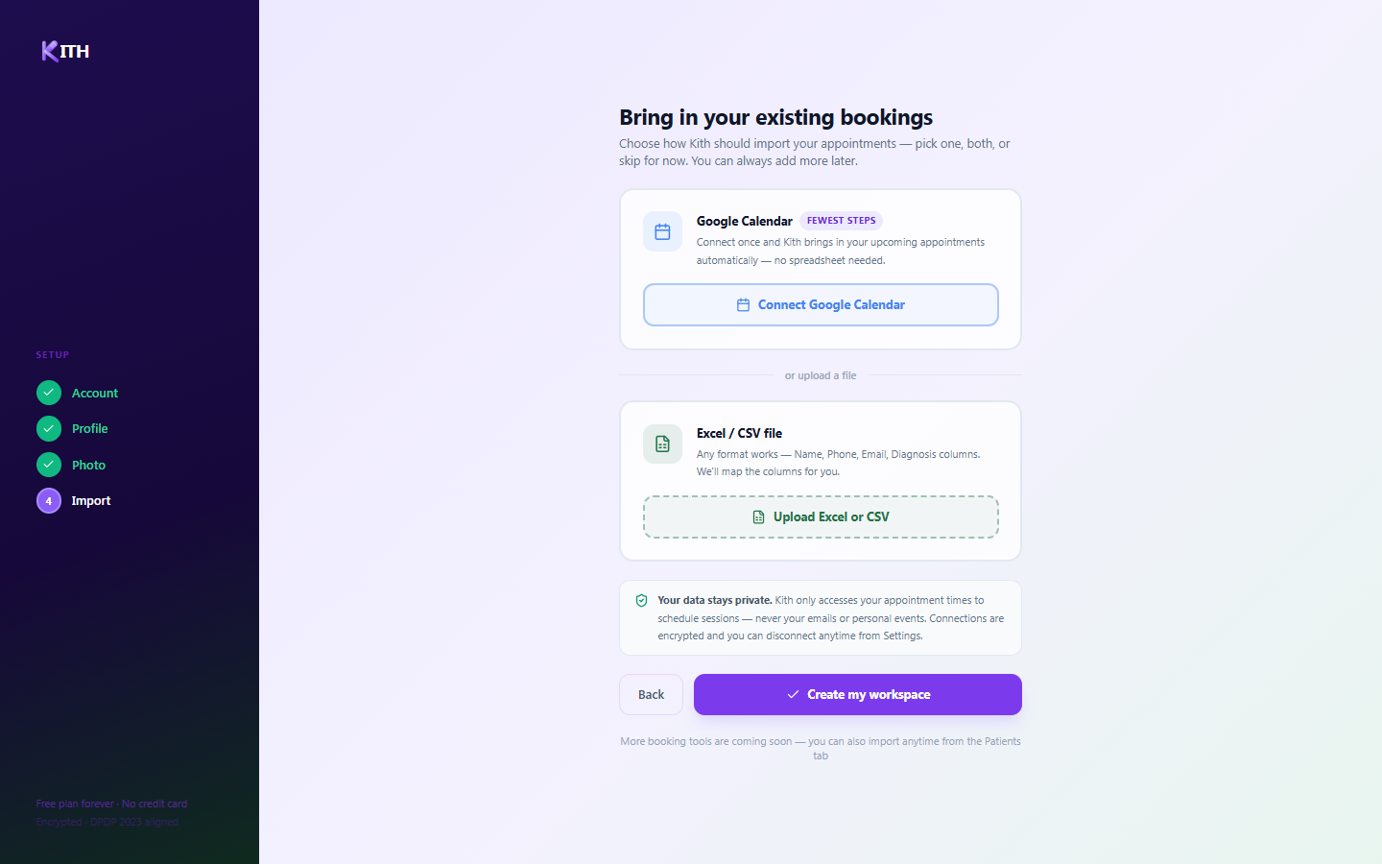
4
CREATE ACCOUNT · STEP 4 OF 4
Bring in your existing bookings
Choose how Kith should import your appointments — pick one, both, or skip for now.
Connect Google Calendar for automatic, ongoing sync — the fewest steps
Or upload an Excel/CSV file of your appointments
Your data stays private — connections are encrypted and can be disconnected anytime
Click "Create my workspace" to finish registration
KITH

Slide 8
KITH
PART 2 OF 3
Guided Workspace Setup
A short six-step wizard confirms your profile, connects your tools, and gets your first patients into Kith.

Slide 9
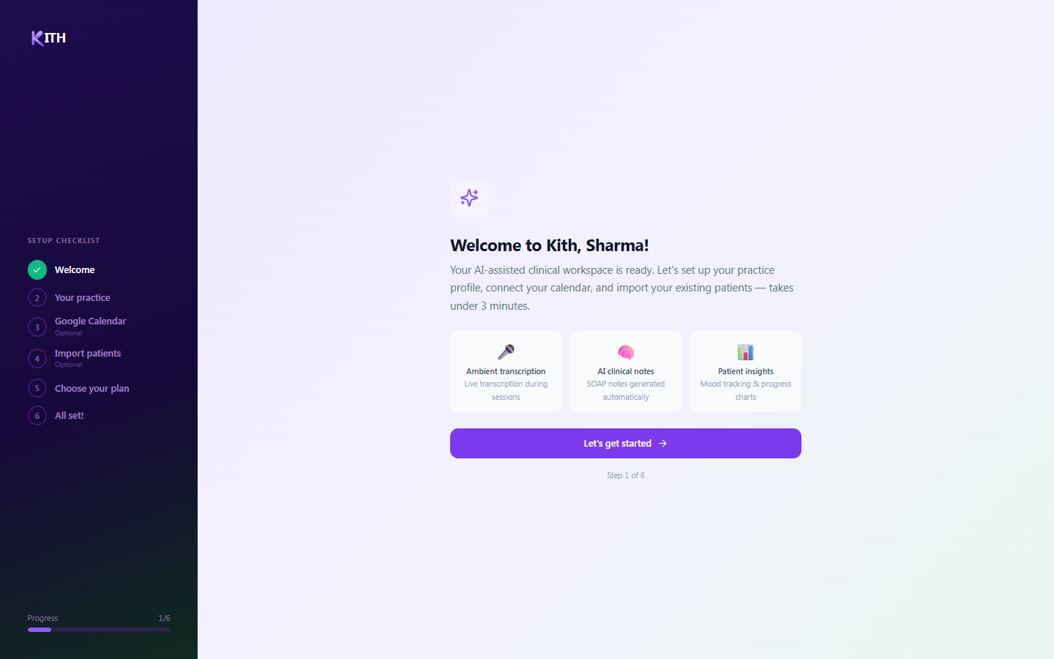
1
GUIDED SETUP · STEP 1 OF 6
Welcome to your workspace
A short guided setup gets your practice ready — it takes under three minutes.
Ambient transcription captures sessions live
AI clinical notes generate SOAP notes automatically
Patient insights track mood and progress over time
Click "Let’s get started" to begin
KITH

Slide 10
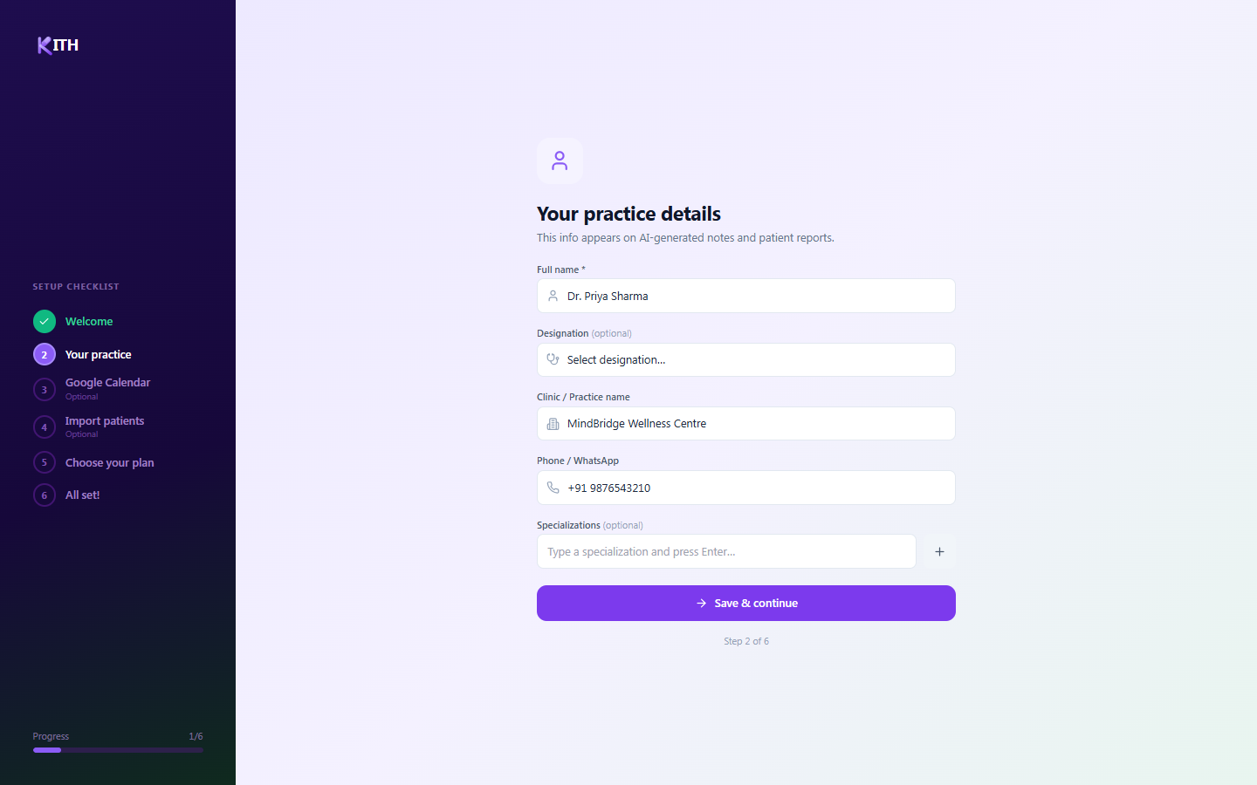
2
GUIDED SETUP · STEP 2 OF 6
Confirm your practice profile
Your registration details are pre-filled — review and add anything that’s missing.
Full name, designation, and clinic name
Phone / WhatsApp number
Optional specializations — type a tag and press Enter to add it
Click "Save & continue"
KITH

Slide 11
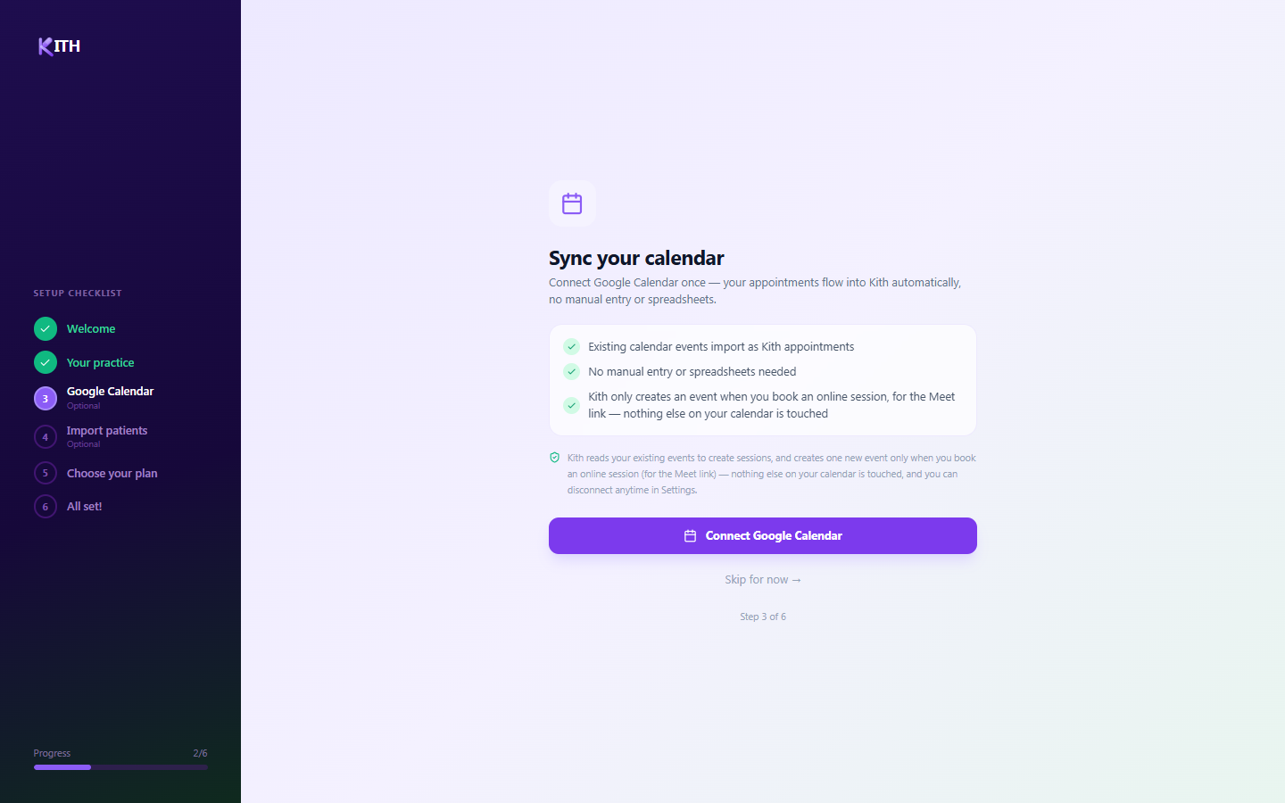
3
GUIDED SETUP · STEP 3 OF 6 · OPTIONAL
Sync your calendar
Connect Google Calendar once — appointments flow in automatically, with no manual entry.
Existing calendar events import as Kith appointments
Kith creates a new event only when you book an online session (for the Meet link) — nothing else on your calendar is touched
Disconnect anytime from Settings → Integrations
Or select "Skip for now" and connect later
KITH

Slide 12
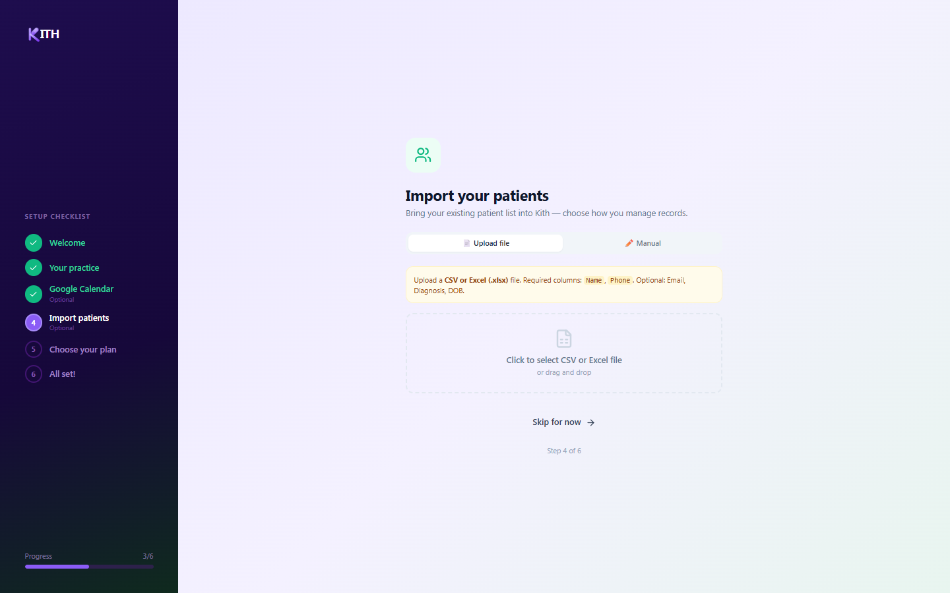
4
GUIDED SETUP · STEP 4 OF 6 · OPTIONAL
Import your patients
Bring your existing patient list into Kith, however you keep records today.
Upload tab — CSV or Excel file (required: Name, Phone; optional: Email, Diagnosis, DOB)
Manual tab — add patients one by one, good for fewer than 10 patients
Limit: 200 patients per import
KITH

Slide 13
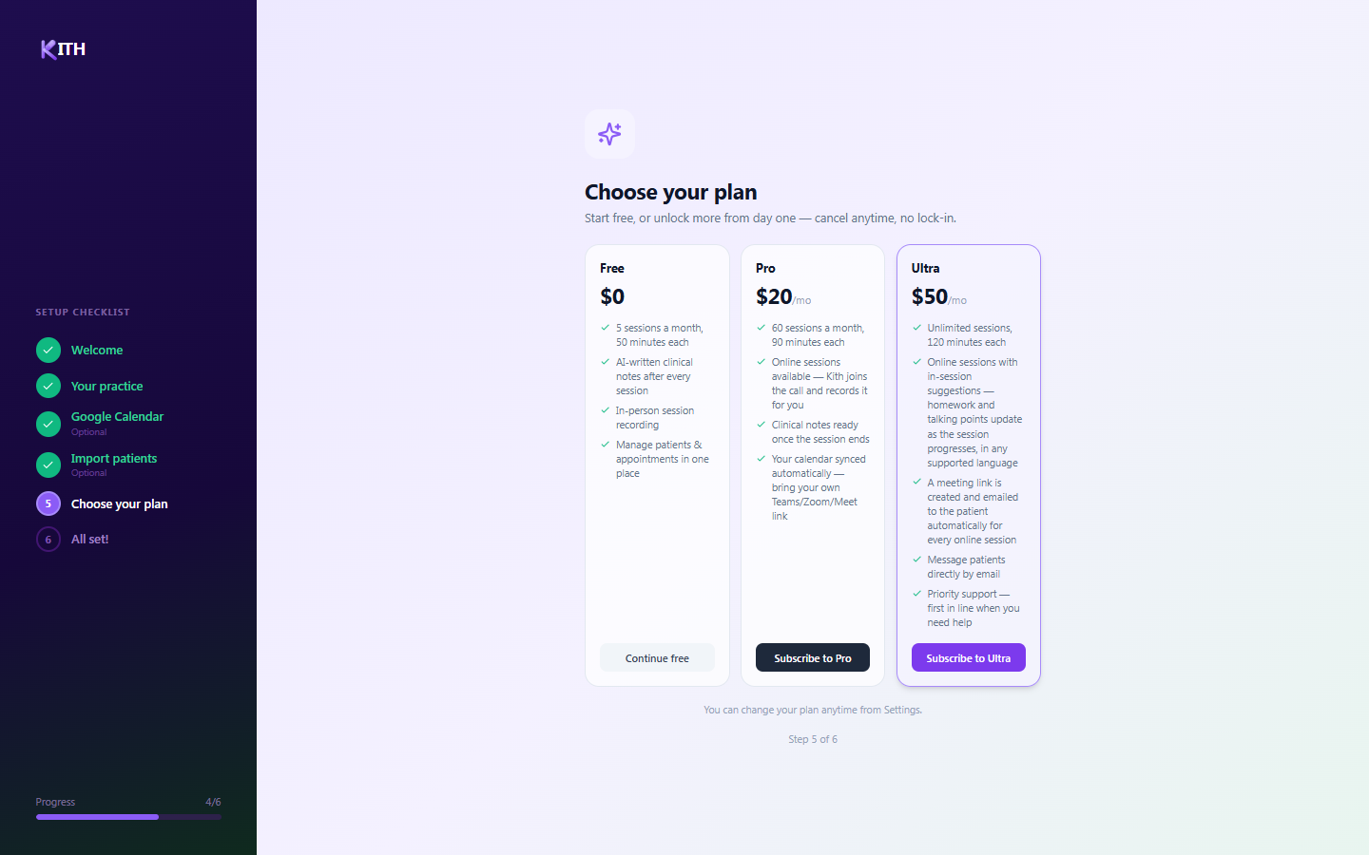
5
GUIDED SETUP · STEP 5 OF 6
Choose your plan
Start free, or unlock more from day one — cancel anytime, no lock-in.
Free — 5 sessions/month, AI clinical notes, in-person session recording
Pro ($20/mo) — 60 sessions/month, online sessions, automatic calendar sync
Ultra ($50/mo) — unlimited sessions, in-session AI suggestions, patient messaging
You can change your plan anytime from Settings
KITH

Slide 14
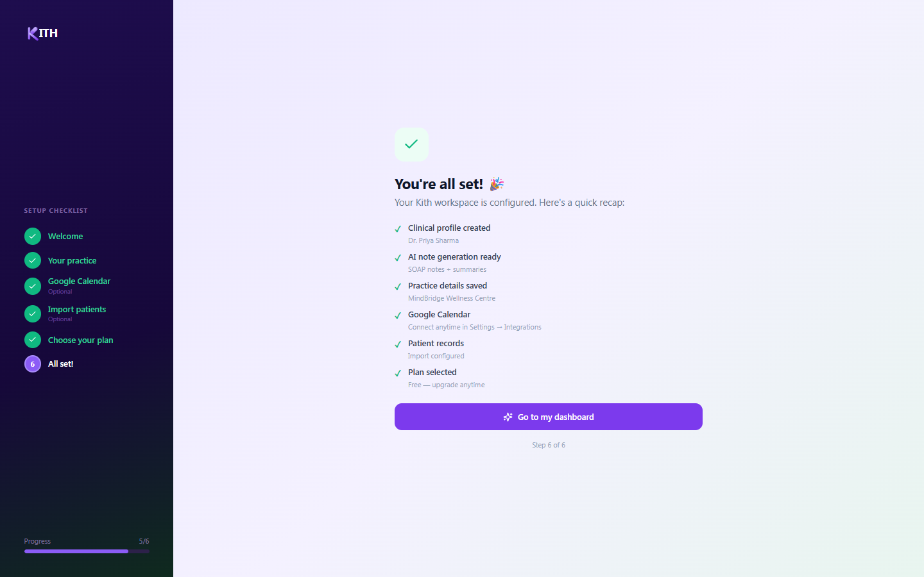
6
GUIDED SETUP · STEP 6 OF 6
You’re all set!
A final recap of what’s configured, then straight to your dashboard.
Clinical profile created and AI note generation ready
Practice details saved
Calendar and patient-record status shown, with links to finish anything skipped
Click "Go to my dashboard" to start working
KITH

Slide 15
KITH
PART 3 OF 3
Your Everyday Workspace
A tour of the four screens you’ll use most: Dashboard, Patients, Appointments, and Settings.

Slide 16
YOUR WORKSPACE
The Dashboard
Your home base — a snapshot of today’s practice at a glance.
Active patients, today’s sessions, and notes generated
Today’s schedule, with one-click access to each session
Recent notes panel
"Schedule session" or "Start session" from the top right
KITH

Slide 17
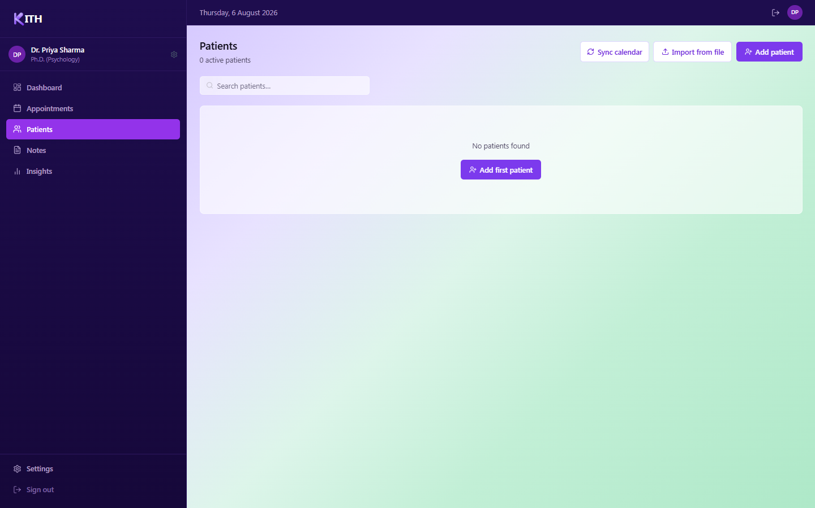
YOUR WORKSPACE
Patients
View and manage your full patient roster in one place.
Browse your active caseload
Open a patient to see history, notes, and progress
Add new patients manually or via file import
KITH

Slide 18
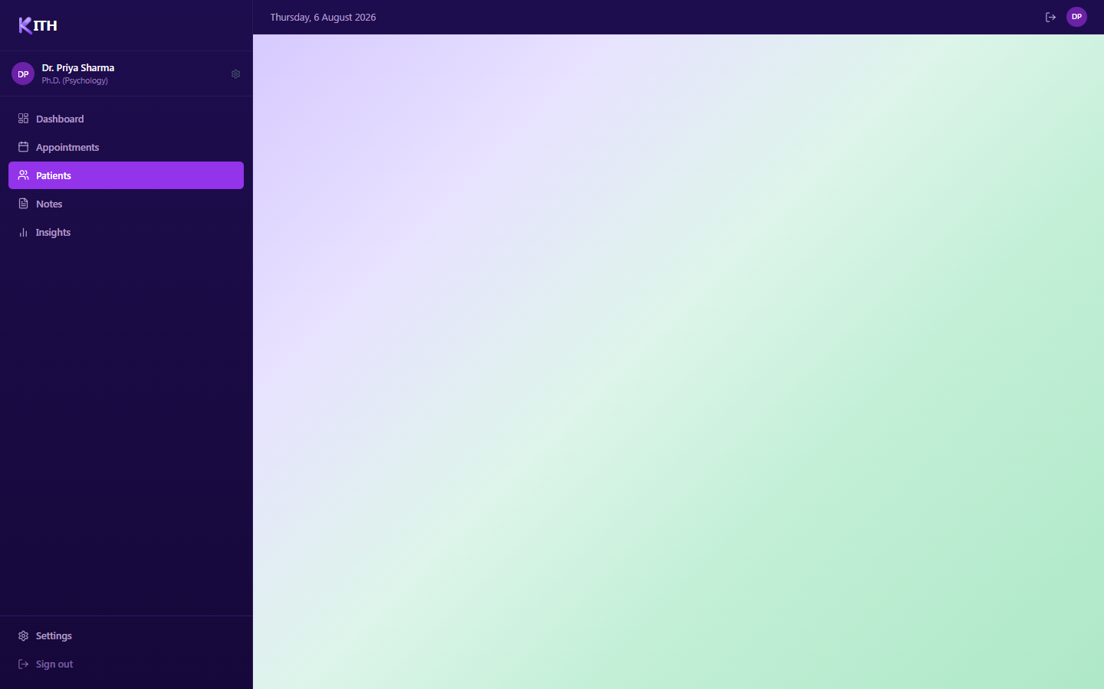
YOUR WORKSPACE
Add a new patient
Register a new patient record directly from the Patients tab.
Enter name, contact details, and diagnosis
Fill in intake details as needed
Save to add them to your active caseload
KITH

Slide 19
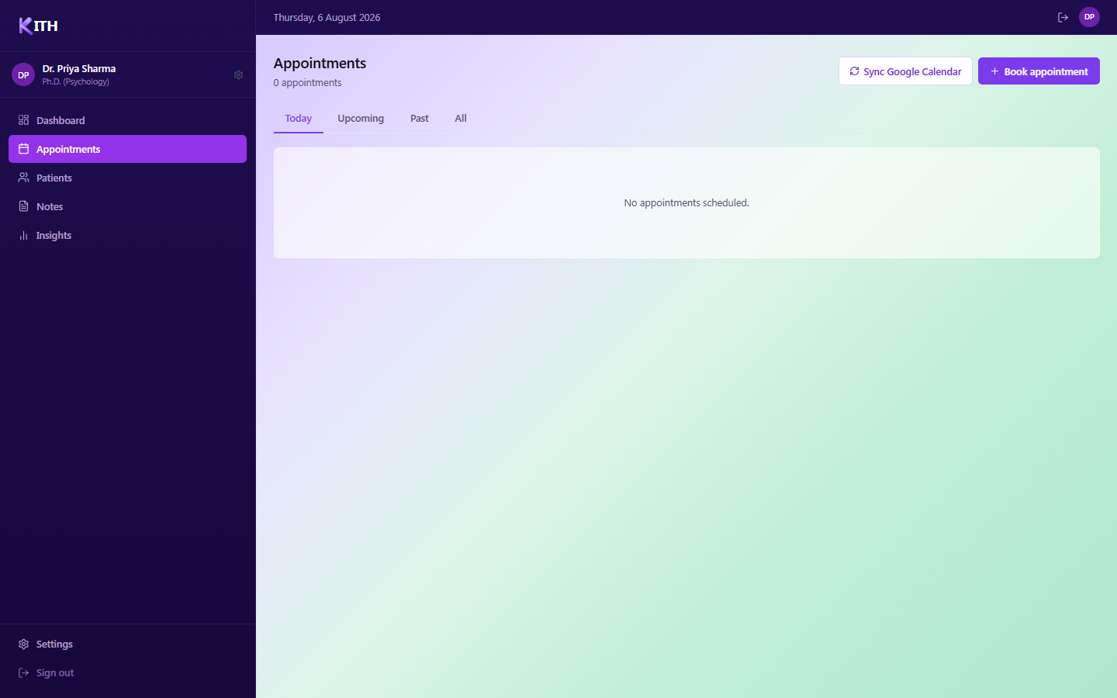
YOUR WORKSPACE
Appointments
Track today’s, upcoming, and past sessions in one calendar view.
Filter by Today / Upcoming / Past / All
"Sync Google Calendar" pulls in the latest events
"Book appointment" schedules a new session directly
KITH

Slide 20
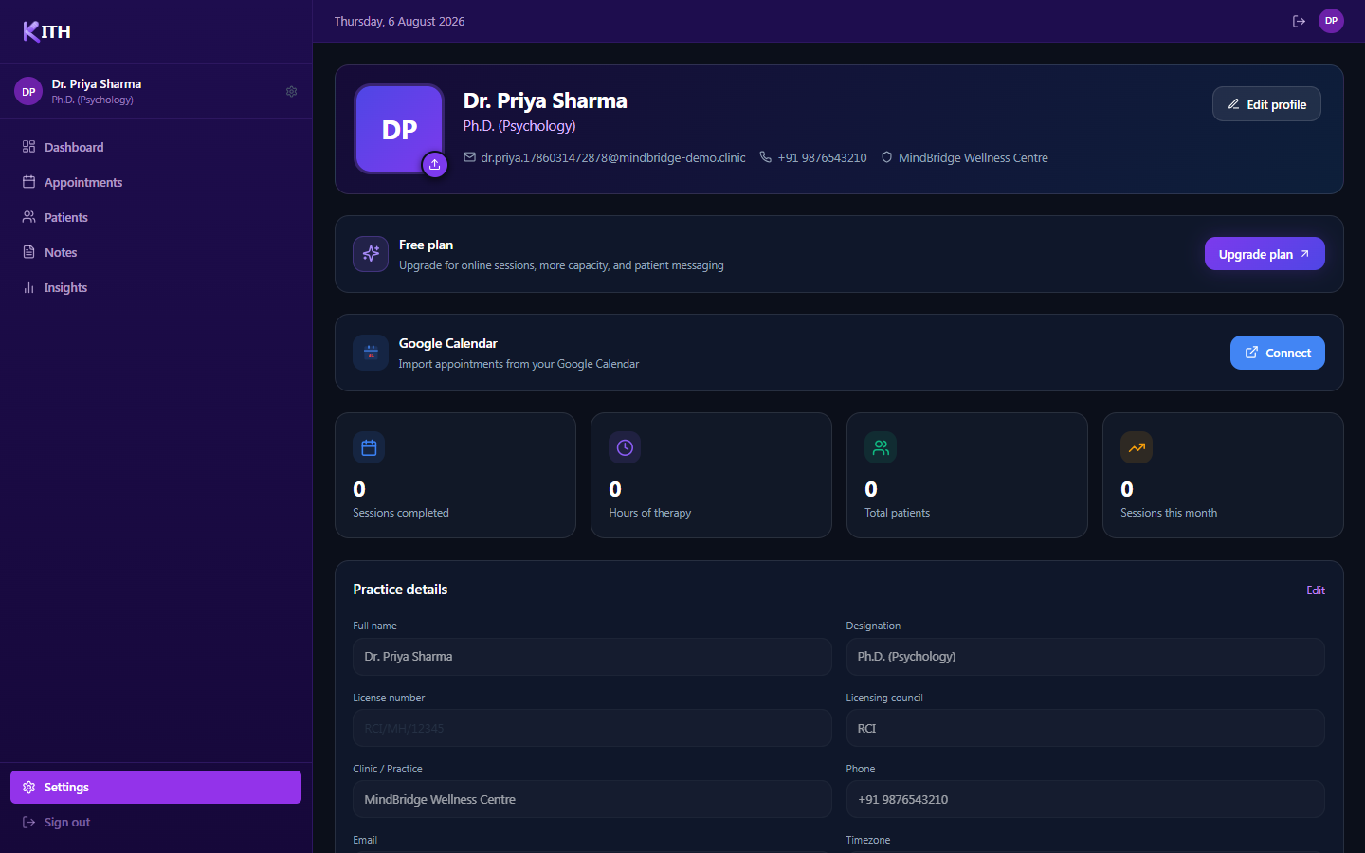
YOUR WORKSPACE
Settings — profile & plan
Manage your practice profile, plan, and usage stats in one place.
Edit your profile photo and practice details
View sessions completed, hours of therapy, and total patients
Upgrade your plan or connect Google Calendar
KITH

Slide 21
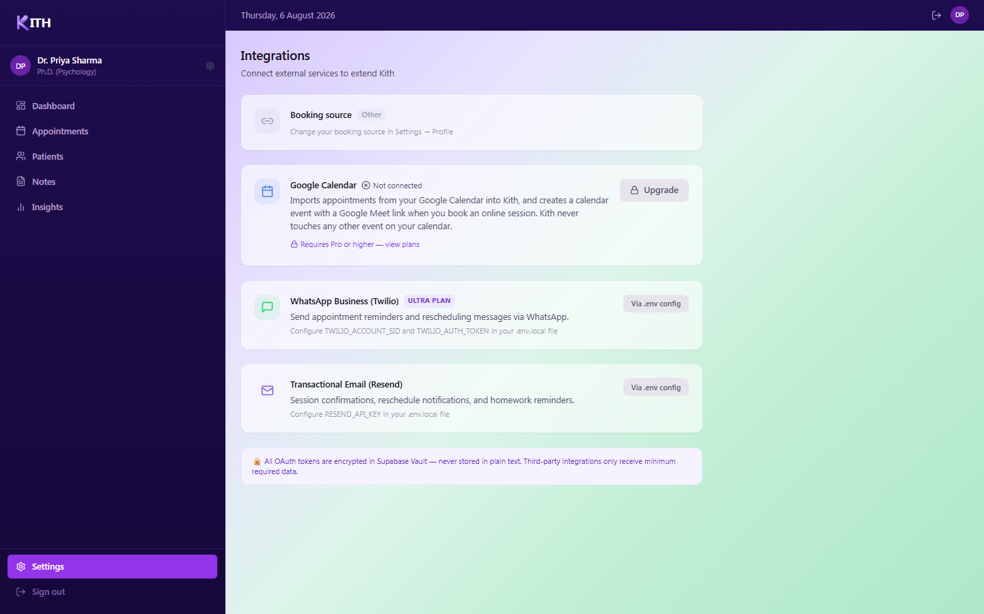
YOUR WORKSPACE
Settings — Integrations
Connect external services to extend what Kith can do.
Google Calendar — imports appointments (requires Pro or higher)
WhatsApp Business & Transactional Email — configured by your admin
All OAuth tokens are encrypted in Supabase Vault
KITH

Slide 22
KITH
You’re ready to go
Keep this guide handy — every screen in your setup and daily workflow is covered here, step by step.
Change your plan, profile, or integrations anytime from Settings
Google Calendar and patient import can be finished later — nothing is locked in during setup
Every AI-generated note starts from the practice details you saved in Step 2
KITH

